Slide 1
Elementary Data Structures
Data Structures and Algorithms
A. G. Malamos

Slide 2
Basic Set Operations
Operations on a dynamic set can be grouped into two categories: queries, which
simply return information about the set, and modifying operations, which change
the set.
SEARCH.S, k
INSERT.S,x
DELETE.S, x
MINIMUM.S
MAXIMUM.S
SUCCESSOR.S,x
PREDECESSOR.S,x
References:
Introduction to Algorithms ,Third Edition, Th H. Cormen, Ch E. Leiserson,
R L. Rivest, Cl Stein

Slide 3
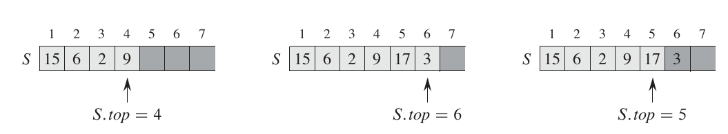
Stacks and queues
In a stack, the element deleted from the set is the one most recently inserted: the stack implements a last-in, first-out, or LIFO, policy. Similarly, in a queue, the element deleted is always the one that has been in the set for the longest time: the queue implements a first-in, first-out, or FIFO, policy.
The INSERT operation on a stack is often called PUSH, and the DELETE operation, which does not take an element argument, is often called POP

Slide 4
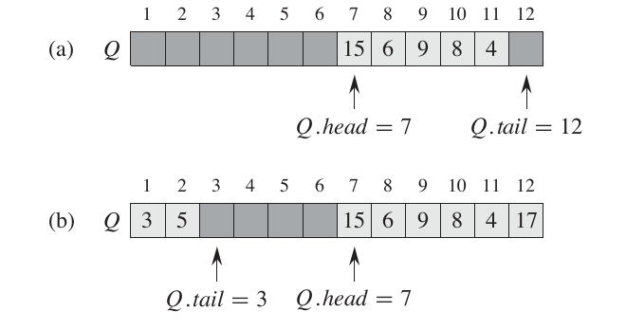
Stacks and queues
We call the INSERT operation on a queue ENQUEUE, and we call the DELETE
operation DEQUEUE; like the stack operation POP, DEQUEUE takes no element argument. The FIFO property of a queue causes it to operate like a line of customers
waiting to pay a cashier. The queue has a head and a tail.

Slide 5
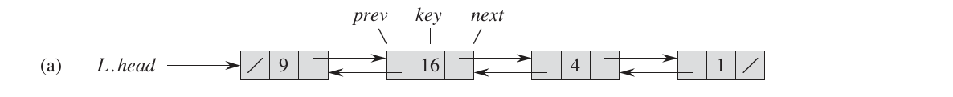
Linked lists
A linked list is a data structure in which the objects are arranged in a linear order.
Unlike an array, however, in which the linear order is determined by the array
indices, the order in a linked list is determined by a pointer in each object
Linked lists provide a simple, flexible representation for dynamic sets, supporting all the set operations listed

Slide 6
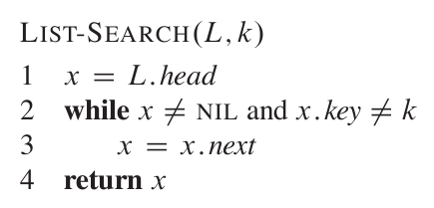
Searching a linked list
To search a list of n objects, the LIST-SEARCH procedure takes O(n) in the
worst case, since it may have to search the entire list.

Slide 7
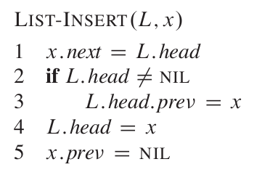
Inserting into a linked list
INSERT on a list of n elements is O(1)

Slide 8
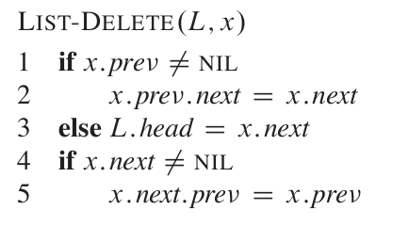
Deleting from a linked list
LIST-DELETE runs inO(1), but if we wish to delete an element with a given key O(n)
is required in the worst case because we must first call LIST-SEARCH to find the
element.

Slide 9
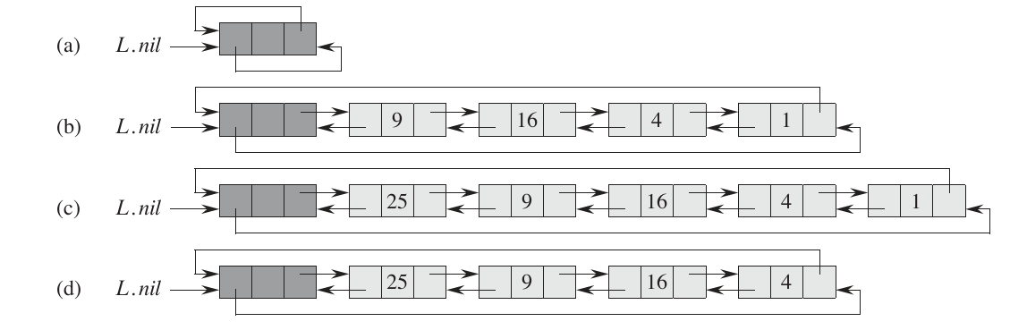
Sentinels
A sentinel is a dummy object that allows us to simplify boundary conditions.
The attribute L:nil:next points to the head of the list, and L:nil:prev
points to the tail.

Slide 10
Representing rooted trees
We represent each node of a tree by an object. As with linked lists, we assume
that each node contains a key attribute. The remaining attributes of interest are
pointers to other nodes, and they vary according to the type of tree.
Fortunately, there is a clever scheme to represent trees with arbitrary numbers of children. It has the advantage of using only O(n) space for any n-node rooted tree.
In the left-child, right-sibling representation each node contains a parent pointer p,and T:root points to the root of tree T.
Instead of having a pointer to each of its children, however, each node x has only two pointers:
1. x:left-childpoints to the leftmost child of node x, and
2. x:right-sibling points to the sibling of x immediately to its right.
If node x has no children, then x:left-child=NIL, and if node x is the rightmost
child of its parent, then x:right-sibling=NIL.

Slide 11
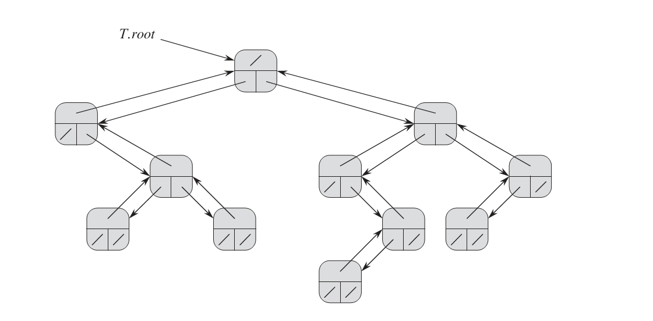
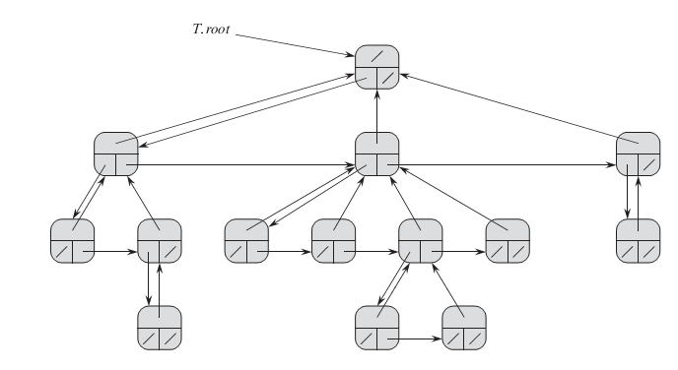
left-child, right-sibling examples

Slide 12
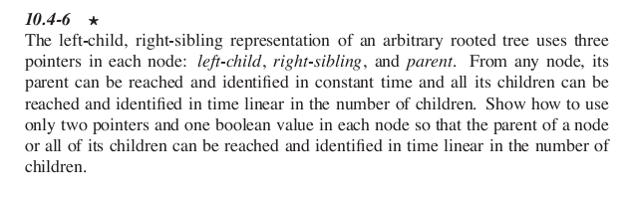
Assignment 1, Exercise 1
To deliver in 2 weeks (between 29 and 31 of Oct)

Slide 13
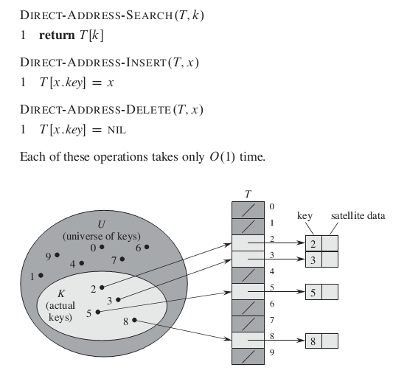
Direct-address tables
Direct addressing is a simple technique that works well when the universe U of
keys is reasonably small.

Slide 14
Hash tables
The downside of direct addressing is obvious: if the universe U is large, storing
A table T of size |U| may be impractical, or even impossible.
With direct addressing, an element with key k is stored in slot k. With hashing,
this element is stored in slot h(k) that is, we use a hash function h to compute the
slot from the key k. Here, h maps the universe U of keys into the slots of a hash
Table T (0…m-1)
There is one hitch: two keys may hash to the same slot. We call this situation
A collision. Fortunately, we have effective techniques for resolving the conflict
created by collisions.

Slide 15
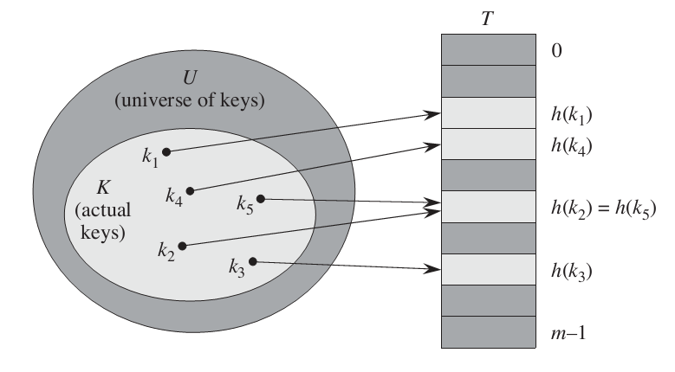
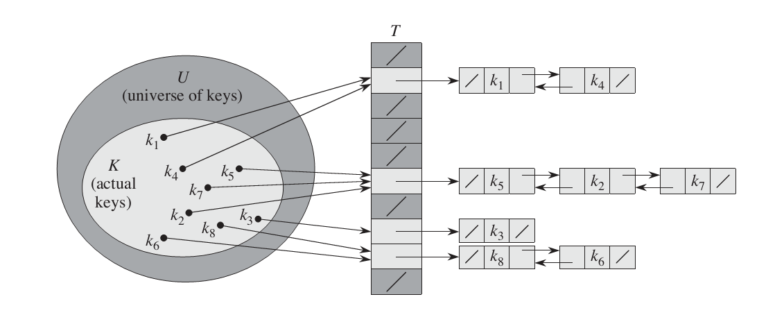
Using a hash function h to map keys to hash-table slots. Because keys k2 and k5 map
to the same slot, they collide.
Collision resolution by chaining.

Slide 16
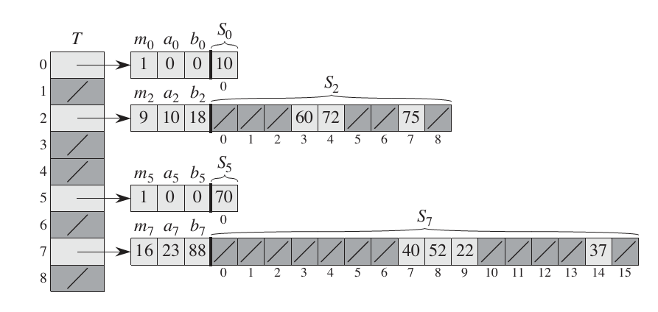
Perfect hashing
Although hashing is often a good choice for its excellent average-case performance, hashing can also provide excellent worst-case performance when the set of
keys is static: once the keys are stored in the table, the set of keys never changes
We call a hashing technique perfect hashing O(1) memory accesses are required to
perform a search in the worst case.
To create a perfect hashing scheme, we use two levels of hashing, with universal
hashing at each level.

Slide 17
How Hashing works
Interpreting keys as natural numbers
Most hash functions assume that the universe of keys is the set N[0, 1,2….]
of natural numbers. Thus, if the keys are not natural numbers, we find a way to
interpret them as natural numbers. For example, we can interpret a character string
as an integer expressed in suitable radix notation.
The division method
In the division method for creating hash functions, we map a key k into one of m
slots by taking the remainder of k divided by m. That is, the hash function is
H=k mod m
The multiplication method
The multiplication method for creating hash functions operates in two steps. First,
we multiply the key k by a constant A in the range 0<A<1and extract the fractional part of k*A. Then, we multiply this value by m and take the floor of the
result. In short, the hash function is
H=m*(k*A mod 1)
Universal hashing
In universal hashing, at the beginning of execution we select the hash function at random from a carefully designed class of functions

Slide 18
Assignment 1 Exercises 2
11.3-1
Suppose we wish to search a linked list of length n, where each element contains a key k along with a hash value h(k). Each key is a long character string. How might we take advantage of the hash values when searching the list for an element with a given key?

Slide 19
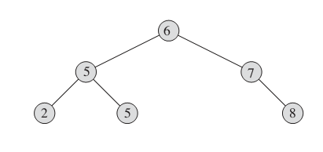
Binary Search Trees
The search tree data structure supports many dynamic-set operations, including
SEARCH, MINIMUM, MAXIMUM, PREDECESSOR, SUCCESSOR, INSERT, and
DELETE. Thus, we can use a search tree both as a dictionary and as a priority
queue.
Basic operations on a binary search tree take time proportional to the height of
the tree. For a complete binary tree with n nodes, such operations run in O(log₂(n))
worst-case time. If the tree is a linear chain of n nodes, however, the same operations take O(n) worst-case time.

Slide 20
What is a binary tree
A binary search tree is organized, in a binary tree, as shown in Figure. We can represent such a tree by a linked data structure in which each node is an object. In addition to a key and satellite data, each node contains Attributes left, right, and p that point to the nodes corresponding to its left child, its right child, and its parent, respectively.
Let x be a node in a binary search tree. If y is a node in the left subtree
Of x, then y.key<=x.key. If y is a node in the right subtree of x, then
y.key>=x.key

Slide 21
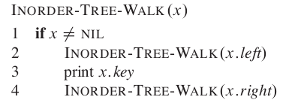
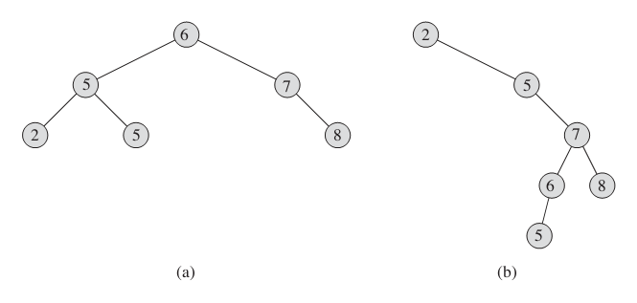
Binary Search Tree Walk
The binary-search-tree property allows us to print out all the keys in a binary
search tree in sorted order by a simple recursive algorithm, called an inorder tree
walk.

Slide 22
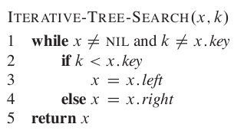
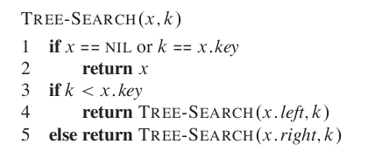
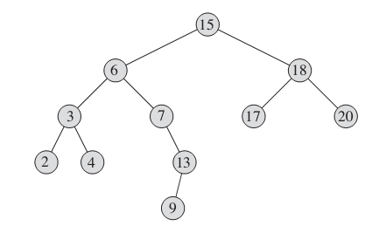
Searching
We use the following procedure to search for a node with a given key in a binary
search tree. Given a pointer to the root of the tree and a key k, TREE-SEARCH
returns a pointer to a node with key k if one exists; otherwise, it returns NIL.
The nodes encountered during the recursion form a simple path downward from the root of
the tree, and thus the running time of TREE-SEARCH is O(h),where h is the height
of the tree.

Slide 23
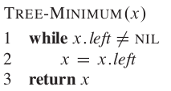
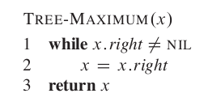
Minimum and maximum
Both of these procedures run in O(h) time on a tree of height h since, as in TREE-SEARCH, the sequence of nodes encountered forms a simple path downward from the root.

Slide 24
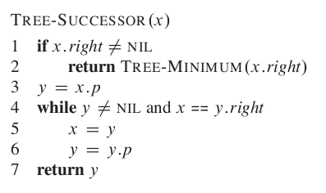
Successor and predecessor
We break the code for TREE-SUCCESSOR into two cases. If the right subtree of node x is nonempty, then the successor of x is just the leftmost node in x’s right subtree, which we find in line 2 by calling TREE- MINIMUM(x.right). The running time of TREE-SUCCESSOR on a tree of height h is O(h),since we either follow a simple path up the tree or follow a simple path down the tree.
The procedure TREE-PREDECESSOR, which is symmetric to TREE-SUCCESSOR, also
runs in time O(h)
Theorem 12.2
We can implement the dynamic-set operations SEARCH,MINIMUM,MAXIMUM,
SUCCESSOR, and PREDECESSOR so that each one runs in O(h) time on a binary
search tree of height h.

Slide 25
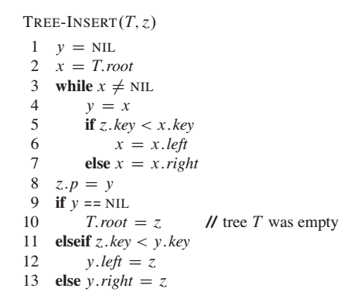
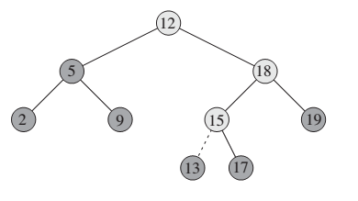
Insertion
The operations of insertion and deletion cause the dynamic set represented by a
binary search tree to change. The data structure must be modified to reflect this
change, but in such a way that the binary-search-tree property continues to hold.
Inserting an item with key13into a binary search tree. Lightly shaded nodes indicate the simple path from the root down to the position where the item is inserted. The dashed line
indicates the link in the tree that is added to insert the item
Like the other primitive operations on search trees, the procedure TREE-INSERT
runs in O(h) time on a tree of height h.

Slide 26
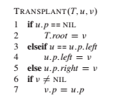
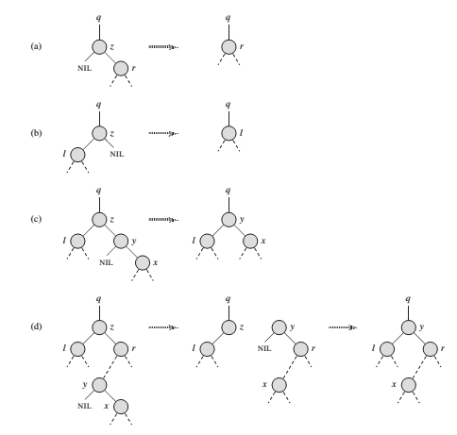
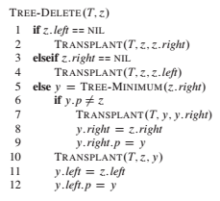
Deletion
The procedure for deleting a given node z from a binary search tree T takes as
arguments pointers to T and z. Deletion is done by considering the four cases shown.
Theorem 12.3
We can implement the dynamic-set operations INSERT and DELETE so that each
one runs in O(h) time on a binary search tree of height h.

Slide 27
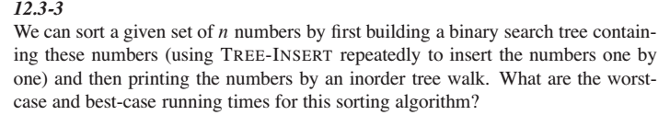
Assignment 1 Exercise 3

