Slide 1
Graphs
Data Structures and Algorithms
A. G. Malamos
Reference
Algorithms, 2006, S. Dasgupta, C. H. Papadimitriou, and U . V . Vazirani
Introduction to Algorithms ,Third Edition, Th H. Cormen, Ch E. Leiserson, R L. Rivest, Cl Stein

Slide 2

How is a graph represented?
We can represent a graph by an adjacency matrix, if there are n = |V| vertices v1,..,vn
This is an nxn array whose (i,j )th entry is
For undirected graphs, the matrix is symmetric since an edge (u,v) can be taken in either
direction.
The biggest convenience of this format is that the presence of a particular edge can be
checked in constant time, with just one memory access. On the other hand the matrix takes up O(n^2) space, which is wasteful.
An alternative representation, with size proportional to the number of edges, is the adjacency list. It consists of |V| linked lists, one per vertex. The linked list for vertex u holds the names of vertices to which u has an outgoing edge that is, vertices v for which (u,v) in E.

Slide 3
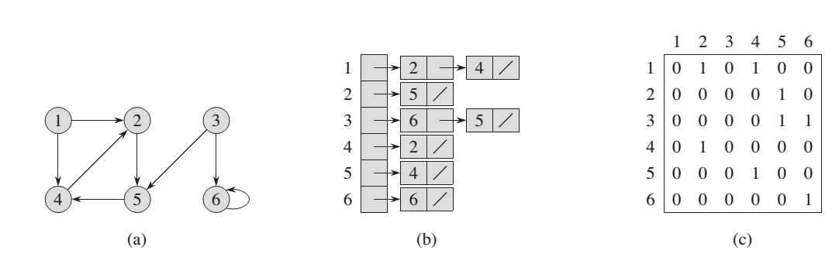

Slide 4
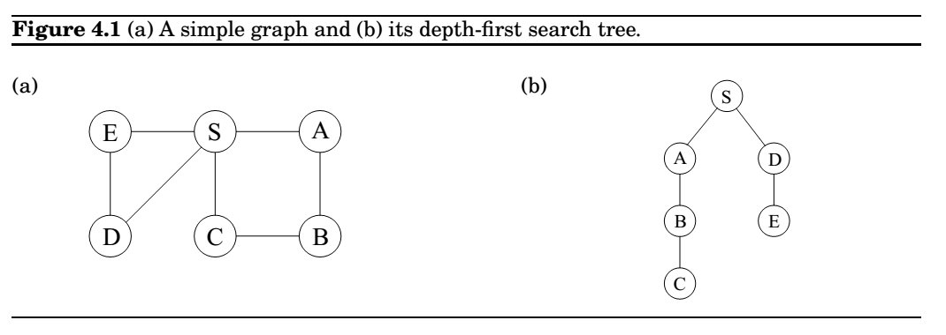
Distances
Depth first search readily identifies all the vertices of a graph that can be reached from a
designated starting point.
However , these paths might not be the most economical ones possible. In the figure, vertex C is reachable from S by traversing just one edge, while the DFS tree shows a path of length 3. This chapter is about algorithms for finding shortest paths in graphs.
The distance between two nodes is the length of the shortest path between them.

Slide 5
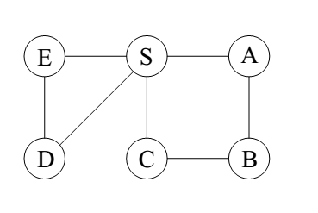
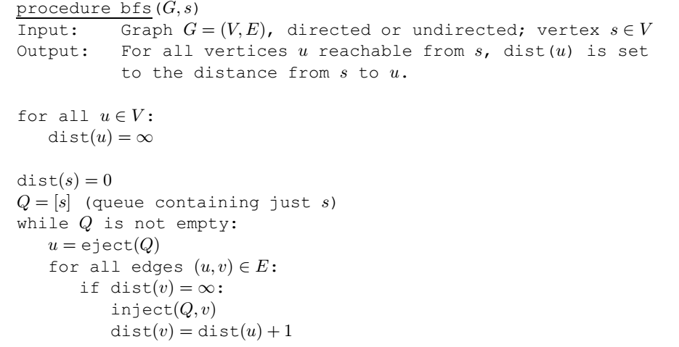
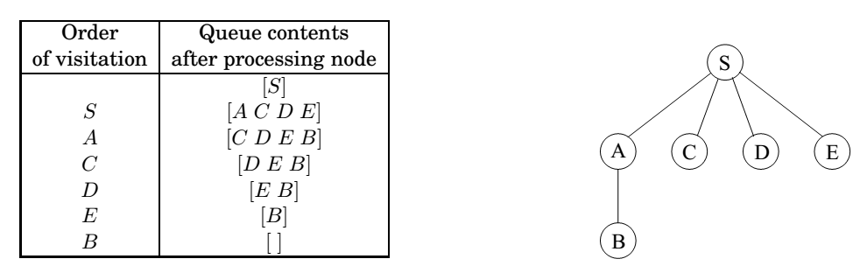
Breadth first search
A convenient way to compute distances from s to the other vertices is to proceed layer by layer . Once we have picked out the nodes at distance 0, 1, 2, …,d, the ones at d + 1 are easily determined: they are precisely the as-yet unseen nodes that are adjacent to the layer at distance d.

Slide 6
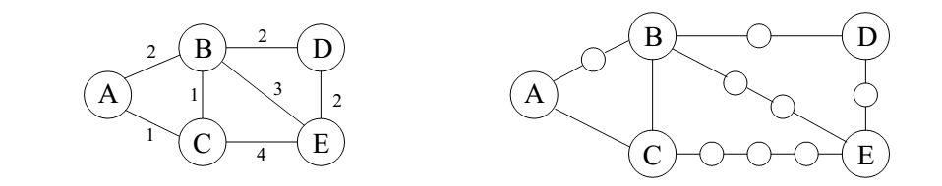
Dijkstra's algorithm
Breadth first search finds shortest paths in any graph whose edges have unit length. Can we adapt it to a more general graph G = (V,E) whose edge lengths λ
are positive integers?
For any edge e = (u; v) of E, replace it by edges of length 1, by adding λ-1
dummy nodes between u and v.

Slide 7
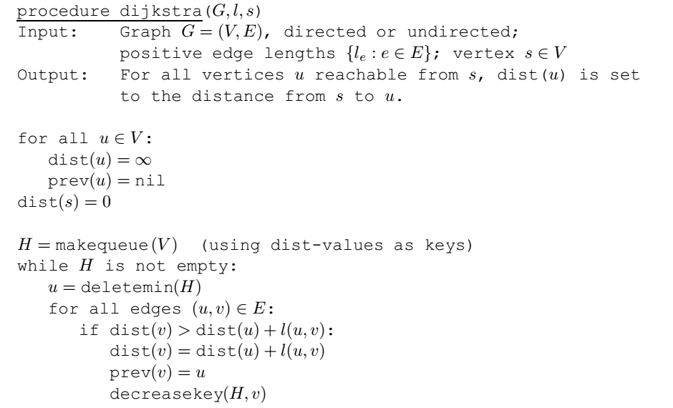
Dijkstra's Shortest path
We can think of Dijkstra's algorithm as just BFS, except it uses a priority queue instead of a regular queue, so as to prioritize nodes in a way that takes edge lengths into account.
/∞

Slide 8
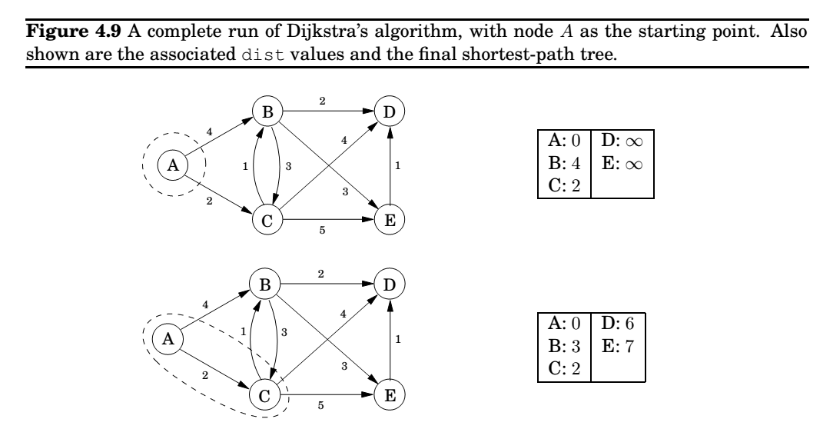
Hint! We keep the shortest until now and we go-on

Slide 9
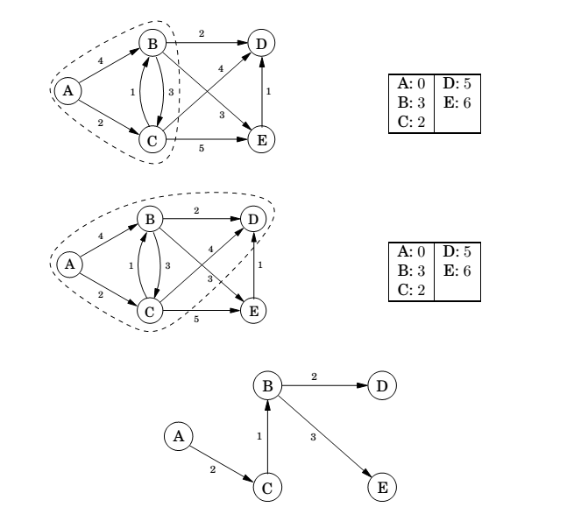

Slide 10
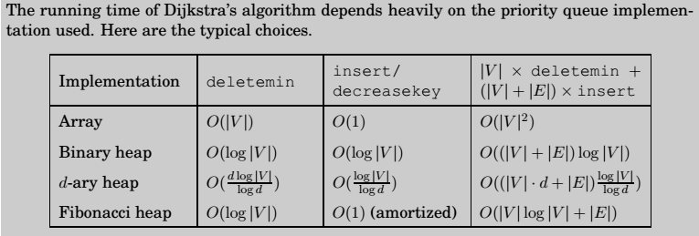
Dijkstra complexity

Slide 11
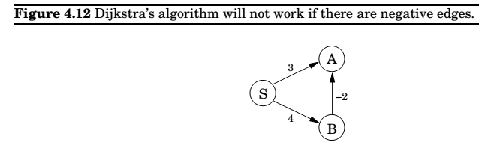


Shortest paths in the presence of negative edges
What needs to be changed in order to accommodate this new complication? To answer this, let's take a particular high-level view of Dijkstra's algorithm. A crucial invariant is that the dist values it maintains are always either overestimates or exactly correct. They start off at ∞, and the only way they ever change is by updating along an edge
This update operation is simply an expression of the fact that the distance to v cannot possibly be more than the distance to u, plus l(u,v).
In fact, Dijkstra's algorithm can be thought of simply as a sequence of update's

Slide 12
Bellman-Ford algorithm
But still, if we don't know all the shortest paths beforehand, how can we be sure to update the right edges in the right order? Here is an easy solution: simply update all the edges, |V| -1 times! The resulting O(|V||E|) procedure is called the Bellman-Ford algorithm
A note about implementation: for many graphs, the maximum number of edges in any
shortest path is substantially less than |V|-1, with the result that fewer rounds of updates are needed. Therefore, it makes sense to add an extra check to the shortest-path algorithm, to make it terminate immediately after any round in which no update occurred

Slide 13
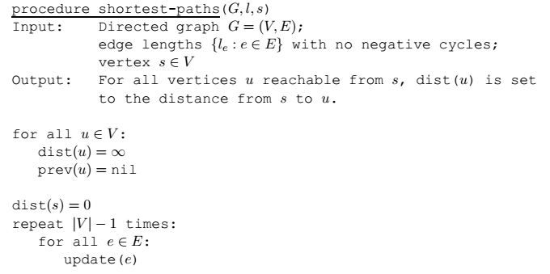
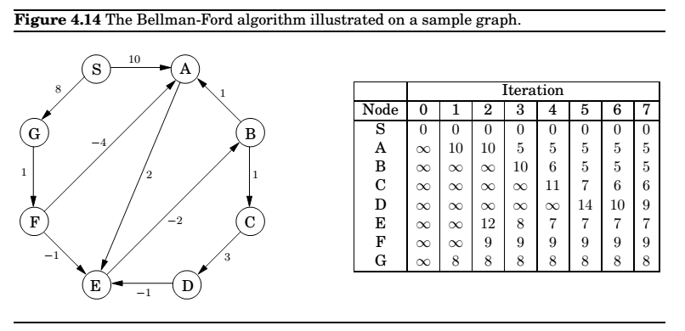
Bellman Ford.. An example

Slide 14
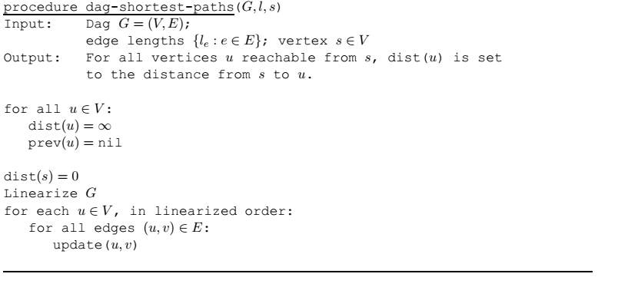

Shortest paths in dags
Single-source shortest-path problem can be solved in just linear time on directed acyclic graphs
In any path of a dag, the vertices appear in increasing linearized order .
Notice that our scheme doesn't require edges to be positive. In particular , we can find
longest paths in a dag by the same algorithm: just negate all edge lengths.

Slide 15
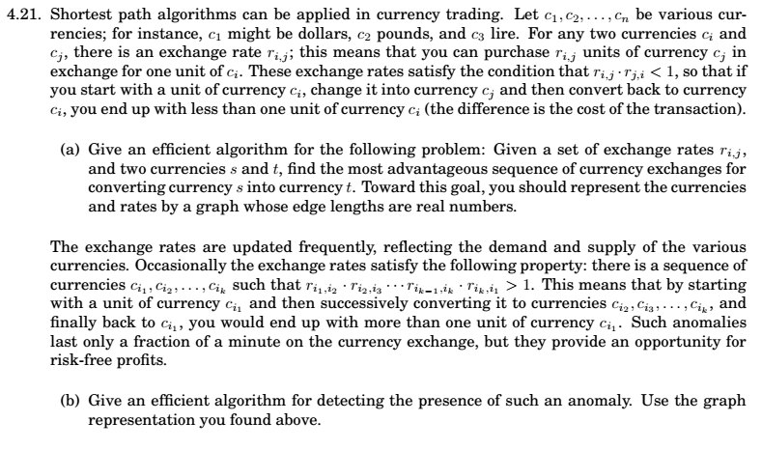
Assignment 2

Slide 16
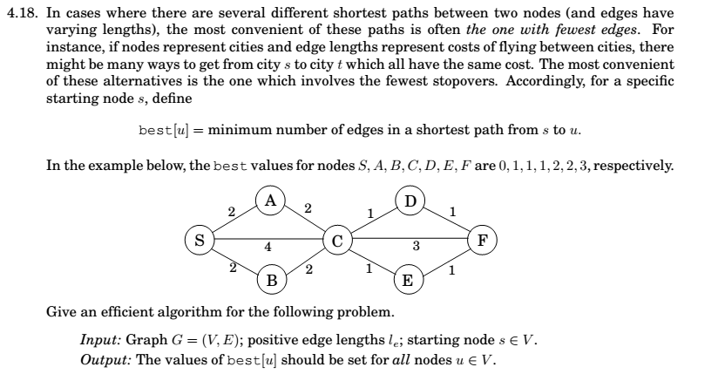
Assignment 2 cont…
Deadline Wed 13/11. You must upload your solutions (typewritten or scanned) on eclass!
Shall we keep the same Doodle time slots or you want to start a new doodle round?

