Slide 1
Advanced Topics in Biomedical Informatics
M. Tsiknakis, PhD
Postgraduate Course on “Informatics Engineering”, Spring 2026

Slide 2
Course title & identity
Title: Advanced Topics in Biomedical Informatics
Biomedical Informatics is a very broad scientific domain
Objectives
Primary: Understanding key concepts and methodologies of a selected biomedical informatics sub-domain;
Secondary: Novel algorithmic implementation starting by reproducing recent published work.
Members of staff
Prof. Manolis Tsiknakis, supported by postdocs and PhD candidates

Slide 3
Scope and Objectives
Focus during this semester is on AFFECTIVE COMPUTING
This class explores computing that relates to, arises from, or deliberately influences emotion.
Topics include
the interaction of emotion with cognition and perception;
the communication of human emotion via face, voice, physiology, and behavior;
construction of computer systems that exhibit skills of emotional intelligence;
affective technologies for the recognition of stress, anxiety, depression, pain and empathy;
and other areas of current research interest.
Weekly reading, discussion, and a term project are required.

Slide 4
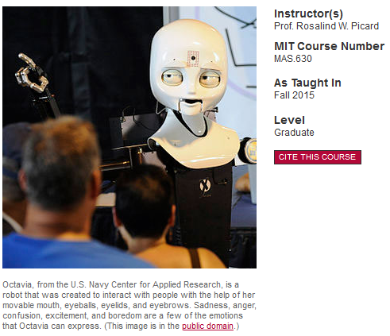
MIT’s Affective Computing
Course builds on experiences and concepts from the relevant MIT OpenCource
Course Description
This course instructs students on how to develop technologies that help people measure and communicate emotion, that respectfully read and that intelligently respond to emotion, and have internal mechanisms inspired by the useful roles emotions play.
https://ocw.mit.edu/courses/media-arts-and-sciences/mas-630-affective-computing-fall-2015/

Slide 5
Syllabus for the year 2023-2024
Βασισμένοι σε ένα μοναδικό σύνολο δεδομένων που έχει δημιουργηθεί στα πλαίσια διδακτορικής διατριβής και περιλαμβάνει
Facial expressions,
Voice recordings,
Motion data - signals from insoles,
Biosignals from wearables (GSR, smart watch data), and
upper body movement.
Θα εστιάσουμε
σε μεθόδους ανάλυσης εκφράσεων του προσώπου,
ανάλυση φωνής και
φυσιολογικών σημάτων και
Στην ανάπτυξη μεθόδων μηχανικής μάθησης/βαθιάς μάθησης για τον υπολογισμό βιοδεικτών για την έγκαιρη διάγνωση ή/και σταδιοποίηση της νόσου.

Slide 6
Approach
Lectures (2-3 hours / week)
Recap, new topics, paper presentations, discussion
Laboratory classes (2 hours from week 6 onwards, if required)
Study specific topics through student’s group presentations
Focus on experimentation with specific concepts
Homework
A number of small-scale home assignments to be presented and discussed in class
Project
One (large) project (team project, due at the end of the semester)
Final assessment (week to follow last lecture)

Slide 7
Εξέταση & Βαθμολόγηση (Grading)
Εξέταση Μαθήματος (Grading)
Η εξέταση θα γίνει με βάση μικρής ή και μεγαλύτερης δυσκολίας ασκήσεις που θα δίνονται κατά τη διάρκεια του εξαμήνου και με την παρουσίαση μιας ατομικής ή ομαδικής εργασίας στο τέλος του εξαμήνου.
Assignment | Percentage of total grade
Class participation & Homeworks | 40 %
Project implementation | 40 %
Written report & Final presentation of the Project | 20 %

Slide 8
Other specific requirements
Pre-requisites
Good written (and spoken) English
For the successful participation in the course, it is recommended that prior knowledge in the following domains is required:
Python,
Machine Learning and
Image Processing.
Expected weekly workload
5-6 hours (average workload including class attendance).
Not evenly distributed (considerably smaller at first, tends to increase towards the end of the semester).

Slide 9
Learning outcome
After the course the student should be able to:
Show a deeper knowledge in the sub-area of biomedical informatics selected for study
Independently perform a research pre-study, in the form of a literature study or a limited research assignment
Critically analyze the content of the research papers and evaluate their significance, importance and relevance to the research field.
Demonstrate implementation skills to complex biomedical informatics problems
Should be able to “reproduce” published results
Ideally, should be able to identify limitations, propose and implement enhancements/extentions.
Independently synthesize the results in the form of a scientific presentation/publication.

Slide 10
Q & A

