Slide 1
Research Methods and Project Management
M. Tsiknakis, PhD
Postgraduate Course on “Informatics Engineering”, Fall 2025

Slide 2
Course title & identity
Title: Research Methods and Project Management
Objectives
  Primary: Understanding the research process in Informatics Engineering and develop the ability to choose the methodology that best suits the type of investigation being conducted & appropriate to the research objectives;
  Secondary: Understanding key concepts and methodologies of successful project management.
Focus
  Research methods, the scientific process, effective project management;
Members of staff
  Prof. Manolis Tsiknakis

Slide 3
About this course
A PhD or master’s level research project is an enormous undertaking, and you might find yourself a bit uncertain about the process or how to achieve the desired outcome.
In this course, you will learn the underlying principles that are needed to conduct research from an engineering perspective.
The objective of the course is to translate current research methods, which are mostly from a social science perspective, into something more relatable and understandable to engineers.
The methods taught in this course will equip you with the knowledge needed to design, plan and construct your own research process.

Slide 4
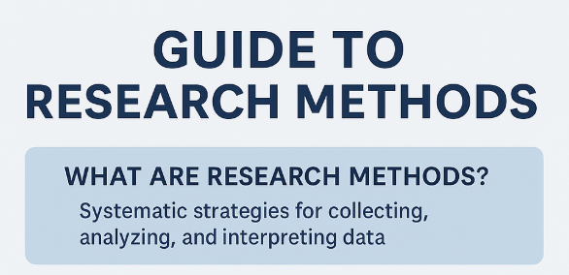

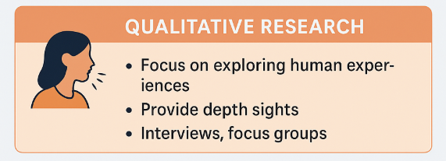
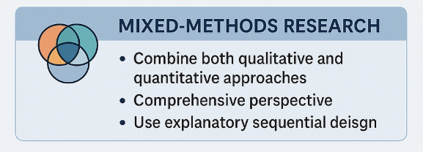
Research methods

Slide 5
Qualitative Research Methods
Key Qualitative Research Methods
Technique | Definition | Best For | Advantages | Limitations | Example
In-depth Interviews | One-on-one conversations with open-ended questions. | Exploring personal experiences, emotions, motivations. | Rich data, flexible, deep insights into individuals. | Time-consuming, interviewer bias. | Interviewing researchers about tool-switching decisions.
Focus Groups | Group discussions with 6–10 participants led by a moderator. | Gathering diverse opinions and group dynamics. | Interactive, reveals group dynamics, idea generation. | Dominant voices can skew discussion, less depth per person. | Gathering postgrads to discuss academic tools.
Ethnographic Research | Observing and interacting with people in their natural environment. | Understanding real-world behaviors and cultural context. | Contextual understanding, authentic data. | Resource-heavy, observer influence, subjective interpretation. | Observing PhD students using digital tools in libraries.
Case Study Research | Detailed investigation of a single case (e.g., person, organization). | Studying complex or rare phenomena in depth. | Detailed analysis, useful for real-world application. | Limited generalizability, possible researcher bias. | Studying one university’s digital transformation.
Content Analysis | Systematic coding and analysis of texts or media. | Studying communication patterns and media trends. | Handles large data, systematic, can be both quantitative and qualitative. | May miss nuance, depends on code accuracy, context loss. | Analyzing tweets on “digital humans” for themes.

Slide 6
Quantitative Research Methods
Key Quantitative Research Techniques
Technique | Definition | Best For | Advantages | Limitations | Example
Surveys & Questionnaires | Structured tools to collect data from a large population using closed-ended questions. | Large-scale studies, public opinion, customer feedback. | Cost-effective, scalable, fast, easy to analyze. | Low response rates, superficial or biased answers. | Surveying students about remote learning satisfaction.
Experimental Research | Controlled studies to test cause-and-effect relationships by manipulating variables. | Scientific research, behavioral studies, product testing. | Establishes causality, high reliability, repeatable results. | Artificial settings, ethical concerns with human studies. | Testing learning methods in randomly assigned student groups.
Longitudinal Studies | Observing the same subjects over a long period to track change. | Studying development, health outcomes, behavior change. | Captures trends over time, strong internal validity. | Expensive, time-consuming, participant dropout risks. | Tracking patients’ health data over 10 years.
Cross-Sectional Studies | Data collected at a single point in time for snapshot analysis. | Market research, demographic profiling. | Quick, efficient, less resource-intensive. | Does not capture change or establish causation. | Analyzing software preferences across user segments in Q1.
Correlational Research | Explores relationships between variables without manipulation. | Predictive analysis, early-stage exploration. | Identifies patterns, natural observation, easy to run. | Cannot prove causation, influenced by external variables. | Studying link between screen time and sleep quality.

Slide 7
Scope and Objectives
The focus will be on the application of the Scientific Method
  reading technical papers
  designing and conducting reviews of literature
  devising research questions and formulating hypothesis
  planning research, testing hypothesis
  analyzing experimental results and
  writing scientific documents & synthesizing broader theories.
FF
Review the literature
FF
Review
Concepts
and
Theories
Define
Research
Problem
Formulate
Hypothesis
& Questions(s)
Design
Research
Protocol
/Experiment
Collect
Data
(Execution)
Analyze
Data
(Test
Hypothesis
if any)
Interpret
and
Report
Review
Previous
Research
Findings
FB
FB
I
III
IV
V
VI
VII
II
FB
FF
Feed Forward
FB
Feed Back
The Scientific Method

Slide 8
Structure and methods
The course will be structured around three activities:
  lectures on research strategy and tactics, experimental design and statistical methods;
  discussions of technical papers;
  and preparation and review of written assignments.
Significant reading, reviewing, and writing will be required, and
students will be expected to participate actively in class discussions.

Slide 9
Detailed look into the Syllabus
The course contains three fundamental sections:
  The first section pertains to knowledge relating to understanding the research process in Informatics Engineering & Computer Science.
  In this section, lectures
    will address and hone into research categories (fundamental research, applied research, experimental, mixed methods, etc),
    will discuss the foundational knowledge demanded in each category,
    will reveal the working assumptions and basic themes for research.
    main focus is to understand the Scientific Method itself

Slide 10
Detailed look into the Syllabus (cntd)
The second section covers existing methodological approaches and the design of research
  Formal methodologies using statistical techniques;
  Design of Experiments (DoE) for Hypothesis Testing;
  (Selected) Methods for Data Analysis and
  Reporting of Research results.
Finally, since research is a process in which a variety of methodologies are employed, the third part of the course will focus on issues related to the management of the research process.
  Understanding key concepts and methodologies of successful project management.

Slide 11
Learning objectives
By the conclusion of the specified learning activities, participants of this course will demonstrate their ability to:
  Understand the process of scientific research - the scientific process;
  Differentiate between the different types of research and be able to select the most appropriate for their research task;
  Choose sources of information appropriate for the type of research being conducted;
  Make research proposals, taking pertinent factors into account;
  Choose the methodology that best suits the type of investigation being conducted & appropriate to the research objectives;
  Understand key concepts of successful Project Management;
  Identify appropriate roles in research project management & produce realistic planning;

Slide 12
Approach
Lectures (2-3 hours / week)
  Recap, new topics, paper presentations, discussion
Laboratory classes (2 hours from week 9-10 onwards, if required)
  Study specific topics through student’s group presentations
  Focus on experimentation with specific PM tools and concepts
Assignments (Delivered on: weeks 3, 6, 8)
  Individual work
Project
  One (large) project (team project, due at the end of the semester)
Homework :
  appr. 2 - 3 small Homework exercises
Final assessment (week to follow last lecture)

Slide 13
Grading
Assignment | Percentage of total grade
1st Assignment | 10 %
2nd Assignment | 10 %
3rd Assignment | 10 %
Class participation & HomeWorks (4) | 20 %
Large Project or Final Exam | 40 %
Final presentation & examination of the Project | 10 %

Slide 14
Specific details
Lecturing strategy
  Professor lectures about half the time; rest of the time is devoted to:
    Student led presentations and discussions of pre-assigned research papers
      Everybody studies all papers;
      One student starts discussion by summarizing the paper;
Learning material
  Lecture notes
  Extended on-line material (e-books, multimedia lectures and short presentations, white papers, …);
  Selected research papers;
  (all learning material will be available through e-class)

Slide 15
Other specific requirements
Pre-requisites
  Good written (and spoken) English
  Introductory Statistics
  No programming skills required
Expected weekly workload
  8-10 hours (average workload including class attendance).
  Not evenly distributed (considerably smaller at first, tends to increase towards the end of the semester).

Slide 16


Course on eClass
For the Greek Students
https://eclass.hmu.gr/courses/TP374/
For ERASMUS
https://eclass.hmu.gr/courses/ECE294/

Slide 17
Q & A

