Slide 1
Research Methods & Project Management
Ανάλυση δεδομένων – Συσχέτιση και Παλινδρόμηση (Correlation & Regression Analysis)
M. Tsiknakis
Postgraduate Course on “Informatics and Multimedia”, Fall 2025

Slide 2
Research process … application of the SM
FF
Review the literature
FF
Review
Concepts
and
Theories
Design
Research
(Including
Sample
Design)
Collect
Data
(Execution)
Analyse
Data
(Test
Hypothesis
if any)
Interpret
and
Report
Define
Research
Problem
Formulate
Hypothesis
Review
Previous
Research
Findings
F
F
I
III
IV
V
VI
VII
II
F
FF
Feed Forward
F
Feed Back

Slide 3
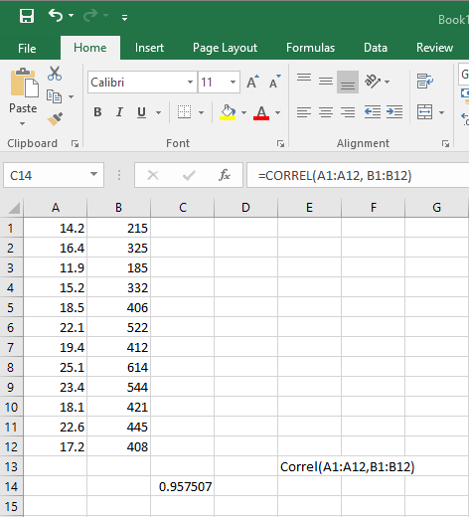
Interpretation of experimental data: Correlation
Answer the following:
  Which of the two variables, i.e. link capacity and temperature, can be considered as an independent variable?
  Calculate the correlation coefficient of these two variables. Is their degree of correlation strong or weak? Explain your answer.
  Make the corresponding scatter diagram.
  Draw the line that best fits the data “by eye”. Is there an optimal line that best fits the data?
  What link capacity do you predict during the period when the temperature in the network environment is 28.5 degrees?
Μεταβλητή X
Μεταβλητή Y

Slide 4
Correlation between two random variables
Two random variables X and Y may be correlated in some way.
This happens when one influences the other, or if they are not mutually exclusive when both are influenced by another variable.
Questions:
  Is there a relationship between two (or more) variables?
  If there is a relationship, what is the nature of this relationship?
Correlation: measure of relationship between variables
  Positively correlated
  Negatively correlated
  Uncorrelated

Slide 5
Correlation between two random variables
Only obvious relationships can be easily found through a visual inspection of a scatterplot.
However, we can, using statistics, make observations regarding the relationship between variables.
Specifically, we will use statistics to:
  Calculate the relationship between variables and
  Predict the value of the dependent variable for any value of the independent variable.

Slide 6
Measuring variability of a variable – variance
Dispersion or Variance of a variable:
Interpretation: the average amount of variability of observations from their mean value

Slide 7
Measuring covariance of two variables - covariance
Covariance between two variables
Interpretation: The average amount of the “simultaneous” variability of x and y from their mean values
Central idea: If the two variables are indeed related, then as one (x) varies around its mean value, the other (y) will also vary around its mean value in a similar way (or in the exact opposite way).

Slide 8
Example
A sample of 5 people was shown a number of advertisements for a chocolate bar and the following week it was measured how many chocolate bars each person bought.
Variable X = the number of advertisements they watched.
Variable Y = How many chocolate bars each person bought in a week.

Slide 9
Difference of values ​​of variables from their mean values
In general, we observe similarity in the behavior of the variables in terms of their variability around their mean values.

Slide 10
The Correlation Coefficient ρ
Ο συντελεστής συσχέτισης ρ
The degree of linear correlation of two random variables X and Y with corresponding variance
and covariance σXY = Cov(X, Y ) = E(X,Y) − E(X)E(Y ), measured by the correlation coefficient ρ defined as

Slide 11


The correlation coefficient ρ/r
Sample correlation coefficient
S_{x} and s_{y} are the sample standard deviations, and s_{xy} is the sample covariance.
Population correlation coefficient
The population correlation coefficient uses σ_{x} and σ_{y} as the population standard deviations, and σ_{xy} as the population covariance.

Slide 12
Scatter plot and correlation coefficient
Scatter plot of two random variables X and Y from n = 20 observations for positive correlation in figures (a), (b) and (c)

Slide 13
Scatter plot and correlation coefficient
Scatter plot of two random variables X and Y from n = 20 observations for negative correlation in figures (a), (b) and (c)

Slide 14
Correlation coefficient
Standardization of covariance
Removing the measure from units of measurement – ​​dividing by standard deviations of the variables
Pearson correlation coefficient:

Slide 15
Values ​​and interpretation of the correlation coefficient
The values ​​of r are always in the interval [-1, +1]
  r=+1: The variables are positively correlated (when one increases, the other increases linearly)
  r=-1: The variables are negatively correlated (when one increases, the other decreases linearly)
  r=0: The variables are uncorrelated
Rule of thumb:
r=±0.1: small correlation
r=±0.3: moderate correlation
r=±0.5: strong correlation
In the example
  a strong correlation emerges.

Slide 16
Correlation between two random variables
We had posed the Questions:
  Is there a relationship between two (or more) variables?
  What is the measure of the relationship between variables
    Positively correlated
    Negatively correlated
    Uncorrelated
  If there is a relationship, what is the nature of this relationship?

Slide 17
Conclusions
In relation to the correlation of two random variables
The correlation coefficients (pearson) and scatter plots show us
  the size and
  the nature of the correlation.
However, modeling the correlation is not a simple process.
It is necessary to find a function/equation that describes the relationship between two variables

Slide 18
Modeling the correlation
Finding a function that describes the relationship between two variables
  the function turns out to be an equation in the case of a linear relationship between the variables.
There is a general methodology for constructing and testing a model: Regression analysis
One variable (y) is considered dependent on the other (x), which is called independent.

Slide 19
The linear regression problem
We assume that the dependence is expressed by a linear relationship
and this relationship is called linear regression Y in X.
The values ​​of Y for each value of X are regressed around the y point of the line
That is, the values ​​of Y for each value of X are above and below this line.

Slide 20
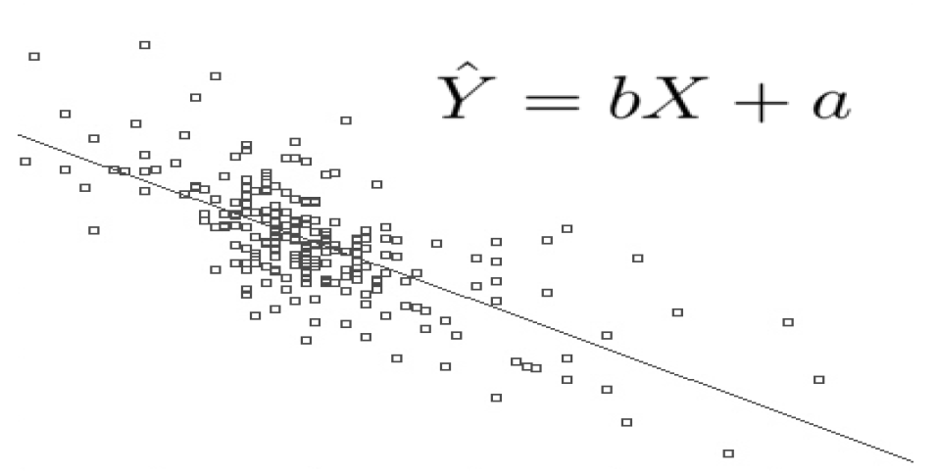
Simple linear regression
Explains and predicts a Dependent Variable(DV) based on a linear relation with an Independent Variable (IV)

Slide 21
Simple linear regression
As we know, the equation of a line is given by the relation:
  y= α + βx……………………….(1)
  where α and β are parameters that we need to calculate,
so that the resulting line gives us as much as possible the best description of the relationship (dependence) that exists between the variables X and Y.
The parameter a gives us the point (0,α), where this line intersects the y'y axis, while β represents the slope of the line.

Slide 22
Linear regression lines
We know that a line is defined by two points on it.
So in a scatterplot of experimental data, many linear regression lines can be drawn.

Slide 23
Example - Scatter plot of experimental data
Suppose we have the scatter plot of experimental data relating two variables x and y
How can we calculate the linear regression line, that is, calculate α & β?

Slide 24
Estimation of the linear regression line
The easiest way to draw a line is to draw it “by eye”. We have drawn such a line in the scatter diagram of Figure in the previous slide. To find α and β, we work as follows:
  We choose two points, say Γ(173,67) and Σ(191,86) on the line we drew “by eye”.
  We substitute the coordinates (x, y) of these points into equation (1),
  which gives us the system:
  Solving this system of equations, we find α= -115.6 and β= 1.06.
So, the equation of the line (1) becomes:
y= -115.6 + 1.06x ……………….………………………….. (2)
Therefore, the line that best fits the experimental data (the points of the scatter diagram) passes through the point (0, -115.6) and has a slope of 1.06.

Slide 25
Optimal Solution- Least squares criterion
Given the fact that there are many potential lines
Which one is the best (line of best fit)?
The answer to this question is given if we minimize
“the total sum of squares of the vertical deviations for each case”

Slide 26

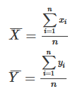

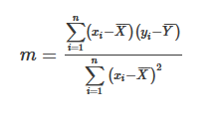
Optimal solution- Least squares criterion
Steps to find the equation of line of best fit for a set of ordered pairs (x1,y1),(x2,y2),...(xn,yn)
Step 1: Calculate the mean of the x-values and the mean of the y-values.
Step 2: The following formula gives the slope of the line of best fit:
Step 3: Compute the y-intercept of the line by using the formula:
Step 4: Use the slope m and the y -intercept b to form the equation of the line.
Example: Use the least square method to determine the equation of line of best fit for the data. Then plot the line.
Solution: https://www.varsitytutors.com/hotmath/hotmath_help/topics/line-of-best-fit

Slide 27
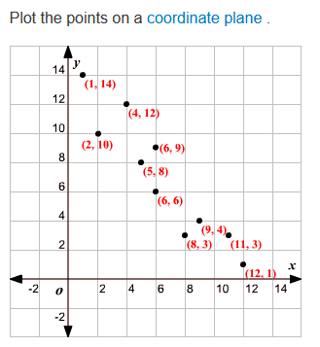
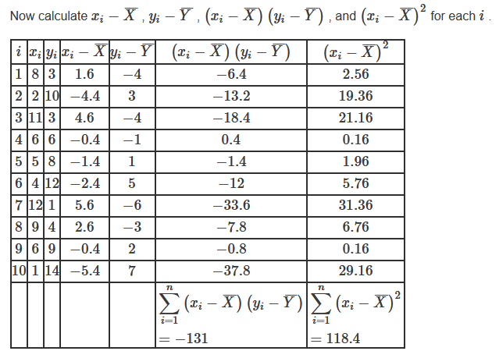
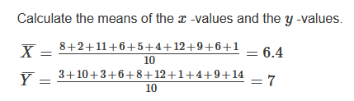
Least squares criterion - Example

Slide 28
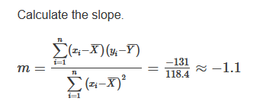
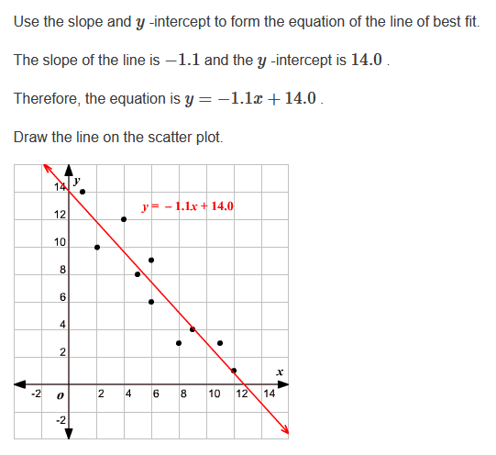
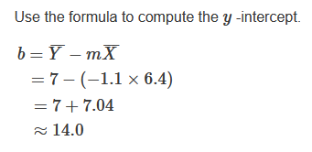
Least squares criterion - Example

Slide 29
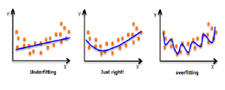
Types of Regression
Polynomial Regression
  A regression equation is a polynomial regression equation if the power of independent variable is more than 1.
  The equation below represents a polynomial equation:
  y=a+b*x^2
  In this regression technique, the best fit line is not a straight line, but rather a curve that fits into the data points.
Important Points
  While there might be a temptation to fit a higher degree polynomial to get lower error, this can result in over-fitting.
  Here is an example of how plotting can help:

Slide 30
Types of Regression
Stepwise Regression
  This form of regression is used when we deal with multiple independent variables.
Ridge Regression
  Ridge Regression is a technique used when the data suffers from multicollinearity (independent variables are highly correlated).
Lasso Regression
  Similar to Ridge Regression, Lasso (Least Absolute Shrinkage and Selection Operator) also penalizes the absolute size of the regression coefficients.
  In addition, it is capable of reducing the variability and improving the accuracy of linear regression models.
ElasticNet Regression
  ElasticNet is hybrid of Lasso and Ridge Regression techniques.

Slide 31
Interpretation of experimental data: Correlation
Charter plot - Create Charts in Excel
https://www.excel-easy.com/data-analysis/charts.html
Variable Y
Variable X
Variable X
Variable Y

Slide 32
Regression
Correlation describes the strength of association between variables
Regression determines the relationship between variables

Slide 33

Q & A

