Slide 1
Research Methods and Project Management Lecture 1 – The Scientific Method
M. Tsiknakis, PhD
Postgraduate Course on “Informatics Engineering” - Fall 2024

Slide 2
Welcome to Research Methods !
Teaches you the skills and practices of research
Reading
Experimenting
Analysing/Decision Making
Critical thinking!
Writing
Presenting
Directly relevant to your Research Activity (thesis/project).
Likely to be relevant to your future activities (research or otherwise…)‏

Slide 3
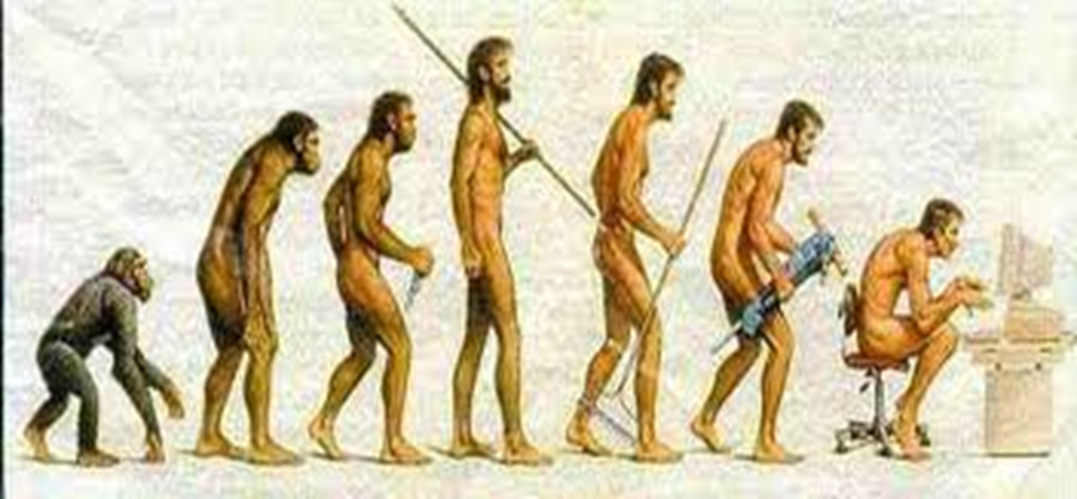
Background and Definition
Man coming to grips with his environment and to understand the nature through experience, reasoning and research.
RESEARCH
Systematic, controlled, empirical & critical investigation of hypothetical propositions about the presumed relations among natural phenomena, i.e.,
Systematic & controlled
Empirical
Self-correcting
Careful study of a given subject, field, or problem, undertaken to discover facts or principles.

Slide 4

What is research?
Term “Research”
Re + Search, whereas Re = Again and Search = to find something;
Therefore,
Research is simply the process of finding solutions to a problem after thorough study and analysis of the situational factors;
The process

Slide 5
Research Methods, Techniques and Methodology
Research Methodology: refers to the study of research methods; it does not admit of a plural.
Research Method: refers to the manner in which a particular research project is undertaken.
Research Technique: refers to a specific approach, or tool-and-its-use, whereby data is gathered and analyzed, and inferences are drawn.

Slide 6
Background
Research is
a combination of both experience & reasoning (εμπειρία και συλλογιστική) and
Is the most successful approach to the discovery of truth (particularly in natural sciences).
REASONING
Deductive (Aristotle) – From whole to part
Inductive (Francis Bacon) – From number of observations to whole
Combined

Slide 7
History
Aristotle (384–322 B.C.) was one of the most important western philosophers, a student of Plato, teacher of Alexander the Great, and tremendously influential in the Middle Ages. Aristotle wrote on logic, nature, psychology, ethics, politics, and art.
He is credited with developing deductive reasoning (επαγωγικό συλλογισμό).
Aristotle's «syllogism» is at the basis of deductive reasoning. A textbook example of a syllogism is:
Major premise (Σημαντική προϋπόθεση): All humans are mortal.
Minor premise: Socrates is a human.
Conclusion: Socrates is mortal.

Slide 8
Background Contd.
Francis Bacon (22 January 1561 – 9 April 1626) was an English philosopher, statesman, scientist, jurist, and author.
Ηe was extremely influential through his works, especially as philosophical advocate and practitioner of the scientific method during the scientific revolution.
Bacon has been called the creator of empiricism.
His works established and popularised inductive methodologies for scientific inquiry, often called the Baconian method, or simply the scientific method.

Slide 9

Part 2: The scientific Method

Slide 10

What is Science ?
A systematic and logical approach to discovering how things in the universe work.
It aims for measurable results through testing and analysis.
It is not meant to prove theories, but rule out alternative explanations until a likely conclusion is reached
Science consists simply of the formulation and testing of hypotheses based on observational evidence.
Science is ongoing.

Slide 11
Scientific Method
Popular in the 19th century.
Scientific method is the logical scheme used by scientists searching for answers to the questions
It is used to produce scientific theories.
When conducting a research, scientists observe the scientific method to collect measurable, empirical evidence in an experiment related to a hypothesis.

Slide 12
Scientific Method: Definition
Definition: Scientific method is the systematic collection of data (facts) and their theoretical treatment through proper observation, experimentation and interpretation.
Conducting research involves using the scientific method at its core.
Therefore, before any research is undertaken, it is important to be aware of the steps.

Slide 13
The Scientific Method
The scientific method is a way to ask and answer scientific questions by making observations and doing experiments.
The steps of the scientific method are to:
Ask a Question
Do Background Research
Construct a Hypothesis
Test Your Hypothesis by Doing an Experiment*
Analyze Your Data and Draw a Conclusion
Communicate Your Results
*It is important for your experiment to be a fair test. A "fair test" occurs when you change only one factor (variable) and keep all other conditions the same. (To be discussed in a future lecture)

Slide 14
Scientific Method … the classical phases
1
Research Question / Problem
What are you interested in?
What do you have to know about it?
2
Background / Observation
Make observations & gather background
information about the problem.
3
Formulate Hypothesis
An educated guess …
It should be possible to measure / test it.
It should help answer the original question.
4
Design Experiment
How will you test your hypothesis?
What tests will answer your question?
5
Test Hypothesis / Collect data
Test your hypothesis by executing your
experiments. Collect data from them.
6
Interpret / Analyse Results
What do your results tell you?
Do they prove or disprove the hypothesis?
... It is OK to be wrong.
7
Publish finding
Write papers for conferences & journals.
Write dissertation.

Slide 15
Research process … application of the SM
FF
Review the literature
FF
Review
Concepts
and
Theories
Design
Research
Protocol
/Experiment
Collect
Data
(Execution)
Analyze
Data
(Test
Hypothesis
if any)
Interpret
and
Report
Define
Research
Problem
Formulate
Hypothesis
& Questions(s)
Review
Previous
Research
Findings
FB
FB
I
III
IV
V
VI
VII
II
FB
FF
Feed Forward
FB
Feed Back

Slide 16
Basic postulates (αξιώματα) of the Scientific Method
It relies on empirical evidence (thus experimentation).
It is committed to only objective considerations (need for fair test, minimize or remove bias)
It results into probabilistic predictions (statistical treatment of results).
The methodology is made known.
Must be made known when reporting.
It presupposes ethical neutrality.
Many times in research we “touch” the boundaries of accepted ethical values.

Slide 17
The Engineering Design Method

Slide 18
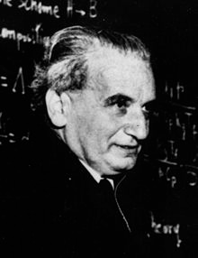
Science vs Engineering
The scientists seeks to understand what is;
The engineer seeks to
create what never was.
- Attributed to: Theodore von Karman
Theodore von Kármán (1881 – 1963) was a Hungarian-American mathematician, aerospace engineer, and physicist who was active primarily in the fields of aeronautics and astronautics. He is responsible for many key advances in aerodynamics, notably his work on supersonic and hypersonic airflow characterization. He is regarded as the outstanding aerodynamic theoretician of the twentieth century.

Slide 19
Science vs Engineering
Gordon Lindsay Glegg, a mechanical engineer from Scotland, said
''A scientist can discover a new star but he cannot make one. He would have to ask an engineer to do it for him.''
Scientific inquiry is the process that scientists use to gain insights about the natural world.
Technological and engineering design is the way that scientific, mathematical, and design principles are applied to create solutions to problems or develop products.

Slide 20
Science vs Engineering
While scientists study how nature (things) works, engineers create new things, such as products, IS, websites, environments, and experiences.
Because engineers and scientists have different objectives, they follow different processes in their work.

Slide 21
Scientific Method vs Engineering Design Process
Scientists perform experiments using the scientific method; whereas, engineers follow the creativity-based engineering design process.
Discuss a couple of Undergraduate Thesis with the objective to classify them as research or engineering projects

Slide 22
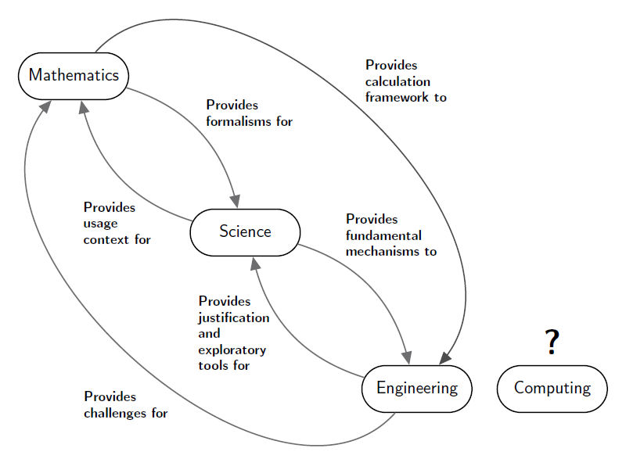
Interplay of Science, Engineering, Maths and Computing
Where does computing fit with this “information processes” view?

Slide 23
Part 3: The SM in ComputerScience

Slide 24
Computer? Science?
Some people claim that Computer Science:
“It’s not about computers. It's about computing.”
“It's not really a science. We do not create models of phenomena”
I believe this to be inaccurate.
The first part is right: It isn't about computers.
The second part is wrong: It IS a science
but also engineering – we build systems

Slide 25
Computer Science
We build models of natural and synthetic phenomena.
These models allow prediction and explanation of these phenomena
What is the correctness of the answers it provides?
How useful will the system be?
How fast will it run? Why?
How much memory will it require?
How much bandwidth does it use?
.....
Our job is to build models – and show that they are useful
Useful for performing tasks, prediction, analysis, etc.
This is a scientific approach, and also principled engineering.
Notes:
E.g. search engines, robots, image processing

Slide 26
Proving Ideas
Scientific progress: Generate ideas, then “prove” their worth
Suppose I have an idea P about how fast an algorithm will run.
“Proof” methods for an idea P:
Try a couple of times
Run realistic/representative experiments that show P (strong)
Prove it mathematically, analytically (very strong)
Traditionally, CS has been analytical
Prove correctness, prove halting, prove complexity.

Slide 27
Complex CS creations
Our computing phenomena had become complex
Compilers, Operating Systems, search engines, …
Most large-scale programs
Human-Computer interfaces
Interactions between multiple programs (e.g., multi-agent systems)
Interactions between the real world and programs (e.g., robots, the web)
These are not amenable to pure mathematical analysis
Just too complex (e.g., robots)
Just too ill-defined (e.g., operating systems: What is best?)
No (sufficient) math (e.g., human-computer interfaces, integrated architectures)
Must use empirical research methods

Slide 28
Map of Computer Science
Excellent You Tube video
https://www.youtube.com/watch?v=SzJ46YA_RaA

Slide 29
General Reading
Richard Hamming, ``You and Your Research''
Available at: http://www.cs.virginia.edu/~robins/YouAndYourResearch.html
Transcription of the “Bell Communications Research Colloquium Seminar”, 7 March 1986
Available at: https://www.youtube.com/watch?v=a1zDuOPkMSw
We will discuss this next week.

Slide 30
Q & A

