Slide 1
Research Methods and Project Management Lecture 2a – Reviewing the Literature
M. Tsiknakis
Postgraduate Course on “Informatics Engineering”, Fall 2025

Slide 2
Research process … application of the SM
FF
Review the literature
FF
Review
Concepts
and
Theories
Design
Research
(Including
Sample
Design)
Collect
Data
(Execution)
Analyse
Data
(Test
Hypothesis
if any)
Interpret
and
Report
Define
Research
Problem
Formulate
Hypothesis
Review
Previous
Research
Findings
F
F
I
III
IV
V
VI
VII
II
F
FF
Feed Forward
F
Feed Back

Slide 3
Step 1
DEFINE
RESEARCH PROBLEM

Slide 4
Definition of a Research Problem
Symptom Detection
Statement of the Problem in a general way;
Understanding the nature of the Problem;
Reviewing the available literature;
Developing ideas through discussions;
Rephrasing and redefining the Research Problem;
Analysis of
the Situation
Problem Definition
Statement of
Research Objectives
Results in clear-cut
research objectives

Slide 5
Defining a research problem … (1/2)
Defining a research problem in Informatics Engineering involves identifying an area of interest where a gap exists between the current state of knowledge or technology and an ideal solution or understanding.
To help guide you through the process, consider the following steps:
Identify a Broad Area of Interest - Start by choosing a general field in Informatics Engineering that excites you.
AI and ML
Narrow Down the Topic - Once you have identified the broader domain, think of subtopics or specific challenges within that field.
AI and ML: Explainable AI, reinforcement learning, AI ethics, neural network optimization
Literature Review and Existing Solutions - Research the current solutions or advancements in your chosen area to identify:
What has already been done?
Are there limitations or gaps in existing technologies, models, or methods?
Are there unsolved problems or inefficient processes that need improvement?

Slide 6
Defining a research problem … (2/2)
Define the Research Problem - With a clear understanding of the gap, you can define your research problem. A good research problem should:
Address a specific gap: It should be clear what hasn’t been solved or what needs improvement.
Be feasible: Ensure that you have the tools, data, and time to explore the problem.
Contribute to the field: Your research should aim to advance knowledge, improve technologies, or offer a new solution.
Refining the Problem – Many times - Once we have an initial problem statement, it is worth trying refining it by focusing on:
Scope: Is your problem too broad or too narrow? Adjust the scope to match the resources and time available.

Slide 7
Step 2
REVIEW
OF
LITERATURE

Slide 8
What is a literature review?
It is either a piece of work in its own right or part of a big essay which discusses what other (important) authors think about a topic.
It shows the reader (the marker) what you have read about the topic!
It shows that you have understood the important issues around the topic!
It gives a foundation for your research!

Slide 9
Review of the Literature Definition
Literature Review is the documentation, i.e. production of a report, of a comprehensive assessment of the published and unpublished work from secondary sources of data in the areas of specific interest to the researcher.
Simple stated: It is an extensive survey of all available past studies relevant to the field of investigation.
The main aim is to find out problems that are already investigated and those that need further investigation.

Slide 10
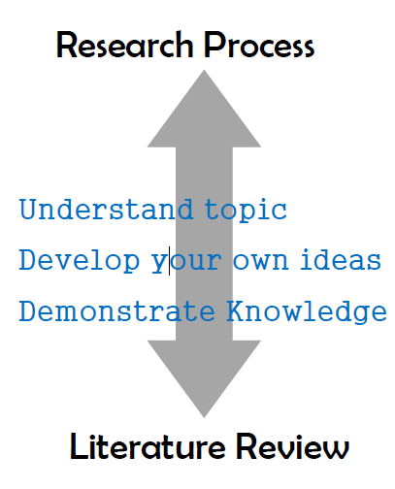
Functions of a LR
Integral part of the research process.
Creating research questions.
Delivering answers or insight into a research problem.

Slide 11
Purpose of a Survey
To gain a background knowledge of the research topic.
To identify the concepts relating to it, potential relationships between them and to formulate researchable hypothesis.
To identify appropriate research methods & design, methods of measuring concepts and techniques of analysis.
To identify data sources used by other researchers.
To learn how others structured their reports.

Slide 12
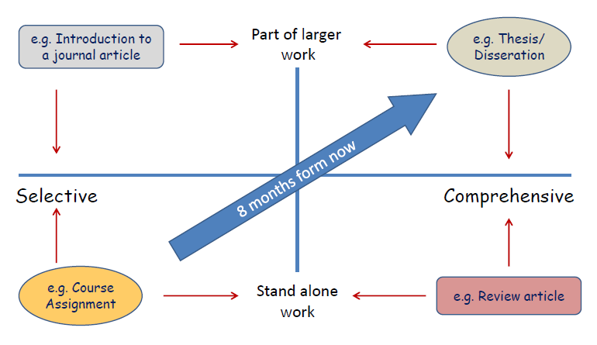
Types of Literature Reviews
Systematic Literature Review

Slide 13
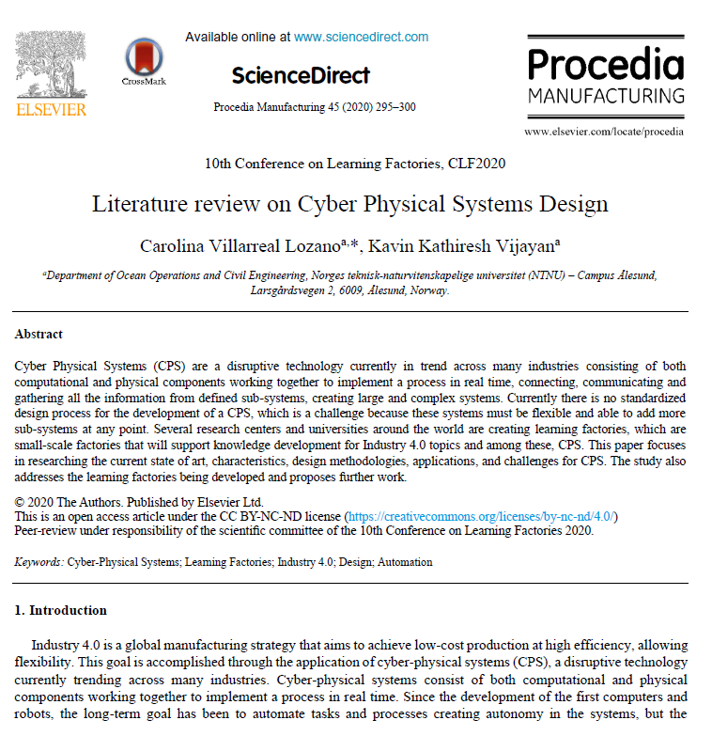
Literature Review
Stand alone article
Excellent starting point for research in a topic

Slide 14
How to write a literature review

Slide 15

Literature …
We often hear from supervisors
“What does the literature show us?”
“Connect your ideas to the literature?”
“Survey the literature on the topic?”
…but WHAT IS “the literature?”

Slide 16

What is “literature”… ?

Slide 17
Other … “sources”
There are other sources … obviously.
The internet
Dedicated web sites
Social communities
etc

Slide 18
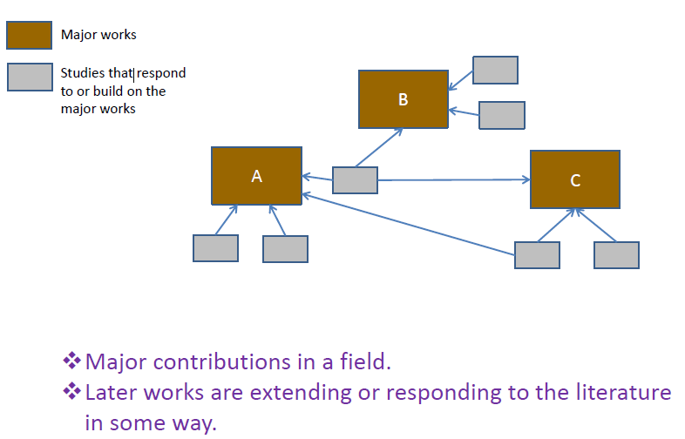
Architecture of … the literature
& Important authors

Slide 19
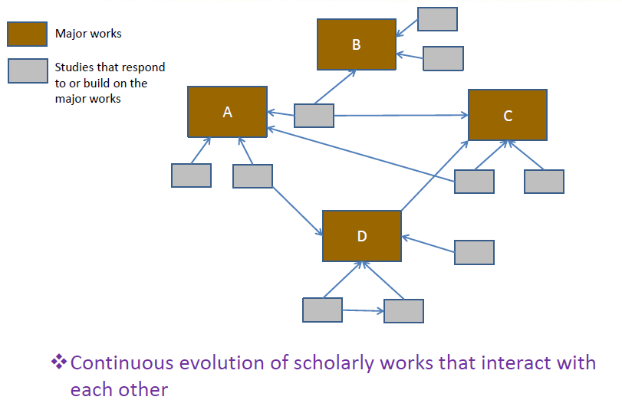
Continuous evolution …

Slide 20
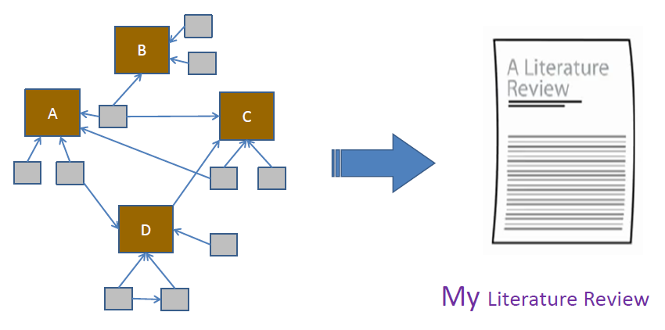
How do we turn a collection of articles into a cohesive story … ??

Slide 21
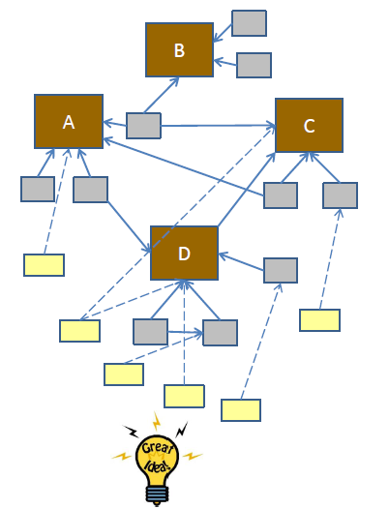
It is like participating in a conversation!
As you understand what the others are saying you begin to formulate your own ideas.
This process of discovering relationships in the literature and connecting our own ideas to them is what helps you to turn
a network of articles
in a cohesive review of the literature.

Slide 22
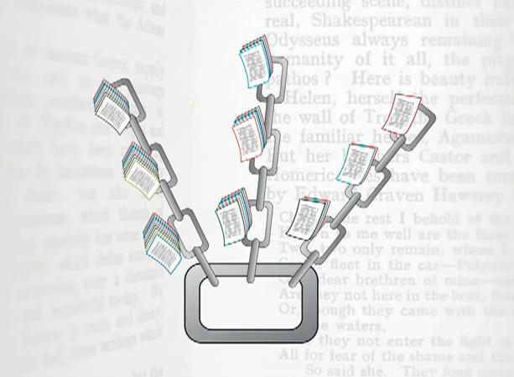
Search for the … missing link!
Research is about telling a story ;
Search for the missing link;

Slide 23
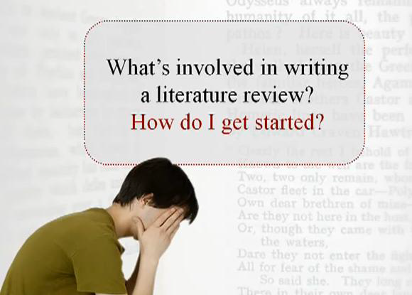

Slide 24
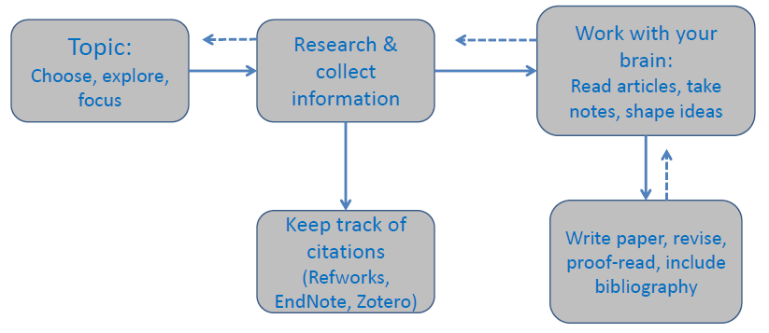
Writing a literature review is … a process
Mendeley
But not a linear process;
As you get deeper one step might move you to previous steps;

Slide 25

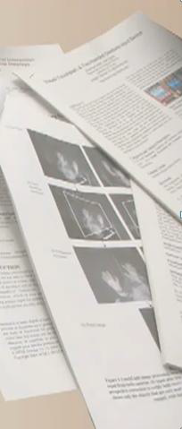
What’s involved in reviewing
Discover relationships between sources
Identify major themes & concepts
Identify critical gaps and disagreements

Slide 26
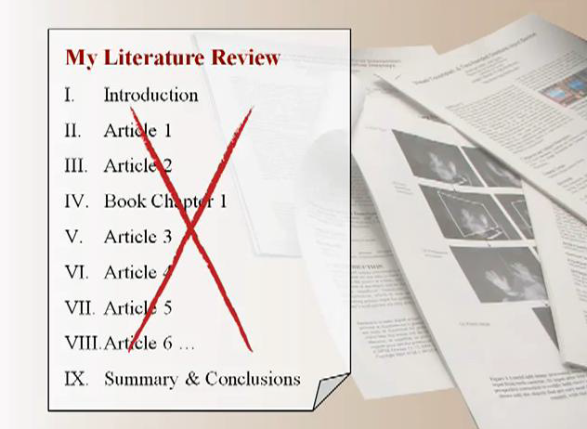
Do NOT fall into the trap ….
Understand & critique.
Integrate and synthesize.
Easily said … but how do we do it?
Some tips!

Slide 27
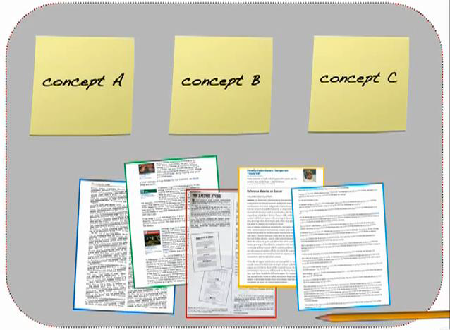
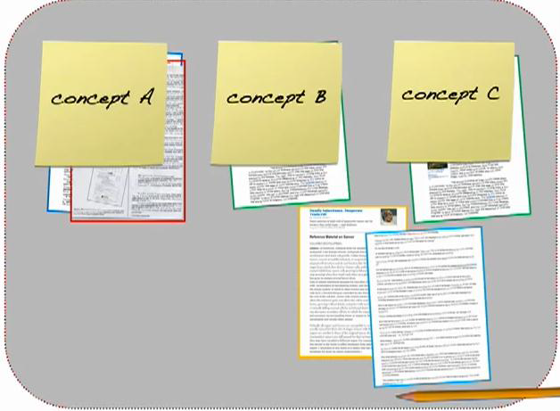
Identify and classify the “main stories”
Identify a few of the Main Concepts
Classify papers per Concept

Slide 28
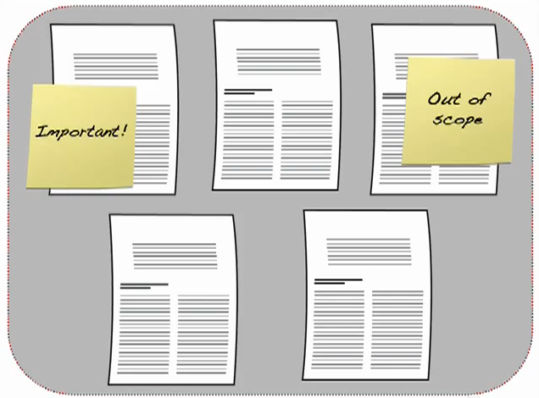
Work with your brain … categorize & select

Slide 29
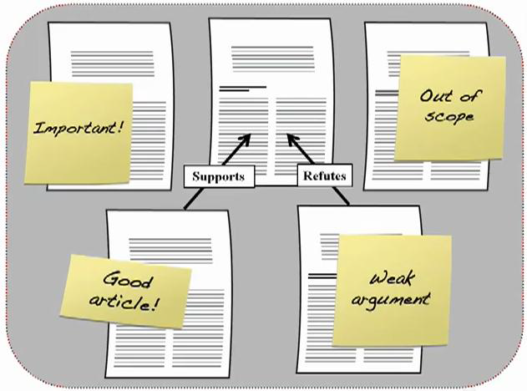
… develop your arguments!!!

Slide 30
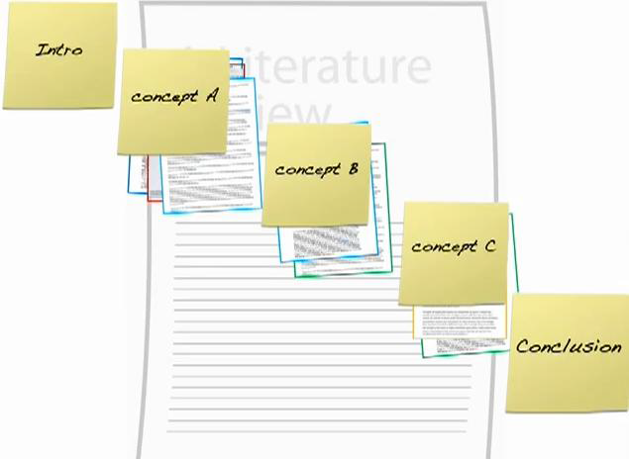
Finish by …
Write your report by structuring your discussion around
the main “concepts” you have discovered
and using the main arguments you have developed for each of these topics.
Include an introduction and a concluding section (of course!!!)

Slide 31
Summarizing - the Literature Review
What it isn’t
Is not an assay/research paper (most of the times).
Does not state or prove your main points.
What it is:
Major concepts;
Relationships between those snapshots;
In a timeline manner;
Key to remember
The objective is to extract
the key concepts from
the major relevant works in your “narrow” topic and
identify their relationships
as they have evolved over time.

Slide 32
Writing A Literature Review
7 Common (And Costly) Mistakes To Avoid https://gradcoach.com/literature-review-mistakes/
Overview: 7 Literature Review Killers
Over-reliance on low-quality sources
A lack of landmark/seminal literature
A lack of current literature
Description instead of integration and synthesis
Irrelevant or unfocused content
Poor chapter structure and layout
Plagiarism and poor referencing

Slide 33
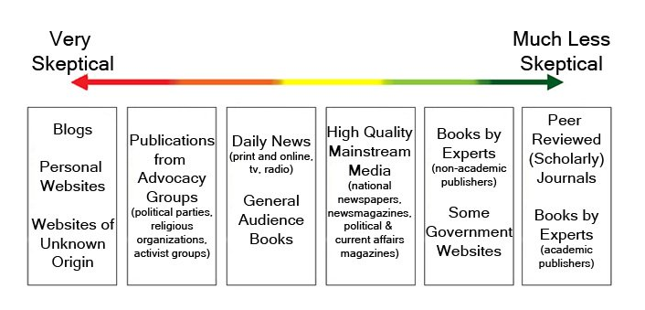
Mistake #1: Low quality sources
One of the most common issues we see in literature reviews is an over-reliance on low-quality sources. This includes a broad collection of non-academic sources like blog posts, opinion pieces, publications by advocacy groups and daily news articles.
Of course, just because a piece of content takes the form of a blog post doesn’t automatically mean it is low-quality.
However, it’s (generally) unlikely to be as academically sound (i.e., well-researched, objective and scientific) as a journal article, so you need to be a lot more sceptical when considering this content and make sure that it has a strong, well-reasoned foundation.
As a rule of thumb, your literature review shouldn’t rely heavily on these types of content – they should be used sparingly.

Slide 34
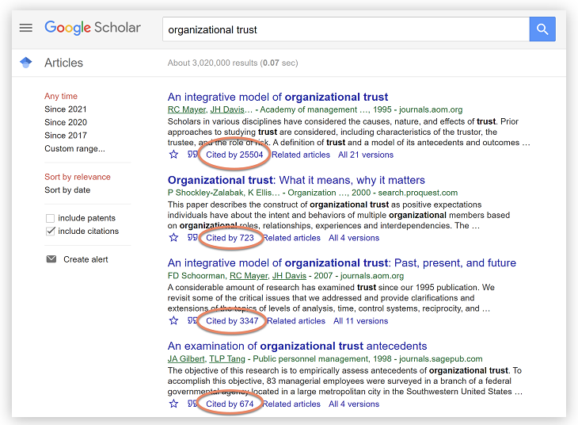
Mistake #2: A lack of landmark/seminal literature
Another issue we see in weaker literature reviews is an absence of landmark literature for the research topic.
Landmark literature (sometimes also referred to as seminal or pivotal work) refers to the articles that initially presented an idea of great importance or influence within a particular discipline.
In other words, the articles that put the specific area of research “on the map”, so to speak.
But do I find landmark or important literature?

Slide 35
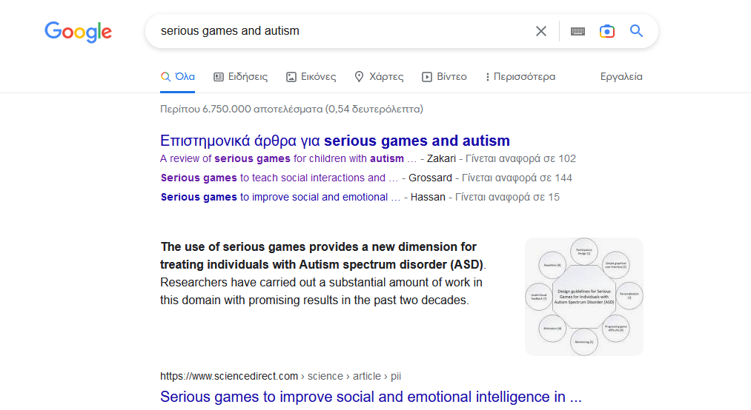
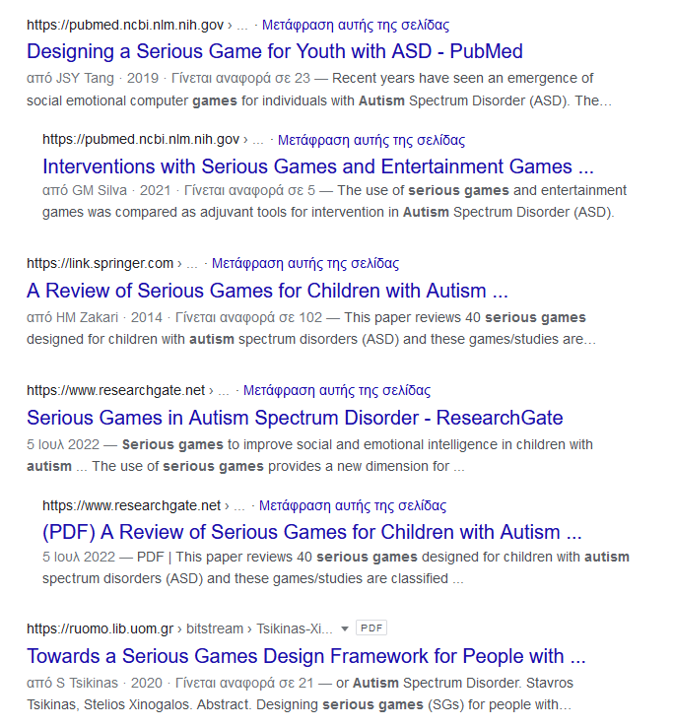
Example
Serious Games and Autism

Slide 36
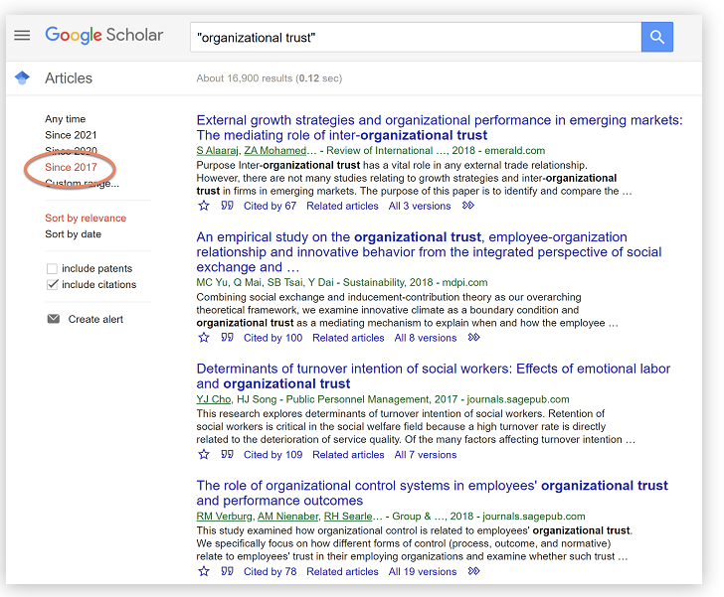
Mistake #3: A lack of current literature
As mentioned, it’s incredibly important to acknowledge the landmark studies and research in your literature review.
However, a strong literature review should also incorporate the current literature.
It should, ideally, compare and contrast the “classics” with the more up to date research, and briefly comment on the evolution.
But, how do you find current literature?
To find current literature in your research area, you can once again use Google Scholar by simply selecting the “Since…” link on the left-hand side. Depending on your area of study, recent may mean the last year or two, or a fair deal longer.

Slide 37
Mistake #4: Description instead of integration and synthesis
All too often, students think that a literature review is simply a summary of what each researcher has said.
A lengthy, detailed “he said, she said”.
This is incorrect.
A good literature review needs to go beyond just describing all the relevant literature.
It needs to integrate the existing research to show how it all fits together.

Slide 38
Mistake #5: Irrelevant or unfocused content
Another common mistake we see in literature review chapters is quite simply the inclusion of irrelevant content. Some chapters can waffle on for pages and pages and leave the reader thinking, “so what?”
So, how do you decide what’s relevant?
Well, to ensure you stay on-topic and focus, you need to revisit your research aims, objectives and research questions.
Remember, the purpose of the literature review is to build the theoretical foundation that will help you achieve your research aims and objectives, and answer your research questions.
Therefore, relevant content is the relatively narrow body of content that relates directly to those three components.

Slide 39
Mistake #6: Poor chapter structure and layout
Even the best content can fail to earn marks when the literature review chapter is poorly structured.
The most common reason that students land up with a poor structure is that they start writing their literature review chapter without a plan or structure.
Of course, as we’ve discussed before, writing is a form of thinking, so you don’t need to plan out every detail before you start writing.
However, you should at least have an outline structure penned down before you hit the keyboard.
So, how should you structure your literature review?
As a quick overview, your literature review should consist of three core sections:
The introduction section – where you outline your topic, introduce any definitions and jargon and define the scope of your literature review.
The body section – where you sink your teeth into the existing research. This can be arranged in various ways (e.g. thematically, chronologically or methodologically).
The conclusion section – where you present the key takeaways and highlight the research gap (or gaps), which lays the foundation for your study.

Slide 40
Mistake #7: Plagiarism (λογοκλοπή) and poor referencing
This one is by far the most unforgivable literature review mistake, as it carries one of the heaviest penalties, while it is so easily avoidable.
All too often, we encounter literature reviews that, at first glance, look pretty good
However, a quick run through a plagiarism checker and it quickly becomes apparent that the student has failed to fully digest the literature they’ve reviewed and put it into their own words.
A related issue that we see quite often is plain old-fashioned poor referencing.
This can include citation and reference formatting issues (for example, IEEE, Harvard or APA style errors), or just a straight-out lack of references.
In academic writing, if you fail to reference a source, you are effectively claiming the work as your own, which equates to plagiarism.
This might seem harmless, but plagiarism is a serious form of academic misconduct and could cost you a lot more than just a few marks.

Slide 41
Mendeley
Mendeley
Mendeley is a free reference manager and an academic social network
https://www.mendeley.com/?interaction_required=true

Slide 42
1st Assignment
Discuss the first Assignment
A number of research papers have been uploaded in eClass, covering a diverse set of topics of Computer Science, Computer Engineering, Telecommunications and Multimedia.
The objective of the assignment is to perform a limited (i.e. NOT systematic or comprehensive) review of current state of the art in a given domain.
In this assignment you are asked to work individually. In specific circumstances you will be allowed to work in groups of two, but you need permission of the course instructor for this.

Slide 43
Q & A

