Slide 1
Research Methods & Project Management Systematic review as a research method
M. Tsiknakis
Postgraduate Course on “Informatics and Multimedia”, Fall 2025

Slide 2
Context
"Indeed, one of my major complaints about the computer field is that whereas Newton could say, "If I have seen a little farther than others, it is because I have stood on the shoulders of giants," I am forced to say, "Today we stand on each other's feet."
Perhaps the central problem we face in all of computer science is how we are to get to the situation where we build on top of the work of others rather than redoing so much of it in a trivially different way. Science is supposed to be cumulative, not almost endless duplication of the same kind of things".
Richard Hamming 1968
Turing Award Lecture

Slide 3
What is a systematic review?
“Systematic literature review (SLR) (also referred to as a systematic review). A form of secondary study that uses a well-defined methodology to identify, analyse and interpret all available evidence related to a specific research question in a way that is unbiased and (to a degree) repeatable.”
(Individual studies contributing to a systematic review are called primary studies; a systematic review is a form a secondary study).”*
* B.A. Kitchenham, “Procedures for Performing Systematic Reviews,” Technical Report TR/SE-0401, Keele University, and Technical Report 0400011T.1, NICTA, 2004.

Slide 4
Advantages
The advantages of systematic literature reviews are that:
The well-defined methodology makes it less likely that the results of the literature are biased
although it does not protect against publication bias in the primary studies.
If studies give consistent results, systematic reviews provide evidence that the phenomenon is robust and transferable.
If the studies give inconsistent results, sources of variation can be studied.

Slide 5
Publication bias
Publication bias is a type of bias that occurs in published academic research.
It occurs when the outcome of an experiment or research study influences the decision whether to publish or otherwise distribute it.
Publication bias refers to a phenomenon in scientific reporting whereby
authors are more likely to submit and
journal editors are more likely to publish studies
with “positive” results (i.e. results showing a significant finding) than studies with “negative” or unsupportive results.

Slide 6
Advantages & Disadvantages
In the case of quantitative studies, it is possible to combine data using meta-analytic techniques.
This increases the likelihood of detecting real effects that individual smaller studies are unable to detect.
The major disadvantage of systematic literature reviews is that they require
considerably more effort than traditional literature reviews.

Slide 7
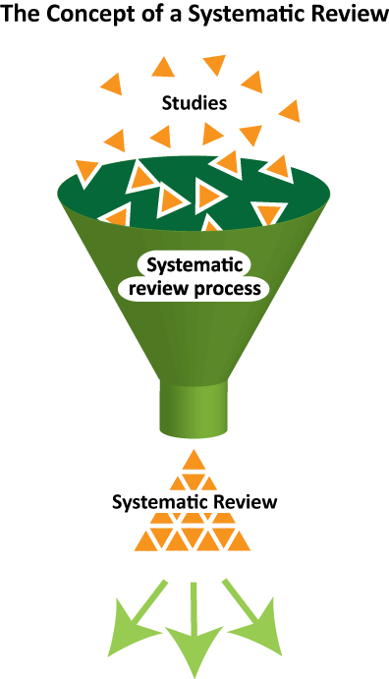
Reasons for performing a SR
Reasons for a systematic review.
To summarize the existing evidence concerning a given topic or technology.
To identify any gaps in current research in order to suggest areas for further investigation.
To provide a framework/ background in order to appropriately position new research activities.
Research Results

Slide 8
The Importance of systematic reviews
Most research in a new area starts with a literature review.
To have scientific value, a literature review must be thorough and fair/unbiased.
Systematic reviews
A review protocol that specifies the research question being addressed.
In accordance with a predefined search strategy that aims to detect as much of the relevant literature as possible.

Slide 9
Systematic Review Protocol
A systematic review protocol describes
the rationale, hypothesis/research question, and planned methods of the review.
It should
be prepared before a review is started
used as a guide to carry out the review and
made publicly available.

Slide 10
Components of the review protocol
Background. The rationale for the survey;
The (research) questions that the review is intended to answer;
The strategy that will be used to search for primary studies including search terms and resources to be searched (databases, specific journals, and conference proceedings);
Primary study selection criteria determine criteria for including in, or excluding a study from the review;
Data extraction strategy. This should define how the information required from each primary study would be obtained;
Synthesis of the extracted data. This should define the synthesis strategy.

Slide 11
Conducting the review Identification of research
Find as many primary studies related to the research question as possible using an unbiased search strategy.
For example, it is necessary to avoid language bias.
Publication bias refers to the problem that positive results are more likely to be published than negative results.

Slide 12
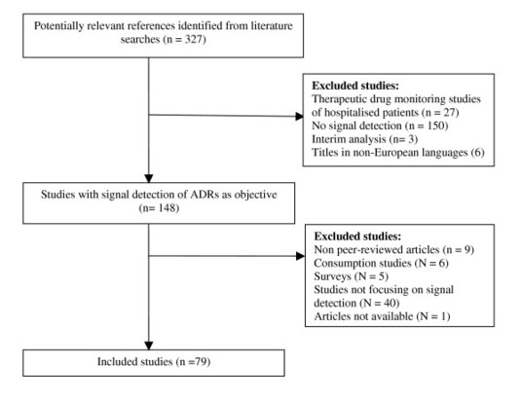
Conducting the review Study selection
Study selection criteria are intended to identify those primary studies that provide direct evidence about the research question.
In order to reduce the likelihood of bias, selection criteria should be decided during the protocol definition.

Slide 13
Conducting the review Data Extraction - Analysis
Design the data extraction forms to accurately collect all the information needed to address the review questions and the study quality criteria.
Title, authors, journal etc.
Date of data extraction
Questions needed to be answered
Additional notes

Slide 14
Conducting the review Data synthesis
Extracted information about the studies should be tabulated in a manner consistent with the review question.
Tables should be structured to highlight similarities and difference between study outcomes.
Study outcomes must be presented in a comparable way.
Binary: yes/ no
Numerical measures: Mean difference, etc.

Slide 15
Reporting the review 1/4
Journal or thesis ?
Title
Authors
Executive summary or structured abstract
Context/Background (importance of the search)
Objectives (questions addressed)
Methods (data sources, study selection etc.)
Results (main findings)
Conclusions (implications for future research)
Background

Slide 16
Reporting the review 2/4
Review questions
Review methods
Data sources and search strategy
Study selection
Study quality assessment
Data extraction
Data synthesis
Results:
Description/ classification of primary studies
Results of any quantitative summaries

Slide 17
Reporting the review 3/4
Discussion
Principal findings
These must correspond to the findings discussed in the results section
Strengths and Weaknesses
Strength and weaknesses of the evidence included in the review. Relation to other reviews, particularly considering any differences in quality and results.
Meaning of findings
Direction and magnitude of effect observed in summarised studies applicability/ generalizability of the findings.

Slide 18
Reporting the review 4/4
Conclusions
Recommendation
Practical implications for the research
Unanswered/new questions for the future
Acknowledgements
Conflict of interest
References and appendices

Slide 19
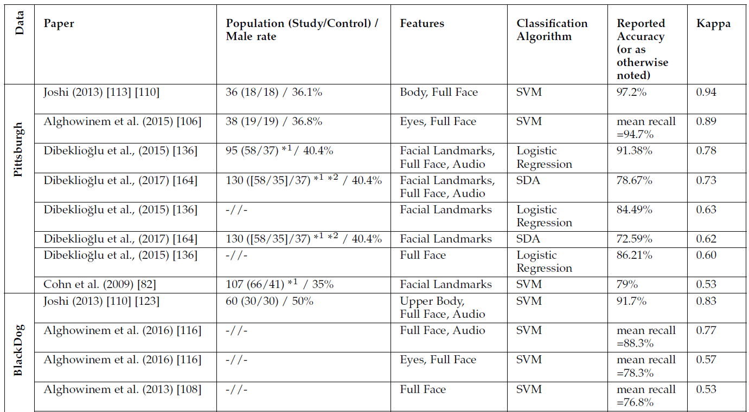
Example
A. Pampouchidou, Automatic Assessment of Depression Based on Visual Cues: A Systematic Review, Transactions of Affective Computing, 2017, DOI 10.1109/TAFFC.2017.2724035
Comparison of approaches for categorical assessment of depression grouped according to the dataset used, ranked within group based on Kappa

Slide 20
Remember …
In Data Synthesis we said …
Study outcomes must be presented in a comparable way.
Binary: yes/ no
Numerical measures: Mean difference, etc.
Decided to use
Cohen's kappa coefficient (κ) is a statistic which measures inter-rater agreement for qualitative (categorical) items.
Cohen's kappa measures the agreement between two raters who each classify N items into C mutually exclusive categories.

Slide 21
Features of Systematic Literature Reviews
Some of the features that differentiate a systematic review from a conventional expert literature review are:
Systematic reviews start by defining a review protocol that specifies the research question being addressed and the methods that will be used to perform the review.
Systematic reviews are based on a defined search strategy that aims to detect as much of the relevant literature as possible.
Systematic reviews document their search strategy so that readers can assess their rigour and the completeness and repeatability of the process (bearing in mind that searches of digital libraries are almost impossible to replicate).
Systematic reviews require explicit inclusion and exclusion criteria to assess each potential primary study.
Systematic reviews specify the information to be obtained from each primary study including quality criteria by which to evaluate each primary study.

Slide 22
Example of a systematic review

Slide 23


Slide 24
Reasons for performing a SR
Context: R& D project focusing on the study of epilepsy and
the Attention Deficit Hyperactivity Syndrome (ADHD) of children.
Can we predict
Video
Can we better classify
Multi
Modal
information
fusion
Video EEG
Can we predict
Epilepsy
EEG
Can we increase
classification accuracy
Genomics
Explain pharmaco-resistance
(same phenotype, different responses)
Identify genomic biomarkers
(pre-disposition)

Slide 25
Reasons for performing a SR
To summarize the existing evidence concerning a given topic or technology.
To identify any gaps in current research in order to suggest areas for further investigation.
To provide a framework/ background in order to appropriately position new research activities
Initial step to a definition phase of a PhD.

Slide 26
The research question(1)
Within such a research framework the first step concerns the systematic documentation of available research results and their evaluation with respect to their sensitivity/specificity, robustness and range of application.
The purpose of this review therefore is to report on the achievements of
existing approaches in vision-based human motion detection and analysis as well as
seizure recognition in epilepsy with a focus on utilized methodologies and associated feature sets.

Slide 27
The research question(2)
It addresses the following questions:
(a) What is the objective behind each work?
(b) Which technological/algorithmic tools are applied?
(c) Which features are being analyzed?
(d) What are the constraints/assumptions?
(e) What is the quality of the results so far obtained?

Slide 28
Research methodology Constraints & search strategy
The period of interest for this review is from the year 2000 and onwards.
The following search string was used in the SCIRUS2 search engine as an initial search action:
human*AND epilepsy AND (video OR vision) AND (motion OR movement OR seizure) AND (analysis OR detection OR recognition) ANDNOT (“case report” OR animal* OR mri OR fmri).

Slide 29
Filtering – information reduction
The results were filtered based on their title and abstract.
Additionally searching of publications by the same authors of initially identified relevant papers, following references, and using the “cited by” function whenever available by the search engine resulted to a total of 36 articles from journals and conferences.

Slide 30
Conducting the review
In classifying the available literature, the functional taxonomy presented in a survey by Moeslund and Granum (2001) dealing with vision-based human motion capture has been considered.
It distinguishes between
initialization,
tracking,
pose estimation and
recognition.
This taxonomy was however rearranged to fit the purposes of this paper.
Specifically, the articles here are first grouped into marker-based and marker-free methods.

Slide 31


The most difficult step...
Identify main “themes”
Research so far can be divided into three groups, each dealing with
motion detection,
analysis or
recognition.

Slide 32
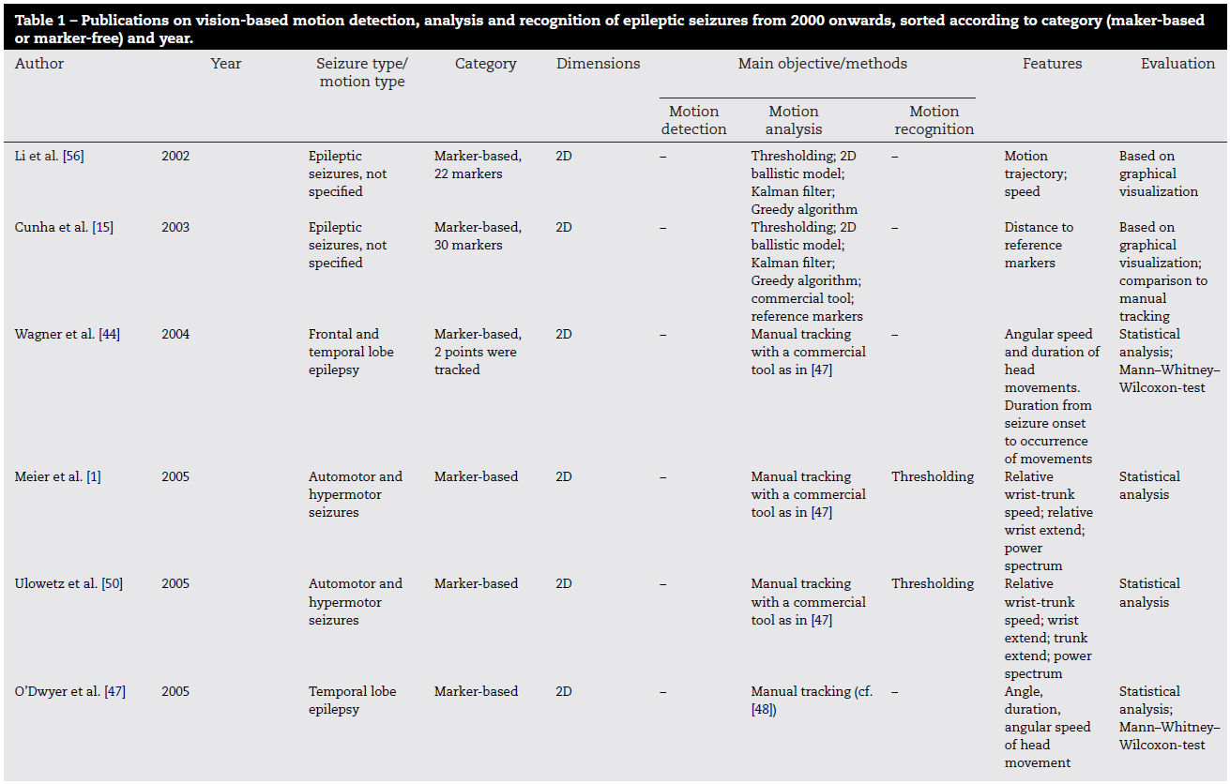
Analysis of the literature

Slide 33
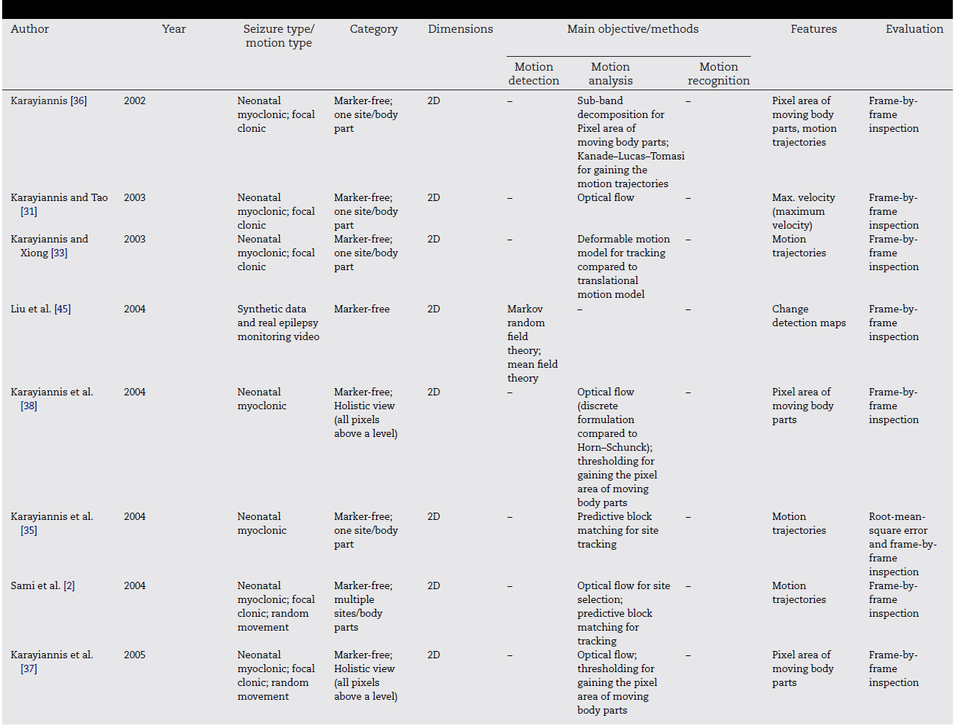
Analysis of the literature

Slide 34
After this point …. Things become easy !!!

Slide 35
Homework 2
Some Systematic Reviews have been uploaded in eClass.
Select 3 of you own choice.
Write a brief note (1-2 pages, double space) identifying for each systematic review with clarity:
The review protocol (that specifies the research question being addressed).
The search strategy (that aims to detect as much of the relevant literature as possible).
Discuss possible differences and commonalities and assess their quality.

Slide 36
Q&A

