Slide 1
Research Methods and Project Management
Lecture 3a – How to Evaluate the Trustworthiness of Scientific Journals
M. Tsiknakis
Postgraduate Course on “Informatics Engineering”, Fall 2025

Slide 2
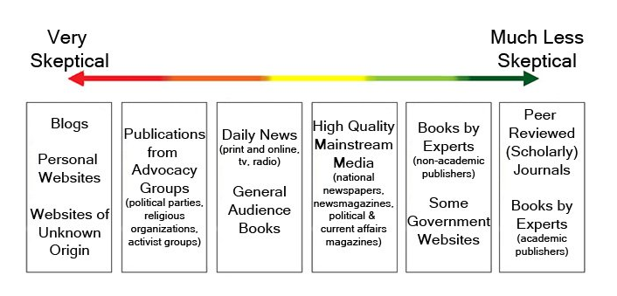
Mistake #1: Low quality sources
One of the most common issues we see in literature reviews is an over-reliance on low-quality sources.
  This includes a broad collection of non-academic sources like blog posts, opinion pieces, publications by advocacy groups and daily news articles.
Of course, just because a piece of content takes the form of a blog post doesn’t automatically mean it is low-quality.
However, it’s (generally) unlikely to be as academically sound (i.e., well-researched, objective and scientific) as a journal article.
As a rule of thumb, your literature review shouldn’t rely heavily on these types of content – they should be used sparingly.

Slide 3
How to assess the Trustworthiness of Literature?
Why Trustworthiness Matters
  Ensures quality and credibility of your research base
  Protects against misinformation and predatory journals
  Supports evidence-based decision making
Key Indicators of a Trustworthy Journal
    Peer-review process (transparent & rigorous)
    Editorial board (qualified, reputable members)
    Clear author guidelines and publication ethics
    Indexing in recognized databases (e.g., PubMed, Scopus)

Slide 4
Evaluating the Trustworthiness of Scientific Journals
Red Flags of Predatory/Low Quality Journals
  Unrealistically fast publication promises
  Unclear or nonexistent peer-review
  Editorial board without verifiable credentials
  Aggressive spam invitations to submit
Tools & Resources for Verification
  Check indexing in trusted databases (PubMed, Scopus, Web of Science)
  Consult Directory of Open Access Journals (DOAJ)
  Use journal evaluation lists
  Check impact factor and publisher reputation

Slide 5
Evaluating the Trustworthiness of Scientific Journals
Practical Evaluation Checklist
  Is the journal indexed in reputable databases?
  Is the peer-review process clearly stated?
  Does the editorial board have recognizable experts?
  Is there transparency about fees and ethics?
  Are past issues of good quality?

Slide 6

Impact Factor of a Journal
The Impact Factor (IF) of a scientific journal is a metric used to measure the average number of citations that recent articles published in that journal receive.
It is often used as an indicator of a journal’s influence or prestige in its field — though it’s not a perfect measure of quality.
How Impact Factor Is Calculated
  For a given year (e.g., 2025):
  Example:
  If articles published in 2023–2024 were cited 5,000 times in 2025, and the journal published 1,000 articles in that period:
  IF=5,000/1,000=5.0
  This means, on average, each article was cited five times in the year 2025.

Slide 7
Impact Factor
Where It Comes From
  The Impact Factor is calculated and published annually by Clarivate in the Journal Citation Reports (JCR).
  Only journals indexed in Web of Science receive an official Impact Factor.
The Impact Factor is a useful starting point for assessing journal visibility and influence, but it should be combined with other indicators
(like peer-review quality, editorial board reputation, indexing, and transparency) to judge trustworthiness.

Slide 8
Ranking of Scientific Journals
Scientific journals are not only evaluated individually, but also grouped into ranking tiers or categories based on several metrics.
These groupings help researchers identify which journals are considered more influential or reputable within their field.
Here’s a clear breakdown of how journals are typically grouped
Group | Typical IF Range (varies by field) | Characteristics
Top-tier | Very high IF/SJR (top 10–25%) | Leading journals, rigorous review, high visibility
Mid-tier | Moderate IF/SJR | Reputable, often more accessible to publish in
Lower-tier | Low IF/SJR or none | Limited reach, may be newer or niche

Slide 9
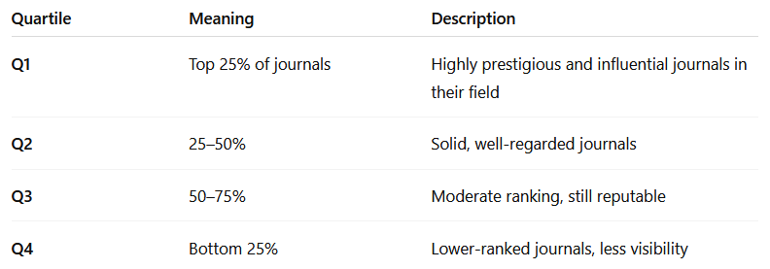
Ranking of Scientific Journals
Quartile Rankings (Q1–Q4) — Most Common Grouping
  Journals are often divided into four quartiles based on their performance (e.g., Impact Factor, citation metrics) within their subject category.
Example: A journal with an Impact Factor of 8 may be Q1 in one field (e.g., Public Health) but only Q3 in another (e.g., Oncology), because rankings are field-specific.

Slide 10
Ranking of Scientific Journals
Ranking by Metrics (e.g., Impact Factor, SJR, CiteScore)
Journals are also grouped based on numerical performance indicators:
  Impact Factor (IF) – Average citations in 2 years (Clarivate JCR).
  SJR (Scimago Journal Rank) – Weighs citations by the prestige of citing journals.
  CiteScore – Similar to IF but uses a 4-year citation window (Scopus).
Group | Typical IF Range (varies by field) | Characteristics
Top-tier | Very high IF/SJR (top 10–25%) | Leading journals, rigorous review, high visibility
Mid-tier | Moderate IF/SJR | Reputable, often more accessible to publish in
Lower-tier | Low IF/SJR or none | Limited reach, may be newer or niche
Note: A “low” impact factor does not necessarily mean “bad” — smaller or specialized fields often have lower citation volumes overall.

Slide 11
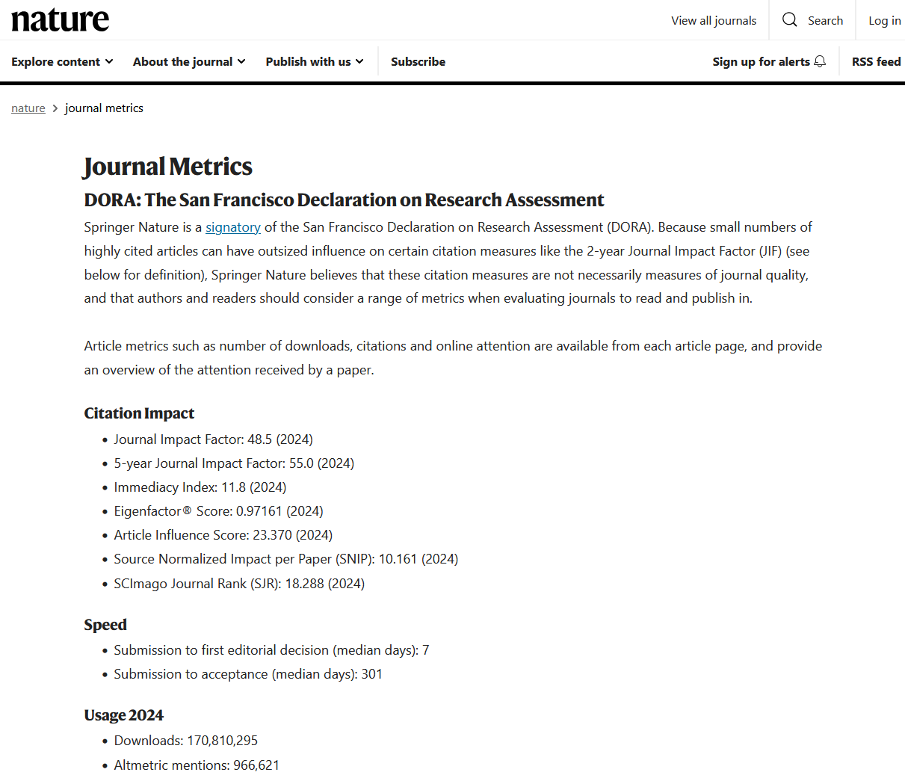
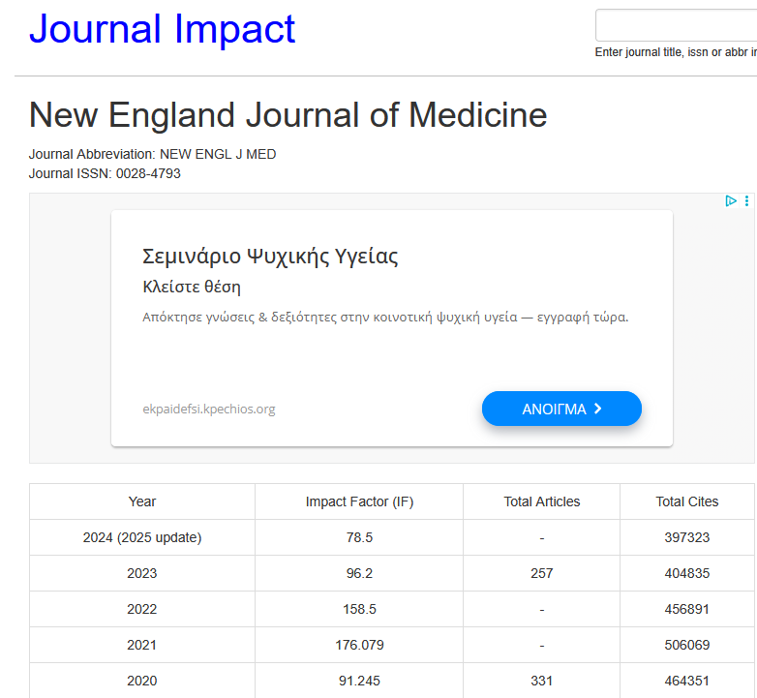


Examples

Slide 12
Referencing
IEEE Referencing style
In-Text Citation (IEEE)
  Citations are indicated by numbers in square brackets.
  The number corresponds to the order in which the source appears in the text.
  The same number is used for repeated references to the same source.
Examples:
  “This method was first introduced in [1].”
  “Several approaches have been proposed [2], [3], [5].”
  “As discussed in [4], this algorithm improves accuracy.”
Reference List Format
  References are listed in numerical order at the end of the document.
  Each entry corresponds to a number used in the text.
  Authors’ initials come before surnames.
  Only the first letter of the title is capitalized (except proper nouns).
Common Reference Types
  a) Journal Article
  [1] A. B. Smith and C. D. Jones, “Title of the article,” Title of Journal, vol. 10, no. 2, pp. 123–130, Mar. 2020.
  Example:
  [1] J. K. Author and S. L. Writer, “Deep learning for autonomous vehicles,” IEEE Transactions on Neural Networks and Learning Systems, vol. 31, no. 6, pp. 1800–1812, Jun. 2020.
  b) Conference Paper
  [2] E. F. Brown, “Title of paper,” in Proceedings of the Conference Name, City, Country, Year, pp. 45–50.
  Example:
  [2] E. F. Brown, “Edge computing in IoT networks,” in Proc. IEEE International Conference on Internet of Things, Paris, France, 2022, pp. 45–50.
  c) Chapter in an Edited Book
  [4] M. N. White, “Chapter title,” in Title of the Book, X. Y. Editor, Ed. City: Publisher, 2021, pp. 100–120.
  Example:
  [4] M. N. White, “Ethical challenges in AI,” in AI Ethics Handbook, J. Black, Ed. London: Routledge, 2021, pp. 100–120.

Slide 13
Referencing
The Association for Computing Machinery (ACM) referencing style is another standard citation style widely used in computer science, software engineering, and information systems.
1. In-Text Citations (ACM)
  Include the author’s last name and year in parentheses.
  If there are two authors, use “and”. For more than two, use “et al.”.
  Page numbers can be added if needed.
Examples:
  “This algorithm was first introduced (Smith 2020).”
  “A similar approach was proposed by Brown and Green (2019).”
  “This topic has been widely discussed (White et al. 2022, p. 45).”
Reference List Format
  References are listed alphabetically by author surname.
  Use a hanging indent (typical in papers).
  Author names are listed as: Surname, First Initial(s).
  Titles use sentence case, not title case.
3. Common Reference Types (ACM Format)
a) Journal Article
  Author(s). Year. Title of the article. Title of Journal volume, number (Month Year), pages. DOI
  Example:
  Smith, J., and Lee, A. 2020. Deep learning for image recognition. Communications of the ACM 63, 6 (Jun. 2020), 30–35. https://doi.org/10.1145/3386569
b) Conference Paper
  Author(s). Year. Title of paper. In Proceedings of Conference Name (Conference Acronym ’Year). ACM, City, Country, pages. DOI
  Brown, E. F. 2022. Edge computing in IoT networks. In Proceedings of the 2022 ACM International Conference on Internet of Things (IoT '22). ACM, Paris, France, 45–50. https://doi.org/10.1145/1234567.8901234

Slide 14
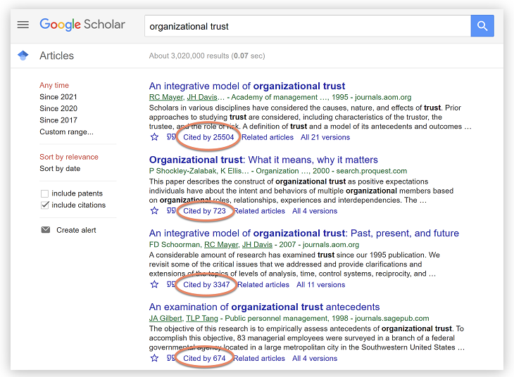
Mistake #2: A lack of landmark/seminal literature
Another issue we see in weaker literature reviews is an absence of landmark literature for the research topic.
Landmark literature (sometimes also referred to as seminal or pivotal work) refers to the articles that initially presented an idea of great importance or influence within a particular discipline.
In other words, the articles that put the specific area of research “on the map”, so to speak.
But do I find landmark or important literature?

Slide 15
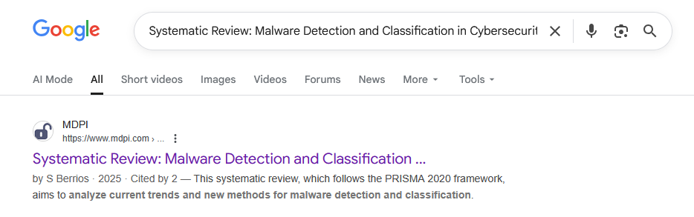

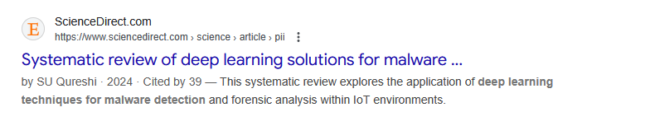
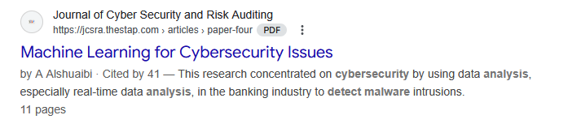
Landmark/seminal literature
Number of citations is an indication of their importance

Slide 16
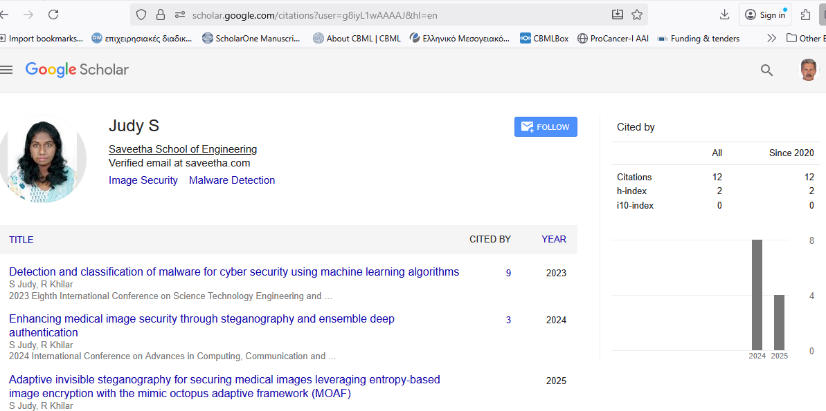
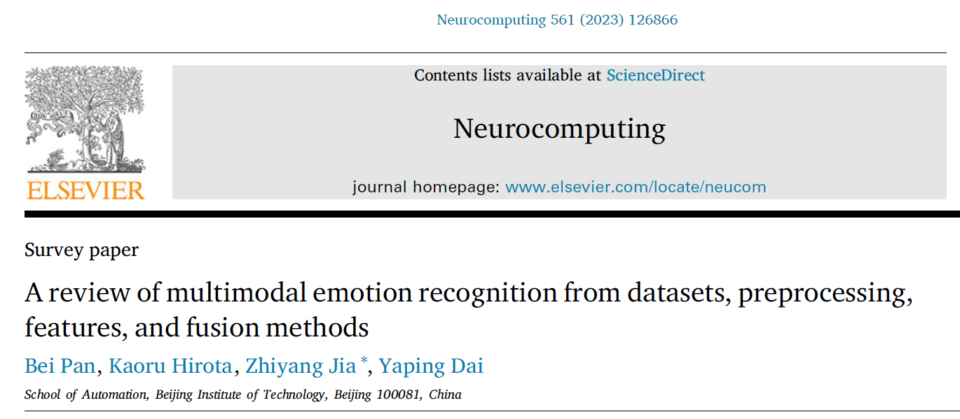
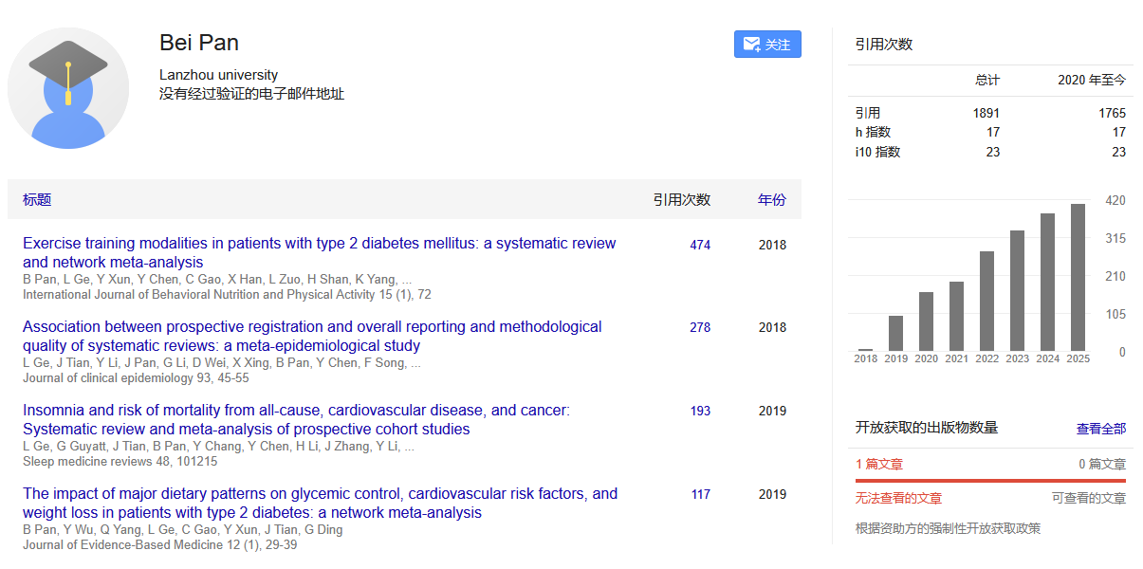
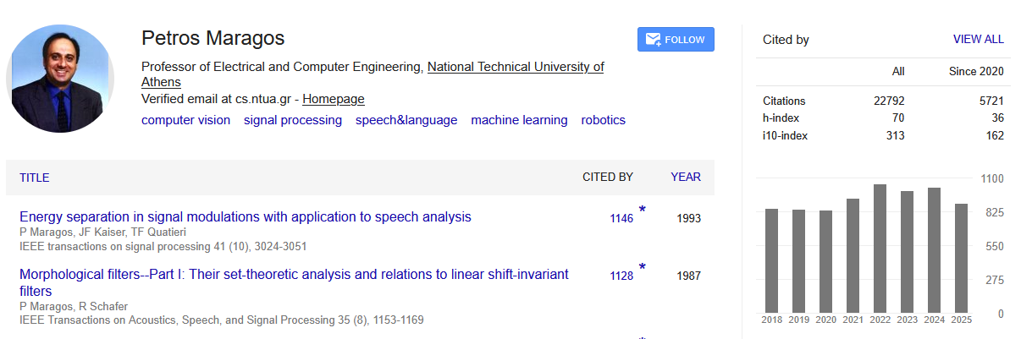
Author Evaluation
Scholar Name Surname
  E.g. Scholar Tsiknakis or Scholar Manolis Tsiknakis
Cited by the authors

Slide 17
Mistake #7: Plagiarism (λογοκλοπή) and poor referencing
This one is by far the most unforgivable literature review mistake, as it carries one of the heaviest penalties, while it is so easily avoidable.
All too often, we encounter literature reviews that, at first glance, look pretty good
However, a quick run through a plagiarism checker and it quickly becomes apparent that the student has failed to fully digest the literature they’ve reviewed and put it into their own words.
A related issue that we see quite often is plain old-fashioned poor referencing.
This can include citation and reference formatting issues (for example, IEEE, Harvard or APA style errors), or just a straight-out lack of references.
In academic writing, if you fail to reference a source, you are effectively claiming the work as your own, which equates to plagiarism.
This might seem harmless, but plagiarism is a serious form of academic misconduct and could cost you a lot more than just a few marks.

Slide 18
Understanding Plagiarism (λογοκλοπή)
Plagiarism is using someone else’s words, ideas, or work without giving proper credit.
It can occur intentionally or unintentionally.
Examples include :
  copying text,
  close paraphrasing,
  or using images/data without credit.
Even unintentional plagiarism is considered academic misconduct.

Slide 19
Common Types of Plagiarism
Direct plagiarism
  Copying text word-for-word without citation.
Mosaic plagiarism
  Paraphrasing too closely or mixing sources.
Self-plagiarism
  Reusing your own work without acknowledgment.
Accidental plagiarism
  Forgetting to cite or misquoting sources.

Slide 20

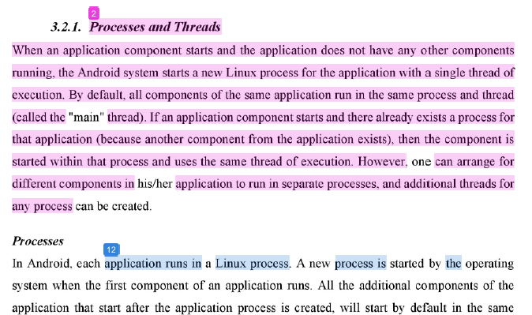
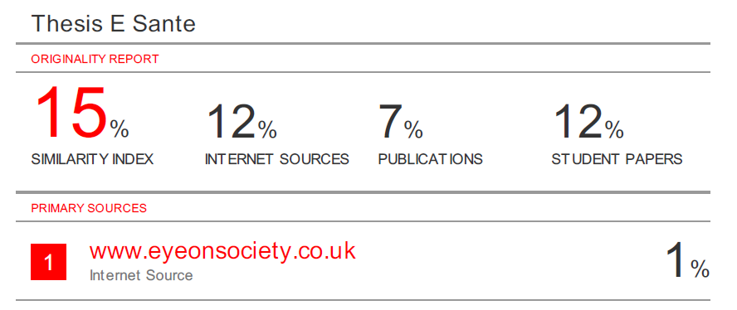
How to Avoid Plagiarism
Cite all sources, even when paraphrasing.
Use quotation marks for direct quotes.
Paraphrase properly in your own words.
Keep accurate notes of all sources.
Use plagiarism detection tools (e.g., Turnitin, Grammarly).
When unsure, always cite the source.
Turnitin Report

Slide 21
Q & A

