Slide 1
Research Methods and Project Management Lecture 4 – Types of Research
M. Tsiknakis
Postgraduate Course on “Informatics Engineering” - Fall 2025

Slide 2
Applied research vs. basic research
Basic research is driven by curiosity
Searches for knowledge
Have led to unexpected and unimaginable technological advancements
Applied research is needs driven research
Systematic inquiry involving the practical application of science
Driven by utility and solves practical problems using theories, knowledge, methods and techniques of science

Slide 3
Basic Research
Basic Research: Basic (aka fundamental or pure) research is driven by a scientist's curiosity or interest in a scientific question.
The main motivation is to expand man's knowledge, not to create something.
There is no obvious commercial value to the discoveries that result from basic research.
Algorithmics, Semantics and to a large extent Logic together constitute the backbone of Theoretical Computer Science,
with Semantics and Logic dealing mostly with qualitative aspects and
Algorithmics dealing mostly with quantitative aspects.
Centre of The Danish National Research Foundation (https://www.brics.dk/IM/folder/BRICS-IM-folder/BRICS-IM-folder.html)
In other words, basic research lays down the foundation for the applied science that follows.

Slide 4
Applied Research
Applied research is designed to solve practical problems of the modern world, rather than to acquire knowledge for knowledge's sake.
One might say that the goal of the applied scientist is to improve the human condition.
For example, applied researchers may investigate ways to:
Develop institutionally wide & friendly information systems
Treat disease: predict response to treatment through AI-based models
Improve agricultural crop production
Improve the energy efficiency of homes or modes of transportation

Slide 5
Type of questions are we asking
Existence
Does X exist?
Description & Classification
What is X like?
What are its properties?
How can it be categorized?
How can we measure it?
What are its components?
Descriptive-Comparative
How does X differ from Y?
Relationship
Are X and Y related?
Do occurrences of X correlate with occurrences of Y?
Causality
Does X cause Y?
Does X prevent Y?
What causes X?
What effect does X have on Y?
Causality-Comparative
Does X cause more Y than does Z?
Is X better at preventing Y than is Z?
Does X cause more Y than does Z under one condition but not others?
Frequency and Distribution
How often does X occur?
What is an average amount of X?
Descriptive-Process
How does X normally work?
By what process does X happen?
What are the steps as X evolves?
Design
What is an effective way to achieve X?
How can we improve X?

Slide 6
Classification of research based on the type of question we are asking?
Existence
Does X exist?
Description & Classification
What is X like?
What are its properties?
How can it be categorized?
How can we measure it?
What are its components?
Descriptive-Comparative
How does X differ from Y?
Relationship
Are X and Y related?
Do occurrences of X correlate with occurrences of Y?
Correlation
Exploratory
Causality
Does X cause Y?
Does X prevent Y?
What causes X?
What effect does X have on Y?
Causality-Comparative
Does X cause more Y than does Z?
Is X better at preventing Y than is Z?
Does X cause more Y than does Z under one condition but not others?
Causal
Relationships
Frequency and Distribution
How often does X occur?
What is an average amount of X?
Descriptive-Process
How does X normally work?
By what process does X happen?
What are the steps as X evolves?
Explanatory
Design
What is an effective way to achieve X?
How can we improve X?
Design

Slide 7
Choose appropriate type of research…
Exploratory Used to build new theories where we don’t have any yet
e.g. What are the experiences of developers who have adopted the Ruby programming language?
Ruby is an interpreted, high-level, general-purpose programming language.
Explanatory Select between competing explanations (theories)
e.g. Why does software inspection work?
e.g. Why do people fail to document their requirements?
Causal Determines whether there are causal relationship between phenomena
e.g. Does using tool X lead to software with fewer defects?
e.g. Do requirements traceability tools help programmers find information more rapidly?
Descriptive Describes sequence of events and underlying mechanisms
e.g. How does pair programming actually work?
(Does pair programming actually work?)

Slide 8
Research Methods … Fundamental Taxonomy
Quantitative Methods
Common “in the lab” Methods
Controlled Experiments
Benchmarks
Simulations
Qualitative Methods
Common “in the wild” Methods
Quasi-Experiments
Survey Research
Ethnographies
Action Research
Case Studies
Artifact/Archive Analysis (“mining”!)
See: Ricardo Eito-Brun, Description of Engineering Artifacts and Archival Data: EAD meets VRA, Social and Behavioral Sciences 147 ( 2014 ) 341 – 344

Slide 9
Quantitative Methods

Slide 10
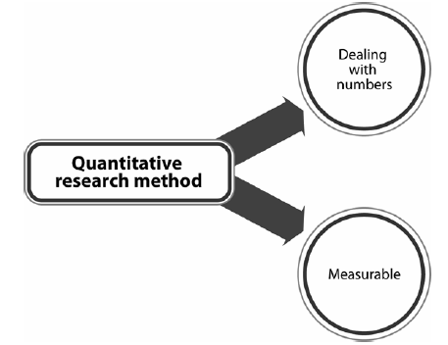
Quantitative Research Methods
Quantitative Research is used to quantify the problem by way of generating numerical data or data that can be transformed into usable statistics.
It is used to answer questions on relationships within measurable variables with an intention to explain, predict and control a phenomenon.
Researchers generally use quantitative research when they want to get objective, conclusive answers.

Slide 11
What are the advantages & limitations of quantitative research methods?
Advantages
Quantitative research methods provide a relatively conclusive answer to the research questions.
When the data is collected and analyzed in accordance with standardized, reputable methodology, the results are usually trustworthy.
With statistically significant sample sizes, the results can be generalized to an entire target group.
Limitations
Does not account for people’s thoughts or perceptions about what you’re evaluating.
Does not explore the “why” and “how” behind a phenomenon.

Slide 12
What quantitative research methods can we use?
Controlled Experiments
Questionnaires/surveys
A questionnaire (also called a survey) is a series of questions, usually written on paper or a digital form.
Closed-ended Questions vs Open-ended questions
Closed-ended questions can be answered by a simple "yes" or "no,"
open-ended questions require more than a simple one-word answer.
Interviews
Verbal communication between the participant and researcher, whose goal is to gather numerical data.
The interview can be conducted face-to-face or not, and it can be structured or unstructured.
Observation
Observation is a systematic way to collect data by observing people in natural situations or settings.
Mostly used for collecting qualitative data, but observation can also be used to collect quantitative data.
Records
Records (also known as external data) can provide critical information to answer research questions.
Records are numbers and statistics that institutions use to track activities, like attendance in a school or the number of patients admitted in a hospital.

Slide 13
Controlled Experiments
Definition: experimental investigation of a testable hypothesis, in which conditions are set up to isolate the variables of interest ("independent variables") and test how they affect certain measurable outcomes (the "dependent variables")
Good for
quantitative analysis of benefits of a particular tool/technique
establishing cause-and-effect in a controlled setting
Limitations
hard to apply if we cannot simulate (recreate) the right conditions in the lab
If we have limited confidence that the laboratory setup reflects the real situation
ignores contextual factors (e.g. social/organizational/political factors)
time-consuming!
See: Pfleeger, S.L.; Experimental design and analysis in software engineering. Annals of Software Engineering 1, 219-253. 1995

Slide 14
Definitions
Independent Variables
Variables (factors) that are manipulated to measure their effect
Typically select specific levels of each variable to test
Dependent Variables
“output” variables - tested to see how the independent variables affect them
Treatments
Each combination of values of the independent variables is a treatment
Simplest design: 1 independent variable x 2 levels = 2 treatments
E.g. tool A vs. tool B

Slide 15
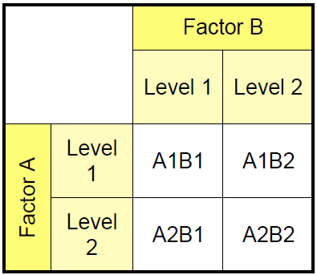
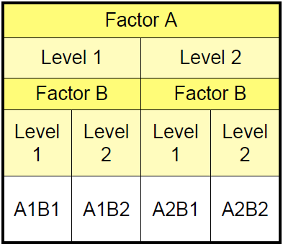
Multiple factors (factorial design)
Crossed Design
Used when factors are independent
Randomly assign subjects to each cell in the table
Balance numbers in each cell!
E.g. 2x2 factorial design:
Nested Design
Used when one factor depends on the level of the another
E.g. Factor A is the technique, Factor B is expert vs. novice in that technique

Slide 16
When not to use experiments
When we can’t control the variables
When there are many more variables than data points
When we cannot separate phenomena from context
Phenomena that don’t occur in a lab setting
e.g. large scale, complex software projects
Effects can be wide-ranging.
Effects can take a long time to appear (weeks, months, years!)
When the context is important
e.g. When we need to know how context affects the phenomena
When we need to know whether our theory applies to a specific real-world setting

Slide 17
Benchmarks
A test or set of tests used to compare alternative tools or techniques.
A benchmark comprises a motivating comparison, a task sample, and a set of performance measures.
Good for
making detailed comparisons between methods/tools
increasing the (scientific) maturity of a research community
building consensus over the valid problems and approaches to them
Limitations
can only be applied if the community is ready
become less useful / redundant as the research paradigm evolves
See:
S. Sim, S. M. Easterbrook and R. C. Holt “Using Benchmarking to Advance Research: A Challenge to Software Engineering”. Proceedings, ICSE-2003

Slide 18
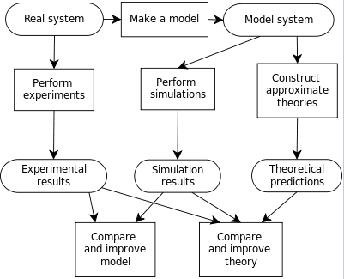
Simulation
Computer simulation is the reproduction of the behavior of a system using a computer to simulate the outcomes of a mathematical model associated with said system.
Simulation of a system is represented as the running of the system's model.
It can be used
to explore and gain new insights into new technology and
to estimate the performance of systems too complex for analytical solutions.
Process of building a computer model, and the interplay
between experiment, simulation, and theory

Slide 19
Simulation of SW development process
An executable model of the software development process, developed from detailed data collected from past projects, used to test the effect of process innovations
Good for:
Preliminary test of new approaches without risk of project failure.
[Once the model is built] each test is relatively cheap.
Limitations:
Expensive to build and validate the simulation model.
Model is only as good as the data used to build it.
Hard to assess scope of applicability of the simulation.
See: Kellner, M. I.; Madachy, R. J.; Raffo, D. M.; Software Process Simulation Modeling: Why? What? How? Journal of Systems and Software 46 (2-3) 91-105, April 1999.

Slide 20
Qualitative Methods

Slide 21
Research Methods …
Quantitative Methods
Common “in the lab” Methods
Controlled Experiments
Benchmarks
Simulations
Qualitative Methods
Common “in the wild” Methods
Quasi-Experiments
Survey Research
Ethnographies
Action Research
Case Studies

Slide 22
Qualitative Research
Qualitative Research is primarily exploratory research.
It is used to gain an understanding of underlying reasons, opinions, and motivations.
It provides insights into the problem or helps to develop ideas or hypotheses for potential quantitative research.
Qualitative Research is also used to uncover trends in thought and opinions, and dive deeper into the problem.
Qualitative data collection methods vary using
unstructured or
semi-structured techniques.
Some common methods include
focus groups (group discussions),
individual interviews, and
participation/observations.
The sample size is typically small, and respondents are selected to fulfil a given quota.

Slide 23
Quasi experiments
An experiment is a study in which the researcher manipulates the level of some independent variable and then measures the outcome.
Experiments are powerful techniques for evaluating cause-and-effect relationships.
Many researchers consider experiments the "gold standard" against which all other research designs should be judged.
Experiments are conducted both in the laboratory and in real life situations.
There are two basic types of research design:
True experiments
Quasi-experiments
True experiments, in which all the important factors that might affect the phenomena of interest are completely controlled, are the preferred design.
Often, however, it is not possible or practical to control all the key factors, so it becomes necessary to implement a quasi-experimental research design.
The prefix quasi means “resembling.”
Thus, quasi-experimental research is research that resembles experimental research but is not true experimental research.

Slide 24
Ethnographies
Computer science is an exact science, and as so, research in this area is usually associated with quantitative methods.
In its turn, ethnography is a qualitative research method, used mainly by social, human and health sciences.
An ethnographic study is concerned about a qualitative project where the researchers tries to define the similarities and/or the differences in a community or a large group of individuals
Nowadays, ethnography has been used in many different research domains beyond the anthropology, which includes technology, psychology, education, medicine, marketing, engineering and design. In fact, ethnography will always fit in studies where people plays a key role in the expected outcomes.
Indeed, research where people can not be considered as an inseparable element of the research context, or the artifact developed.

Slide 25
Survey Research
“A comprehensive system for collecting information to describe, compare or explain knowledge, attitudes and behaviour over large populations”
Good for
Investigating the nature of a large population
Testing theories where there is little control over the variables
Limitations
Relies on self-reported observations
Difficulties of sampling and self-selection
Information collected tends to subjective opinion
See: Shari Lawarence Pfleeger and Barbara A. Kitchenham, Principles of Survey Research, Software Engineering Notes, (6 parts) Nov 2001 - Mar 2003

Slide 26
What is Survey Research?
Survey Research ≠ Questionnaires
Can use questionnaires in any method
E.g. pre- and post- test in experiments
Can do survey research without questionnaires
E.g. using interviews, data logging, etc
Distinguishing features:
Precondition: a clear research question that asks about the nature of a particular target population
Selection of a representative sample from a well-defined population
Data analysis techniques used to generalize from that sample of the population

Slide 27
When to use Survey Research
To evaluate the frequency of some characteristic across a population
e.g. how many companies use agile methods?
To evaluate the severity of some condition that occurs in a population
e.g. what’s the average cost overrun of software projects?
To identify factors that influence a characteristic or condition
e.g. What factors cause companies to adopt new requirements documentation tools?

Slide 28
Risks: Self-selection Bias
Sampling the right population might not be enough
Low response rates (e.g. under 10%) are common
Low response rates may invalidate the sampling method
Participants who choose to respond might be non-representative:
e.g. People who are least busy
e.g. People who have a strong opinion on the research topic
Probe reasons for low response rate
e.g. follow up phone calls to non-respondents

Slide 29
Action Research
“Research and practice intertwine and shape one another. The researcher mixes research and intervention and involves organizational members as participants in and shapers of the research objectives.”
Mix research with intervention:
Work to solve some real-world problem
Simultaneously study the process of solving it
Good for
any domain where you cannot isolate {variables, cause from effect, …}
when effecting a change is as important as discovering new knowledge
Useful where implementing a change requires a long-term commitment
Limitations
hard to build generalizations.
See: Lau, F; Towards a framework for action research in information systems studies.
Information Technology and People 12 (2) 148-175. 1999.

Slide 30
Case Studies
“A technique for detailed exploratory investigations, both prospectively and retrospectively, that attempt to understand and explain phenomenon or test theories, using primarily qualitative analysis”
Good for
Answering detailed how and why questions
Gaining deep insights into chains of cause and effect
Testing theories in complex settings where there is little control over the variables
Limitations
Hard to find appropriate case studies
Hard to quantify findings
See: Flyvbjerg, B.; Five Misunderstandings about Case Study Research. Qualitative Inquiry 12 (2) 219-245, April 2006

Slide 31
Types of Case Studies
Explanatory
Adjudicates between competing explanations (theories)
e.g. How important is implementation bias in requirements engineering?
Rival theories: existing architectures are useful for anchoring, vs. existing architectures are over-constraining during RE
Descriptive
Describes sequence of events and underlying mechanisms
E.g. How does pair programming actually work?
E.g. How do software immigrants naturalize?
Causal
Looks for causal relationship between concepts
E.g. How do requirements errors and programming errors affect safety in real time control systems?
Exploratory
Used to build new theories where we don’t have any yet
Choose cases that meet particular criteria or parameters
E.g. What do CMM level 3* (CMM - Capability Maturity Model) organizations have in common?
* Earning certifications at an individual and organizational level can create a sense of professionalism in clients. One certification that many technology and software organizations pursue is the CMM level 3 certification. Knowing what the CMM level 3 certification is and how to get it can help you market to larger populations of consumers and show that you have professional certifications at your organization.

Slide 32
Myths about Case Study Research
General, theoretical (context-independent) knowledge is more valuable than concrete, practical (context-dependent) knowledge.
One cannot generalize on the basis of an individual case; therefore, the case study cannot contribute to scientific development.
The case study is most useful for generating hypotheses; that is, in the first stage of a total research process, whereas other methods are more suitable for hypothesis testing and theory building.
The case study contains a bias toward verification, that is, a tendency to confirm the researcher’s preconceived notions.
It is often difficult to summarize and develop general propositions and theories on the basis of specific case studies.
See: Flyvbjerg, B.; Five Misunderstandings about Case Study Research. Qualitative Inquiry 12 (2) 219-245, April 2006

Slide 33
Many available methods…
Common “in the lab” Methods
Controlled Experiments
Rational Reconstructions
Exemplars
Benchmarks
Simulations
Common “in the wild” Methods
Quasi-Experiments
Survey Research
Ethnographies
Action Research
Case Studies
Artifact/Archive Analysis (“mining”!)

Slide 34
Warning
No method is perfect !
Don’t get hung up on methodological purity !
Pick something and get on with it !
Some knowledge is better than none !

Slide 35
Homework for next week (lecture)
Ahmad Nauman Ghazi, Kai Petersen, Sri Sai Vijay Raj Reddy, Harini Nekkanti, Survey research in software engineering: problems and strategies, Preprint submitted to e-Informatica Software Engineering Journal, February 2017
Should be studied carefully.
Seek to understand terms not explained in the lecture, i.e. sampling,
Probabilistic sampling techniques:
Random Sampling
Systematic Sampling
Stratified Sampling
Non-probabilistic Sampling
Convenience Sampling & Judgment Sampling
Quota Sampling & Snowball Sampling
Be prepared to present in class next week

Slide 36
Q & A

