Slide 1
Research Methods and Project Management Lecture 5 – Case Study as a Research Method
M. Tsiknakis
Postgraduate Course on “Informatics Engineering”, Fall 2025

Slide 2
Research Methods …
Quantitative Methods
Common “in the lab” Methods
Controlled Experiments
Benchmarks
Simulations
Qualitative Methods
Common “in the wild” Methods
Quasi-Experiments
Survey Research
Ethnographies
Action Research
Case Studies

Slide 3
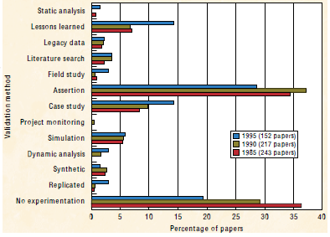
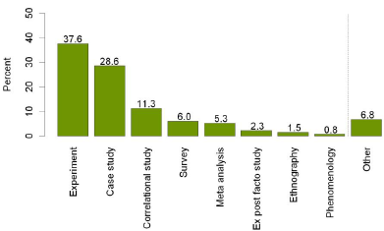
Research Methods in Computer Science
Easterbrook, S. M., Singer, J., Storey, M, and Damian, D. Selecting Empirical Methods for Software Engineering Research. Appears in F. Shull and J. Singer (eds) "Guide to Advanced Empirical Software Engineering", Springer, 2007.
Gordona Dodif-Crnkovic, “Scientific Methods in Computer Science”
Andreas Höfer, Walter F. Tichy, Status of Empirical Research in Software Engineering, Empirical Software Engineering Issues, p. 10-19, Springer, 2007.

Slide 4
Case study - definition
Empirical research is research using empirical evidence. It is a way of gaining knowledge by means of direct and indirect observation or experience.
A case study is an empirical inquiry (following the SM) that investigates a contemporary phenomenon within its real-life context, especially when the boundaries between the phenomenon and context are not clearly evident [Robert K. Yin. Case Study Research: Design and Methods;]
empirical inquiry: yes, it is empirical research
contemporary: (close to) real-time observations
boundaries between the phenomenon and context not clear

Slide 5
Type of Case Studies
Exploratory | Confirmatory
Exploratory case studies are used as initial investigations of some phenomena to derive new hypotheses and build theories.(*) | Confirmatory case studies are used to test existing theories. They are especially important for refuting theories: a detailed case study of a real situation in which a theory fails may be more convincing than failed experiments in the lab.(*)
(*) Steve Easterbrook, Janice Singer, Margaret-Anne Storey, and Daniela Damian. Selecting empirical methods for software engineering research. In Forrest Shull, Janice Singer, and Dag I. K. Sjoberg, editors, Guide to Advanced Empirical Software Engineering, pages 285—311. Springer London, 2008.

Slide 6
Example of an EXPLORATORY case study
Title: Exploring the Adoption of Blockchain Technology for Supply Chain Management
Objective: To explore the potential of blockchain technology to enhance transparency, traceability, and security in supply chain systems.
Context: A mid-sized food logistics company is experiencing challenges related to transparency in its supply chain, including tracking the origin of products, monitoring real-time shipments, and ensuring the integrity of transactional records.
Methodology:
Exploration of Technology:
Researchers review blockchain frameworks (e.g., Ethereum, Hyperledger) to identify suitable solutions.
Comparison of features such as transaction speed, scalability, and ease of integration.
Pilot/Demonstrator Deployment:
A blockchain-based system is built and deployed to track the supply chain of one product (e.g., coffee beans).
Smart contracts are used to automate quality checks and payment processes.
Data Collection:
Interviews with stakeholders (suppliers, warehouse managers, and retailers).
System logs and performance metrics are analyzed to assess efficiency and accuracy improvements.
Exploratory Analysis:
Evaluate how the blockchain affects existing workflows.
Identify challenges such as user resistance, integration costs, and technological limitations.
Findings:
Enhanced traceability: End-to-end visibility into the origin and transportation of goods.
Improved security: Reduced risk of tampering due to immutable records.
Challenges: High energy consumption, difficulty in integrating legacy systems, and the need for training stakeholders.
Conclusion: While blockchain shows promise for improving supply chain processes, significant barriers to adoption remain. The study provides a foundation for further applied research on addressing these barriers.

Slide 7
Example of a CONFIRMATORY Case Study
Title: Validating the Effectiveness of Machine Learning Algorithms for Spam Detection
Objective: To confirm the hypothesis that a hybrid machine learning model combining Naive Bayes and Support Vector Machines (SVM) performs better in detecting spam emails than using either algorithm individually.
Context: Email spam detection has been studied extensively, and hybrid machine learning approaches have been proposed as potentially more effective. This study aims to confirm these claims using real-world data from an email service provider.
Methodology:
Hypothesis: The hybrid Naive Bayes-SVM model achieves higher precision and recall compared to standalone models.
Data Collection: A dataset of 50,000 labeled emails is collected, split into 70% training and 30% testing sets.
Experiment Design: The Naive Bayes model, the SVM model, and the hybrid model are trained and tested on the dataset.
Performance metrics include precision, recall, F1-score, and overall accuracy.
Implementation: Each model is implemented using Python's scikit-learn library.
The hybrid model combines Naive Bayes for initial classification and SVM for refining edge cases.
Validation: Statistical methods, such as paired t-tests, are applied to confirm whether the performance differences are significant.
Findings:
The hybrid model achieves an F1-score of 92%, compared to 88% for Naive Bayes and 90% for SVM alone.
The precision and recall metrics for the hybrid model are consistently higher across multiple test runs.
Statistical analysis confirms the improvement is significant at a 95% confidence level.
Conclusion: The confirmatory study validates that the hybrid Naive Bayes-SVM approach is superior for spam detection, supporting prior research findings. The results strengthen the argument for adopting hybrid machine learning models in real-world email filtering systems.

Slide 8
Summary: exploratory vs confirmatory
Exploratory Case Study
This case study is exploratory because it focuses on understanding how a relatively new technology can be applied to a specific domain, without starting with predefined hypotheses.
It involves learning, observation, and experimentation to inform future implementations.
Confirmatory Case Study
The example presented is a confirmatory case study because it tests and verifies a specific hypothesis, with clearly defined metrics and statistical validation to confirm the results.

Slide 9
Overview of research methodology characteristics
Methodology | Primary objective | Primary data | Design
Survey | Descriptive | Quantitative | Fixed
Case study | Exploratory/Confirmatory | Qualitative | Flexible
Experiment | Explanatory | Quantitative | Fixed
Action research | Improving | Qualitative | Flexible

Slide 10
Case studies - spectrum
Case studies are widely used in computer science
“studying a case” vs. “doing a case study”
7. Simulation
what if?
6. Formal Model
underlying concepts ?
5. Literature survey
what is known/unknown ?
4. Observational (case) Study
what is it?
3. Comparative study
is it better ?
2. Pilot Case, Demonstrator
is it appropriate ?
1. Feasibility study
is it possible ?

Slide 11
Feasibility Study
Here is a new idea, is it possible ?
Is it possible to solve a specific kind of problem … effectively ?
+ computer science perspective (P = NP, Turing test, …)
+ engineering perspective (build efficiently; fast — small)
+ economic perspective (cost effective; profitable)
Is the technique new / novel / innovative ?
+ compare against alternatives
See literature survey; comparative study
Proof by construction
+ build a prototype
+ often by applying on a “CASE”
Conclusions
+ primarily qualitative; "lessons learned“ + quantitative
- economic perspective: cost - benefit
- engineering perspective: speed, memory footprint, etc

Slide 12
Example of a Feasibility Study in CS
Title: Feasibility of Implementing Edge Computing for Smart City Traffic Management
Objective: To evaluate the feasibility of adopting edge computing to process traffic data in real time for improving traffic flow and reducing congestion in a smart city setting.
Methodology:
Technical Feasibility:
Assess whether existing IoT infrastructure (traffic cameras, sensors) supports edge computing integration.
Test edge devices (e.g., Raspberry Pi, NVIDIA Jetson) for computational capability to handle real-time data analysis.
Evaluate communication protocols (e.g., MQTT, CoAP) for edge-to-cloud data synchronization.
Operational Feasibility:
Analyze the deployment strategy, including installation at traffic intersections and integration with current systems.
Assess the training requirements for city personnel managing edge devices.
Economic Feasibility:
Estimate the cost of deploying and maintaining edge devices compared to the current cloud-centric approach.
Conduct cost-benefit analysis by comparing potential reductions in congestion and fuel usage.

Slide 13
Example of a Feasibility Study in CS
Legal and Ethical Feasibility:
Review data privacy and security implications, especially for sensitive information like vehicle and pedestrian data.
Ensure compliance with local regulations on IoT and data usage.
Pilot Implementation:
Deploy a small-scale prototype at three major intersections.
Monitor key metrics: latency, system reliability, and traffic optimization over three months.
Findings:
Technical Feasibility: Edge devices processed data 40% faster than the cloud system, significantly reducing latency.
Operational Feasibility: Deployment was straightforward, but managing multiple devices increased complexity.
Economic Feasibility: Initial setup costs were high, but long-term operational savings outweighed these costs.
Legal Feasibility: Minor adjustments were needed to align with data privacy regulations.
Conclusion: The study concludes that implementing edge computing for traffic management is feasible, offering significant benefits in real-time responsiveness and traffic optimization. However, scaling the solution requires careful planning to address operational and legal challenges.

Slide 14
Feasibility Study: exploratory or confirmatory
A feasibility study is generally exploratory in nature, though it can have confirmatory elements depending on its design and purpose. Here’s a breakdown of why this is the case:
Feasibility Studies are Exploratory
Purpose: Feasibility studies aim to determine whether a project, solution, or approach is viable. This involves exploring technical, financial, operational, and legal aspects, often without a predetermined hypothesis.
Approach: They examine possibilities, identify challenges, and outline requirements, making them more about discovery than verification.
Outcome: The focus is on understanding the practical considerations and potential risks, not necessarily confirming a predefined theory or expectation.
Feasibility Studies Can Be Confirmatory
In some cases, a feasibility study might also serve a confirmatory purpose, especially if it is conducted to validate specific assumptions or claims. For example:
A study might test whether a prototype system can meet predefined performance benchmarks (e.g., processing speed or reliability).
It may confirm the accuracy of cost estimates or validate compliance with regulatory standards.
In such cases, the study is partially confirmatory because it tests specific hypotheses or criteria while still exploring broader feasibility issues.

Slide 15
Pilot Case (a.k.a. Demonstrator)
Here is an idea that has proven valuable; does it work for us ?
proven valuable
+ accepted merits (e.g. “lessons learned” from feasibility study).
+ there is some (implicit) theory explaining why the idea has merit.
does it work for us?
+ context is very important
Demonstrated on a simple yet representative “CASE”
+ “Pilot case” ≠ “Pilot Study”
Proof by construction
+ build a prototype
+ apply on a “case”
Conclusions
+ primarily qualitative; "lessons learned"
+ quantitative; preferably with predefined criteria

Slide 16


Pilot Study
To obtain high-quality outcomes, a good research study with relevant experimental design and accurate performance is required.
Analyzing its feasibility prior to performing the main study (also known as the full study or large-scale main trial) can be very beneficial for this purpose.
A pilot study is the first step of the entire research protocol and is often a smaller-sized study assisting in planning and modification of the main study.

Slide 17

Pilot Case Study
Context: In the workplace, some individuals engage in the voluntary and intentional generation, promotion, and realization of new ideas for the benefit of individual performance, group effectiveness, or the organization. The literature classifies this phenomenon as innovative behaviour. Despite its importance to the development of innovation, innovative behaviour has not been fully investigated in software engineering.
Objective/Research Question: To understand (what are) the factors that support or inhibit innovative behaviour in software engineering practice.
Method: We conducted a pilot case study in a Canadian software company using interviews and observations as data collection techniques. Using qualitative analysis, we identified relevant factors and relationships not addressed by studies from other areas.
Results: Individual innovative behaviour is influenced by individual attitudes and also by situational factors such as relationships in the workplace, organizational characteristics, and project type. We built a model to express the interacting effects of these factors.
Conclusions: Our results contribute to …… and to topics that deserve further study

Slide 18
Pilot Case
Andréa Mendonça, et al., An approach for problem specification and its application in an Introductory Programming Course, Frontiers in Education (FIE) Conference, 2009
In the present paper we describe POP (problem oriented programming) - a teaching approach for introductory programming courses, aiming at developing students' skills in dealing with ill-defined problem specifications and programming.
To evaluate this approach, a pilot case study was conducted during the second academic semester of 2008 in two classes of introductory programming lab of the computer science course at the Federal University of Campina Grande.

Slide 19
Comparative Study
Here are two techniques, which one is better ?
Where are the differences ? What are the tradeoffs ?
Criteria check-list
+ predefined - should not favor one technique
+ qualitative and quantitative
- qualitative: how to remain unbiased ?
- quantitative: represent what you want to know ?
+ Criteria check-list should be complete and reusable !
➡ If done well, most important contribution (replication !)
Score criteria check-list
+ Often by applying the technique on a “CASE”.
Compare
+ typically in the form of a table.

Slide 20

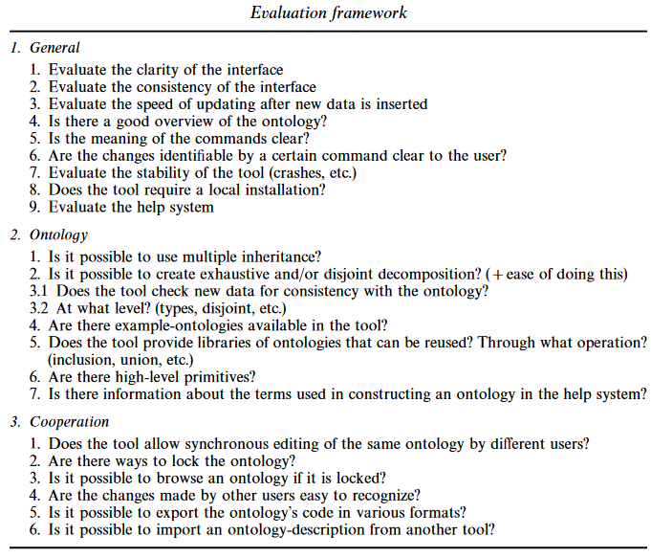
Comparative Study - examples
Ontologies are becoming increasingly important in a variety of different fields, such as intelligent searching on the web, knowledge sharing and reuse, knowledge management, etc. Therefore, we expect that the need for tools to support the construction of ontologies will increase significantly in the coming years.
We investigate several of these tools. We evaluate the tools using two different ontologies.
The evaluation was conducted using a framework, which incorporates aspects of ontology buildings and testing, as well as cooperation with other users.
Our conclusions are that …..

Slide 21
Observational Study [Ethnography]
Understand phenomena through observations
Systematic collection of data derived from direct observation of the everyday life
+ phenomena is best understood in the fullest possible context
➡ observation & participation
➡ interviews & questionnaires
Observing a series of cases “CASE”
+ observation vs. participation ?
Action Research
+ Action research is carried out by people who usually recognize a problem or limitation in their workplace situation and devise a plan to counteract the problem,
implement the plan,
observe what happens,
reflect on these outcomes,
revise the plan,
implement it,
reflect,
revise
and so on.
Conclusions
+ primarily qualitative: classifications/observations/…

Slide 22
Example
How Developers use API Documentation: An Observation Study, M. Meng, et al, Merseburg University of Applied Sciences, 2019
Results of an empirical study that examined how developers use documentation when getting into a new API.
Our work is driven by the hypothesis that problems with API documentation may in part reflect usability problems, and in particular, that content and structure of the documentation sometimes do not match the expectations and work habits of developers.
Consequently, for API documentation to be an effective aid in learning an API, we need to know which general strategies software developers adopt when solving programming tasks, which information they need and which information resources they turn to.
To address these issues, we conducted a study using the observation method.
Asked developers to solve a series of programming tasks with an API that was unfamiliar to them.
Analyzed which strategies they adopted to solve the tasks, which parts of the API documentation they used, and which design features of the API documentation led to problems.
Propose several design guidelines that can help to make API documentation more effective.

Slide 23
Systematic Literature Review
What is known ? What questions are still open ?
source: B. A. Kitchenham, “Procedures for Performing Systematic Reviews”, Keele University Technical Report EBSE-2007-01, 2007
Systematic
“comprehensive”
➡ precise research question is prerequisite
+ defined search strategy (rigor, completeness, replication)
+ clearly defined scope
- criteria for inclusion and exclusion
+ specify information to be obtained
the “CASES” are the selected papers
outcome is organized
Classification | Taxonomy | Conceptual model
table | tree | frequency

Slide 24
The Formal Methods Model?
The Formal Methods Model is an approach to Software Engineering that applies mathematical methods or techniques to the process of developing complex software systems.
Use a formal specification language to define each characteristic of the system.
The language is very particular, and employs a unique syntax whose components includes objects, relations, and rules.
When used together, these components can validate the correctness of each characteristic.
Think of the process like balancing a series of equations.
At each step in the series, if the right-side of the equation doesn't equal the left, there is a problem that must be addressed.

Slide 25
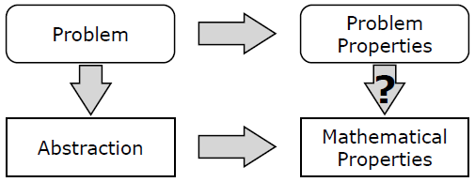
Formal Model
How can we understand/explain the world ?
make a mathematical abstraction of a certain problem
+ analytical model, stochastic model, logical model, re-write system, ...
+ often explained using a “CASE”
prove some important characteristics
+ based on inductive reasoning, axioms & lemma’s, …
Motivate
which factors are irrelevant (excluded) and which are not (included) ?
which properties are worthwhile (proven) ?

Slide 26

Example
Safety analysis in systems engineering (SE) processes, as usually implemented, rarely relies on formal methods such as model checking since such techniques, however powerful and mature, are deemed too complex for efficient use.
Amongst the modeling tools used or developed within the SE community, the systems modeling language (SysML) should be mentioned as the result of the Object Management Group (OMG)
Recently, the architecture analysis and design language (AADL) has gained importance as a powerful modeling tool by allowing a number of formal analyses.

Slide 27
Simulation
What would happen if … ?
study circumstances of phenomena in detail
+ simulated because real world too expensive; too slow or impossible
make prognoses about what can happen in certain situations
+ test using real observations, typically obtained via a “CASE”
Motivation
which circumstances are irrelevant (excluded) and which are not (included) ?
which properties are worthwhile (to be observed /predicted) ?
Examples
distributed systems (grid); network protocols
+ too expensive or too slow to test in real life
embedded systems — simulating hardware platforms
+ impossible to observe real clock-speed / memory footprint / …

Slide 28
Case studies - spectrum
7. Simulation
Test prognoses with real observations obtained via a “CASE”
Case studies are widely used in computer science
“studying a case” vs. “doing a case study”
6. Formal Model
often explained using a “CASE”
5. Literature survey
“CASES” = selected papers
4. Observational Study
Observing a series of “CASES”
3. Comparative study
Score criteria check-list; often by applying on a “CASE”
2. Pilot Case, Demonstrator
Demonstrated on a simple yet representative “CASE”
1. Feasibility study
Proof by construction; often by applying on a “CASE”

Slide 29

Case Study Research
Introduction
Origins of CS
Research Philosophy
Research Methods
1. Feasibility study
2. Pilot Case
3. Comparative study
4. Observational Study [a.k.a. Ethnography]
5. Literature survey
6. Formal Model
7. Simulation
Conclusion
Studying a Case vs. Performing a Case Study
+ Proposition
+ Unit of Analysis
+ Threats to Validity
Sources
Robert K. Yin. Case Study Research: Design and Methods. 3rd Edition. SAGE Publications. California, 2009.
Runeson, P. and Höst, M. 2009. Guidelines for conducting and reporting case study research in software engineering. Empirical Softw. Eng. 14, 2 (Apr. 2009), 131-164.
Bent Flyvbjerg, "Five Misunderstandings About Case Study Research." Qualitative Inquiry, vol. 12, no. 2, April 2006, pp. 219-245.
Read for next Lecture (9577 Citations)

Slide 30
Conclusion
The case study methodology is well suited for many kinds of software engineering research, as the objects of study are contemporary phenomena, that are hard to study in isolation.
Case studies do not generate the same results on
e.g. causal relationships as controlled experiments do, but they provide deeper understanding of the phenomena under study.
As they are different from analytical and controlled empirical studies, case studies have been criticized for
being of less value,
impossible to generalize from,
being biased by researchers, etc
This critique can be met by applying proper research methodology practices as well as reconsidering that knowledge is more than statistical significance.
Next Assignment

Slide 31
Excellent reading material
Types of Case Study. Part 1 of 3 on Case Studies
https://www.youtube.com/watch?v=gQfoq7c4UE4
Planning a Case Study. Part 2 of 3 on Case Studies
https://www.youtube.com/watch?v=o1JEtXkFAr4
Replication or Single Cases. Part 3 of 3 on Case Studies
https://www.youtube.com/watch?v=b5CYZRyOlys
Case studies in engineering
https://www.researchgate.net/publication/262611798

Slide 32

Homework
Read Chapter 2 “Challenges and Recommendations When Increasing the Realism of Controlled Software Engineering Experiments by Dag I.K. Sjøberg, et al.
Be prepared to discuss it in the classroom.

Slide 33
Q & A

