Slide 1
Research Methods and Project Management
Lecture 6 – Threads to validity of a study
M. Tsiknakis
Postgraduate Course on “Informatics Engineering”, Fall 2025

Slide 2
Validity of Research
Due to the large influence that external factors have on researchers and their studies, Prof Ioannidis has dedicated much of his career to exposing the unreliability of scientific studies.
He declared that “much of what biomedical researchers conclude in published studies - conclusions that doctors keep in mind when they prescribe antibiotics or blood-pressure medication, or when they advise us to consume more fiber or less meat, or when they recommend surgery for heart disease or back pain - is misleading, exaggerated, and often flat-out wrong. He charges that as much as 90 % of the published medical information that doctors rely on is flawed.”
* Ioannidis, J. “Why Most Published Research Findings are False.” PLoS Medicine.
2.8 (2005), Accessed on 29 October 2018.

Slide 3
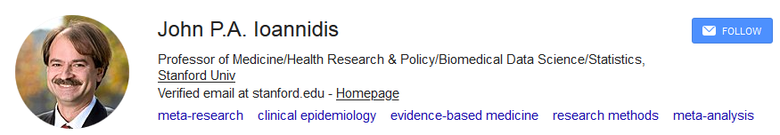
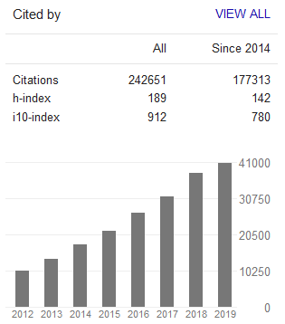
Validity of Research
see : John Ioannidis: "Reproducible Research: True or False?" | Talks at Google
https://www.youtube.com/watch?v=GPYzY9I78CI
John P.A. Ioannidis, MD, DSc, is a Professor of Medicine, Health Research and Policy, and Statistics at Stanford University.
He is also the founding Director of the just-launched Meta-Research Innovation Center at Stanford (METRICS)

Slide 4
Threats to validity (Case Studies)
Source: Runeson, P. and Höst, M. 2009. Guidelines for conducting and reporting case study research in software engineering.
1. Construct validity
  Do the operational measures actually reflect what the researcher had in mind ?
2. Internal validity
  Are there any other factors that may affect the results ?
    ➡ Mainly when investigating causality !
3. External validity
  To what extent can the findings be generalized ?
    ➡ Precise research question & units of analysis required
4. Reliability
  To what extent is the data and the analysis dependent on the researcher (the instruments, …)
Other categories have been proposed as well
  credibility, transferability, dependability, confirmability

Slide 5
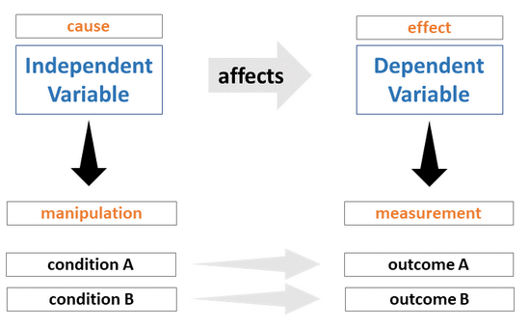
Types of Experimental Variables
Independent Variable
  The variable that is changed on purpose by the experimenter
  This is the “if” part of a hypothesis
Dependent Variable
  The variable that responds
  Also known as the effect, result, or responding variable
  This is the “then” part of a hypothesis

Slide 6
Types of Experimental Variables
  Extraneous variable.
    An extraneous variable is any extra factor that may influence the outcome of an experiment, even though it is not the focus of the experiment.
    Controllable or Uncontrollable variables
  Extraneous variables should always be considered and controlled when possible as they may introduce unwanted variation in your data.
  All experiments have extraneous variables.
  Examples are:
    aspects of the environment where the data collection will take place, e.g., room temperature, background noise level, light levels;
    differences in participant characteristics (participant variables); and
    test operator, or experimenter behavior during the test, i.e., their instructions to the test participants are not consistent.

Slide 7
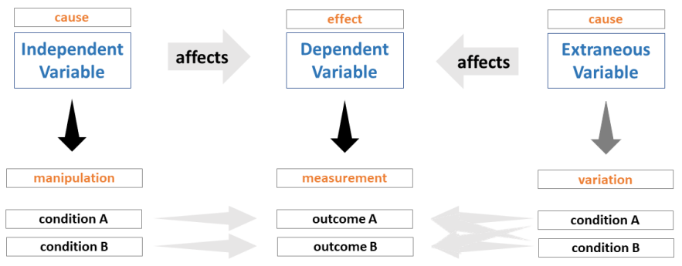
Types of Experimental Variables
Extraneous variables should always be considered and controlled when possible as they may introduce unwanted variation in your data.
Effect of extraneous variables on the relationship between the independent and dependent variables.

Slide 8
Threats to validity — Examples (1/2)
1. Construct validity
  Do the operational measures reflect what the researcher had in mind ?
  (Are we measuring what we believe that we are measuring?)
  Time recorded vs. time spent
  Execution time, memory consumption, …
    + noise of operating system, sampling method
  Participants in interviews have pressure to answer positively.
2. Internal validity
  Are there any other factors that may affect the results ?
  Were phenomena are observed under special conditions
    + in the lab, close to a deadline, …
    + major turnover in team, contributors changed (open-source), …
  Similar observations repeated over time (learning effects).

Slide 9
Construct validity
This aspect of validity reflects to what extent the operational measures that are studied really represent what the researchers have in mind and what is investigated according to the research questions.
Construct validity asks: “Are we actually measuring the concept we think we are measuring?”
If, for example, the constructs discussed in an interview questions are not interpreted in the same way by the researcher and the interviewed persons, there is a threat to the construct validity.
  This is why questionnaires before been used are “validated”

Slide 10
Example - Measuring “Developer Productivity” Using Only Lines of Code (LOC)
Scenario
  A study aims to evaluate how a new programming framework affects developer productivity.
  Researchers measure productivity using Lines of Code produced per hour.
Threat to Construct Validity
  LOC does not accurately reflect the construct “productivity.”
    More lines might mean less efficiency, not more.
    Different languages/frameworks generate more or fewer lines naturally.
    Code quality, correctness, and maintainability are ignored.
Why It Matters
  The study may misinterpret “more LOC” as “higher productivity,” when it may indicate verbosity, inexperience, or poor abstractions.

Slide 11
Example - Using Benchmark Accuracy as a Measure of “Model Robustness”
Scenario
  A machine learning researcher claims to measure robustness of an image classifier, after they evaluate the model only on clean benchmark test sets.
Threat to Construct Validity
  Accuracy on clean test data is not the same construct as robustness.
  Robustness should involve resistance to:
    noise,
    adversarial inputs,
    distribution shift,
    missing data,
    real-world distortions.
Why It Matters
  The operational measure (“test accuracy”) fails to capture the real construct (“robustness”), invalidating the claim.

Slide 12
Example - Measuring “Usability” by Recording Only Task Completion Time
Scenario
  A study compares two user interfaces and claims to measure usability.
  The only metric collected is time to complete a task.
Threat to Construct Validity
  Usability is a multidimensional construct that includes:
    satisfaction,
    learnability,
    error rate,
    cognitive load,
    user preference, etc
  Completion time captures only efficiency, not usability as a whole.
Why It Matters
  A system could be fast but frustrating, confusing, or error-prone — yet the study would wrongly conclude it has “better usability.”

Slide 13
Internal validity
This aspect of validity is of concern when causal relations are examined.
When the researcher is investigating whether one factor affects an investigated factor there is a risk that the investigated factor is also affected by a third factor.
If the researcher is not aware of the third factor and/or does not know to what extent it affects the investigated factor, there is a threat to the internal validity.
  E.g. relation of link capacity to humidity
    Need to keep temperature (the third factor/variable) constant
Internal validity concerns whether changes in the dependent variable are truly caused by the independent variable, rather than by uncontrolled or confounding factors.

Slide 14
Example - Algorithm Performance Comparison → Confounding Variables
Scenario
  A researcher evaluates a new scheduling algorithm and compares its performance to existing approaches. They run all algorithms on a shared HPC cluster.
Threat
  Uncontrolled system load (e.g., other users’ jobs, background processes) influences runtime measurements.
Why It Threatens Internal Validity
  Performance differences may be caused by machine load variance, not by the algorithm itself. Therefore, the causal claim “algorithm A is faster than B” becomes invalid.
How to Mitigate
  Use controlled, isolated environments (e.g., containers, bare-metal nodes).
  Repeat trials many times.
  Monitor CPU, memory, and I/O during experiments.

Slide 15
Example - Software Engineering Tool Evaluation → Selection Bias
Scenario
  A new code-analysis tool is tested for effectiveness in finding bugs. Two groups of developers are assigned to use:
  Group 1 → the new tool & Group 2 → the existing tool
Threat
  If the groups differ in prior experience (e.g., Group 1 has senior developers, Group 2 has novices), tool effectiveness will be confounded with participant expertise.
Why It Threatens Internal Validity
  The study might conclude that the tool is better, when in fact the developers’ skills—not the tool—caused the difference.
How to Mitigate
  Use random assignment.
  Balance groups on key characteristics (e.g., programming experience).
  Use within-subject designs when feasible (a more complex topic)

Slide 16
Example - Machine Learning Model Evaluation → History Effects
Scenario
  A team tests a machine learning model for anomaly detection on streaming data collected over two weeks.
  Week 1 → Baseline model & Week 2 → Improved model
Threat
  Unexpected external changes occur between weeks (sensor failures, network congestion, new traffic patterns).
Why It Threatens Internal Validity
  Observed improvements (or declines) might be due to changes in data distribution, not the model itself.
How to Mitigate
  Use randomized or interleaved A/B testing.
  Replay the same datasets to each model when possible.
  Control environmental factors affecting data.

Slide 17
Example - Network Protocol Experiment → Maturation Effects
Scenario
  Evaluating a new routing protocol in long-running simulations.
Threat
  As simulations run longer, caching, warming-up, or memory fragmentation gradually affect throughput.
Why It Threatens Internal Validity
  Performance drift arises due to system maturation, not the protocol design.
How to Mitigate
  Restart systems before each trial.
  Use multiple short controlled runs instead of one long run.
  Monitor resource usage over time.

Slide 18
Threats to validity — Examples (2/2)
3. External validity
  To what extent can the findings be generalized ?
  Does it apply to other languages ? other sizes ? other domains ?
  Background & education of participants
  Simplicity & scale of the team
    + small teams & flexible roles vs. large organizations & fixed roles
4. Reliability
  To what extent is the data and the analysis dependent on the researcher (the instruments, …)?
  How did you cope with bugs in the tool, the instrument ?
  Classification: if others were to classify, would they obtain the same ?

Slide 19
External validity
This aspect of validity is concerned with to what extent it is possible to generalize the findings, and to what extent the findings are of interest to other people outside the investigated case.
During analysis of external validity, the researcher tries to analyze to what extent the findings are of relevance for other cases.
External validity concerns whether research findings generalize beyond the specific conditions of the study—to other systems, populations, datasets, contexts, or environments.

Slide 20
Example - Software Engineering Tools Evaluation → Population Validity
Scenario
  A study evaluates a new debugging tool using undergraduate participants or crowdworkers from online platforms.
Threat to External Validity
  The participants do not represent the intended user population (e.g., experienced professional developers).
Why It Matters
  Beginners may:
    struggle more,
    rely more on UI cues,
    have different debugging strategies,
    leading to results that do not generalize to experts.

Slide 21
Example - Machine Learning Model Benchmarking → Dataset Generalizability
Scenario
  A researcher trains a computer-vision model on a well-curated benchmark dataset (e.g., CIFAR-10, ImageNet) and reports high accuracy.
Threat to External Validity
  The dataset does not reflect real-world conditions—noise levels, lighting variation, camera differences, domain shifts.
Why It Matters
  The model’s high performance may fail to generalize to deployment environments such as:
    industrial inspection images,
    medical imaging devices,
    embedded camera systems.
Example
  A model that works well on benchmark traffic-sign datasets may fail in rain, night-time, or low-resolution dashcam footage.

Slide 22
Example - Cybersecurity Experiments → Threat Model Generalizability
Scenario
  An intrusion-detection model is evaluated using known attack patterns from a public dataset (e.g., KDD, CIC-IDS).
Threat to External Validity
  The dataset includes outdated attack types and does not evolve like real adversaries.
Why It Matters
  Findings may not generalize to modern, adaptive attackers, making the solution ineffective in deployment.

Slide 23
Example - Network Protocol Simulations → Setting Generalizability
Scenario
  A routing protocol is tested in a network simulator (NS-3, OMNet++, Mininet) using simplified topologies and uniform link qualities.
Threat to External Validity
  Simulated networks often omit:
    physical interference,
    real wireless contention,
    asymmetric links,
    packet corruption due to hardware issues.
Why It Matters
  A protocol that looks robust in simulation might fail in real mobile, wireless, or IoT environments.

Slide 24
Reliability
This aspect is concerned with:
to what extent the data and the analysis are dependent on the specific researchers?
Hypothetically, if another researcher later on conducted the same study, the result should be the same.
Threats to this aspect of validity is, for example, if it is not clear how to code collected data or if questionnaires or interview questions are unclear.
In general, Reliability deals with how stable, repeatable, and dependable a measurement or instrument is.

Slide 25
Example - Measuring Software Performance (Test–Retest Reliability)
Scenario
  A researcher evaluates the execution time of a sorting algorithm.
  They run the algorithm multiple times on the same machine using the same input dataset.
Reliability Issue
  If runtime varies dramatically between runs because of OS scheduling, background processes, or thermal throttling, then the measurement instrument (performance test) has poor reliability.
Why It Matters
  Low test–retest reliability means the researcher cannot confidently attribute performance differences to algorithmic improvements — the measurement isn't stable.
How to Improve
  Use isolated or containerized environments.
  Repeat measurements and compute variance.
  Disable power-saving or dynamic frequency scaling.

Slide 26
Example - Code Review Assessment Tool (Inter-Rater Reliability)
Scenario
  A study measures code quality by having multiple expert reviewers score submitted code on readability and maintainability.
Reliability Issue
  If Reviewer A gives a score of 9/10 and Reviewer B gives 4/10 for the same code, then the measurement suffers from low inter-rater reliability.
Why It Matters
  Because the scoring is inconsistent, the study’s conclusions about “quality” cannot be trusted — disagreements reflect the measurement method, not the code.
How to Improve
  Use standardized rubrics.
  Provide reviewer training.
  Compute Cohen’s κ to quantify reliability.
    Cohen's kappa coefficient ('κ', lowercase Greek kappa) is a statistic that is used to measure inter-rater reliability for qualitative (categorical) items.

Slide 27
Example - UX Questionnaire for Evaluating User Satisfaction (Internal Consistency Reliability)
Scenario
  A usability study uses a multi-item questionnaire (e.g., 10 items representing “user satisfaction”).
  Several questions are intended to measure the same underlying construct.
Reliability Issue
  If some questions correlate poorly with others, or contradict the expected direction (e.g., a user gives high scores on 9 items but very low on 1 item), the questionnaire shows low internal consistency.
Why It Matters
  The measurement instrument doesn't consistently capture satisfaction; different items may be measuring different things (e.g., satisfaction vs. perceived difficulty).
How to Improve
  Analyze Cronbach’s alpha - Cronbach's alpha or coefficient alpha, is a reliability coefficient and a measure of the internal consistency of tests and measures.
  Remove poorly performing items.
  Pilot-test the questionnaire before main data collection.

Slide 28
Conclusion
The case study methodology is well suited for many kinds of software engineering research, as the objects of study are contemporary phenomena, that are hard to study in isolation.
Case studies do not generate the same results on e.g. causal relationships as controlled experiments do, but they provide deeper understanding of the phenomena under study.
As they are different from analytical and controlled empirical studies, case studies have been criticized for
  being of less value,
  impossible to generalize from,
  being biased by researchers, etc
This critique can be met by applying proper research methodology practices as well as reconsidering that knowledge is more than statistical significance.

Slide 29
Internal and External Validity in Experimental Research
Suggest to listen the following presentations on YouTube regarding VALIDITY of Experimental Research
https://www.youtube.com/watch?v=Hd7GTlQ7SXs (Types of validity)
https://www.youtube.com/watch?v=FOnPrhGygg0&t=135s
(Forms of Validity in Research and Statistics)
https://www.youtube.com/watch?v=Ak7eQMJd6J8
https://www.youtube.com/watch?v=mZafK0VPpeY

Slide 30
Internal and External Validity in Experimental Research
Listen the following presentation on YouTube
  Reliability, validity, generalizability and credibility. Pt .1 of 3: Research Quality
    https://www.youtube.com/watch?v=4NQHeI8GD54
  Research Review: 7 - Internal and external validity; Summary of research methods
    https://www.youtube.com/watch?v=Ak7eQMJd6J8

Slide 31
Assignment
Write a short assay to discuss
  The criticism for Case Studies as being of less value, and impossible to generalize from and
  The threads to validity of experimental research (and Case studies), i.e. Construct validity, internal validity, external validity and reliability (seek to identify examples for each of the thread)
Seek to identify relevant literature for your Assignment, upon which you base your arguments.
  In essence I want you to do a short literature survey and develop a “position paper” on the topic.

Slide 32
Q & A

