Slide 1
Research Methods and Project Management
Lecture 7 – Experimental Design (or Design of Experiments)
M. Tsiknakis
Postgraduate Course on “Informatics Engineering”, Fall 2024

Slide 2
Research Methods …
Quantitative Methods
Common “in the lab” Methods
  Controlled Experiments
  Benchmarks
  Simulations
Qualitative Methods
Common “in the wild” Methods
  Quasi-Experiments
  Survey Research
  Ethnographies
  Action Research
  Case Studies

Slide 3
Research process … application of the SM
FF
Review the literature
FF
Review
Concepts
and
Theories
Design
Research
Protocol
Collect
Data
(Execution)
Analyse
Data
(Test
Hypothesis
if any)
Interpret
and
Report
Define
Research
Problem
Formulate
Hypothesis
& Questions(s)
Review
Previous
Research
Findings
FB
FB
I
III
IV
V
VI
VII
Experiments
II
FB
FF
Feed Forward
FB
Feed Back

Slide 4
Introduction to DOΕ
The term experiment is defined as the systematic procedure carried out under controlled conditions in order
  to discover an unknown effect
  to test or establish a hypothesis, or
  to illustrate a known effect.
An experiment is a test or a series of tests
“All experiments are designed experiments, some are poorly designed, some are well-designed”

Slide 5
Engineering Experiments
Designed experiments have many potential uses in improving processes and products, including:
  Comparing Alternatives.
    We might want to compare the results from two different types of components. The experiment(s) should allow us to make an informed decision that evaluates both quality and cost.
  Identifying the Significant Inputs (Factors) Affecting an Output (Response)
    Separating the vital few from the trivial many.
    We might ask a question: "What are the significant factors beyond?"
  Achieving an Optimal Process Output (Response)
    "What are the necessary factors, and what are the levels of those factors, to achieve the exact performance?”
  Reducing Variability
    "Can the algorithm be changed so it is more likely to always come out the same?"
  Minimizing, Maximizing, or Targeting an Output (Response)
    "How can the system function as optimal as possible without overcoming the cost (or memory constraints)?"
  Improving process or product "Robustness"
    Fitness for use under varying conditions.
    "Can the factors and their levels be modified so the system will perform nearly the same no matter what type of environment it is used in?"

Slide 6
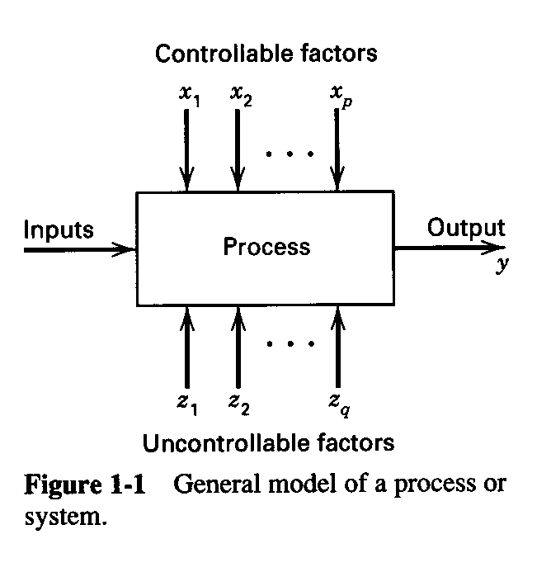

Engineering Experiments
A process is the transformation of inputs into outputs.
In the context of engineering,
  inputs are factors or process variables such as people, materials, methods, environment, machines, procedures, etc. and
  outputs can be performance characteristics or quality characteristics of a product.
Experiments are used widely in the engineering world
  Evaluation of system properties.
  Process (Algorithm) characterization & optimization.
  Product design & development.
  Component & system tolerance determination.
  Etc, etc …
General model of a process/system

Slide 7
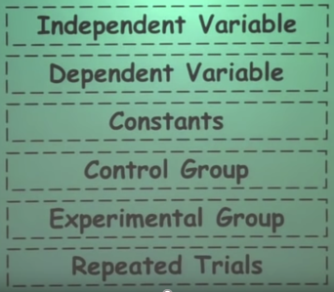
Concepts of Experimental Design
Variables are things that change in the experiment
Variables are factors that influence an experiment or that are of interest as a result.
These include variables we change to test a hypothesis; variables we measure to determine results; and variables you hold constant to produce a valid experiment.
Important Concepts
  The independent variable
  The dependent variable
  Constants
  Control group
  Experimental group
  Repeated trials
General model of a process/system

Slide 8
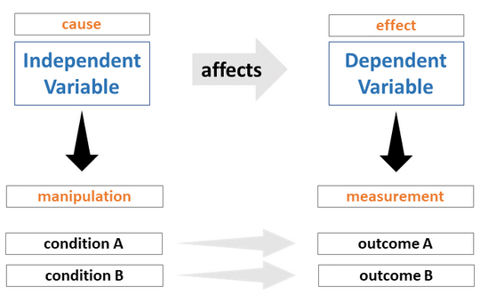
Types of Experimental Variables
Independent Variable
  The variable that is changed on purpose by the experimenter
  This is the “if” part of a hypothesis
Dependent Variable
  The variable that responds
  Also known as the effect, result, or responding variable
  This is the “then” part of a hypothesis

Slide 9
Types of Experimental Variables
  Extraneous variable.
    An extraneous variable is any extra factor that may influence the outcome of an experiment, even though it is not the focus of the experiment.
    Controllable or Uncontrollable variables
  Extraneous variables should always be considered and controlled when possible as they may introduce unwanted variation in your data.
  All experiments have extraneous variables.
  Examples are:
    aspects of the environment where the data collection will take place, e.g., room temperature, background noise level, light levels;
    differences in participant characteristics (participant variables); and
    test operator, or experimenter behavior during the test, i.e., their instructions to the test participants are not consistent.

Slide 10
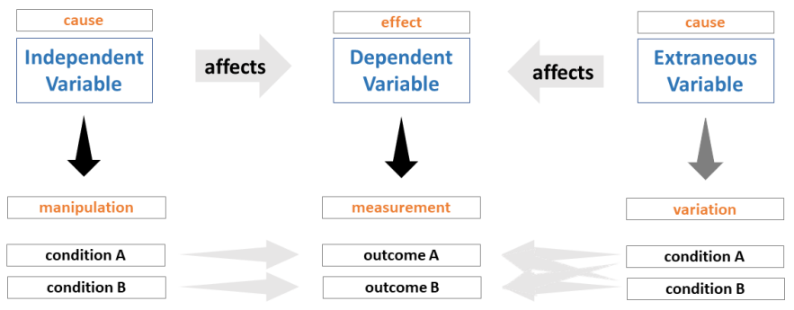
Types of Experimental Variables
Extraneous variables should always be considered and controlled when possible as they may introduce unwanted variation in your data.
Effect of extraneous variables on the relationship between the independent and dependent variables.

Slide 11
Types of Experimental Variables
Controlled (or constant) variables
  Are extraneous variables that we keep constant or controlled during the course of the experiment, as they may have an effect on our dependent variables as well.
Participant variables
  Participant variables can be defined as the differing individual characteristics that may impact how a participant responds in an experiment.
  Examples of participant variables include gender, age, ethnicity, socioeconomic status, literacy status, mood, clinical diagnosis etc.

Slide 12
The Basic Principles of DOE
Randomization
  Running the tests in an experiment in random order
  Notion of balancing out effects of “lurking” variables (Έννοια της εξισορρόπησης των επιπτώσεων των “κρυμμένων” μεταβλητών)
Replication
  Replication versus repeat measurements (i.e. repetition)?
  Sample size (improving precision of effect estimation, estimation of error or background noise)

Slide 13
Randomization (1/2)
While designing experiments, there are factors, such as power surges, fluctuations in ambient temperature and humidity, raw material variations, etc. that
  can adversely affect the experimental results and
  therefore, must be either minimized or removed from the experiment.
Randomization is one of the methods experimenters often rely on to reduce the effect of experimental bias.
By properly randomizing the experiment, we assist in averaging out the effects of noise factors that may be present in the process.
In other words, randomization can ensure that all levels of a factor have an equal chance of being affected by noise factors.

Slide 14
Randomization (2/2)
Example: A teacher wants to know how good her class is in mathematics. So she will give each student a number and will draw numbers from a bunch of chits. This will include a randomly selected sample size and it won’t have any biases depending on teachers interference.
For example: a teacher decides to take a viva in the class and randomly starts asking the students.
Here, all the participants have equal chance of getting into the experiment. Like with our example, every student has equal chance of getting a question asked by the teacher.

Slide 15
Replication
In engineering, science, and statistics, replication is the repetition of an experimental condition so that the variability associated with the phenomenon can be estimated.
ASTM (American Society for Testing and Materials), in the standard E1847, defines replication as:
"the repetition of the set of all the treatment combinations to be compared in an experiment.
Each of the repetitions is called a replicate."
Replication has two important properties.
  The first property is that it allows the experimenter to obtain an estimate of the experimental error.
  The second property is that it permits the experimenter to obtain a more precise estimate of the factor/interaction effect.

Slide 16
Randomization vs Replication
Randomization and replication are fundamental principles in engineering experiments and help ensure the reliability and validity of the results.
Both randomization and replication work together in experimental design.
  Randomization helps in ensuring unbiased and fair testing conditions
  While replication ensures that results are reliable and repeatable.
They differ:

Slide 17
Randomization
Randomization: Randomization is the process of assigning experimental units (e.g., samples, test conditions, or subjects) to treatments or conditions in a random manner.
Purpose:
  Eliminates Bias: Reduces the impact of unknown or uncontrolled variables by ensuring no systematic pattern influences the results.
  Accounts for Variability: Distributes variability due to extraneous factors evenly across treatments.
  Improves Generalizability: Makes the results more broadly applicable by simulating randomness inherent in real-world scenarios.
Example: In a study comparing two welding techniques, randomly assigning different operators to each technique ensures that the operator's skill does not systematically affect the outcome.

Slide 18
Replication
Replication: Replication involves repeating the experiment or specific treatments multiple times to ensure consistency and reliability of results.
Purpose:
  Reduces Noise: Minimizes the impact of random errors by averaging the results.
  Estimates Variability: Provides a measure of experimental variability and helps quantify uncertainty.
  Enhances Reliability: Confirms the reproducibility of results across repeated trials.
Example: Performing multiple tensile tests on samples of the same material to measure strength ensures the results are not due to chance or single anomalies.

Slide 19
Other concepts
Control Group
  The group or standard to which everything is compared
Experimental Group
  The group being tested with the independent variable
  Each test group has only one factor different from the other test groups: the independent variable

Slide 20
Cofounding
The term confounding refers to the combining influences of two or more factor effects in one measured effect.
In other words, one cannot estimate factor effects and their interaction effects independently.
Effects which are confounded are called aliases.
A list of the confoundings which occur in an experimental design is called an alias structure or a confounding pattern.

Slide 21
Q & A
Experimental Design - Yale
http://www.stat.yale.edu/Courses/1997-98/101/expdes.htm

