Slide 1
Research Methods & Project Management Hypothesis Testing Descriptive & Inferential Statistics
M. Tsiknakis

Slide 2
Research process … application of the SM
FF
Review the literature
FF
Review
Concepts
and
Theories
Design
Research
(Including
Sample
Design)
Collect
Data
(Execution)
Analyse
Data
(Test
Hypothesis
if any)
Interpret
and
Report
Define
Research
Problem
Formulate
Hypothesis
Review
Previous
Research
Findings
F
F
I
III
IV
V
VI
VII
II
F
FF
Feed Forward
F
Feed Back

Slide 3
Experimental Design for Evaluating
Question: How do we deal with assertions such as the following?
a) P is a “better solution” than Q.
b) P produces “good quality” results.
c) Typical users would feel “more comfortable” using P than Q.

Slide 4
Examples in CS
(a) P is a “better solution” than Q.
(a) One sorting algorithm produces results quicker than another for the same task, e.g. sorting a list of numbers into order.
(b) P produces “good quality” results.
(b) A program for scheduling deliveries of packages to widely separated locations produces schedules whose overall delivery time is minimized.
(c) Typical users would feel “more comfortable” using P than Q.
(c) Users prefer Mozilla Firefox as a web browser to Internet Explorer or Netscape Navigator.

Slide 5
Testing & Evaluating such assertions
The nature of such assertions (hypothesis) is quite different from that of “P is correct”.
These make claims about “quality” of solutions.
While (a) and (b) may sometimes be dealt with by formal analysis – e.g. counting number of operations for (a) – this may be extremely hard in general.
Claims such as (c) can not be dealt with by any type of “rigorous mathematical proof”.

Slide 6
Experiment(s) to evaluate solutions
What kind of experiments do we need to design?
General approaches
Conduct a number of test-runs of both programs using identical data. Monitor “time” taken by each.
Examine the delivery schedules produced by the program when it is tested on cases for which the “best schedule” is already known.
Ground truth known
Construct a questionnaire to be completed by users and analyze the responses from an “unbiased” sample of these, e.g. standard opinion poll methods.

Slide 7
Possible limitations
Possible objections
a. Random data was used and the results are just a coincidence.
b. The random data was “biased”.

Slide 8
Possible answers
To answer objection (a) one approach is to reason that the “chance” of the results being a coincidence is “too small”.
For example –
If a die is thrown 6.000 times one would expect each of the 6 possible outcomes to occur “roughly” 1.000 times.
If, however, a 6 was obtained on 5.000 of the throws, then “most people” would agree that the die used was “biased”.

Slide 9
Problematic issue
5.000 identical outcomes when only 1.000 had been “expected” is accepted as indicating “bias” in the die used.
But, what if the results had been – 3.000 identical OR 2.000 identical OR 1.500 OR 1.250 OR 1.100 … ?
In other words:
How large must the discrepancy be between what is expected to happen (1000 ´ 6s) and what happens in practice (???? ´ 6s) in order to be “confident” that the die is biased?

Slide 10
Deciding between “coincidence” and “real behavior”
In statistics the notion of “statistical significance” has been developed as a method of answering this question.
We will describe some of the standard ideas used to assess experimental results by statistical methods.
Our interest is in applying these ideas when conducting an experiment.

Slide 11
Hypothesis Testing
Hypothesis
in statistics, is a claim or statement about a property of a population.
Hypothesis Testing or Significance Testing
is a method for testing a claim or hypothesis about a parameter in a population, using data measured in a sample.

Slide 12
Example of a Hypothesis
Children of age 10-12 years old are spending 3 hours daily watching TV.
How can we prove/test this statement/claim?
A. What do we need to know to justify/prove this claim?
B. Based on what we know, what are the methods allowing us to test this claim?

Slide 13
Answer to A
A. What do we need to know to justify/prove this claim?
Randomly select, say 100, children and find out their daily time watching TV.
We need to have some sample observations, i.e., a sample set!
Population
Sample set

Slide 14
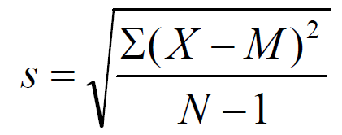
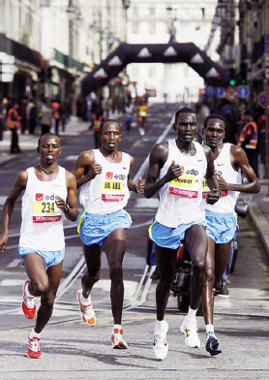
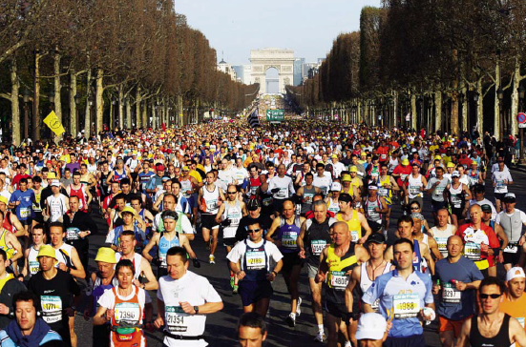
Using Samples to estimate Population parameters
Acknowledge error
Smaller samples, less spread

Slide 15


Answer to B:
Based on what we know, what are the methods allowing us to test this claim?
Remind the claim: The random data was “biased”
This is what we will learn in this part of the course.
i.e. Make conclusions about the population based on sample observations;
Make conclusions

Slide 16
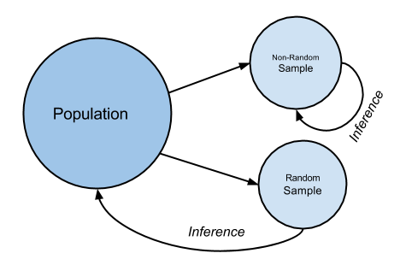
Using Samples to estimate Population Parameters : Statistical reasoning
In most research experimental situations, examination of all members of a population is not typically conducted due to the cost and time required.
Instead, we typically examine a random sample, i.e., a representative subset of the population.

Slide 17
Descriptive Statistics
Descriptive statistics is the term given to the analysis of data that helps describe, show or summarize data in a meaningful way such that, for example, patterns might emerge from the data.
Descriptive statistics do not allow us to make conclusions beyond the data we have analysed. They are simply a way to describe our data.
Typically, there are two general types of statistics that are used to describe data:
Measures of central tendency: these are ways of describing the central position of a frequency distribution for a group of data.
We can describe this central position using a number of statistics, including the mode, median, and mean.
Measures of spread: these are ways of summarizing a group of data by describing how spread out the scores are.
To describe this spread, a number of statistics are available to us, including the range, quartiles, absolute deviation, variance and standard deviation.

Slide 18
Inferential Statistics
Often, however, we do not have access to the whole population we are interested in investigating, but only a limited number of data instead.
Properties of samples, such as the mean or standard deviation, are not called parameters, but statistics.
Inferential statistics are techniques that allow us to use these samples properties to make generalizations about the populations from which the samples were drawn.
It is, therefore, important that the sample accurately represents the population.

Slide 19
Using Samples to Estimate Population Parameters : Statistical reasoning
In most research experimental situations, examination of all members of a population is not typically conducted due to the cost and time required.
Instead, we typically examine a random sample, i.e., a representative subset of the population.
Descriptive Statistics
Inferential Statistics

Slide 20
Summarizing Data: Measures of Central Tendency and Measures of Variability
We will first talk about the important concepts of statistical inference.
We will then give a few descriptive measures of the most important characteristic of a data set, i.e. its central tendency.
After that, we will discuss a few descriptive measures of the other important characteristic of a data set, that relate to measure of variability.

Slide 21
Central Limit Theorem
The Central Limit Theorem states that if we have a population
with mean μ and standard deviation σ
and take sufficiently large random samples from the population,
then the distribution of the sample means will be approximately normally distributed.
This will hold true regardless of whether the source population is normal or skewed,
provided the sample size is sufficiently large (usually n > 30).
If the population is normal, then the theorem holds true even for samples smaller than 30.

Slide 22
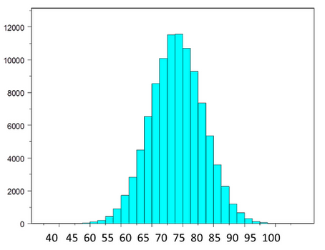
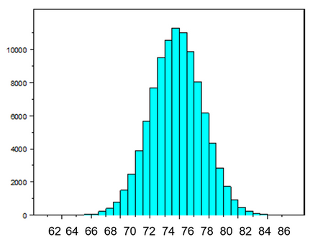
Central Limit Theorem with a Normal Population
The figure below illustrates a normally distributed characteristic, X, in a population in which
the population mean is 75
with a standard deviation of 8.
If we take simple random samples of size n=10 from the population and compute the mean for each of the samples, the distribution of sample means should be approximately normal according to the Central Limit Theorem.
Note that the sample size (n=10) is less than 30, but the source population is normally distributed, so this is not a problem.

Slide 23
Κεντρικό Οριακό Θεώρημα Central Limit Theorem
Central Limit Theorem - Sampling Distribution of Sample Means - Stats & Probability
https://www.youtube.com/watch?v=4YLtvNeRIrg
Central limit theorem - Inferential statistics
https://www.youtube.com/watch?v=JNm3M9cqWyc

Slide 24
Measures of Central Tendency
As said, three of the many ways to measure central tendency are:
Mean : the average of the data
Median : the middle value of the ordered data
Mode : the value that occurs most often in the data
Descriptive measures of population are parameters. Descriptive measures of a sample are statistics.
For example, a sample mean is a statistic and a population mean is a parameter.

Slide 25
Measures of central tendency
Let’s look at a very simple set of data representing the execution time of an algorithm in seconds measured ten times,
55, 56, 56, 58, 60, 61, 63, 64, 70, 78.
Mean execution time = (55 + 56 + 56 + 58 + 60 + 61 + 63 + 64 + 70 + 78) / 10 = 62.1
In the previous set since the number of data is 10 (even) the 5th and 6th item correspond to the middle data items.
So the median is the average of the 5th and 6th item, which is,
Median = (60 + 61)/2 = 60.5
Mode refers to the data item that occurs most frequently in a given data set.
In the above data set 56 occurs twice while all of the others occur only once. So the mode time is 56.

Slide 26

Definition and Basic Properties: sample mean
Suppose that
x=(x₁,x₂,…,x_{n})
is a sample of size n from a real-valued variable x.
The sample mean is simply the arithmetic average of the sample values:
If we want to emphasize the dependence of the mean on the data, we write m(x) instead of just m.

Slide 27


Variance (Διακύμανση)
In probability theory and statistics, variance is the expectation of the squared deviation of a random variable from its mean. (Στη θεωρία πιθανοτήτων και στη στατιστική, η διακύμανση είναι η προσδοκία της τετραγωνικής απόκλισης μιας τυχαίας μεταβλητής από τον μέσο όρο της.)
Informally, it measures how far a set of (random) samples are spread out from their average value.
Variance is an important tool in the sciences, where statistical analysis of data is common. The variance is the square of the standard deviation.
The variance of a random variable X is the expected value of the squared deviation from the mean of X:

Slide 28
Mean and Variance
Given N samples from a population P -
X= {x₁,x₂,x₃,…,x_{N}} - (assuming a uniform distribution)
The average (or mean) value of X is
μ(X) = (x₁+x₂+x₃+…+x_{n})/N
The variance, V(X) of X is
[(x₁-μ(X))²+(x₂-μ(X))²+…+(x_{n}-μ(X))²]/N

Slide 29
Standard Deviation
Variance provides one method for describing the “spread” of a range of samples drawn (uniformly) from a population.
Standard deviation (which is closely related to variance) is another.
Given N samples from a population P – X={x₁,x₂,x₃,…,x_{N}} – the standard deviation of X is
S.D.(x) = [V(x)] ^{(1/2)}
i.e. the square root of variance.
The notation s(x) (or just s) is sometimes used.

Slide 30
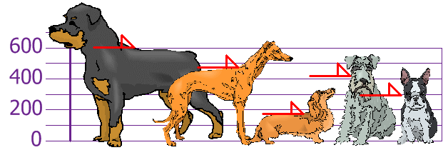
Example
You and your friends have just measured the heights of your dogs (in millimeters):
The heights (at the shoulders) are: 600mm, 470mm, 170mm, 430mm and 300mm.
Find out the Mean, the Variance, and the Standard Deviation.

Slide 31
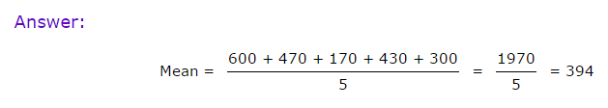
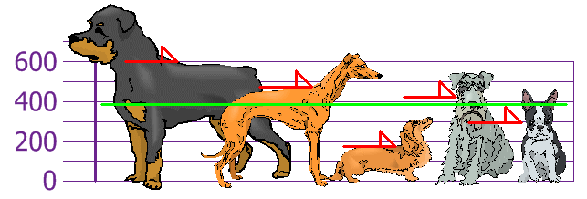
Step 1
Your first step is to find the Mean

Slide 32
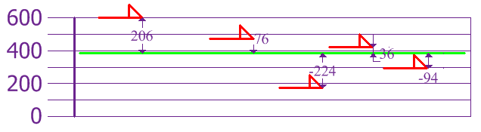
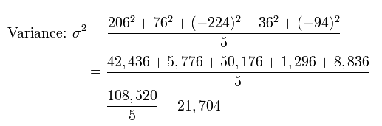
Step 2 - Variance
Now we calculate each dog's difference from the Mean:
To calculate the Variance, take each difference, square it, and then average the result:
So, the Variance is 21,704.
Is this correct?

Slide 33
Step 3 – Standard deviation
The Standard Deviation is just the square root of Variance, so:
Standard Deviation: σ = √21704 = 147,32... = 147 (to the nearest mm)
Now we can show which heights are within one Standard Deviation (147mm) of the Mean.

Slide 34
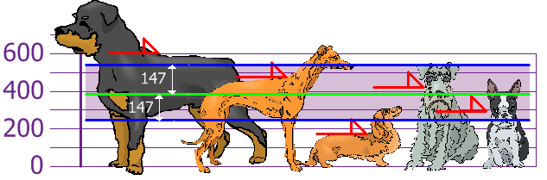
Step 3 – Standard deviation (cntd)
So, using the Standard Deviation we have a "standard" way of knowing what is normal, and what is extra large or extra small.

Slide 35
But ... there is a small change with Sample Data
Our example was for a Population (the 5 dogs were the only dogs we were interested in).
But if the data is a Sample (a selection taken from a bigger Population), then the calculation changes!
When you have "N" data values that are:
The Population: divide by N when calculating Variance (like we did)
A Sample: divide by N-1 when calculating Variance

Slide 36


Formulas
Looks complicated, but the important change is to divide by N-1 (instead of N) when calculating a Sample Variance.

Slide 37
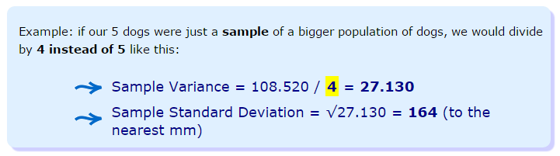
Example
All other calculations stay the same, including how we calculated the mean.

Slide 38

Covariance (Συνδιακύμανση)
Co-variance, measures how two variables vary with respect to each other.
Mathematically it is defined as,
Positive covariance signifies that the higher values of one variable correspond with the higher values of the other variable, and similarly for the lower ones.
Negative covariance, on the other hand, signifies that the higher values of one variable correspond to the lower values of the other.
A covariance very close to zero signifies the lack of correlation between two variables.

Slide 39

Correlation & Correlation Coefficient
Correlation (συσχέτιση) is a measure for quantifying how the two different variables are related to each other.
The correlation coefficient is obtained by dividing the covariance by the product of the standard deviations of the two variables. Mathematically it is defined as,
The values lie between +1 and -1.
+1 signifying a perfect increasing linear relationship (correlation).
-1 signifying a perfect decreasing linear relationship (anti-correlation).

Slide 40
Hypothesis & Hypothesis testing

Slide 41
Hypothesis Testing
Hypothesis
in statistics, is a claim or statement about a property of a population.
Hypothesis Testing or Significance Testing
is a method for testing a claim or hypothesis about a parameter in a population, using data measured in a sample.

Slide 42
Example of a Hypothesis
Children are spending 3 hours daily watching TV.
How can we prove/test this statement/claim?
A. What do we need to know to justify/prove this claim?
B. Based on what we know, what are the methods allowing us to test this claim?

Slide 43
Definitions
Null Hypothesis (denoted H ₀):
is the statement being tested in a test of hypothesis.
Alternative Hypothesis (H ₁):
is what is believed to be true if the null hypothesis is false.

Slide 44
Null Hypothesis: H₀
Must contain condition of equality
=, >, or <
Test the Null Hypothesis directly
Reject H ₀ or fail to reject H ₀

Slide 45
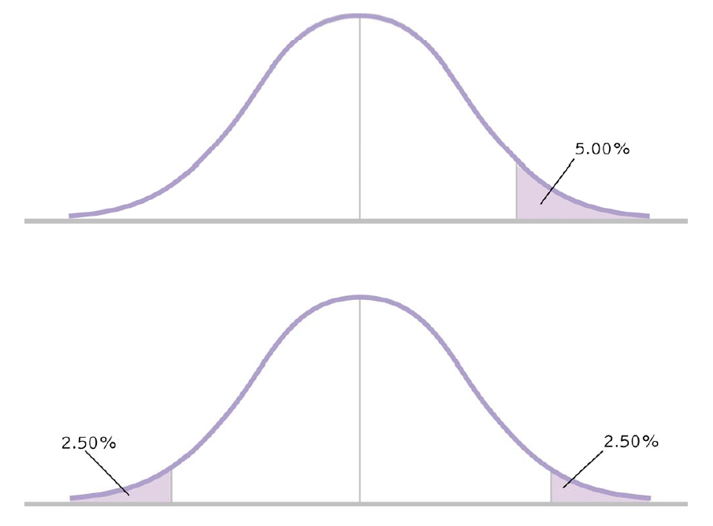
One Tailed vs. Two Tailed Tests

Slide 46
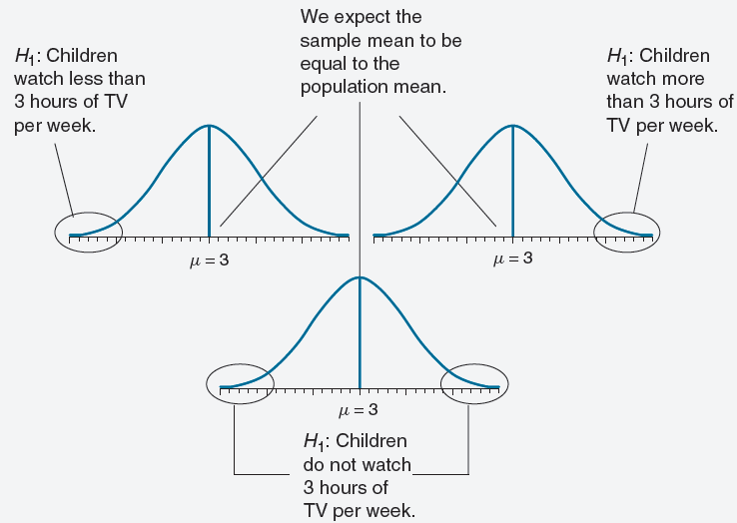
Time of Children watching TV

Slide 47
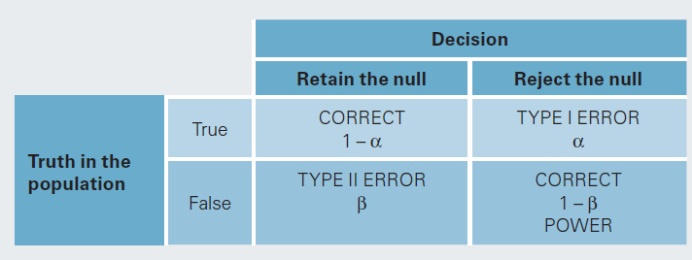
Errors – Type I and Type II

Slide 48
Errors in Hypothesis Testing & Power
Type I Error
The mistake of rejecting the null hypothesis when it is true.
The probability of doing this is called the significance level, denoted by α (alpha).
Common choices for a: 0.05 and 0.01
Type II Error
the mistake of failing to reject the null hypothesis when it is false.
denoted by ß (beta)
The power in hypothesis testing is the probability of rejecting a false null hypothesis.
Specifically, it is the probability that a randomly selected sample will show that the null hypothesis is false when the null hypothesis is indeed false.

Slide 49
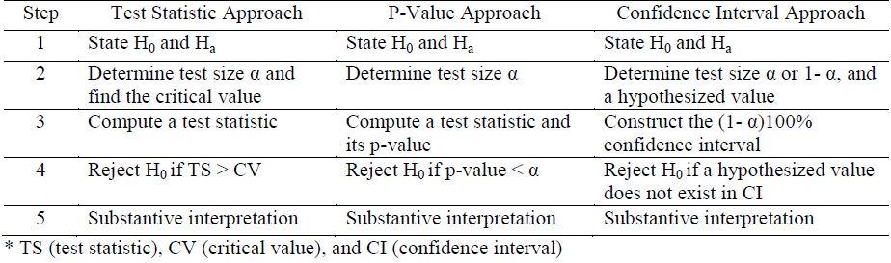
Three Approaches of Hypothesis Testing

Slide 50

Q & A

