Slide 1
Research Methods & Project Management
Hypothesis Testing – Part 2
(Στατιστικός Έλεγχος Υποθέσεων)
M. Tsiknakis

Slide 2
Hypothesis Testing
Hypothesis
  in statistics, is a claim or statement about a property of a population.
Hypothesis Testing or Significance Testing
  is a method for testing a claim or hypothesis about a parameter in a population, using data measured in a sample.

Slide 3
Hypothesis Testing
(Στατιστικός έλεγχος υποθέσεων)
Hypothesis testing is an inferential process/method offered by Statistics and is applied to stochastic decision problems between two alternative hypotheses.
One hypothesis has been commonly denoted by H0 and is called the null hypothesis, and the other by H1 and is called the alternative hypothesis.
A necessary condition for the correct application of statistical tests and, above all, for the correct interpretation of their results, is the understanding of their logic and meaning.
We will try to highlight this logic below.

Slide 4
Example of a Hypothesis
Children are spending 3 hours daily watching TV.
How can we prove/test this statement/claim?
  A. What do we need to know to justify/prove this claim?
  B. Based on what we know, what are the methods allowing us to test this claim?

Slide 5
Definitions
Null Hypothesis (denoted H ₀):
is the statement being tested in a test of hypothesis.
Alternative Hypothesis (H ₁):
is what is believed to be true if the null hypothesis is false.

Slide 6
Null Hypothesis: H₀
Must contain condition of equality
  =, >, or <
Test the Null Hypothesis directly
  Reject H ₀ or fail to reject H ₀

Slide 7
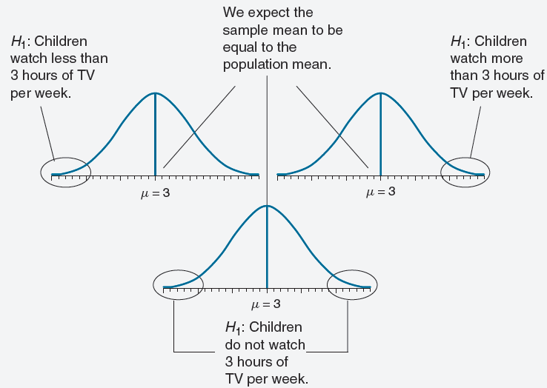
One Tailed vs. Two Tailed Tests
Time of Children watching TV

Slide 8
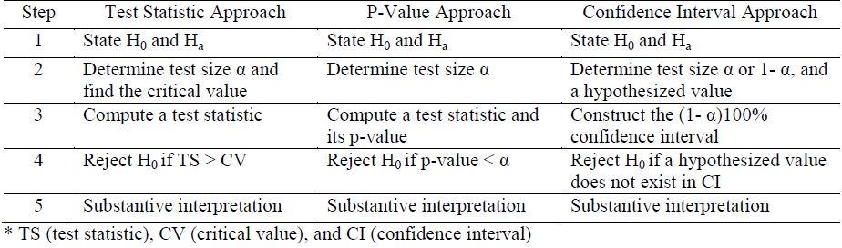
Three Approaches of Hypothesis Testing

Slide 9
Basic concepts
The general idea of ​​the statistical hypothesis testing process is as follows:
  We set as the null hypothesis (H0) the one we doubt, the one that is being questioned, and
  we examine whether a random sample taken from the population supports, that is, provides evidence in favor of rejecting it, compared to the alternative (H1).

Slide 10
Basic concepts
That is, H0 is rejected or not rejected based on what is observed in the random sample we took from the population.
More specifically, assuming that H0 is true, if what is observed in the sample is extreme, that is, if it has a very low probability of occurring, then we reject H0 .
In the opposite case, that is, if what is observed in the sample is not extreme/rare, then the sample we took does not give us enough evidence to reject H0 and we “fail to reject it”.
Of course, with this strategy we take a “risk”, because even … extremes, even with a very low probability, can occur….. So there are errors!!

Slide 11
Type I error
More specifically, if we judge that what is observed in the random sample is extreme and we reject H0, then one of the following may have happened:
  either H0 is indeed not true, in which case we decided correctly,
  or H0 is true and the extreme is due to chance, that is, something rare happened (a sample that rarely appears appeared).
In the second case, we incorrectly rejected H0.
  This error is called a type I error.
  Since, under H0, the extreme is likely to occur, even with a very small probability, e.g. 0.001,
  then, we incorrectly reject H0 with a probability of 0.001.

Slide 12
Type II error
Accordingly, it is possible to incorrectly fail to reject H0 . That is, to fail to reject H0 when in fact H1 is true.
  This error is called a type II error.
The “risk”, therefore, is twofold, with the probability of
  incorrectly rejecting H0 , P(type I error) = P(reject H0|H0 is true) and
  incorrectly not rejecting H0 , P(type II error) = P(fail to reject H0|H1 is true).

Slide 13
Estimation of Probabilities
It is obvious that in order to proceed, we must clarify:
  a) what exactly do we mean when we say “what is observed in the sample”? How is it expressed? Can it be measured, quantified?
  b) How do we judge whether “what is observed in the sample” is or is not “extreme”? That is, by what clear rule is what is observed in the sample considered “extreme”?
We must also answer the reasonable questions:
  How are the probabilities of type I and type II errors calculated?
  Can they be minimized?
  Are they related in some way?
  Can we put them under our control?

Slide 14
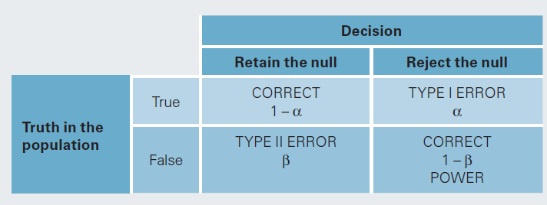
Errors – Type I and Type II

Slide 15
Errors in Hypothesis Testing & Power
Type I Error
  The mistake of rejecting the null hypothesis when it is true.
  The probability of doing this is called the significance level, denoted by α (alpha).
  Common choices for a: 0.05 and 0.01
Type II Error
  the mistake of failing to reject the null hypothesis when it is false.
  denoted by ß (beta)
The power in hypothesis testing is the probability of rejecting a false null hypothesis.
  Specifically, it is the probability that a randomly selected sample will show that the null hypothesis is false when the null hypothesis is indeed false.

Slide 16
Errors, Significance Level and Critical values
Significance Level
Level of Confidence (1 - α) | Significance level (α)
 |  | One - Tailed | Two - Tailed
90% | 0.10 | +1.282 or -1.282 | +/- 1.645
95% | 0.05 | +1.645 or -1.645 | +/- 1.960
99% | 0.01 | +2.326 or -2.326 | +/- 2.576
99.9% | 0.001 | +3.090 or – 3.090 | +/- 3.291

Slide 17
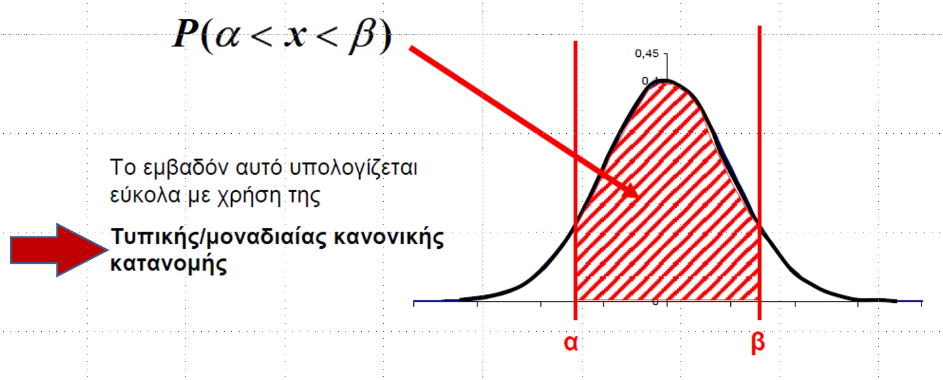
Estimation of the probability
To calculate the probability that the value of a variable is between two specific limits, we need to calculate the area under the curve and between the two limits.
This area is easily calculated using the standard normal distribution.

Slide 18
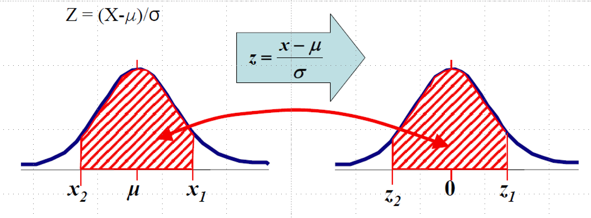
The standard normal distribution
The standard normal distribution is a normal probability distribution that has a mean (μ) = 0 and a standard deviation (σ) = 1.
Most quantities that follow a Normal Distribution do NOT have a mean = 0 and a standard deviation = 1.
However, it is possible to standardize non-standard cases using the relationship:

Slide 19
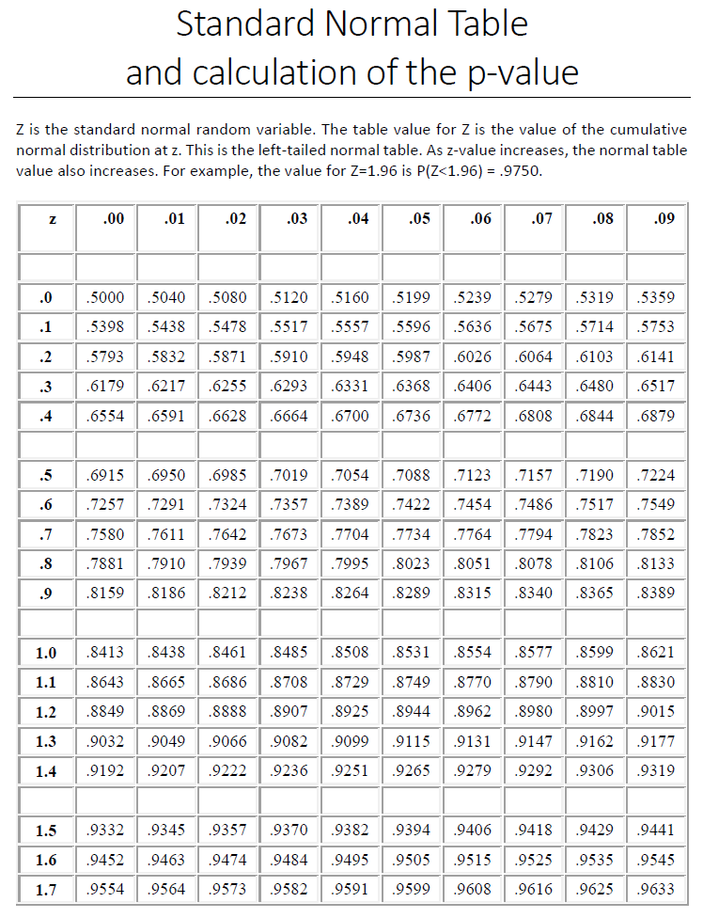
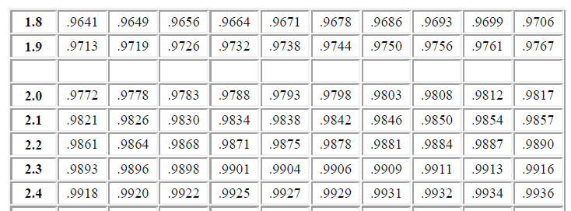
Standard Normal Table

Slide 20
Approaches for Hypothesis Testing

Slide 21
Hypothesis testing
In general, hypothesis testing follows next five steps.
  State a null and alternative hypothesis clearly (one-tailed or two-tailed test).
  Determine a test size (significance level). Pay attention to whether a test is one-tailed or two-tailed to get the right critical value and rejection region.
  Compute a test statistic or p-value or construct the confidence interval, depending on testing approach.
  Decision-making: reject or do not reject the null hypothesis by comparing the subjective criterion in 2) and the objective test statistic or p-value calculated in 3)
  Draw a conclusion and interpret substantively.

Slide 22
Test statistic - Definition
Test Statistic:
is a sample statistic or value based on sample data.
Example:
x – µ_{x}
z =
σ /
n
Standard Error of
the Mean (SEM)

Slide 23
Error levels & Critical values
Type I error
Level of Confidence (1 - α) | Significance level (α)
 |  | One - Tailed | Two - Tailed
90% | 0.10 | +1.282 or -1.282 | +/- 1.645
95% | 0.05 | +1.645 or -1.645 | +/- 1.960
99% | 0.01 | +2.326 or -2.326 | +/- 2.576
99.9% | 0.001 | +3.090 or – 3.090 | +/- 3.291

Slide 24
Practical Problem
A SW engineer claims that a given algorithm executes in 20 ms.
An independent laboratory performed tests which resulted in the following data:
21, 18, 19, 16, 18, 24, 22, 19, 24, 14, 18, 15 (n=12)
Assuming the measured data to be normally distributed with a standard deviation of 3 (sd=3), carry out a hypothesis test in order to accept or reject the engineer’s claim.

Slide 25
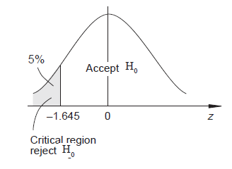

Solution (1/3)
For this problem denoting the execution time by X, then
and it is required to test
Significance level, α = 0,05 (say)
Critical region, z < - 1.645

Slide 26


Solution (2/3)
Now the test statistic is
Calculation gives
And thus
x – µ_{x}
z =
σ /
n

Slide 27
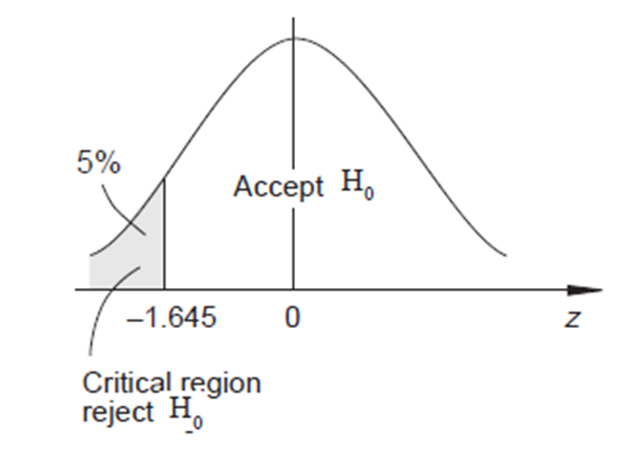
Decision
This value does not lie in the critical region.
Thus there is not sufficient evidence, at the 5% level of significance, to support rejection of the engineer’s claim (i.e. algorithm execution time is 20 ms).
-1.15

Slide 28
Scope of Hypothesis Testing
To accept
or
To reject the Null Hypothesis (Η₀)

Slide 29
The process
First we find the result from using the statistical criterion we applied (statistical value)
For each possible statistical value, the probability of a value at least equal to it occurring when H0 is true (critical value) has been defined by statisticians
Then, based on the critical value, we determine the rejection region of H0.
Finally, if the statistical value is within the limits of this region, we should reject H0 .
Otherwise, we should accept it.

Slide 30
Example
Let's assume that using the statistical criterion we used we found the statistical value = 3.67
From the corresponding tables we find that for a statistical significance level α=0.05
and for a two-tailed hypothesis, the critical value is +/- 1.960

Slide 31
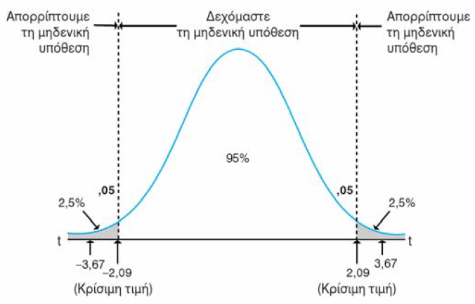
Example of a Two-tailed Hypothesis Test
- 1,96
1,96
The statistical value falls within the rejection region of H0 (gray area). Therefore, we should reject H0 and accept H1.

Slide 32
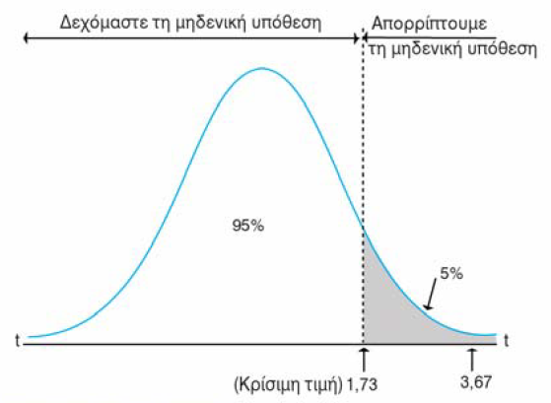
Example of a One-tailed Hypothesis Test
1.645
The statistical value falls within the rejection region of H0 (gray area). Therefore, we should reject H0 and accept H1.

Slide 33
Research Methods & Project Management
Hypothesis Testing – Part 3
Χρήση p value για Στατιστικό Έλεγχο Υποθέσεων
Use of p-value for the statistical test of Hypothesis
M. Tsiknakis

Slide 34
Three Approaches of Hypothesis Testing

Slide 35
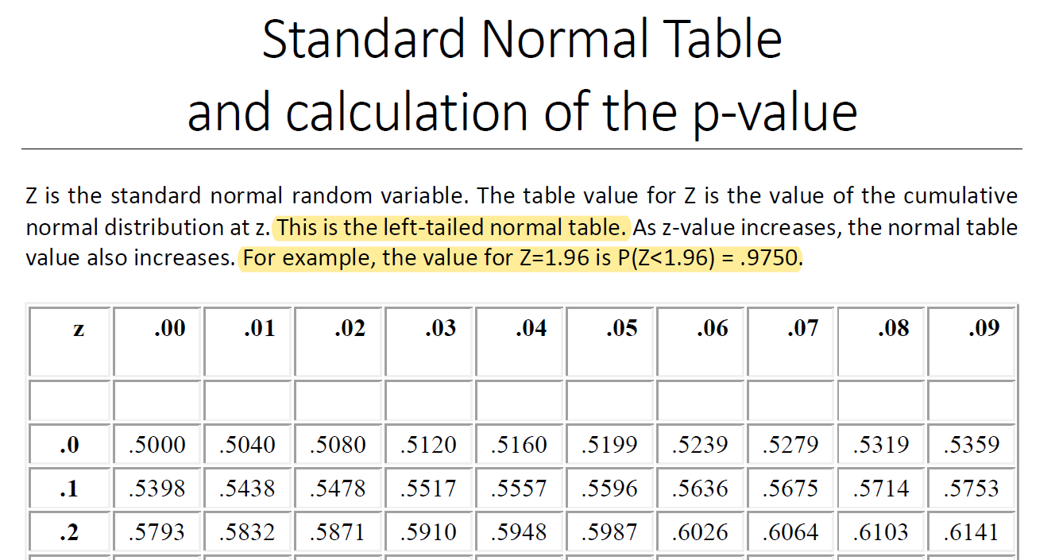
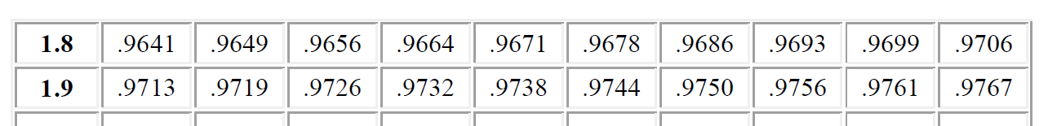
Υπολογισμός p-value – Estimation of p-value
The standard Normal Table
For z = 1.96
P(z<1.96) = 0.9750

Slide 36
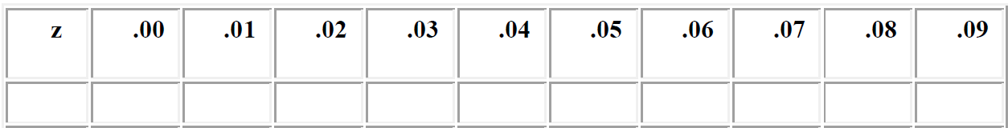
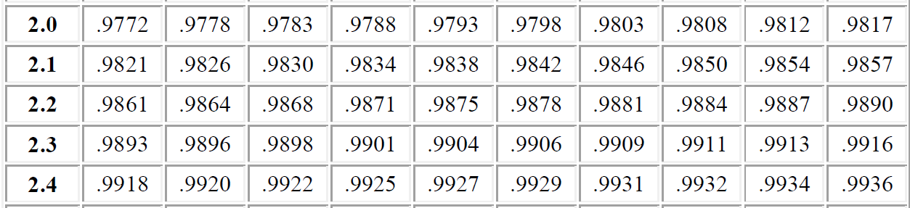
P-value : How to use the Standard Normal Table (1/2)
Question: For a right-tailed z-test, if the test statistic is 2.00. Find the p-value for a hypothesis test using the standard normal table.
  The p-value is given by: p-value = P(Z>2.00) =1-P(Z<2.00) =1-0.9772 =0.0228
  Since p-value < .05, the right-tailed z-test is significant at the .05 level, i.e. we reject the Null Hypothesis

Slide 37
P-value : How to use the Standard Normal Table (2/2)
Question: For a two-tailed z-test, if the test statistic is 2.00.
  The p-value is given by:
  p-value = P(Z<-2.00 or Z>2.00)
  =2*P(Z>2.00)
  =2*[1-P(Z<2.00)]
  =2*(1-0.9772)
  =0.0456
  Since p-value < .05, the two-tailed z-test is significant at the .05 level
    Therefore, we reject the Null Hypothesis

Slide 38
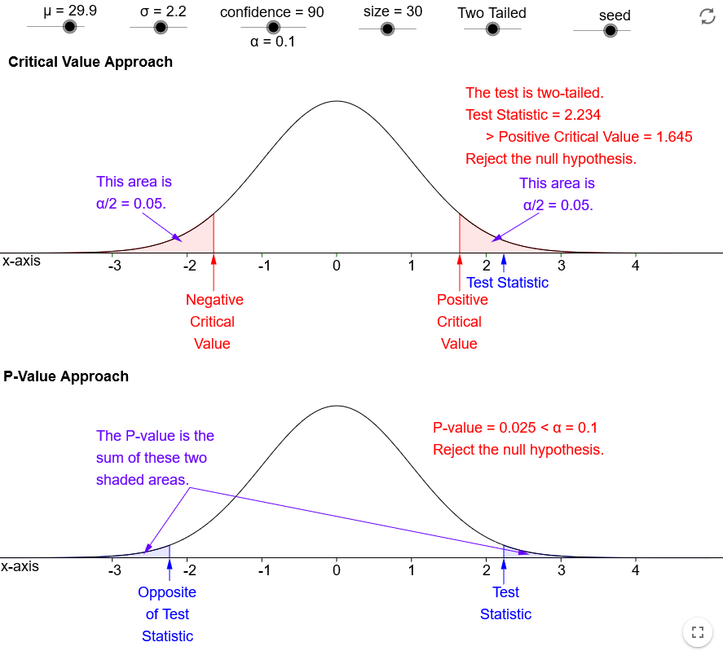
Test statistic and p-value approach
https://www.geogebra.org/m/BE4xewDy#material/YRh9H3t5

Slide 39

Q & A

