Slide 1
Internet of Things
Inspired by slides for course EEEM048/COM3023 by Dr Payam Barnaghi, Dr Chuan H Foh, Institute for Communication Systems
Electronic Engineering Department, University of Surrey
Notes:
1

Slide 2
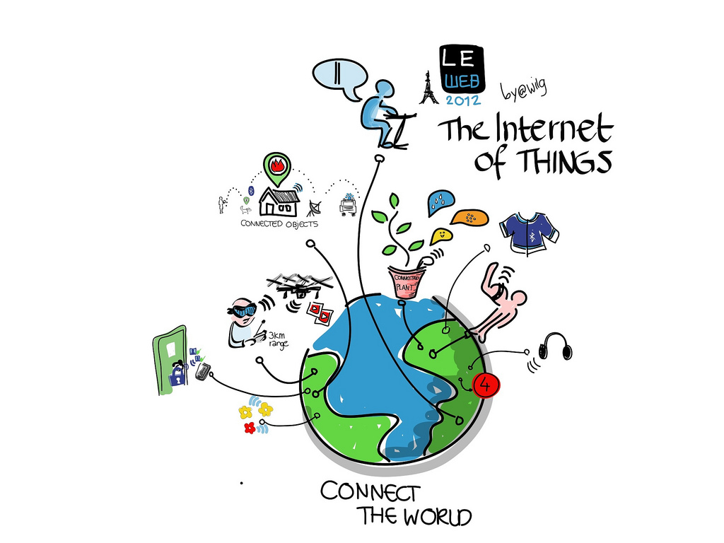
Image courtesy: Wilgengebroed

Slide 3
Internet of Things (IoT)
Extending the current Internet and providing connection, communication, and inter-networking between devices and physical objects, or "Things," is a growing trend that is often referred to as the Internet of Things.
“The technologies and solutions that enable integration of real world data and services into the current information networking technologies are often described under the umbrella term of the Internet of Things (IoT)”

Slide 4
Aims of the course
The main aim of this course is to introduce the fundamental concepts of the Internet of Things and its applications and architecture models;
Introduction to the technologies and mechanisms for sensing, actuation, processing and cyber-physical data communication.
Discussing semantic technologies, service oriented solutions and networking technologies that enable the integration of Internet of Things data and services into the cyber world (i.e. the Internet and the Web).
To develop practical skills that can be transferred into a real-world environment.

Slide 5
Topics
Cyber-Physical systems, smart devices, sensors and actuators
Key applications, protocols and architectures
Networks and Communications (Wireless Multi-hop Networks (WMN), Mobile Ad-hoc Networks (MANET), Wireless Sensor Networks (WSN))
Reliability, Security, Privacy and Trust issues and solutions
Software platforms and services
Intelligent Data Processing and Semantic technologies
Connecting Things to the Web (Web of Things)
Applications, system models, Standards, and Physical-Cyber-Social systems (invited industry speaker?)

Slide 6
Sensors are becoming popular

Slide 7
Computing Power
Smaller size
More Powerful
More memory and more storage
"Moore's law" over the history of computing, the number of transistors in a dense integrated circuit has doubled approximately every two years.

Slide 8
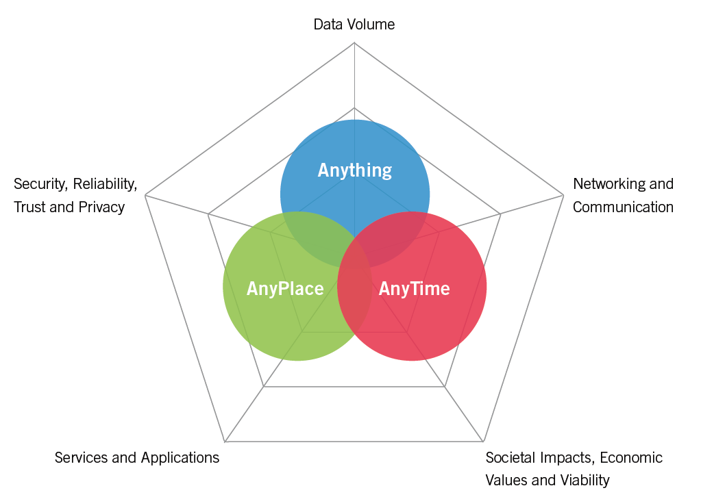
Cyber-Physical-Social Data
P. Barnaghi et al., "Digital Technology Adoption in the Smart Built Environment", IET Sector Technical Briefing, The Institution of Engineering and Technology (IET), I. Borthwick (editor), March 2015.

Slide 9
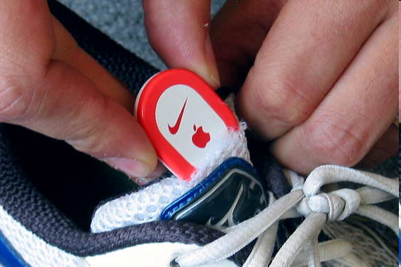
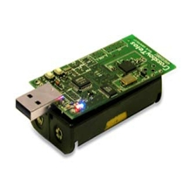
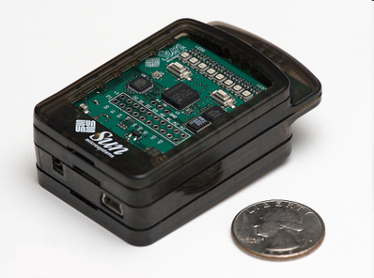
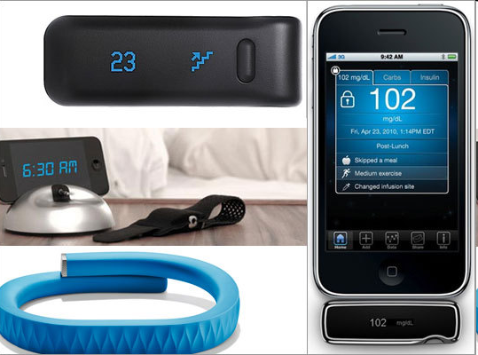
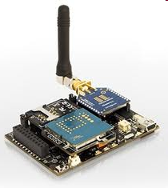
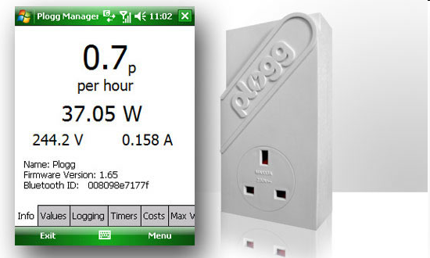
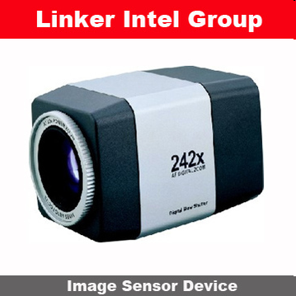
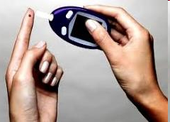
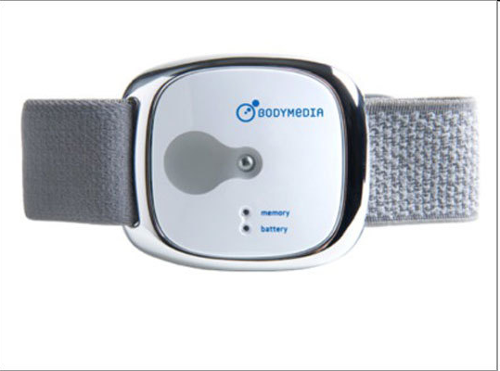
Sensor devices are becoming widely available
- Programmable devices
- Off-the-shelf gadgets/tools

Slide 10
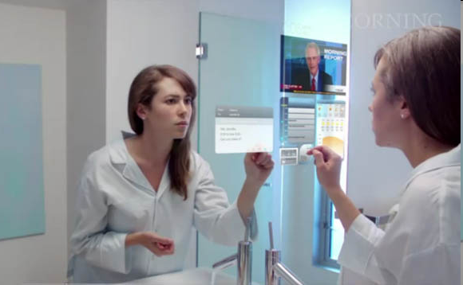
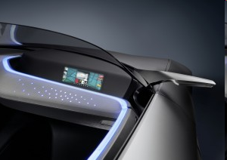
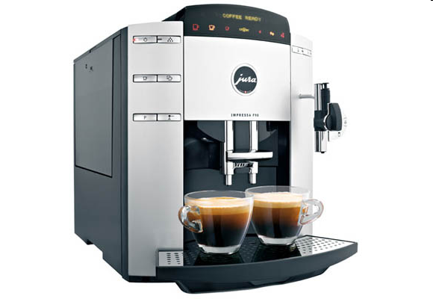
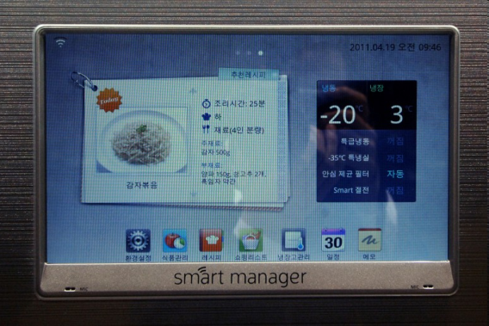
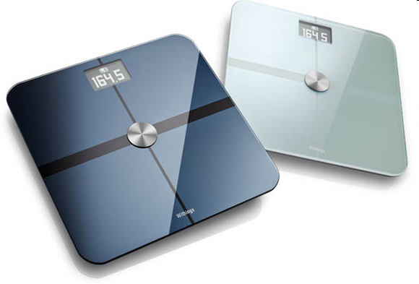
More “Things” are being connected
Home/daily-life devices
Business and
Public infrastructure
Health-care
…

Slide 11






People Connecting to Things
ECG sensor
Internet
Motion sensor
Motion sensor
Motion sensor

Slide 12
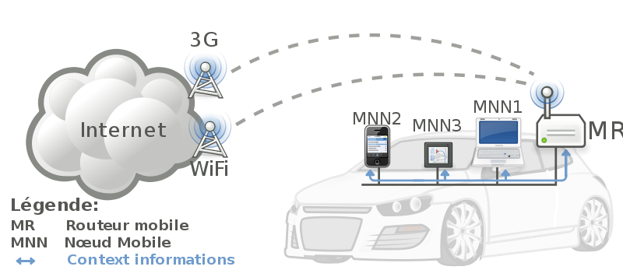


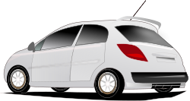
Things Connecting to Things
- Complex and heterogeneous
resources and networks

Slide 13







Wireless Sensor Networks (WSN)
End-user
Core network
e.g. Internet
Gateway
Sink
node
Gateway
Computer services
The networks typically run Low Power Devices
Consist of one or more sensors, could be different type of sensors (or actuators)

Slide 14
Why should I learn about IoT?
Emerging technologies
Growing IoT Services and Applications in various areas including smart cities, healthcare, transport, logistics, retail, safety and security, etc.
Business trends and new opportunities

Slide 15
Some numbers

Slide 16
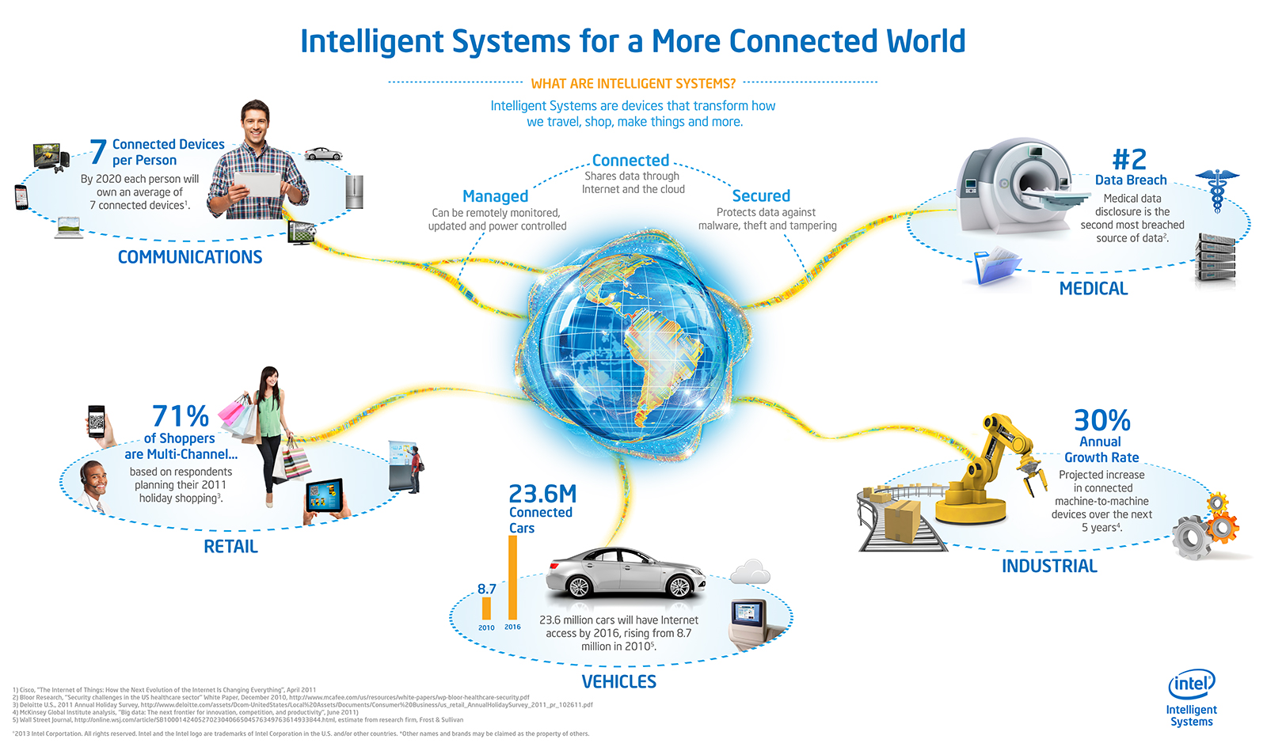
Opportunities
Source: http://blog.trentonsystems.com/internet-of-things-crosses-business-personal-boundaries/

Slide 17
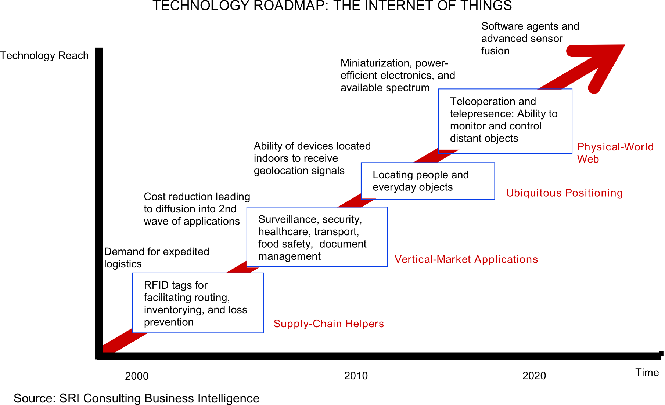
Technology trend

Slide 18
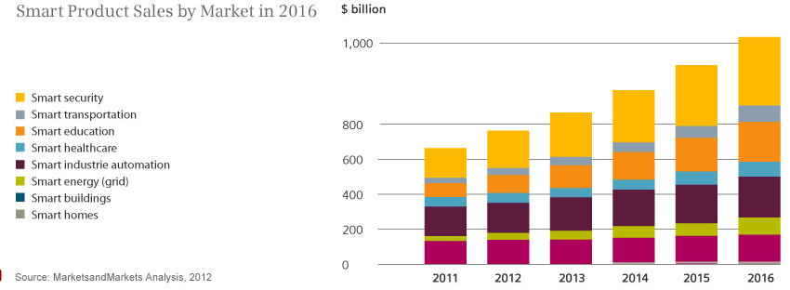
Smart product sales
Source: Siemens, http://www.siemens.com/innovation/apps/pof_microsite/_pof-fall-2012/_html_en/facts-and-forecasts-growth-market-of-the-future.html

Slide 19
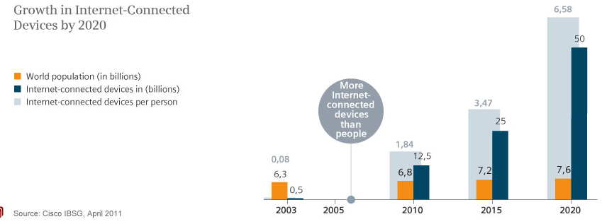
Internet Connected devices
Source: Siemens, http://www.siemens.com/innovation/apps/pof_microsite/_pof-fall-2012/_html_en/facts-and-forecasts-growth-market-of-the-future.html

Slide 20
Global Data Generation
Everyday around 20 quintillion (10^18) bytes of data are produced (Source: http://www-01.ibm.com/software/data/bigdata/).
- This data includes textual content (unstructured, semi-structured, structured) to multimedia content (images, video and audio), on a variety of platforms (enterprise, social media, and sensors).

Slide 21
IoT ecosystem

Slide 22
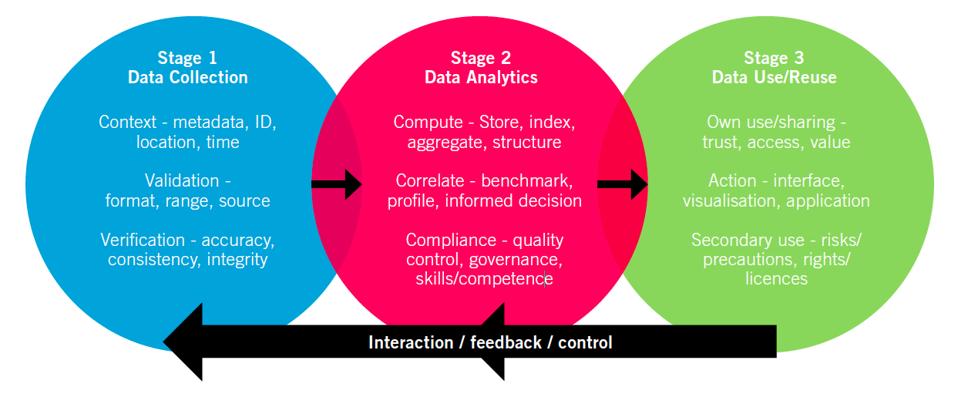
Data Lifecycle – the M-D-E cycle
Source: The IET Technical Report, Digital Technology Adoption in the Smart Built Environment: Challenges and opportunities of data driven systems for building, community and city-scale applications, http://www.theiet.org/sectors/built-environment/resources/digital-technology.cfm

Slide 23
Overview: Hardware Platform
User/Environment
“Thing”
Sensors & Actuators
Device level
Communications
Network
Gateway
The Internet
Network level
Servers

Slide 24
Sensors & Actuators
Sensors:
They are mainly input components
They sense and collect surrounding information
Basically three types:
Passive, omnidirectional (e.g. mic)
Passive, narrow-beam sensor (e.g. PIR)
Active sensors (e.g. sonar, radar, etc.)
Actuators:
They are mainly output components
They alter the surrounding. Some examples:
Adding lighting, heat, sound, etc.
Controlling motors to move objects
Displaying messages
and others…

Slide 25
Things
We can turn almost every object into a “thing”.
A “thing” still looks much like an embedded system currently.
A “thing” generally consists of four main parts:
Sensors & actuators
Microcontroller
Communication unit
Power supply
A “thing” has the following properties:
It’s usually powered by battery. This implies limited source of energy.
It’s generally small in size and low in cost. This limits their computing capability.
It doesn’t usually perform complicated tasks.
Power consumption is the main design issue.

Slide 26
Communications
A “thing” always feature communications for “team working”
The Role of Communications
Providing a data link between two nodes
Communication type:
Wireline (e.g. copper wires, optical fibers)
Wireless (e.g. RF, IR). RF-based communication is the most popular choice (and also our focus)
Popular RF-based communication solutions:
IEEE 802.15.4
IEEE 802.11 (or Wifi)
Bluetooth
Near Field Communication (NFC), e.g. RFID
LPWAN

Slide 27
Networks
The Roles of Networks
Managing nodes (discovery, join, leave, etc).
Relaying data packets from the source to the destination node in the network.
Networks are a distributed system. All nodes need to perform networking related tasks.
RF-based Network in IoT is usually a Wireless Multi-hop Network. Some examples:
Wireless Sensor Networks (WSNs)
Mobile Wireless Ad hoc Networks (MANETs)
Wireless Mesh Networks (WMNs)
Vehicular Ad Hoc Networks (VANETs)
and others...
Main concern: Reliability & Performance

Slide 28

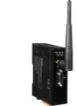
The Internet
The Internet serves as a wide area networking for a local network.
The Internet uses TCP/IP. This implies that things must also support TCP/IP.
Gateway (or sink)
For a practical deployment, a gateway is often needed in a network.
It offers relaying packets between the network and the Internet.
The Internet
Data link
Gateway
Network

Slide 29

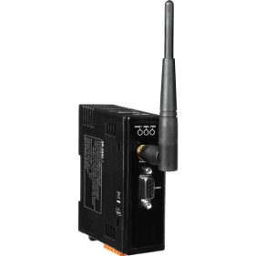
Protocol Stack
Thing
Thing
Application
Application
TCP/UDP
TCP/UDP
Network (IP)
Network (IP)
IEEE 802.15.4 PHY/MAC
IEEE 802.15.4 PHY/MAC
Wireless Medium
Server
Application
Gateway
TCP/UDP
Network (IP)
Network (IP)
The Internet
IEEE 802.3 (Ethernet)
IEEE 802.3 (Ethernet)
IEEE 802.15.4 PHY/MAC

Slide 30
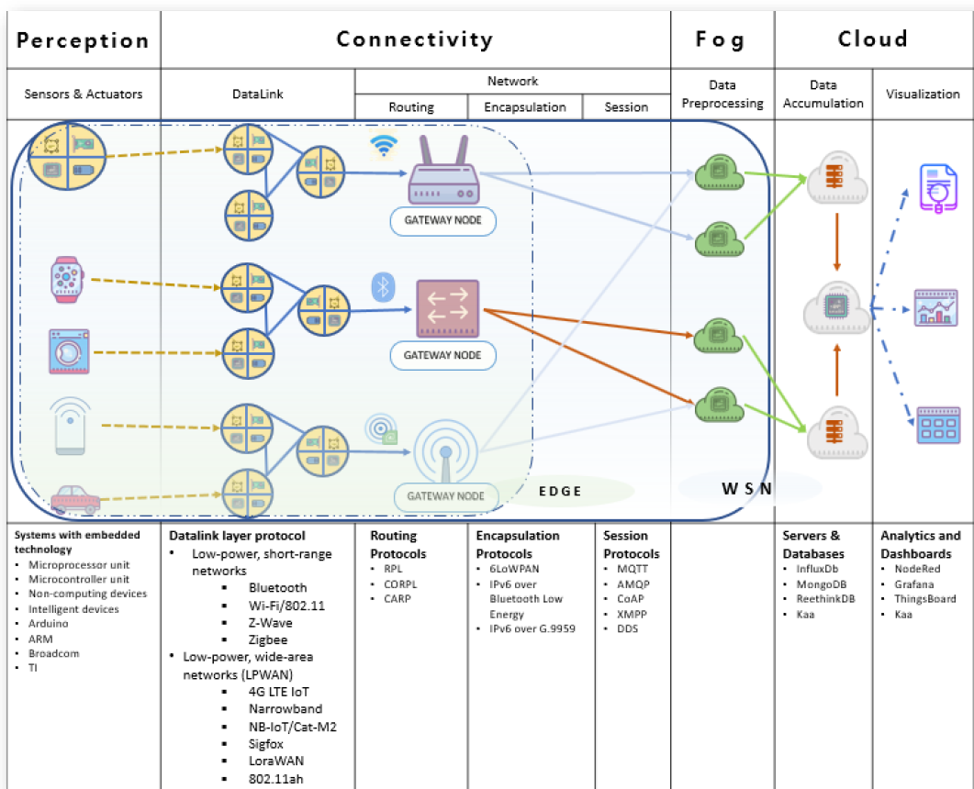
I O T E C O S Y S T E M

Slide 31
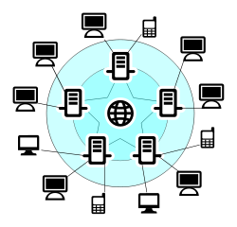



Example: Type of Services in IoT
Data
Data
Sender
Receiver
A sample data communication in conventional networks
Fire!
Some bits
01100011100
Core network
e.g. Internet
End-user
Sink
node
Gateway
A sample data communication in WSN

Slide 32
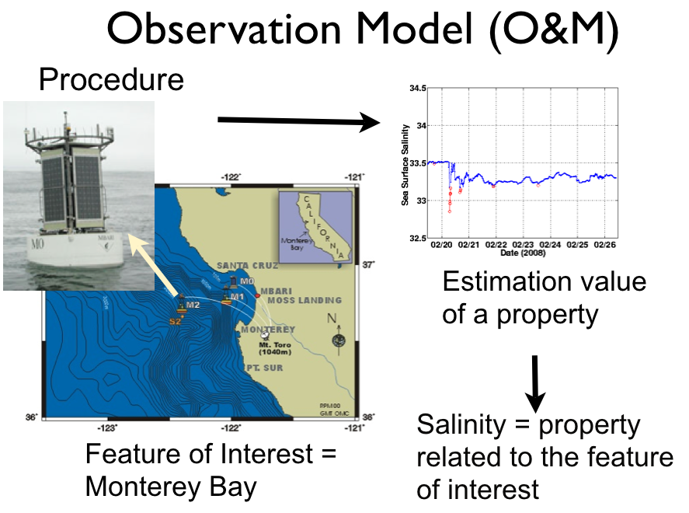
Observation and measurement data
Source: W3C Semantic Sensor Networks, SSN Ontology presentation, Laurent Lefort et al.

Slide 33
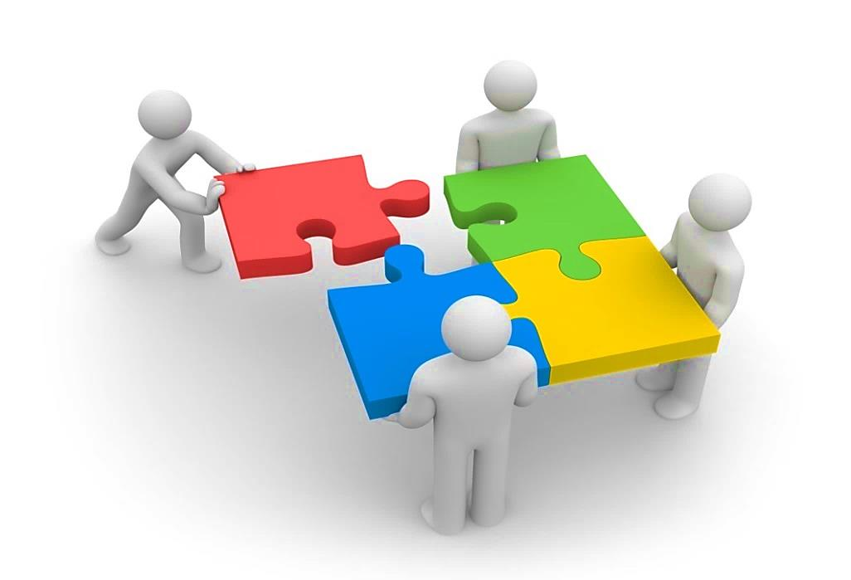
Internet of Things (IoT) Ecosystem
IoT Platforms
Federation Inter-operability
Cloud
Big data
networking
Semantics
User Centric
Security
Trust
Privacy
Architecture Reference Model
Security/Privacy/Trust by Design

Slide 34
“The ultimate goal is transforming the raw data to insights and actionable knowledge and/or creating effective representation forms for machines and also human users and creating automation.”
This usually requires data from multiple sources, (near-) real time analytics and visualisation and/or semantic representations.

Slide 35








“People want answers, not numbers” (Steven Glaser, UC Berkley)
Freezing!
What is the temperature at home?
Core network
e.g. Internet
Sink
node
Gateway

Slide 36
IoT challenges

Slide 37

Five key challenges on IoT
Rapid technological development
Users' take up and acceptability
Need to move into deployment
Risk of fragmentation
International competition
Notes:
Intelligence at the edge vs. intelligence in the cloud, security and privacy, connectivity and reliability of data transmission at large scale, semantic interoperability
Privacy, security, legal framework, user-friendliness
Uncertainty about business models
Uncertainty about standard. Between siloes, between standards, between MS

Slide 38
Intelligent Data Processing
Sensing and data collection, sensor data and data-centric networks
Access, subscription and integration
Data processing and stream data analysis
Query and discovery
Data classification and clustering

Slide 39
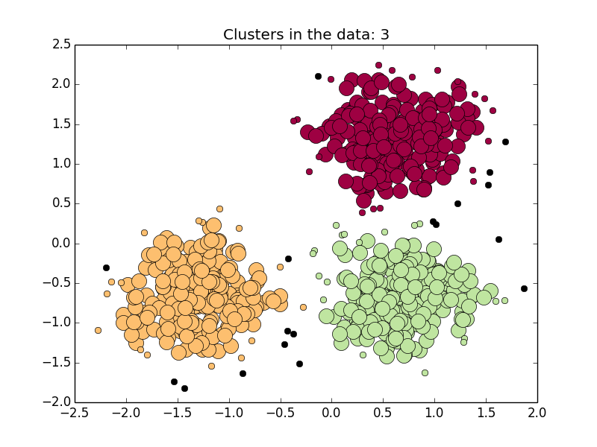
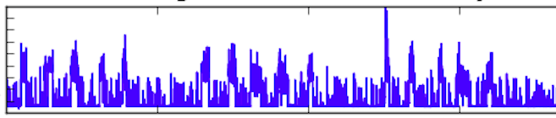
“Each single data item is important.”
“Relying merely on data from sources that are unevenly distributed, without considering background information or social context, can lead to imbalanced interpretations and decisions.”
?

Slide 40
Security & Privacy
Are they important?
What is the risk?
What are the challenges?
Device level
Network level
System level
User level
Solutions?

Slide 41
Semantic technologies and connecting Things to the Web
Meta-data models and schemas
Linked data and Linked IoT data concepts
Semantic technologies and semantic sensor networks
Interoperability issues
Web of Things

Slide 42
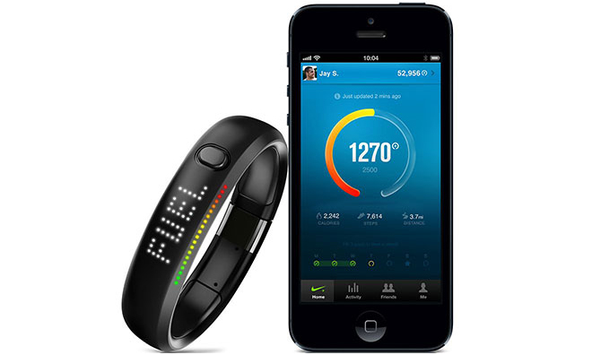
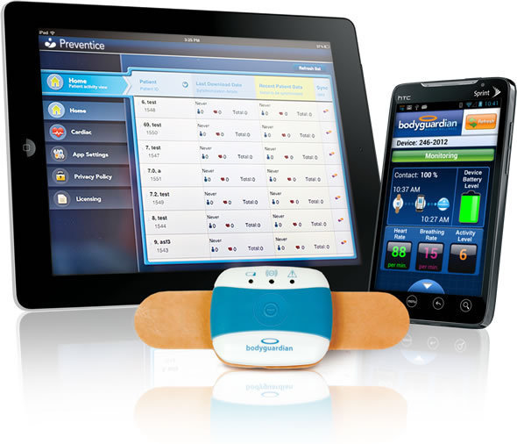
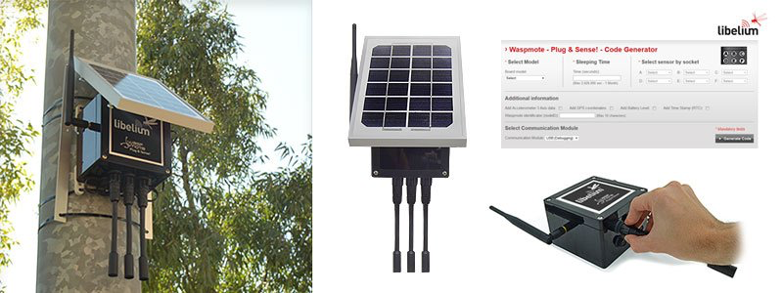
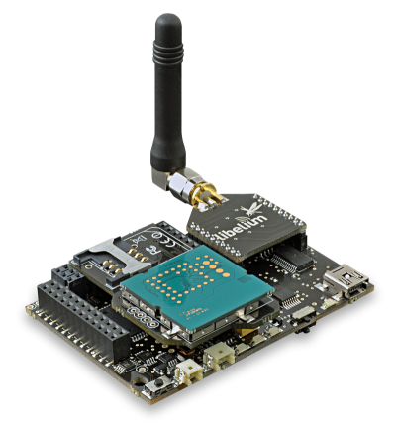
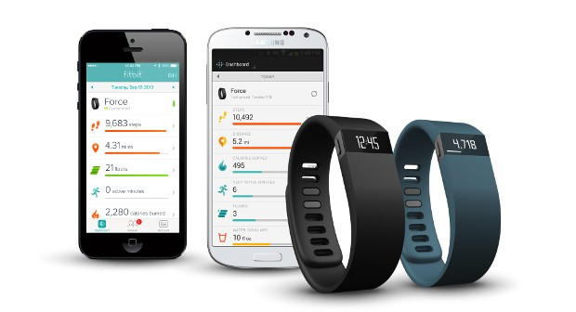
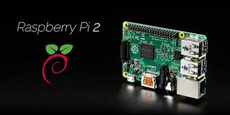
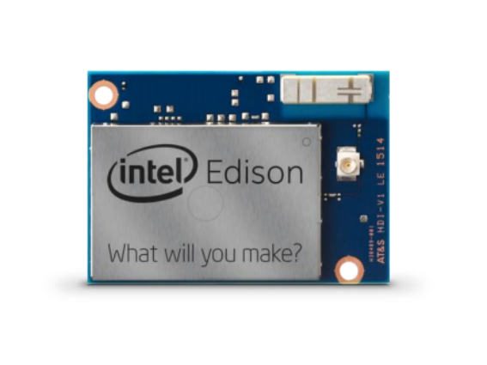
Device/Data interoperability
The slide adapted from the IoT talk given by Jan Holler of Ericsson at IoT Week 2015 in Lisbon.

Slide 43
System models, Applications and Standards
Applications: Smart City, Smart Living, Healthcare, Smart Grid, Smart Agriculture, Smart Farming, Wearables, Environment, Smart Manufacturing, etc.
Physical-Cyber-Social Systems
Machine-to-machine communications
System models and Standards

Slide 44
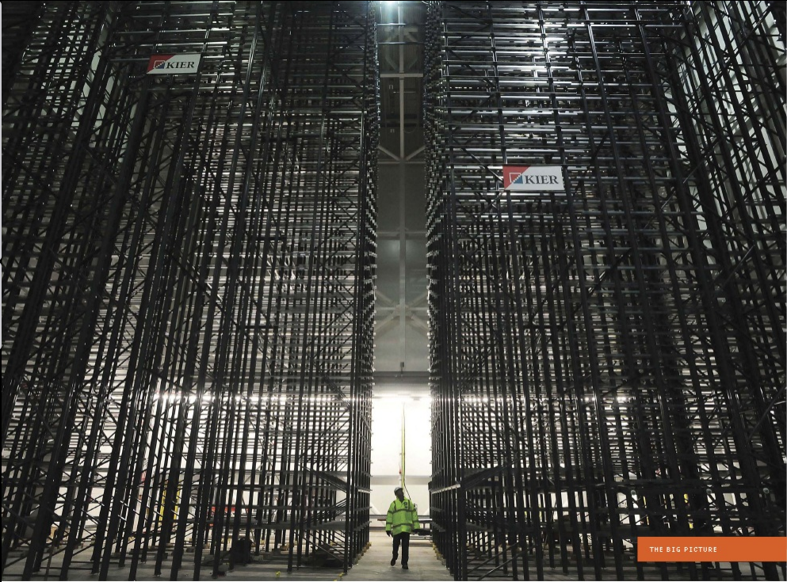
Image courtesy: IEEE Spectrum

