Slide 1
ICT PROJECT MANAGEMENT
Review and Comparative assessment of PRINCE2, PMBOK, PM²
Lilit Yenokyan
4/2/2019
Modified by M Tsiknakis

Slide 2

WHAT IS THE PROJECT MANAGEMENT?
Achieve all goals within given constraints:
Time
Cost
Scope
The manager’s job includes:
Having a clear vision
Organizing and controlling the procedures
Creating happy and motivated teams
Delivering success
Making clients satisfied and happy

Slide 3
PRINCE2, PMBOK, PM²
Let’s discuss these in details

Slide 4

PRINCE2
PRojects IN Controlled Environments
Developed by UK Government
Used in UK, Australia, Western Europe

Slide 5
The 7s of PRINCE2
7 principles
Continued business justification
Learn from experience
Define roles and responsibilities
Manage by stages
Manage by exception
Focus on products
Tailor to suit the project environment
7 processes
Starting up a Project
Initiating a Project
Directing a Project
Controlling a Stage
Managing a Stage Boundary
Managing Product Delivery
Closing a Project
7 themes
Business Case
Organisation
Quality
Plans
Risk
Change
Progress
https://prince2.wiki/principles/manage-by-exception/

Slide 6
Core Principle: Manage by Exception
https://prince2.wiki/principles/manage-by-exception/
As it is important that you understand it, I will start a simple explanation and then give you the PRINCE2 definition.
When it comes to factors like time, cost, and scope, the Project Manager has some tolerance to play with before he/she has to advise the Project Board that there is or might be a problem (e.g., costs could change ±10%).
If the problem is small and it remains within the tolerances (e.g. the costs increase by 2% – less than the 10% tolerance), then the Project Manager can deal with it and doesn’t have to alert the Project Board and take up their time.

Slide 7
Core Principle: Manage by Exception
The PRINCE2 definition for Manage by Exception is as follows: A PRINCE2 project has defined tolerances for each project objective to establish limits of delegated authority.
PRINCE2 lists 6 tolerances that can be set. These are:
  Time
  Cost
  Quality
  Scope
  Risk
  Benefit

Slide 8
Core Principle: Manage by Exception -examples
Tolerance Quality: You are creating a new GSM (a common name used to refer to a mobile telephone in Europe) and you want the keyboard to work for an average user for 7 years but you have a tolerance of ±5%.
Tolerance Scope: The requirements for a new GSM will have mandatory requirements plus ‘nice to have’ requirements. So the project can decide which ‘nice to have’ requirements to include, but must include the mandatory requirements.
Tolerance Benefit: A Benefit is a measurable improvement resulting from the project for one or more of the stakeholders. For example, increase marketing share by 5%, or create a new profitable market segment. One question asked throughout the project is: “Is the project still on track to meet the expected benefits?”
Tolerance Risk: Again, we’ll use the example of the GSM. Example: You find out that the risk is now very high - that one of the providers cannot supply a 5 megapixel camera with the correct integration specifications. This can cause many issues for your project.
To summarize: Manage by Exception provides the above management layer with a system to manage and control the lower management layer, and they don’t need to be bothered by each small issue.

Slide 9
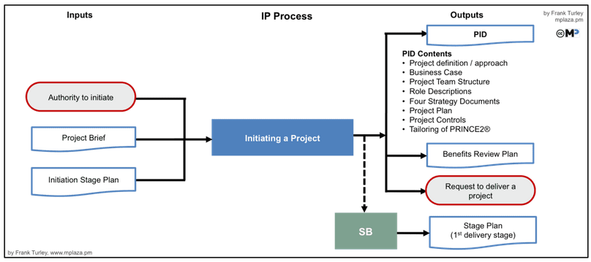
Process - Initiating a Project
Inputs
Things to be done
Outputs
Project Initiating Document

Slide 10
Process - Initiating a Project
Inputs
  The Trigger is the “Authority to Initiate the Project” which comes from the Project Board.
  The Project Brief comes from the SU process. The information in the Project Brief is expanded and refined and it will become part of the Project Initiation Documentation.
  The Initiation Stage Plan comes from the Starting up a Project process.

Slide 11
Things to be done
PRINCE2 recommends eight activities in the Initiating a Project, which are:
  Preparing the Risk Management Approach, which will answer how to manage risk during the project.
  Preparing the Change Control Approach, which will give information on how to manage the products produced during the project.
  Preparing the Quality Management Approach , which will answer the question on how to ensure quality.
  Preparing the Communication Management Approach, which will answer questions related to communication with stakeholders.
  Setup of Project Controls, which will provide information on how the Project Board can control the project.
  Creating the Project Plan, which covers Product Descriptions, risks, timescales and costs.
  Refining the Business Case.
  Lastly, assembling the Project Initiation Documentation (PID), which is to collect and assemble information from most of the documents created to date.

Slide 12
Outputs
The four management strategy documents:
  Quality Management Approach
  Change Control Approach
  Risk Management Approach
  Communication Management Approach
The Project Management Team Structure and Roles Descriptions (part of Project Initiation Documentation ).
The Project Plan is a plan for the whole project created which includes all Product Descriptions (part of PID).
The Business Case is the responsibility of the Executive and provides the information to justify the project. The Project Manager will most likely assist the Executive (part of PID). The Project Initiation Documentation forms a contract between the Project Manager and the Project Board.
An overview of how the project will be controlled (part of PID).
The Benefits Management Approach is an overview of what and when Benefits will be realized both during and after the project, and who (Senior User) is responsible for these benefits
Request to deliver a project: The final output of the Initiating a Project process is a request to the Project Board to deliver the project or, in other words, to sign off on the PID and allow the project to continue.

Slide 13

PMBOK
Created and published by the Project Management Institute
Project Management Body of Knowledge
Mostly used:
United States
Canada
the Middle East
Australia.

Slide 14
PMBOK is not a methodology, it is a guide!
5 basic process groups
Initiating
Planing
Executing
Monitoring and Controlling
Closing
10 knowledge areas
Integration,
Scope
Time
Cost
Quality
Human Resource
Communications
Risk
Procurement
Stakeholder.
47 processes
Integration.
Scope.
Schedule.
Cost.
Quality.
Resource.
Communications.
Project Risk
….

Slide 15

PM²
Developed by the European Commission
based on many other well-known PM methodologies like PRINCE2, IPMA and Agile Alliance

Slide 16
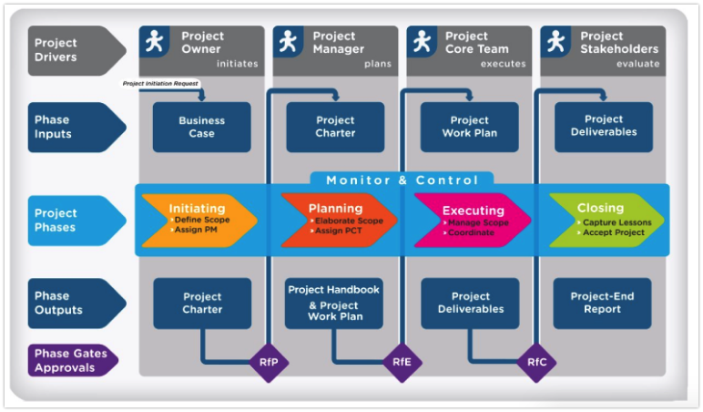

Slide 17
LET’S REVIEW
PM2 was built on the model of many known project management methodologies which include PMBOK and PRINCE2
All three pay much attention to risk, cost and scope management, and quality control.
PRINCE2 is a product-based methodology
PMBOK is based on knowledge and is process-based similar to PM2
Perform the implementation of the project using any methodology like PRINCE2 and continuously referring to PMBOK as a source of knowledge and a guideline.
PRINCE2 does not define the interpersonal and soft skills while PMBOK emphasizes it a lot
PMBOK is more descriptive, and PRINCE2 is more prescriptive.

Slide 18


THANKS!
Any questions?

