Slide 1
Distributed Systems Structural Models
Papadakis Harris
Dept. of Engineering Informatics
ΤΕΙ of Crete

Slide 2
Client/Server Paradigm
Basic idea: to structure the system as a set of collaborating processes
Servers (or servers) that offer their services
E.g. file system service, database service
Customers who are consumers of the services
A client-server system is a system in which the network connects various resources
Thus, clients (or front end) can request services from a server (or back end) that offers information or additional computing power

Slide 3
Client/Server Paradigm
The model is usually based on a simple request / reply protocol,
The client sends an application request asking the server for a service
The server performs the service and returns the requested data or an error message
In other words, in the client-server model, the client places an requests and the server returns a response and/or makes a series of actions
The server can be activated immediately for this request or add the request to a queue

Slide 4
Client/Server Paradigm

Slide 5
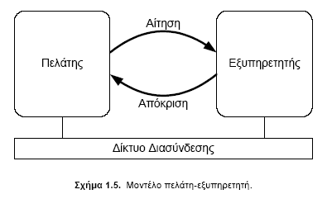
Client/Server Paradigm

Slide 6
Client/Server Paradigm
Server types can include the following:
Application servers
Data servers
Compute servers
Database servers
Resource or Communications servers
…
Transaction servers (combine the functions of the database server and application server)

Slide 7
Client/Server Paradigm
Advantages
The server provides centralized control of shared resources
Since the client communicates with the server via a defined interface system, it does not need to know the server or how it works
Security
Simplicity
Disadvantages
Robustness
Scalability

Slide 8
Three Tier C/S Model
The distinction between customers and servers is often unclear
For example, a database server may also be a client of a file server in which database tables are stored, acting as intermediaries between base clients and file servers
The database server provides processing of primary data to meet customer requests
In practice, the three-level customer and server organization is the most common in distributed database management systems (which is a common application)
The first level provides the user interface,
The second is the processing of data (data processing)
The third is the storage of data (data storage)

Slide 9
Three Tier C/S Model
The interface tier
has a pure client role and contains applications that allows users to interact with the application and the database
The complexity of this level may vary considerably
In the simplest case, the interface simulates a text terminal, this level being limited to tasks such as editing
The most common case is to support a graphical interface with windows, menus and dialog boxes
The application handles the screen and the user input devices (mouse and keyboard) and communicates with the next level only to send the user's queries and to display the data returned from the base

Slide 10
Three Tier C/S Model
The processing tier
provides a bridge between the user interface and the data storage, which can be provided by file servers or database servers
The tasks of the processing layer depend on the implemented application, but its purpose is to derive data from general purpose information systems and process them to meet the requirements of the application
The utility of distinguishing storage and processing roles lies in the fact that data can be used in different ways
For example, search meta-engines provide a new level of processing that converts user questions into queries to multiple search engines, evaluates results, and returns a more complex site to the user

Slide 11
Three Tier C/S Model
The storage tier
It has a pure server role, since it contains the applications that manage the data that the user finally accesses
This level is independent of the processing level, in the sense that the data stored is available even when the processing application is not used
So that the same level of storage can be used with many different processing levels, which is very common in practice
The storage level can be either a file system or an integrated database

Slide 12
Three Tier C/S Model
The storage tier
The data tier is generally also responsible for maintaining the consistency of data in relation to different applications
The data is organized independently of the applications, in such a way that the changes in this organization do not affect the applications, nor do the applications affect the organization of the data
In those cases where the functions in the data are more readily expressed by object manipulations, it is logical for the data layer to be implemented with an object-oriented database
Such a database contains the implementation of the functions that can be performed on these objects
Therefore, some of the functionalities that are at the processing level are now being moved to the data layer

Slide 13
Three Tier C/S Model
The classic client-server model is made up of two logical entities, one for each role, usually located on different machines
A customer machine
A server machine
The simplest architecture is to keep only the client interface level and transfer to the server the processing and storage levels
The problem of this way of organizing is that it is not really distributed

Slide 14
Multi-Tier architectures
Physically two-tiered architecture
When this model expands to three logical levels, the division of levels into machines can be done in various ways
One solution is to divide the interface layer between the client and the server so that the terminal control is done to the client but the data presentation and the application control are controlled by the server
So the client is completely standardized, regardless of the applications, since they are actually implemented on the server
For example, it may be a browser, so applications do not require additional installation, management, and maintenance actions

Slide 15
Multi-Tier architectures

Slide 16
Multi-Tier architectures
Moving in the opposite direction, we can transfer part of the processing to the customer
In order to control the input and some processing of the results locally without involving the server
For example, the client can check the validity of the input data in date fields
We can go further, transferring part and the storage level to the customer
For example, a browser will gradually create a local disk base with web pages from the Internet to speed up browsing, basically taking part of the storage layer through the local base

Slide 17
Multi-Tier architectures
Physically three-tiered architecture
The server can also act as a client
Programs that are part of the processing layer are located on a separate server, but there is also the option of being partly distributed among the client and server machines
Example: transaction processing
A separate process called a transaction controller coordinates all transactions on potentially different data servers

Slide 18
Multi-Tier architectures

Slide 19
Additional Distribution
In a distributed large scale system, apart from the fact that applications can be distributed on the logical levels (interface, processing and storage), the processing and storage levels themselves can be further distributed
Vertical distribution
The allocation of different logical tasks to different machines, like in three-tier models

Slide 20
Additional Distribution
Multiple machines participate in the operation of a single tier
For instance, a distributed database serving as the storage tier
Horizontal distribution
Customers can also be distributed
Collaborative applications may not have a single server
Then we talk about peer-to-peer distribution
Customers perform the same application to start a session
Later a third customer can contact either of them, and then also start the same application software

Slide 21
Additional Distribution

Slide 22
P2P Paradigm
Complete decentralization
No special purpose components (i.e: servers)
Main types of P2P Systems
Unstructured
Structured

Slide 23
P2P Paradigm
Advantages
Robustness
Scalability
Self-organizing
Disadvantages
Security
Scalability

Slide 24
Unstructured P2P Systems
Gnutella
Random graph
Highly-robust
Flood-based resource location
Inefficient traffic load due to
Duplicate messages
Topology mismatch

Slide 25
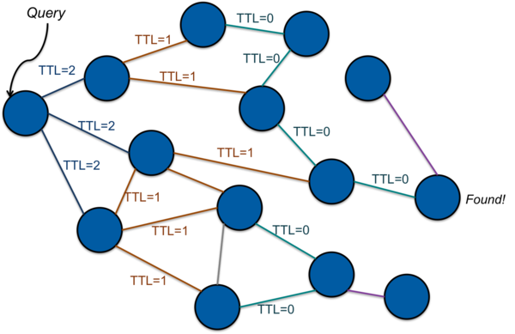
Unstructured P2P Systems
Flooding

Slide 26
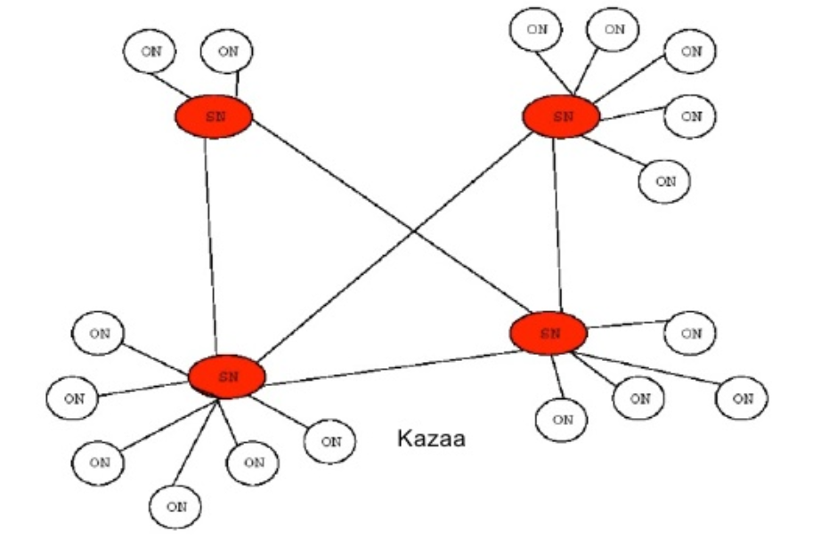
Improvements
Dynamic Querying
SuperNodes

Slide 27
Structured P2P Systems
Based on Distributed Hash Tables
In order to avoid blind search
Insert <key,value> pairs
Data (value) assigned a key from a uniform hash function
Nodes also assigned a key from a uniform hash function
Each node stores data whose key is closest to its own
More organized topology
More efficient lookup
Less robust
More attack-prone

Slide 28
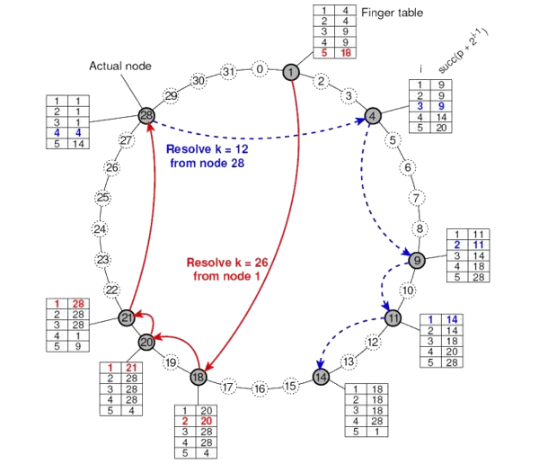
Structured P2P Systems
Chord

Slide 29
Structured P2P Systems
Churn
The continuous process of node arrival and departure in DHTs.
One metric of churn is session time-time between when a node joins the network until the next time it leaves. Also consider lifetime and availability.
Even temporary loss of routing neighbor weakens the correctness (consistency) and performance of DHTs.
Unavailability of neighbors reduce a node’s effective connectivity, forcing it to choose suboptimal routes and increasing the failures.

Slide 30
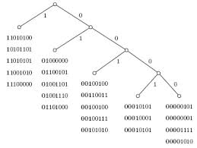
Structured P2P Systems
Kademlia
Based on Hamming distance
Allows for more versatility and thus robustness

