Slide 1
Blending work and fun to assure international education for all
Nuno Escudeiro nfe@isep.ipp.pt

Slide 2
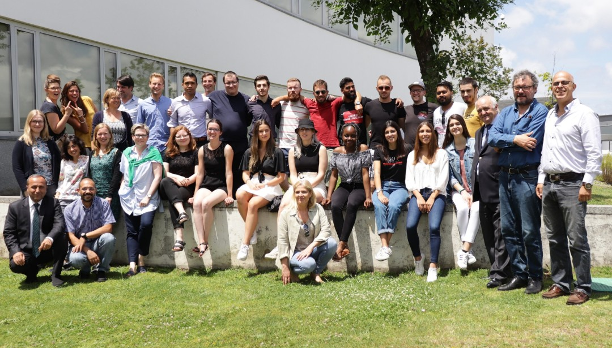
Blended Mobility to build bridges!

Slide 3
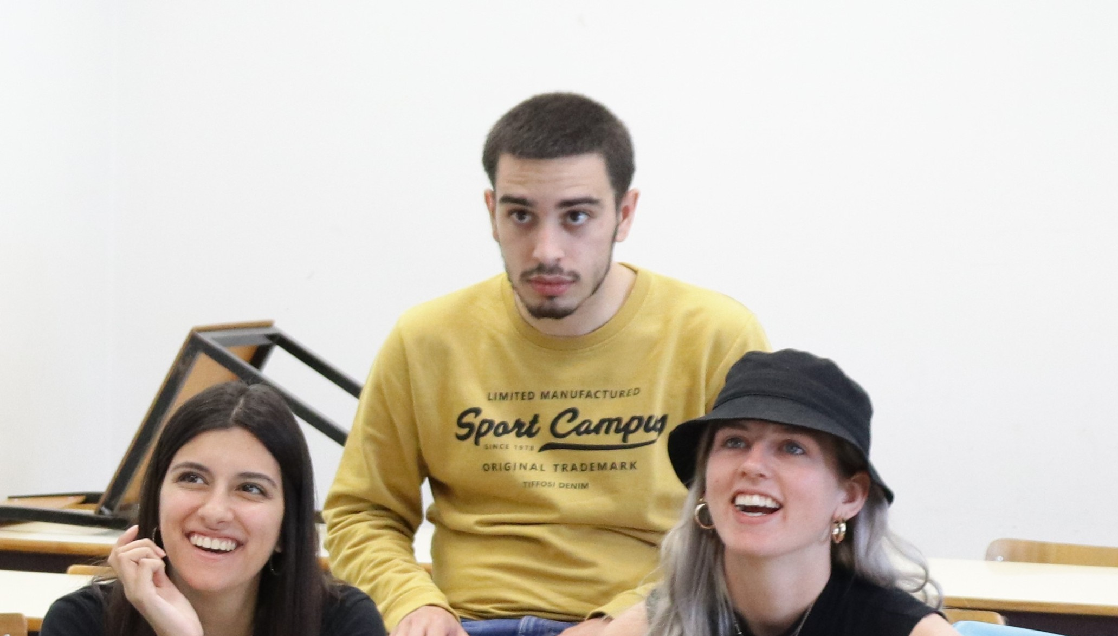
“A well-established model to enhance education, cultural awareness & employability
Interdisciplinary international student teams
are working together,
both physically and virtually,
for a period of 4-5 months
in collaboration with startup founders
as real clients in the field.
The projects focus on developing a
working proof-of-concept for a challenge from a company,
including a Marketing & Business Plan.

Slide 4
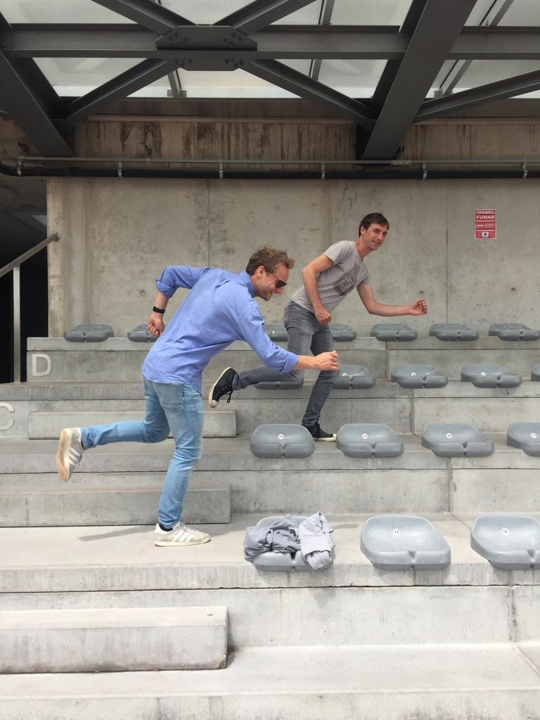
ADVANTAGES FOR STUDENTS
Develop & enhance your personal and professional competences
Work in an exciting multicultural, multidisciplinary environment
Get experience in working within a remote team
Gain international contacts, partnerships and strengthen your international network
Promote teamwork and communication skills in international context
Find your talent
Boost your employability
Overcome international mobility barriers

Slide 5
Blended-AIM path
Export
Capacity building
Export concept to EU neighbors
Exporting the concept
Inception
Co-financing EU
LLP Multilateral Erasmus
MUTW
EU countries
IT, software development, academic projects
Growing
Own funding
EU countries + Russia
Multidisciplinary (IT, Digital Arts, Management, Marketing)
Client company from 2013/14
Maturity
Co-financing EU
Erasmus+ Strategic partnership
Blended/AIM
Support companies developing innovative ideas at low cost, low cost proof of concept, Middle-East interest
Network
Service for incubators, startups and R&D
Ad-hoc International and multidisciplinary teams of students
IT, academic project
Multidisciplinary
Client company
Moving outside EU
Startups niche
2009/10
2010/11
2011/12
2012/13
2013/14
2014/15
2015/16
2016/17
2017/18
2018/19
1
2
3
4
5
6
ATHENA European University

Slide 6
BlendEd in a nutshell

Slide 7
Blended-AIM project course

Slide 8
Blended-AIM project course
MUTW – Multinational Undergraduate Team Work
MUTW – Me and U Together Win

Slide 9
Blended-AIM team
Instituto Politécnico do Porto, Portugal
Universität Siegen, Germany
Odisee Technologiecampus - Ghent, Belgium
LUCA School of Arts, Belgium
Glasgow Caledonian University, United Kingdom
Hellenic Mediterranean University, Greece
University of Human Develpment, Iraq
University of Maribor, Slovenia
University Institute of Maia, Portugal
Federal University of Technology Minna, Nigeria
Rhine-Waal University of Applied Sciences, Germany
Trier University of Applied Sciences, Germany
AP University of Applied Sciences and Arts Antwerp, Belgium
Vilnius Gediminas Technical University, Lithuania
Università degli Studi Niccolò Cusano, Italy
University of Orléans, France
University of Vigo, Spain
Maria Curie-Skłodowska University, Poland
IMEC–iStart, imec’s business accelerator, Belgium
EO4GEO, Geospatial Data Sector Skills Alliance, Italy
OVO - SusTech4Africa, Belgium
KU, Germany
FHJ, Austria
UI, Iceland
VSTU, Russia
TUS, Bulgary
UV, Spain
VTU, Bulgary
EU, Turkey
UPB, Germany
MP, Germany
GISIG, Italy
Evolaris, Austria
Trilogis, Italy
UWS, Germany
EAEC, Cyprus
EACG, Cyprus
12 startups, Belgium.

Slide 10
Course plan in three stages
A - PREPARATION
New edition organization (September)
Call for challenges (Praxis platform, companies, October)
Select challenges according to learning outcomes and available competences
Invite students (November till December)
Select students (December, January)
Invite supervisor teachers
Create teams
Kick-off logistics (prep phase, f2f meeting, travel and accommodation, January).
B - DEVELOPMENT
Launch the course edition (early February)
Preparatory phase (2 weeks before kick-off): team website (who we are), cultural stereotypes
Kick-off meeting (physical, 5 working days, end of February): team building, know the client and the challenge, know the team, know the ECTS-budget, organize work and tools, seminars / workshops (agile development, intercultural team work, ...), pitch and discuss proposal with the client, peer evaluation round 1
Team work at a distance, at home institution (virtual): regular meetings online, groupware platforms, distributed development environment
Peer evaluation round 2 (mid-term, April)
Closing logistics (closing f2f meeting, travel and accommodation, March/April).
C - CLOSURE
Closing meeting (physical, 5 working days, end of June): finalize deliverables (product, business plan, marketing campaign, ...), pitch and discussion with teachers and client representatives, peer evaluation round 3, assessment, give grades
Course edition debriefing: things to improve, preliminary organization of next edition
Final dinner.

Slide 11
Course plan in three stages
A - PREPARATION
New edition organization (September)
Call for challenges (Praxis platform, companies, October)
Select challenges according to learning outcomes and available competences
Invite students (November till December)
Select students (December, January)
Invite supervisor teachers
Create teams
Kick-off logistics (prep phase, f2f meeting, travel and accommodation, January).
B - DEVELOPMENT
Launch the course edition (early February)
Preparatory phase (2 weeks before kick-off): team website (who we are), cultural stereotypes
Kick-off meeting (physical, 5 working days, end of February): team building, know the client and the challenge, know the team, know the ECTS-budget, organize work and tools, seminars / workshops (agile development, intercultural team work, ...), pitch and discuss proposal with the client, peer evaluation round 1
Team work at a distance, at home institution (virtual): regular meetings online, groupware platforms, distributed development environment
Peer evaluation round 2 (mid-term, April)
Closing logistics (closing f2f meeting, travel and accommodation, March/April).
C - CLOSURE
Closing meeting (physical, 5 working days, end of June): finalize deliverables (product, business plan, marketing campaign, ...), pitch and discussion with teachers and client representatives, peer evaluation round 3, assessment, give grades
Course edition debriefing: things to improve, preliminary organization of next edition
Final dinner.
2022-2023
Setup phase from 7Feb23 to 12Feb23
Kick-off meeting (Orléans, France) 13Feb23 to 17Feb23
Midterm meeting (online) 10Apr23
Closing meeting (Rome, Italy) 26Jun23 to 30Jun23

Slide 12
2022-23 projects
Notes:
Today, our mid-term ambition is to have a consortium of 50, 60 universities running the course with the teams of students being dynamically created depending on students’ particular interest and the available challenges submitted by companies to a centralized pool.
You are all very welcome to join us developing further this exciting paradigm.
Take a deeper look online at blendedmobility.com or search for blended mobility at the Wikipedia.
Thank you for your attention!

Slide 13
2022-23 projects
Internationalisation & scaling
YEATapp, Belgium
Virtual Reality and Performance
Université d'Orléans UFR Sciences et Techniques, CIAMS Research Lab, France
Digital marketing platform for real estate projects
MEFA S.A., Germany
European Students Space
UBIGREAT, Belgium
Farm IT – smart farm management IT system
Casal da Cotovia + INIAV, Portugal

Slide 14
2022-23 projects
Internationalisation & scaling: Launch YEAT in Europe, in the countries were we are not active yet. Set out the complete plan, and make sure all devisions are covered. Also, pay attention to user preferences in each country where we maybe need to adapt the app.
Develop a full automated admission for a restaurant owner, so a Yeat-employee does not need to interveen.
YEATapp is a mobile application that informs you via an instant notification when a last-minute table is available in a highly recommended restaurant. Download YEAT, favorite your restaurants, get notified, book in the app and enjoy your lunch or dinner, https://yeatapp.com

Slide 15
2022-23 projects
Virtual Reality and Performance: develop a tool using virtual reality for the purpose of evaluating performance and training skills (motor and/or cognitive).
Université d'Orléans UFR Sciences et Techniques pôle STAPS, the CIAMS research laboratory is a public laboratory which aims to develop research projects in the field of motricity with a view to performance or health https://www.univ-orleans.fr/fr/sciences-techniques

Slide 16
2022-23 projects
Digital marketing platform for real estate projects: create a platform that can be integrated into existing or to-be-designed websites and therefore seamlessly integrated into existing communication processes. For each client, a separate frontend is to be created for each building project, which will then offer in detail all planned residential units that are to be marketed in the respective building project. Interested parties can view detailed plans, floor plans, schedules, equipment details, contract conditions, pictures of the construction process, etc.
MEFA S.A. is an agency for strategic communication with a team of specialists from design, digital, communication, live & strategy, www.mefa-agentur.com

Slide 17
2022-23 projects
European Students Space: B2B2C: an environment where companies (brands, enterprises, associations, ...) set up their own 'space' or environment in which they activate their 'audience' and let them connect with each other to strengthen the brand identity. In B2B2C, we are in the process of launching pilot projects in certain sectors or fields of interest. There is no pilot project in the pipeline for European Students (Erasmus).
UBIGREAT is a global social network where people are dropped into various communities based on interests, where they can chat or connect with like-minded people, https://unblnd.com

Slide 18
2022-23 projects
FarmIT – smart farm management IT system: Develop a low-cost digital assistant to farmers looking to be more sustainable and ethical. Develop an integrated system able to manage the use of water, watering, and fertigation. Providing visual maps of the farm with production, amount of water and fertilizers used,
Casal da Cotovia is family-owned grower of blueberries operating 100% under organic agriculture principles and certifications. It has a strong compromise with sustainability: environmental, social, and economical.
INIAV is the State Laboratory, in the area of competences of Agriculture, Forestry and Rural Development, which develops research activities in the agronomic and veterinary areas, https://www.iniav.pt/

Slide 19
What’s next?
Notes:
Today, our mid-term ambition is to have a consortium of 50, 60 universities running the course with the teams of students being dynamically created depending on students’ particular interest and the available challenges submitted by companies to a centralized pool.
You are all very welcome to join us developing further this exciting paradigm.
Take a deeper look online at blendedmobility.com or search for blended mobility at the Wikipedia.
Thank you for your attention!

Slide 20
Education at a truly European dimension
Check the projects, check the tools
BlendEd http://blendedmobility.com/en
Praxis www.praxisnetwork.eu – search for blended
ATHENA https://athena-uni.eu/ .

Slide 21
We have the resources to welcome you
Student’s kit and checklist
http://blendedmobility.com/en/download-toolkit
Wikipedia
http://blendedmobility.com/en/blended-mobility-wikipedia
MUTW white book
https://www.amazon.com/Multinational-Undergraduate-Team-Work-International/dp/1607509830
In vídeo
https://www.youtube.com/watch?v=czbJze0U0Sg&t=6s, 2019
https://www.youtube.com/watch?v=pH7-70Z1zkk, 2017
https://www.youtube.com/watch?v=Tlx2Mi-ejGw, 2011
BlendEd website
http://www.blendedmobility.com/en
Join the consortium
http://blendedmobility.com/en/apply-as-institution
Contact us at
http://blendedmobility.com/en/contact
Or by email to nfe@isep.ipp.pt

Slide 22
Until 23rd December 2022
Education at a truly European dimension
Apply
By email to Nuno Escudeiro – nfe@isep.ipp.pt
… or to your teachers

Slide 23
Thank you! Give it a try nfe@isep.ipp.pt

