Slide 1
Distributed Systems and Applications Introduction
Papadakis Harris
Dept. of Engineering Informatics
ΤΕΙ of Crete

Slide 2
Distributed Systems- Contents
Definition
Parallel Processing
Distributed Computin
Clusters
Examples
Design Principles
General Requirements
Specific Requirements

Slide 3
Distributed Systems
Two developments in technology have allowed the emergence of DS
More powerful microprocessors
High Speed Data Networks (LANs, WANs)
Today it is possible to connect a large number computers through fast networks
Multi-processor connectivity
Instead, there were centralized (centralized) systems in the past, which consisted of a central computer, peripherals and maybe some terminals

Slide 4
Definition
Distributed system is:
"A set of independent computers presented to users as a logical system"
The definition refers to both h / w and s / w.
Differences between computers or the way they communicate does not concern users
Users use the system in a consistent and uniform way
"You know you have a distributed system when the malfunction of an unknown system does not allow you to do your job" Lamport

Slide 5
Middleware
In order to support different kinds of computers and networks while offering a uniform picture to end users, DSs usually include a special software level, called middleware.
This software is logically placed between a higher level consisting of users and applications and a lower level consisting of operating systems

Slide 6
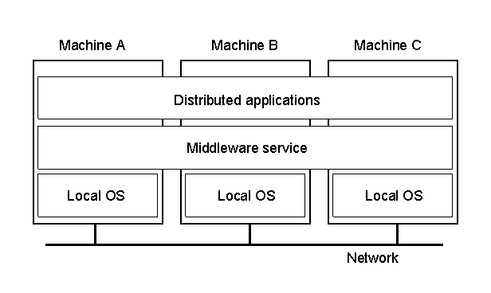
Middleware
Παράδειγμα ΚΣ οργανωμένου σαν middleware, το επίπεδο του οποίου καλύπτει πολλά υπολογιστικά συστήματα

Slide 7
DS Examples
World Wide Web
P2P Systems
Electronic banking
DNS
Sensor Networks
Today, almost everything…

Slide 8
Parallel Processing
Parallel processing is an extensive field in computer architecture
It aims at improving processing speed without being based on improving hardware technology
Generally speaking, a computer is considered parallel if it consists of several processing units that work closely together to solve the same problem in less time than a processor would need to solve the same problem.
These processors are said to be tightly coupled
Over the last decade the theory of parallel processing has begun to bear fruit
The first commercial parallel computer systems with dual or quad-core Pentium processors appeared at a cost so small that they could be used by a not very large business or even by a private individuals at home
Parallel processing has now begun in the so-called "desktop computing", ie desktop computers

Slide 9
Παράλληλη Επεξεργασία
Parallel processing requires close collaboration between processors and their feature is that they solve a common problem
The goal of collaboration is to accelerate work and deliver greater performance
For these reasons, parallel computers consist of processors that are very close to one another, not just in the same room or in the same box, but often on the same card
The aim is to minimize the communication time between them and therefore the interconnection network typically has a very high speed
In some cases, processors are specifically designed to solve a specific problem or a class of similar problems (e.g., multiplying tables, basic image processing algorithms)
These computers are called special purpose and are in contrast to general purpose computers that, as their name suggests, are designed to run any application

Slide 10
Grid Computing
Another innovation in recent years is the rapid growth of networks and the relatively inexpensive creation of ultra-fast standardized local or even wide-area networks.
Examples are GigaBit Ethernet, ATM, and WDM
The spread of such networks enabled the development of a new computational model where many simple desktop computers are connected through the fast network can function as a large, virtual parallel machine
This technology is known as "grid-computing", while clusters of such computers are called “clusters”
This technology is a bridge between parallel and distributed technology

Slide 11
Distributed Computing
Distributed editing resembles parallel processing in many points
First of all, as with parallel processing, we have many computers that communicate with each other and exchange information, working together on the same goal
In contrast to parallel processing, however, the distances between computers are often very large and for reasons of economy and distance reasons they are connected to each other by networks with limited speed (eg modem, ISDN, ATM, FDDI, etc.)
Local computers of a distributed system are largely independent and need to communicate less often than the processors of a parallel system
These computers are said to be loosely coupled (loosely coupled)
Although speed is a criterion for evaluating a distributed system as well as a parallel system, there are some more important criteria in the performance of distributed systems

Slide 12
Clusters
Cluster
a group of computers interconnected through a standard high-speed network to work together to solve a specific problem
Often the building materials of a cluster are simple office computers like those that can be bought at cheap price and without specific features
What gives value to the cluster is the communication between these computational nodes through a local or wide-area ultra-fast network

Slide 13
Clusters
In recent (ie: 15 :P) years, the development of very fast networks, such as GB Ethernet, ATM, and WDM, has facilitated the development of clusters and has led to the creation of a gray zone between parallel and distributed processing
Indeed, the main difference between parallel and distributed processing is the frequency and amount of communication exchanged between the nodes
In the parallel processing we have a close cooperation through dense communication, while in the distributed processing the cooperation is relaxed and the communication less
With this technology we can use a standardized network designed primarily for distributed processing so that we achieve close cooperation between the nodes through the given wide bandwidth of communication, essentially simulating the operation of a large parallel computer

Slide 14
Clusters
The first obvious advantage is cost-related
Instead of buying a very expensive parallel system, one can buy many cheap computers and connect them to a cost-effective network
Overall, the cost is smaller and the system is easily expandable
Another advantage of clusters is ease of error isolation and correction
If a computer is damaged it is repaired or replaced by buying a new one

Slide 15
Clusters
Typically, a classic parallel computer is offered with closed architecture while its software depends on the particular company and its specific hardware architecture
In the case of clusters, open software has been developed which offers the ability to orchestrate the communication almost for an unlimited number of nodes while the user can intervene in generating parallel code using tools such as MPI (Message Passing Interface)
The basic programming model here is the Single Program Multiple Data (SPMD) corresponding to SIMD, where the same program is run by all nodes but with different data for each node
Most of the times we can easily simulate MPMD though.

Slide 16
Clusters
Disadvantages
A disadvantage of the clusters technology is that communication is through the I / O bus which is slower than the memory bus used on pure-bred parallel computers
Also in the cluster, communication is done with software as opposed to hardware-using multiprocessors
Generally, clusters are suitable for a variety of applications
Requiring a large number of processing nodes and frequent communication with each other but not having excessive bandwidth requirements so we need to resort to the multiprocessor solution
Such applications are for example databases, file servers, Web servers, complex system simulations, and so on.
The basic criteria for designing a cluster is the cost of acquiring and maintaining the hardware and software taking into account the particular application (or applications) we intend to use
Typically, scientific applications have more computational power requirements while database and concatenation processing applications have large storage requirements

Slide 17
Design Principles of DS
General requirements (Applicable to any system)
Flexibility: Easily to change or expand the system
Open Source: Multiple vendors
Performance: High processing speed
Performance metrics include response time, and degree of use of system resources
The main problems in performance are the delay in network communication and the need for synchronization of multiple machines

Slide 18
Design Principles of DS
Specific requirements (Applies specifically to distributed systems)
Transparency: image of a single system
Scalability: unlimited processor increment
Reliability: high availability, security, fault tolerance
Security is critical for users to accept their systems to participate in a distributed system, while error tolerance is also important as error sources multiply as the system grows, affecting its availability

Slide 19
Design Principles of DS
Flexibility, openness, and performance are key design goals for any system, whether distributed or not
Transparency and scaling, on the other hand, are distinctive features of distributed systems that appear repeatedly when designing them
For this reason, we will study these factors in more detail below
Finally, even though reliability is a feature which is important in any system, it becomes more important in a distributed system
If not taken into account when designing the system, it can lead to paradoxes such as an error in a single machine causing problems for the whole system

Slide 20
Goals of DS
A DS must meet the following conditions
Easily connect users and resources
Exhibits transparency
Supports Open Architecture
It is scalable
In size
Geographically
In Management

Slide 21
Connectivity
Easy for users to access remote resources
Controlled use of shared resources
e.g. printers, disks, networks
Facilitate cooperation
e.g. groupware, e-commerce
Security

Slide 22
Transparency
Hide the fact that processes and resources are remote in space
Background achievement of the image of a single system for users, hiding the dispersion of resources on different machines and the need to communicate through the network
The DS is displayed to the user as if it were a unique computer system
Hide distribution to its users

Slide 23
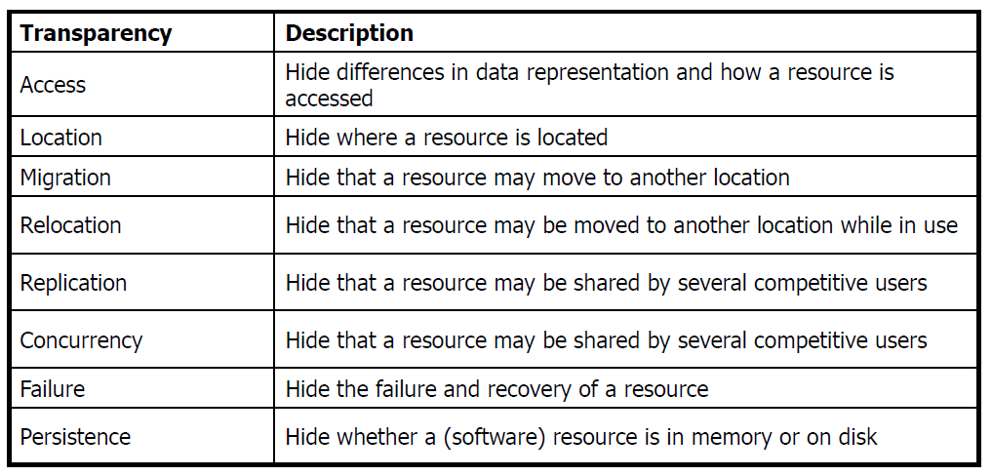
Transparency
Different forms of transparency in a distributed system

Slide 24
Transparency
Types of transparency
Access transparency: accessing resources with a unified way
It means that users can access all system resources without having to worry about incompatibilities between the various components
This means that the distributed system should provide a unified way of accessing all system resources
Location transparency: access resources without knowing their location
It means that users can access the system resources without knowing the machine that provides these resources
This means (at least) that the resource names should be logical and not encode data about resource location

Slide 25
Transparency
Types of transparency
Migration transparency : Move resources without changing access
Migration Transparency means that resources can be moved according to the needs of applications without changing the way they are accessed
This obviously implies location transparency, since otherwise it is impossible to change the position of a resource without changing the way it is accessed
Relocation transparency : Move resources while using them
Relocation transparency means that resources can be moved even when used, without changing their way of access
Relocation Transparency is a more robust form of migration transparency, and obviously requires transparency of location

Slide 26
Transparency
Types of transparency
Replication transparency: Multiple copies of resources
It means that a resource can be replicated in multiple copies to increase either availability or system performance without the number or location of the copies being visible to the resource user
This means that all copies must be accessed with the same name, which implies that location transparency is required
Concurrency transparency: parallel use of the same resource
It means that multiple users can access the same resource at the same time (or at the same time), without realizing that they are in competition and without creating data consistency problems
This usually requires the provision of distributed lock mechanisms or distributed transactions

Slide 27
Transparency
Types of transparency
Failure transparency : Hiding failures from the system
It means that failures in a part of the distributed system should not be perceived by users not involved in this part
Since the scaling of a distributed system statistically multiplies the errors that may occur to it, failure transparency is necessary to avoid generalized system operating problems due to local failures

Slide 28
Transparency
Transparency is not always feasible or easily achievable
Although transparency is always welcome in a distributed system, its achievement may cost too much
For example, if a file has been replicated in multiple copies, if all updates require updating all the copies, then updates may take too long to complete, especially if the copies are remote
In general, some physical constraints, such as communication delay (signal transmission speed) in a wide area network, can not be eliminated, so the dilemma often arises if we prefer transparency or performance
Transparency or performance
Big cost of achieving full transparency
Unable to hide inherent limitations
Trade-off between transparency and performance

Slide 29
Open Architecture
A system that provides services in accordance with predefined rules so that collaborative implementations from different manufacturers can run on different platforms
These rules describe syntax and semantics and are encoded in protocols e.g. network protocols
In DS, services are defined by interfaces / IDLs
IDLs (Interface Definition Language) help describe such protocols
Independent producers can construct different implementations of the same interfaces resulting in different components operating in exactly the same way
An appropriate interface definition must be complete and neutral.

Slide 30
Open Architecture
Interoperability
We have when two implementations of a system or system components from different manufacturers can coexist and work together as long as they both follow a common protocol
Portability
The capability of an application that has been deployed for a DS A to be executed in a different DS B but which provides the same interfaces as A
Flexibility
Ability to configure a system from different components implemented by different manufacturers or developers
The system is a collection of individual components that can be easily adapted or replaced

Slide 31
Scalability
Many definitions for scalability
A system may be variable in terms of:
Size
Add more users / resources to the system
Geography
Users / resources may be remote from each other
Management
Ease of management, even if the DS includes different organizations
Increase in size has a cost on performance
The goal is to avoid size increase to negatively impact performance, since increasing the size of a system makes it more difficult to synchronize and sysnchronize

Slide 32
Size Scalability
Size scalability: Increase of machines and users
eg, the ability to increase the number of processors from dozens, to thousands or millions
Not centralized services, data, and algorithms
There is no global information
Decisions made using only local information
Tolerance in machine failures
There is no universal clock

Slide 33
Size Scalability
Centralized server
Bottle-neck as the number of users increases
Communication overload
Storage overload
Centralized data
Communication overload
Decentralized algorithms
No machine has complete information about the overall system status
Each machine makes decisions based on information available locally
Malfunctioning of a machine does not affect the algorithm

Slide 34
Size Scalability
Size scalability requires us to abandon centralized services, data and algorithms in processor systems
Centralized services pose problems because of their inability to serve a large number of requests from the entire system without becoming bottlenecks
For example, a centralized user authentication server may be desirable in terms of security, since we need to monitor a single machine, but it is certain that it will cause problems when they users grow significantly
A similar problem is generated by centralized data, again because it can lead to congestion problems when accessing them
For example, a centralized database does not require advanced copy sync algorithms, such as a distributed database, but will become a bottleneck for multiple users

Slide 35
Size Scalability
Another disadvantage of centralized algorithms is that they require excessive communication to gather input data into a machine, and possibly to distribute the results later in the system
For example, a centralized routing algorithm can be simple to implement, but requires data collection from all system routers to work.
Thus, we prefer the distributed algorithms, ie those that satisfy the following conditions:
No process has complete system status information. This would have an excessive cost of communication
Processes need to make decisions based on local information only. Only the incomplete picture of the system status of each process can be used
The failure of a machine must not cause problems in the algorithm. Otherwise the system will become more and more unreliable as its engines grow.
We can not assume that there is a universal clock. This is due to the unpredictable delay and unreliability of communications that prevent perfect clock synchronization

Slide 36
Scalability
Geographic scalability: Increase distances
A DS that expands geographically usually presents performance problems
Geographic escalation requires tackling the inevitable problems of broadband communications, such as signal propagation delay
For example, when a machine performs a remote process call on a machine located thousands of kilometers away, it is difficult to hide the significant additional cost of the propagation delay
Modern communication
The client requesting a service becomes blocked until it gets an answer
The approach works well in LANs but not in WANs
Interactive applications have latency requirements

Slide 37
Scalability
Geographical Scaling - Troubleshooting
Replace synchronous communication with asynchronous
That is, instead of the application remaining idle until the remote process call is completed, it continues with other tasks and is interrupted when the response is returned from the server to receive it normally
This is the tactic followed by an operating system when a call to the kernel requires a long wait until the requested data is returned from one device: the process that made the call is blocked and the control is given to another ready process or to another thread of the same process
Of course, if the process that made the call needs its results to continue, it does not gain anything, and the communication method has become more complex
Resource allocation to the network
In such a way that the appropriate data are closer to the respective users
For example, a phone book database can be partitioned so that the local directory of each city is close to the city's subscribers, since users are more likely to locally search for long distance telephones
In this method, if the data has a physical partition, the only problem is to ensure that all applications are routed to the correct location in a transparent manner

Slide 38
Scalability
Geographical Scaling - Troubleshooting
Play back copies in multiple locations
If all data is needed in all locations, another solution is to replicate in multiple locations so that all or most users have a copy near them
In this case, however, there are problems of synchronizing the copies, which are intensified when more data are updated
Copies (replication)
Increases availability
Balances the load
It hides delays in communication
It leads to better performance

Slide 39
Scalability
Geographical Scaling - Troubleshooting
Caching data in cache
A variation of the playback is to store the data in the cache of the machines so that if the information already received is retrieved, it can be returned from the local cache
However, this technique introduces even greater synchronization and consistency problems than reproduction, since it can be used by any machine (and there may be millions of machines) and not just the few copies of a server
Caching
Making copies of data / services close to the client
The decision is taken by the client and not by the server
An important problem is to update the copies

Slide 40
Scalability
Management
In a DS we have many independent management areas
There are contradictions in the policies that each sector applies in terms of resource use, payments, security,
E.g. in the same domain users trust the administrator and other users
Their trust, however, is not the same for other areas
One sector must be protected from attacks from another sector

Slide 41
Scalability
Techniques to achieve scaling
Hiding delays in communication
Do something else as you expect a response from the server
Asynchronous communication
This is not possible in interactive applications
The goal is to reduce the communication burden
Messages exchange is an important metric in DSs
Some calculations instead of the server are made to the client
e.g. fill out a database form

Slide 42
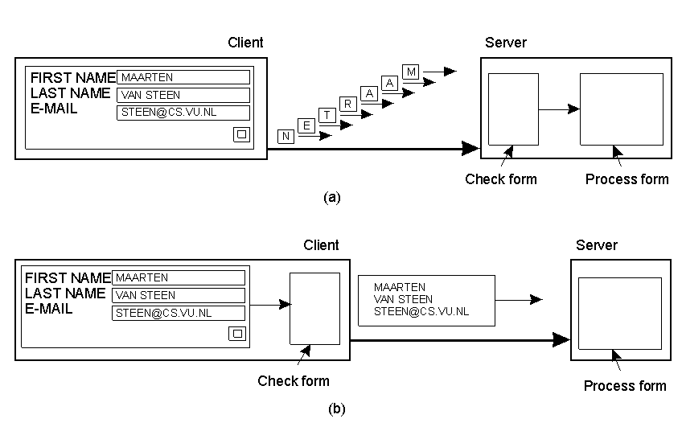
Κλιμάκωση

Slide 43
Scalability
Distribution
Divide an item into smaller pieces and distributed it across the system
e.g. DNS - Domain Name Service
Only one server is used to assign names to addresses for a single authority group
Hierarchically structured as a tree
non-overlapping domains
The names in each zone are served by a server
E.g. nl.vu.cs.flits

Slide 44
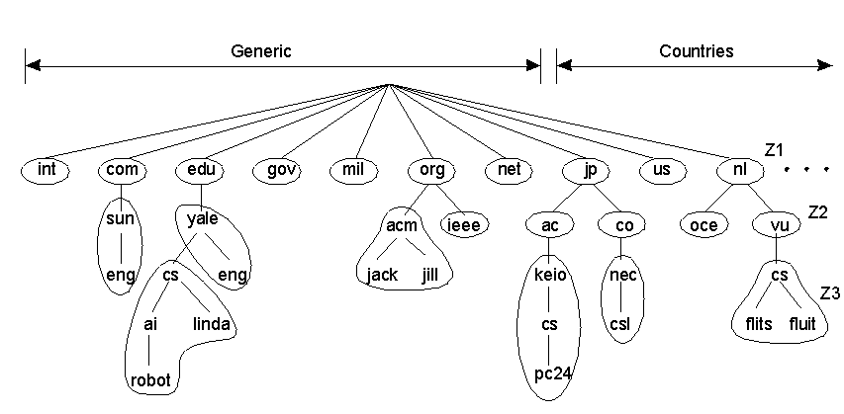
Scalability

