Slide 1
Distributed Systems Introduction to Cloud Computing
Papadakis Harris
Department of Informatics Engineering
TEI of Crete

Slide 2
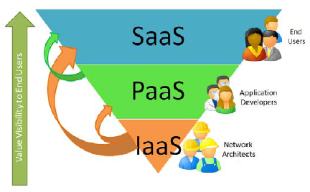
Cloud Computing Categories
Three basic services:
Software as a Service (SaaS) model. Applications through the browser
Platform as a Service (PAAS) model. Delivering a computing platform for custom software development as a service
Infrastructure as a Service (IAAS) model. Delivering IT infrastructure as a service
XaaS, the list continues to grow...

Slide 3
SaaS
It started around 1999
An application is offered to a customer as an on-demand service
Software Delivery Model:
Hosted on vendor's web servers
It goes down to the customer’s device and switches off when the on-demand contract expires.

Slide 4
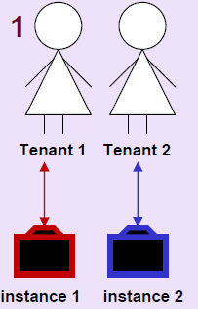
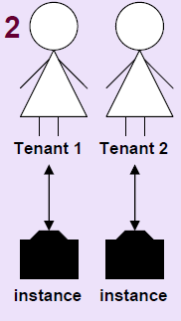
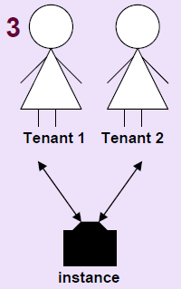
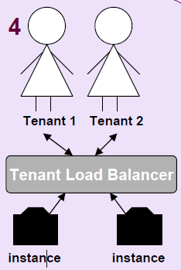
SaaS
Maturity levels
Each one has its own custom version of the app and executes its own snapshot
Customizable. Same implementation but distinct snapshots.
Co-habitation. (+): Effective resource use (-): Limits to scalability.
Load controller. (+) scalability

Slide 5
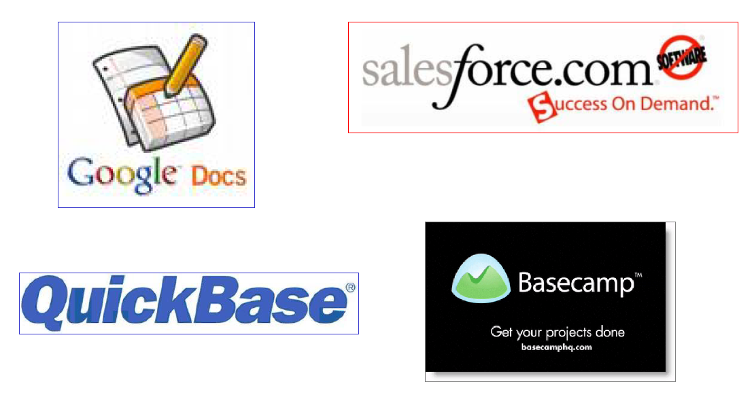
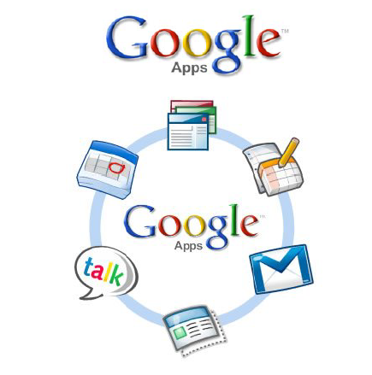
SaaS
Examples

Slide 6
PaaS
Delivering an integrated computing platform (for manufacturing / testing / deploying applications) as a service.
Deploy your applications and do not worry about purchasing and managing the underlying hardware and software layers

Slide 7
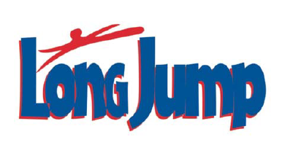
PaaS
Examples

Slide 8
IaaS
Delivering processing infrastructures (typically a virtual environment platform) as a service
Purchase resources
Servers
Software
Storage space
Network equipment

Slide 9
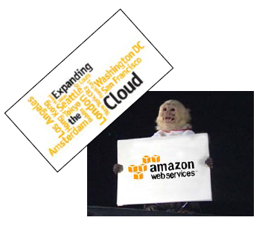
IaaS
Example

Slide 10
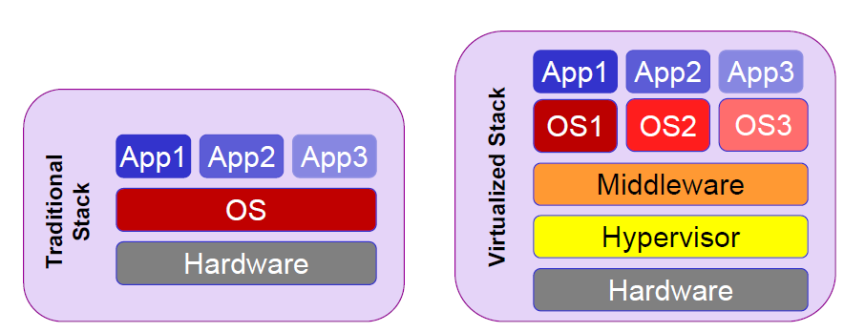
IaaS
Virtual System Technology is an important parameter for IaaS
Resource sharing: Web, storage, data, network, software and databases servers
Higher usage rates

Slide 11
IaaS

Slide 12
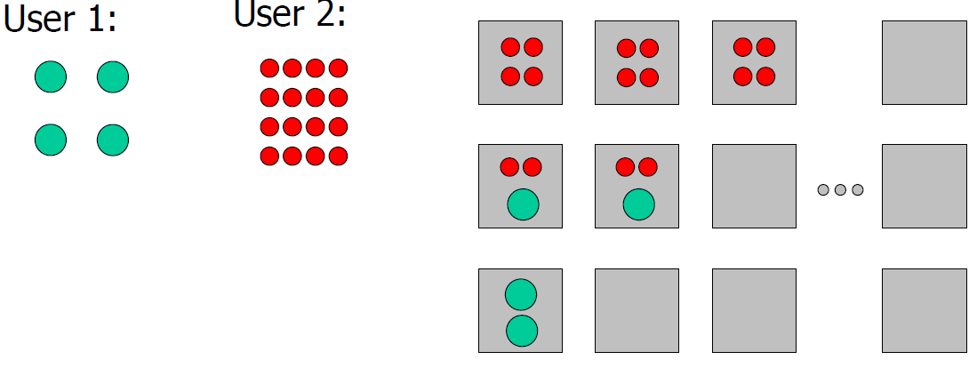
IaaS
Sharing resources
Providing computing resources as a service through:
virtualization
Dynamic provisioning

Slide 13
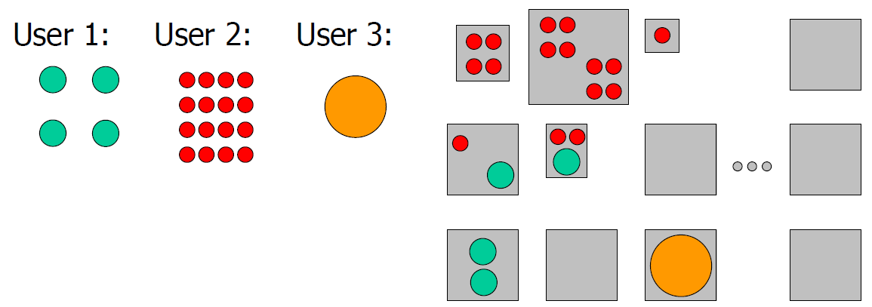
IaaS
Sharing heterogeneous resources

Slide 14
History - Evolution

Slide 15
Prerequisites Technologies
Virtualization
Web 2.0
Distributed Storage
Distributed Computing
Utility Computing
Network Bandwidth & Latency
Fault‐Tolerant Systems

Slide 16
Why do we need Cloud Computing?
Large scale big data processing applications
Flexibility
Scalability
Customized services to current needs:
Hardware
Software
Results:
Cost reduction
Reduce maintenance
High resource utilization
Greater availability
Reduced carbon footprint

Slide 17
Flexibility
Software: Any software platform
Access: access resources from any computer connected to the Internet
Deploy the application from anywhere, anytime

Slide 18
Scalability
Software control
Add - cancel resources immediately
Commitment of the resources needed
Illusion of infinite resources available

Slide 19
Adaptability
Everything in your wishlist
software platforms
storage
bandwidth
speed

Slide 20
Cost
Pay-as-you-go model
Small / medium businesses can take advantage of the infrastructure of corporate giants.
There is no overhead cost

Slide 21
Maintenance
Reduce the size of the client IT department
It is now the responsibility of the cloud service provider.
This includes:
software updates
security patches
System health monitoring
backup system
…etc

Slide 22
Exploitation
Sharing big amounts of resources leads to better use of them
CPU cycles
storage
bandwidth

Slide 23
Availability-Reliability
Availability
Having access to software, platform, infrastructure from anywhere and at any time
All you need is a device connected to the Internet
Reliability
Fault Tolerance is controlled by cloud providers and users no longer have to worry about it.

Slide 24
CO2 footprint
Unification of servers
higher utilization
Reduced power consumption

Slide 25
Disadvantages
Security
Privacy
Dependence on suppliers
Depends on the network
Immigration

Slide 26
ΤestCase: Apache Hadoop
MapReduce: Removal that simplifies application development. Applications that process large volumes of data
Hadoop: Open source MapReduce software platform
Distributes processing and data across multiple nodes
Processes the data locally at each node
Transparent fault-tolerance through
Automatic data overlay
Automatically detect and restart nodes that fail.

Slide 27
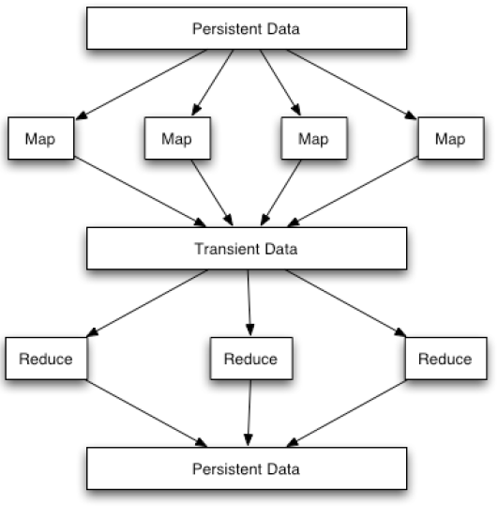
TestCase: Apache Hadoop
Programming Model MapReduce
Programming that is easily parallelizable
Divided into two phases:
Mapping –performs a custom function for all objects in a table
Reduce- Collating results mapping using a custom function
Scaled well
Simple example:
Mapping: Elevation of elements in the square {1, 2, 3, 4} -> {1, 4, 9, 16}
Reduce: Sums up the results: 30

Slide 28
ΤestCase: Apache Hadoop
HDFS
Very large distributed file system
10K nodes, 100 millions files, 10 PB
It works on "cheap" material
Files are stored in replicas to handle hardware failure
The system detects faults and recovers from them
Optimized for Batch Processing
The data positions are opaque, so that the calculation can be moved to where the data is located
It provides a very high total bandwidth

Slide 29
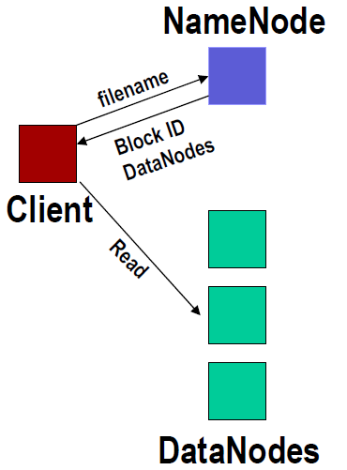
ΤestCase: Apache Hadoop
Distributed file system
Single namespace for the entire system
Consistency of data
Write‐once‐read‐many access model
The user can only append to existing files
The files are divided into blocks.
Usually 128 MB block size
Each block is replicated in many DataNodes
Intelligent Client
The Client can find the location of the blocks.
The Client has access to data directly from the DataNode

