Slide 1
Blending work and fun to assure international education for all
Nuno Escudeiro nfe@isep.ipp.pt

Slide 2
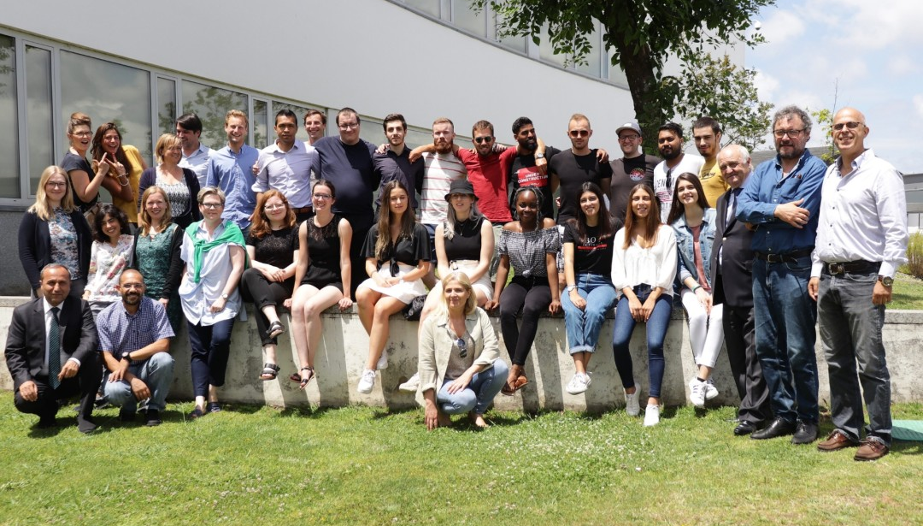
Blended Mobility to build bridges!
A project course unit empowering students to the labour market.

Slide 3
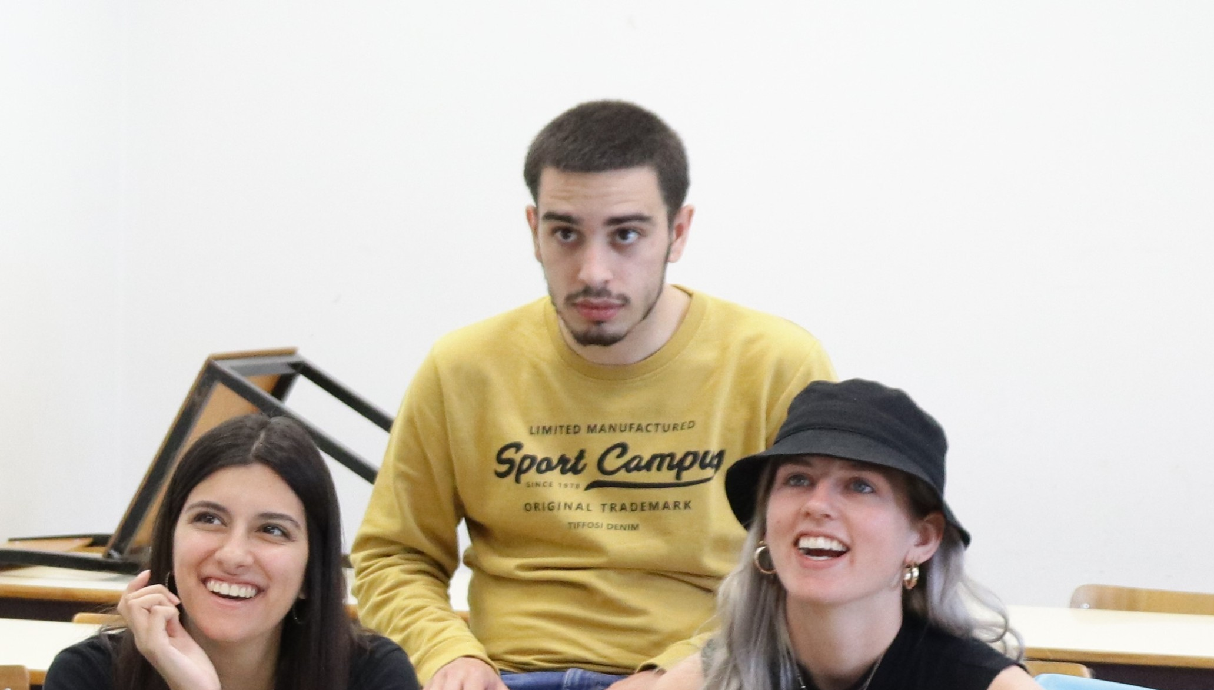
“A well-established model to enhance education, cultural awareness & employability”
Interdisciplinary international student teams
are working together,
both physically and virtually,
for a period of 4 months
in collaboration with startup founders
as real clients in the field.
The projects focus on developing a
working proof-of-concept for a challenge from a company,
including a Marketing & Business Plan.

Slide 4
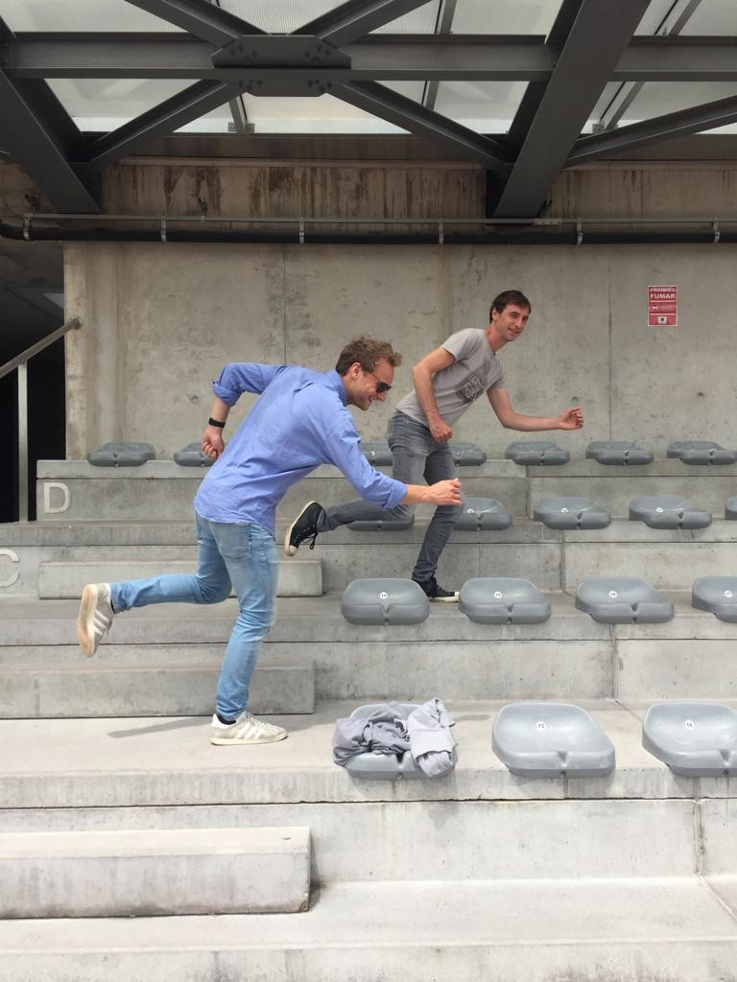
ADVANTAGES FOR STUDENTS
Develop & enhance your personal and professional competences
Work in an exciting multicultural, multidisciplinary environment
Get experience in working within a remote team
Gain international contacts, partnerships and strengthen your international network
Promote teamwork and communication skills in international context
Find your talent
Boost your employability
Overcome international mobility barriers

Slide 5
Course plan in three stages
A - PREPARATION
New edition organization (September)
Call for challenges (Praxis platform, companies, October)
Select challenges according to learning outcomes and available competences
Invite students (November till December)
Select students (December, January)
Invite supervisor teachers
Create teams
Kick-off logistics (prep phase, f2f meeting, travel and accommodation, January).
B - DEVELOPMENT
Launch the course edition (early February)
Preparatory phase (2 weeks before kick-off): team website (who we are), cultural stereotypes
Kick-off meeting (physical, 5 working days, end of February): team building, know the client and the challenge, know the team, know the ECTS-budget, organize work and tools, seminars / workshops (agile development, intercultural team work, ...), pitch and discuss proposal with the client, peer evaluation round 1
Team work at a distance, at home institution (virtual): regular meetings online, groupware platforms, distributed development environment
Peer evaluation round 2 (mid-term, April)
Closing logistics (closing f2f meeting, travel and accommodation, March/April).
C - CLOSURE
Closing meeting (physical, 5 working days, end of June): finalize deliverables (product, business plan, marketing campaign, ...), pitch and discussion with teachers and client representatives, peer evaluation round 3, assessment, give grades
Course edition debriefing: things to improve, preliminary organization of next edition
Final dinner.

Slide 6
Course plan in three stages
A - PREPARATION
New edition organization (September)
Call for challenges (Praxis platform, companies, October)
Select challenges according to learning outcomes and available competences
Invite students (November till December)
Select students (December, January)
Invite supervisor teachers
Create teams
Kick-off logistics (prep phase, f2f meeting, travel and accommodation, January).
B - DEVELOPMENT
Launch the course edition (early February)
Preparatory phase (2 weeks before kick-off): team website (who we are), cultural stereotypes
Kick-off meeting (physical, 5 working days, end of February): team building, know the client and the challenge, know the team, know the ECTS-budget, organize work and tools, seminars / workshops (agile development, intercultural team work, ...), pitch and discuss proposal with the client, peer evaluation round 1
Team work at a distance, at home institution (virtual): regular meetings online, groupware platforms, distributed development environment
Peer evaluation round 2 (mid-term, April)
Closing logistics (closing f2f meeting, travel and accommodation, March/April).
C - CLOSURE
Closing meeting (physical, 5 working days, end of June): finalize deliverables (product, business plan, marketing campaign, ...), pitch and discussion with teachers and client representatives, peer evaluation round 3, assessment, give grades
Course edition debriefing: things to improve, preliminary organization of next edition
Final dinner.
14th Edition of the course – 2023-2024
Setup phase from 05Feb24 to 11Feb24
Kick-off meeting (Maribor, Slovenia) 12Feb24 to 16Feb24
Midterm meeting (online) 17Apr24
Closing meeting (Vilnius, Lithuania) mid/end of Jun24

Slide 7
2023-24 projects
Notes:
Today, our mid-term ambition is to have a consortium of 50, 60 universities running the course with the teams of students being dynamically created depending on students’ particular interest and the available challenges submitted by companies to a centralized pool.
You are all very welcome to join us developing further this exciting paradigm.
Take a deeper look online at blendedmobility.com or search for blended mobility at the Wikipedia.
Thank you for your attention!

Slide 8
2023-24 projects
FarmIT Farmers’ Game for efficient use of water and zero-waste agriculture
Sociedade Agricola Casal da Cotovia, INIAV, Portugal
BlendEd the Digital Transformation
BlendEd Consortium, Portugal-Belgium-Slovenia-Greece-Germany
Writing aid
Creative Therapy, Belgium

Slide 9
2023-24 projects – FarmIT
FarmIT Farmers’ Game for efficient use of water and zero-waste agriculture
Sociedade Agricola Casal da Cotovia, INIAV, Portugal
Develop a low-cost digital assistant to farmers looking to be more sustainable and ethical.
Develop an integrated system able to manage the use of water, watering, and fertigation.
Providing visual maps of the farm with production, amount of water and fertilizers used.
Gamify the application to promote usage.

Slide 10
2023-24 projects – BlendEd
BlendEd the Digital Transformation
BlendEd Consortium, Portugal-Belgium-Slovenia-Greece-Germany
Develop a webapp to structure the BlendEd Program and manage BlendEd course editions.
Cooperate with the 17 European universities in the consortium plus 6 African universities that are starting the course in 2023/24.
Develop an analytical dashboard to produce key performance indicators.
The webapp will have an area open to public and another one with restricted access for teachers, students and admin staff,

Slide 11
2023-24 projects – Writing Aid
Writing aid
Creative Therapy, Belgium
Creative therapy makes interactive physiotherapy equipment used for measuring motion and balance.
In this challenge the students will work on the development of games and digital support of a writing aid.
The idea is to mount a 3d printed part on an interactive writing pen (used in combination with a tablet).
The design of the app and the corresponding games is free to be decided by the students.
Beautiful Figma prototypes are also seen as valuable deliverables for user testing and pitching of the concept.

Slide 12
What’s next?
Notes:
Today, our mid-term ambition is to have a consortium of 50, 60 universities running the course with the teams of students being dynamically created depending on students’ particular interest and the available challenges submitted by companies to a centralized pool.
You are all very welcome to join us developing further this exciting paradigm.
Take a deeper look online at blendedmobility.com or search for blended mobility at the Wikipedia.
Thank you for your attention!

Slide 13
We have the resources to welcome you
Student’s kit and checklist
http://blendedmobility.com/en/download-toolkit
Wikipedia
http://blendedmobility.com/en/blended-mobility-wikipedia
MUTW white book
https://www.amazon.com/Multinational-Undergraduate-Team-Work-International/dp/1607509830
In vídeo
https://www.youtube.com/watch?v=czbJze0U0Sg&t=6s, 2019
https://www.youtube.com/watch?v=pH7-70Z1zkk, 2017
https://www.youtube.com/watch?v=Tlx2Mi-ejGw, 2011
BlendEd website
http://www.blendedmobility.com/en
Join the consortium
http://blendedmobility.com/en/apply-as-institution
Contact us at
http://blendedmobility.com/en/contact
Or by email to nfe@isep.ipp.pt

Slide 14
Education at a truly European dimension
Get to know your new challenge in higher education
BlendEd http://blendedmobility.com/en

Slide 15
Until 15th December 2023
Education at a truly European dimension
Apply
By email to Nuno Escudeiro – nfe@isep.ipp.pt

Slide 16
Thank you! Give it a try nfe@isep.ipp.pt

