Slide 1
Distributed Systems Hadoop
Papadakis Harris
Department of Informatics Engineering
TEI of Crete

Slide 2
Contents
Map-Reduce
Hadoop
HDFS

Slide 3
Map-Reduce
Functional programming on distributed processing
Motivated by the need to process large amounts of data using hundreds (or thousands) of processors
Data are critical for computing, positioning computing in the data location.
Provide clean programming abstraction similar to functional programming.
The interface deals with all execution details.

Slide 4
Map-Reduce History
Developed by Google to simplify their data processing jobs on large data
Details emerged from two published papers
James Dean, Sanjay Ghemawat, MapReduce : Simplified Data Processing on Large Clusters, Proceedings of OSDI ‘04, 2004
Sanjay Ghemawat, Howard Gobioff, and Shun‐Tak Leung, Google File System, Proceedings of Symposium of Operating Systems Principles, ACM SIGOPS, 2004
Since Google’s implementation is proprietary and not available to public, an Apache Project called Hadoop emerged as an open source implementation
Primary Contributors: Yahoo!, Facebook

Slide 5
Example of need
Processing web data on a single machine
20+ billions webpages x 20KB = 400+ terabytes
A computer can read 30-35 MB / sec from the disk
~ Four months to read the internet
~ 1,000 hard disks just to save the web
Even more to analyze the data
It takes too long on a unique machine, but with 1,000 machines?
<3 hours to run on 1000 machines
But how long to program? What about overhead?
Communication, coordination, recovery from machine failure
Status report, Debugging, Optimization, Location
Inventing the wheel: What should be done for each program!

Slide 6
Map-Reduce Features
Automatic Parallelization and Distribution of Data
Fault Tolerance
Status and Monitoring Tools
Clean Programming Abstraction

Slide 7
Programming model MapReduce
1. Read a lot of Data
2. MAP: extract something you need from each record
3. Shuffle and Sort
4. REDUCE: aggregate, summarize, filter or transform
5. Write the results
Outline stays the same
Map and Reduce change to fit the problem
Model seems restrictive but it is Turing Complete.
Multiple maps and reduces needed to solve a complex problem

Slide 8
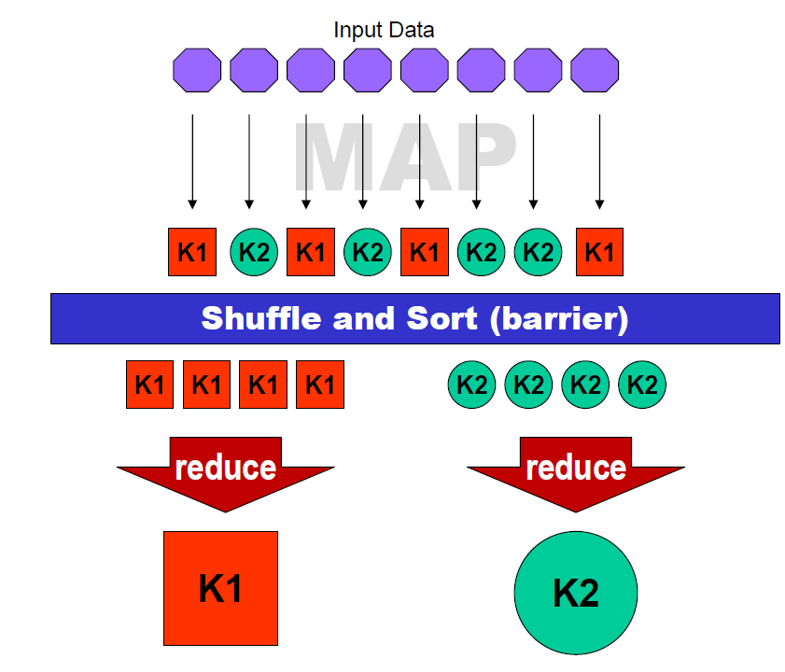
Programming model MapReduce
map (in_key, in_value) -> (out_key, intermediate_value) list
reduce (out_key, intermediate_value list) ->out_value list

Slide 9
Parallelism
Map functions run in parallel, create intermediate values from each input data set
The programmer must specify a proper input split (chunk) between mappers to enable parallelism
Reduce functions also run in parallel, each will work on different output keys
Number of reducers is a key parameter which determines map‐reduce performance
All values are processed independently
Reduce phase cannot start until the map phase is completely finished

Slide 10
Data Locality
Hadoop Master program creates tasks based on the location of the data. It tries to send the map tasks to the same machine (or at least same rack) with the data that will be processed.
Map inputs are divided into 64 MB blocks
Minimizes communication at the network level

Slide 11
Fault Tolerance
Hadoop Master program keeps track of progress of each task
If a node fails, it re‐executes the task on other node that is alive
If particular input key/value pairs keep crashing they are blacklisted and skipped from re‐execution
Tolerate small failures, allow the job to run in best‐effort basis
For large datasets containing potentially millions of records, we don’t want to stop computation for a few records not processing correctly
User can set the failure tolerance level

Slide 12
Hadoop
What is Hadoop?
Open Source Implementation of Google Distributed Computing
Includes Open Source Implementations of MapReduce, BigTable, GFS κ.λπ.
It is supported by the Apache Foundation
Primary Collaborations - Yahoo !, Facebook
It is used by Yahoo to run on a 2000+ nodes, and many other web companies.

Slide 13
Hadoop Map-Reduce
Implementation of Google’s MapReduce Programming Model
Express complex tasks in the form of Maps and Reduces to enable large‐scale processing of data
Βenefits:
Automatic Parallelization and Distribution of Data
Fault Tolerance
Status and Monitoring Tools
Clean Programming Abstraction

Slide 14
Mapper class

Slide 15
Data Types Input/Output
Writable Class
Type for writable data as bytes (Serialization)
IntWritable, Text etc
All values must be Writable
You can create your own Writable data type
Class WritableComparable (subclass of Writable)
Required for sorting by Reducers
All keys must be WritableComparable

Slide 16
Reducer class
The Reducer class is executed for each key generated by the mapper, we use the Iterator class to run the values of each key
You can perform the required reduce function in the value of each key and create key / value pairs at will.

Slide 17
A Simple Program
Lets try to write a Hadoop program that counts the number of even and odd numbers in a list
Input: Text File with one integer value per line
Output: Text File Containing the number of even and Number of Odd numbers in the Input file
Mapper:
Read each line, and create a pair of key/value (“even/odd”, 1) for the line number
Reducer:
Sum up all the values of each key (even/odd)
The end!

Slide 18
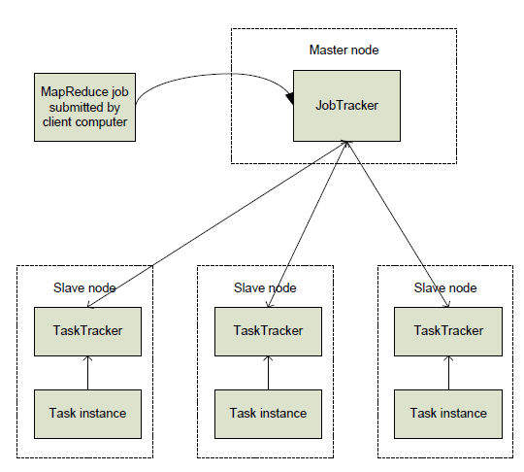
How a job is executed in Hadoop?
MapReduce job is submitted to JobTracker masternode.
JobTracker creates jobs and send them to TaskTrackers nodes.
Each TaskTracker creates task instances for each job and executes them, reports on their status and sends results back to JobTracker.

Slide 19
HDFS
Hadoop Distributed File System (HDFS) is a distributed file system designed to run on low-cost hardware.
It has many similarities to existing distributed file systems. However, differences from other distributed file systems are important.
Very tolerant to faults.
It provides quick access to application data and is suitable for applications that have large data sets.
Loosen some POSIX requirements to allow streaming access to system data files.
Part of Apache Hadoop Core project. Project’s URL is http://hadoop.apache.org/core/.

Slide 20
HDFS Architecture

Slide 21
HDFS Architecture
HDFS has data block size typically 64MB. The NTFS (Microsoft) and ext4 (Linux) filesystems typically have only 4 KB. - Small files (significantly smaller than 64MB) are a big problem for HDFS designed to handle huge files efficiently
HDFS provides reliability by copying data to more than 1 node

Slide 22
HDFS Architecture
Master Node in HDFS has the role of NameNode.
NameNode keeps a variety of metadata for the file system such as the index that describes where each file or chunk is located, ie in which node.
The remaining nodes have the role of DataNode, ie they store the data.

