Slide 1
Advanced Topics in Biomedical Informatics
M. Tsiknakis, PhD
Postgraduate Course on “Informatics Engineering”, Spring 2024

Slide 2
Course title & identity
Title: Advanced Topics in Biomedical Informatics
Biomedical Informatics is a very broad scientific domain
Objectives
Primary: Understanding key concepts and methodologies of a selected biomedical informatics sub-domain;
Secondary: Novel algorithmic implementation starting by reproducing recent published work.
Members of staff
Prof. Manolis Tsiknakis, supported by some PhD students

Slide 3
Scope and Objectives
Focus during this semester is on AFFECTIVE COMPUTING
This class explores computing that relates to, arises from, or deliberately influences emotion.
Topics include
the interaction of emotion with cognition and perception;
the communication of human emotion via face, voice, physiology, and behavior;
construction of computer systems that exhibit skills of emotional intelligence;
affective technologies for the recognition of stress, anxiety, depression, pain and empathy;
and other areas of current research interest.
Weekly reading, discussion, and a term project are required.

Slide 4
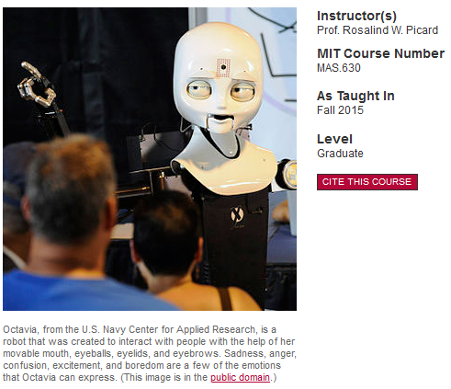
MIT’s Affective Computing
Course builds on experiences and concepts from the relevant MIT OpenCource
Course Description
This course instructs students on how to develop technologies that help people measure and communicate emotion, that respectfully read and that intelligently respond to emotion, and have internal mechanisms inspired by the useful roles emotions play.
https://ocw.mit.edu/courses/media-arts-and-sciences/mas-630-affective-computing-fall-2015/

Slide 5
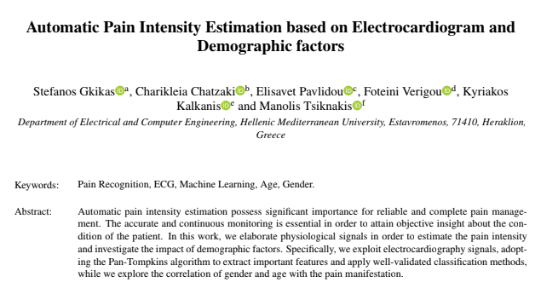
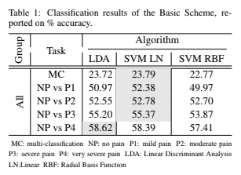
Results of our work during 2021-2022
Starting point was a recent conference paper at:
2017 Seventh International Conference on Affective Computing and Intelligent Interaction Workshops and Demos (ACIIW)
Available at: arXiv:1708.08755
Result
Our results outperform published results

Slide 6
Results of our work during 2022-2023
The purpose of this work is to exploit the RPs and through the use of the RQA features construct a multi-channel convolutional neural network (CNN) which can differentiate the primary emotions, described in the German EMODB database.
Result
A. Pentari et al., "Multi-channel CNN-based emotion recognition using recurrence plot representations of speech," 2023 IEEE International Conference on Bioinformatics and Biomedicine (BIBM), Istanbul, Turkiye, 2023, pp. 4820-4826, doi: 10.1109/BIBM58861.2023.10385734.

Slide 7
Approach
Lectures (2-3 hours / week)
Recap, new topics, paper presentations, discussion
Laboratory classes (2 hours from week 6 onwards, if required)
Study specific topics through student’s group presentations
Focus on experimentation with specific concepts
Homework
A number of small-scale home assignments to be presented and discussed in class
Project
One (large) project (team project, due at the end of the semester)
Final assessment (week to follow last lecture)

Slide 8
Syllabus for the year 2023-2024
Focus on
one emotion, i.e. pain and
one disease, i.e. Parkinson
Explore facial expressions as indicators/biomarkers.

Slide 9
PD – Globally unique dataset
Βασισμένοι σε ένα μοναδικό σύνολο δεδομένων που έχει δημιουργηθεί στα πλαίσια διδακτορικής διατριβής.
Facial expressions, voice, signals from insoles, biosignals from wearables, upper body movement.
Η σχετική πρόταση μας στο ΕΛΙΔΕΚ έχει καταταγεί στην πρώτη θέση πανελλαδικά.

Slide 10
Εξέταση & Βαθμολόγηση (Grading)
Εξέταση Μαθήματος
Η εξέταση θα γίνει με βάση μικρής ή και μεγαλύτερης δυσκολίας ασκήσεις που θα δίνονται κατά τη διάρκεια του εξαμήνου και με την παρουσίαση μιας ατομικής ή ομαδικής εργασίας στο τέλος του εξαμήνου.
Assignment | Percentage of total grade
Class participation & Homeworks | 40 %
Project implemnetation | 40 %
Written report & Final presentation of the Project | 20 %

Slide 11
Other specific requirements
Pre-requisites
Good written (and spoken) English
Για την επιτυχή παρακολούθηση του μαθήματος είναι επιθυμητές γνώσεις σε:
Python,
Machine Learning and
Image Processing.
Expected weekly workload
8-10 hours (average workload including class attendance).
Not evenly distributed (considerably smaller at first, tends to increase towards the end of the semester).

Slide 12
Learning outcome
After the course the student should be able to:
Show a deeper knowledge in the sub-area of biomedical informatics selected for study
Independently perform a research pre-study, in the form of a literature study or a limited research assignment
Critically analyze the content of the research papers and evaluate their significance, importance and relevance to the research field.
Demonstrate implementation skills to complex biomedical informatics problems
Should be able to “reproduce” published results
Ideally, should be able to identify limitations, propose and implement enhancements/extentions.
Independently synthesize the results in the form of a scientific presentation/publication.

Slide 13
Q & A

