Slide 1
Environmental Certification
Applied in the Tourism Sector
Here is where your presentation begins

Slide 2
BASIC CONCEPTS

Slide 3
What is Environmental Certification?
It Is an initiative where a company voluntarily undertakes to comply with predefined environmental standards
As we shall see these standards may be many. We will use the general term Environmental Management Initiative (EMI) to describe compliance with them

Slide 4
EMIs can be many: here we will look in three well known globally.
ISO 14001 environmental management systems
Corporate social (CSR) responsibility (CSR) initiatives
The Hotel Carbon Measurement Initiative (HCMI)
Notes:
http://www.wrap.org.uk/sites/files/wrap/WRAP%20EMS%20guide%20Mar2015.pdf

Slide 5
Some important slides will be repeated in all three EMIs below
Repetition is key to learning!
Notes:
http://www.wrap.org.uk/sites/files/wrap/WRAP%20EMS%20guide%20Mar2015.pdf

Slide 6
Why engage in environmental certification?
ENVIRONMENT
MONEY
CUSTOMERS
RECOGNITION
COMPETITIVENESS
Improve organizations environmental performance
Operational and cost savings and better financial performance
Increase sales and customers loyalty.
Better brand recognition or business reputation
Increased competitiveness in the marketplace

Slide 7
What is an Environmental Action Plan ?
An action plan is a living document that lays out the environmental commitments and the procedures to measure, monitor and report upon them in order to decrease the firm’s environmental impact in key areas

Slide 8
Action Plan Components
OBJECTIVES
The specific goals specified by the firm’s policy, by taking account of its activities and current environmental performance. They must be realistic, coherent and well quantifiable (e.g. reduce solid waste production)
TARGETS
The specific measures that are set for the attainment of the objectives (e.g. introduce glass and metal recycling bins)
EMI KEYWORDS
ACTIONS
The specific steps, including time and resources, to reach the objectives and the targets.

Slide 9
Objectives: What they are?
Objectives aim at making more tangible the focus of the certification and at better communicating it to employees and other engaged entities (e.g providers)
Some examples:
Reduce effluents and emissions
Minimize raw material usage
Use recycled products where feasible
Reduce Unplanned Releases
Reduce Energy Consumption

Slide 10
Objectives: How they are set?
By considering both the costs and impacts of all possible objectives and selecting those that will have the largest environmental impact in the more cost efficient way.
Don’t Forget
Objectives should be a compact and manageable set of goals

Slide 11
How to select promising objectives? (a logical approach)
Does the objective have an important impact on the environment
Yes
Significant
No
Is the objective controlled by current legislation?
Yes
Significant
No
Does the objective talk to customers/ consumers?
Yes
Significant
No
The objective is currently non- significant (reassess periodically)
Impact is significant and should be included in your EMI if the cost of its attainment is reasonable
Notes:
http://www.wrap.org.uk/sites/files/wrap/WRAP%20EMS%20guide%20Mar2015.pdf

Slide 12
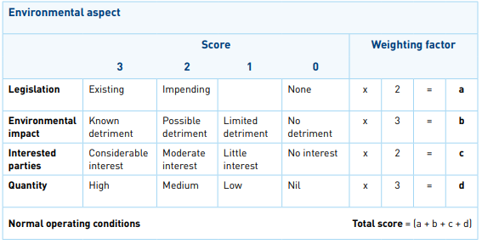
How to select promising objectives? (a weighted approach)
Each objective is weighted against criteria weighting factors; the higher scoring are selected
Notes:
http://www.wrap.org.uk/sites/files/wrap/WRAP%20EMS%20guide%20Mar2015.pdf

Slide 13
Use your intuition and knowledge and perhaps some data collection to help you select your objectives!
Notes:
http://www.wrap.org.uk/sites/files/wrap/WRAP%20EMS%20guide%20Mar2015.pdf

Slide 14
Targets: How they are set?
When setting targets, be SMART
Specific: each target should address one issue only
Measurable: they should be expressed quantitatively
Achievable: they should be something you can really achieve, technically and financially
Realistic: they should be challenging but not overly ambitious
Time-bound: they should be assigned an end date for delivery

Slide 15
Actions: How do they look like?
Action name:
Action description:
Relation to Objective and Target:
Data collection requirements:
Time delivery/ review:
Cost allocated:
Staff responsible:

Slide 16
Developing an Action Plan

Slide 17
Your action plan must be factual and data based. Data collection is essential both for setting up as well as monitoring and updating your EMI
Notes:
http://www.wrap.org.uk/sites/files/wrap/WRAP%20EMS%20guide%20Mar2015.pdf

Slide 18
Why data collection?
Data collection is needed in order:
to register where exactly you stand before launching your EMI
to assist you in selecting your EMI objectives
you register progress in achieving the targets of the EMI

Slide 19
Monitoring and Measurement
Through monitoring and measurement an organization can measure its progress in meeting its stated environmental objectives and targets through specific periods of time

Slide 20
What data is collected?
Organizational data: e.g activities, available technologies, number of employees etc.
Legal requirements
Environmental performance data: any organization’s activity, product and service which can interact with the environment and create environmental impact

Slide 21
Methods and Tools for data collection
Checklists
Amount of Use/Material per time period
Disposal Cost Avoidance
Monthly Bills
On Site Measurements
Approximate
Accurate

Slide 22
Putting your EMI together in 5 steps
Brainstorm the idea for your EMI
Mobilise the organisation and collect ideas & suggestions for proposed objectives
Collect data required to monitor the selected objectives’ and targets’ progress
Launch a data collection to set the baseline for your EMI
Develop the EMI action plan
Expand the stable objectives and targets to specific actions, planned in time, budgeted in cost and staffed in terms of human resources
2
4
3
5
1
Develop a first set of objectives and targets
Use the comments collected and your company knowledge and intuition to lay out a first set of EMI objectives and specific targets
Brainstorm the data collection exercise to finalise your objectives and targets
Exploit the data collection experience to assess and stabilise your objectives and targets

Slide 23
2. Running & updating your EMI in 3 steps
MONITOR you action plan: collect all data required to update your action plan progress
REPORT on the action plan progress internally and externally to the organisation
2
1
3
BTAINSTORM the action plan progress internally in your organisation and possibly introduce changes to it

Slide 24
Reporting is how you communicate your EMI action plan progress internally and externally to your organisation
Notes:
http://www.wrap.org.uk/sites/files/wrap/WRAP%20EMS%20guide%20Mar2015.pdf

Slide 25
Reporting Goals
Environmental Reporting should serve two goals:
Provide information which can support decision making of company executives
Provide concise and clear communication aiming at customers and value chain partners who might not possess special knowledge

Slide 26
Present the progress of the action plan and its environmental impact,
Provide comparable information, through time
Present the background information so that the audience can verify the information provided
/

Slide 27
CERTIFICATIONS

Slide 28
Three common standards for the tourism industry
ISO 14001:2015 (Environmental Management System)
CSR (Corporate Social Responsibility)
HCMI (Hotel Carbon Measurement Initiative)

Slide 29
ISO 14001:2015
(Environmental Management System)

Slide 30
ISO 14000 includes a large family of environment related standards

Slide 31
ISO 14000 Family of Standards
ISO 14001 & 14004: EMS (Environmental Management System)
ISO 14010 t0 14015: Environmental Auditing
ISO 14031: Environmental Performance Evaluation (EPE)
ISO 14021-25: Environmental Labeling
ISO 14040-43: Life Cycle Assessment (LCA)
ISO 14050: Terms and Definitions
ISO 14060: Environmental Aspects in Product Standards
Notes:
https://www.slideshare.net/kamranyounas3/iso-14000-96292957

Slide 32
ISO 14001:2015 is the most popular standard of the ISO 14000 family. It provides guidelines for the establishment and continuous improvement of an EMS as discussed above

Slide 33
What is the purpose of ISO 14001?
To help you set up an action plan to improve your environmental performance and thereby enhance your environmental credentials, market visibility and your ‘preferred supplier’ status.

Slide 34
Tools for data collection
Checklists: for checking that the EMS meets the ISO 14001: 2015 requirements
Data Tables: for collecting and registering data required by the EMS

Slide 35
You can easily get lost when collecting data; this is why you must first set clear objectives and targets to guide you to only what makes sense to them.

Slide 36
Putting your ISO 14001 together in 5 steps
Brainstorm the idea for your ISO 14001
Mobilise the organisation and collect ideas & suggestions for proposed objectives
Collect data required to monitor the selected objectives’ and targets’ progress
Launch a data collection to set the baseline for your ISO 14001
Develop the ISO 14001 action plan
Expand the stable objectives and targets to specific actions, planned in time, budgeted in cost and staffed in terms of human resources
2
4
3
5
1
Develop a first set of objectives and targets
Use the comments collected and your company knowledge and intuition to lay out a first set of ISO 14001 objectives and specific targets
Brainstorm the data collection exercise to finalise your objectives and targets
Exploit the data collection experience to assess and stabilise your objectives and targets

Slide 37
2. Running & updating your ISO 14001 in 3 steps
MONITOR you action plan: collect all data required to update your action plan progress
REPORT on the action plan progress internally and externally to the organisation
2
1
3
BTAINSTORM the action plan progress internally in your organisation and possibly introduce changes to it

Slide 38
Data Tables (examples)
Energy Consumption
Period | USe in kWh |  |  |  | Info
 | DHW | HVAC | Lighting | Devices
… | … | … | … | … | …
…. | …. | …. | …. | …. | ….
….. | ….. | ….. | ….. | ….. | …..
….. | ….. | ….. | ….. | ….. | …..
Possible Energy Resources
Electricity
Gas
Oil
District Heating
Solid Fuels

Slide 39
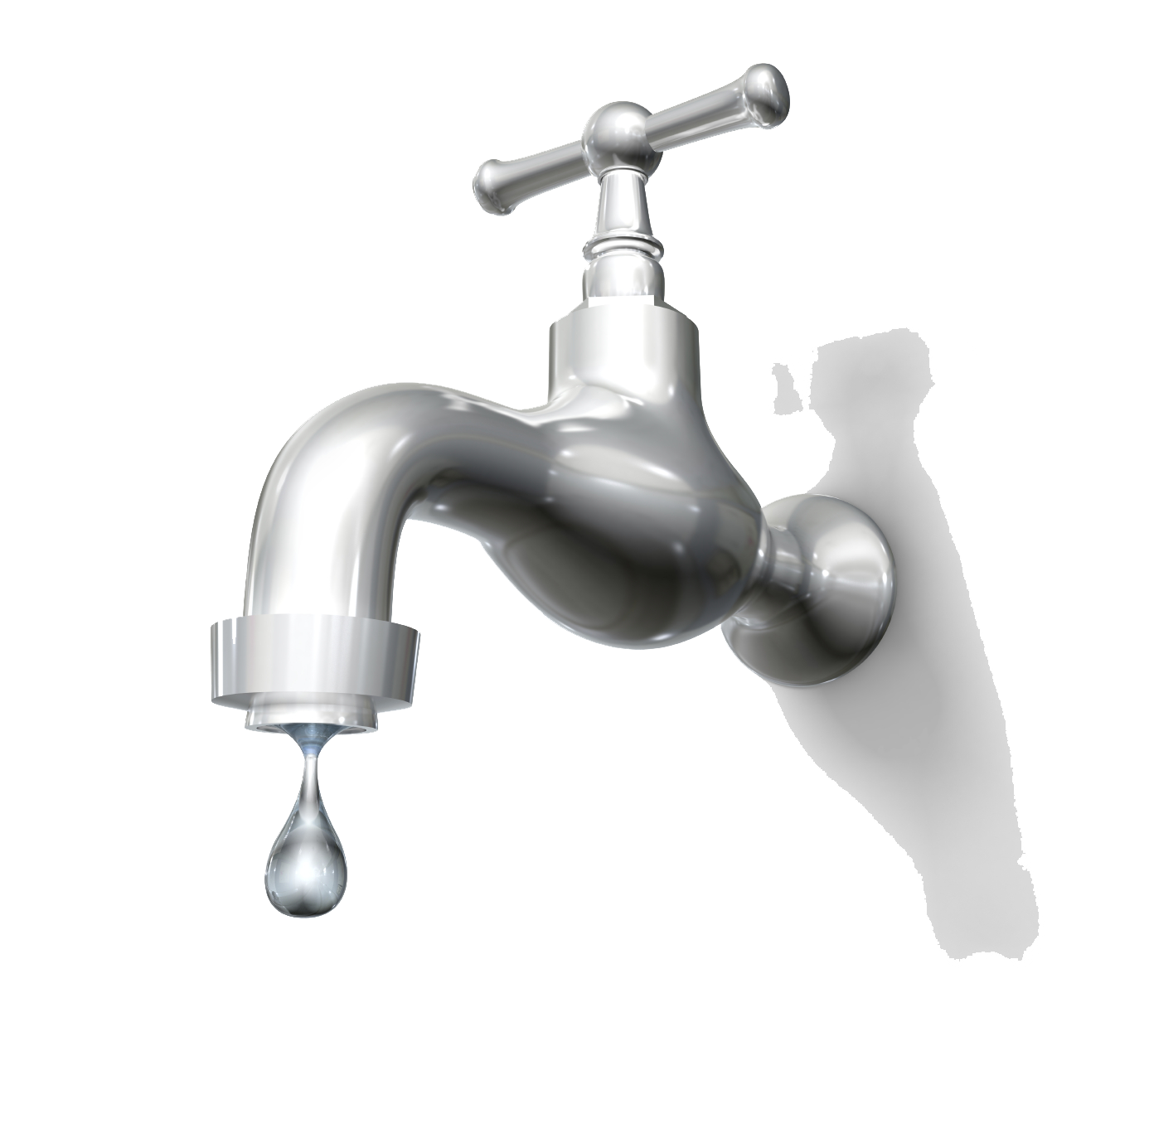
Data Tables (examples)
Water Consumption
Period | USe in m3 |  |  | Info
…. | …. |  |  | ….
… | …. |  |  | ….
…. | …. |  |  | ….
….. | …. |  |  | …..

Slide 40
Data Tables (examples)
Wastewater
Period | Type |  |  |  |  |  | Info
 | Domestic |  |  | Other
…. | …. |  |  | …. |  |  | ….
… | … |  |  | … |  |  | …
…. | …. |  |  | …. |  |  | ….
…. | …. |  |  | …. |  |  | ….
…. | …. |  |  | …. |  |  | ….
Wastewater is used water from any combination of domestic, industrial, commercial or agricultural activities

Slide 41
Data Tables (examples)
Wastes per Department
Period | Kind of Wastes (kg) |  |  |  |  |  | Info
 | Plastic | Glass | Paper | Organic | Metal | Other
…. | …. | …. | …. | …. | …. | …. | ….
… | … | … | … | … | … | … | …
…. | …. | …. | …. | …. | …. | …. | ….

Slide 42
Data Tables (examples)
Overview of Purchasing
Item | Quantity per year | Department | Supplier
…. | …. | …. | ….
…. | … | …. | ….
…. | …. | …. | ….
…. | ….. | ….. | ….

Slide 43
Data Tables (examples)
Recycling per year
Material Type | Annual Tomes (m3)
…. | ….
…. | ….
…. | ….
…. | ….
Total : | …..
Recyclable materials include many kinds of glass, paper, cardboard, metal, plastic, tires, textiles, batteries, and electronics

Slide 44
CSR
(Corporate Social Responsibility)

Slide 45
What is Corporate Social Responsibility (CSR)?
Corporate Social Responsibility (CSR) is a commitment of the organisation to specific social and environmental goals. CSR initiatives can fall in one or more of the four categories below:
Environmental Responsibility
Ethical Responsibility
Philanthropic Responsibility
Economic Responsibility

Slide 46
A CSR is not restricted to environmental issues as is the ISO 14001!

Slide 47
What is the purposes of a CSR
Corporate Social Responsibility (CSR) aims at contributing to environmental and/ or social goals (of a philanthropic, activist or charitable nature) by engaging in respective practices
The environmental past of a CSR can, for example, involve reducing pollution, greenhouse gas emissions and a sustainable use of natural resources

Slide 48
Putting your CSR together in 5 steps
Brainstorm the idea for your CSR
Mobilise the organisation and collect ideas & suggestions for proposed objectives
Collect data required to monitor the selected objectives’ and targets’ progress
Launch a data collection to set the baseline for your CSR
Develop the CSR action plan
Expand the stable objectives and targets to specific actions, planned in time, budgeted in cost and staffed in terms of human resources
2
4
3
5
1
Develop a first set of objectives and targets
Use the comments collected and your company knowledge and intuition to lay out a first set of CSR objectives and specific targets
Brainstorm the data collection exercise to finalise your objectives and targets
Exploit the data collection experience to assess and stabilise your objectives and targets

Slide 49
2. Running & updating your CSR in 3 steps
MONITOR you action plan: collect all data required to update your action plan progress
REPORT on the action plan progress internally and externally to the organisation
2
1
3
BTAINSTORM the action plan progress internally in your organisation and possibly introduce changes to it
CSR content is a aimed at customers; a quality report is promoting your premise is of a high importance!
See a good example here

Slide 50
Tools for data collection
Checklists: in order to perform an internal audit to define the exact scope of the CSR and compliance with specific items of legislation
Data Tables: for collecting and registering data required by the CSR

Slide 51
Data collection must be driven by your objectives and targets and not be generic!

Slide 52
Data Tables (examples)
Energy Consumption
Period | USe in kWh |  |  |  | Info
 | DHW | HVAC | Lighting | Devices
… | … | … | … | … | …
…. | …. | …. | …. | …. | ….
….. | ….. | ….. | ….. | ….. | …..
….. | ….. | ….. | ….. | ….. | …..
Possible Energy Resources
Electricity
Gas
Oil
District Heating
Solid Fuels

Slide 53
Data Tables (examples)
Energy in Situ Production
Period | USe in kWh |  |  |  | Info
 | PV | Solar Thermal |  | Other
… | … | … |  | … | …
…. | …. | …. |  | …. | ….
….. | ….. | ….. |  | ….. | …..
….. | ….. | ….. |  | … | …..

Slide 54
Data Tables
Water Consumption
Period | USe in m3 |  |  | Info
…. | …. |  |  | ….
… | …. |  |  | ….
…. | …. |  |  | ….
….. | …. |  |  | …..

Slide 55
Data Tables (examples)
Wastewater
Period | Type |  |  |  |  |  | Info
 | Domestic |  |  | Other
…. | …. |  |  | …. |  |  | ….
… | … |  |  | … |  |  | …
…. | …. |  |  | …. |  |  | ….
…. | …. |  |  | …. |  |  | ….
…. | …. |  |  | …. |  |  | ….
Wastewater is used water from any combination of domestic, industrial, commercial or agricultural activities

Slide 56
Data Tables (examples)
Wastes per Department
Period | Kind of Wastes (kg) |  |  |  |  |  | Info
 | Plastic | Glass | Paper | Organic | Metal | Other
…. | …. | …. | …. | …. | …. | …. | ….
… | … | … | … | … | … | … | …
…. | …. | …. | …. | …. | …. | …. | ….

Slide 57
Data Tables (examples)
Recycling per year
Material Type | Annual Tomes (m3)
…. | ….
…. | ….
…. | ….
…. | ….
Total : | …..
Recyclable materials include many kinds of glass, paper, cardboard, metal, plastic, tires, textiles, batteries, and electronics

Slide 58
HCMI
(Hotel Carbon Measurement Initiative)

Slide 59
What is Hotel Carbon Measurement Initiative (HCMI)?
HCMI is a methodology and tool developed by the International Tourism Partnership (ITP) and World Travel & Tourism Council (WTTC) in partnership with KPMG and 23 global hotel companies. HCMI applies the principles of the Greenhouse Gas (GHG) Protocol Corporate Standard at the hotel level.

Slide 60
Purpose of HCMI
Hotel Carbon Measurement Initiative (HCMI) enables hotels to measure and report on carbon emissions in a consistent way. It can be used by any hotel from small guesthouses to 5 stars resorts in amy geographical locations.

Slide 61
The HCMI is a kind of a restricted EMS that looks into ONLY the carbon footprint of the premise and not its general environmental performance.
However it is also very popular among hotels. There are more than 25.000 hotels globally implementing the HCMI

Slide 62
Data collection must now cover all aspects of the premise carbon footprint
HVAC,
Lighting,
DHW,
Mobility services,
Services (e.g. laundry washing)

Slide 63
Putting your HCMI together in 5 steps
Brainstorm the idea for your HCMI
Mobilise the organisation and collect ideas & suggestions for proposed objectives
Collect data required to monitor the selected objectives’ and targets’ progress
Launch a data collection to set the baseline for your HCMI
Develop the HCMI action plan
Expand the stable objectives and targets to specific actions, planned in time, budgeted in cost and staffed in terms of human resources
2
4
3
5
1
Develop a first set of objectives and targets
Use the comments collected and your company knowledge and intuition to lay out a first set of HCMI objectives and specific targets
HCMI is only about carbon data reporting. However, it is a not a bad idea to use HCMI in the general context, develop some objectives and an action plan around it, even if these will not need to be part of your HCMI report
Brainstorm the data collection exercise to finalise your objectives and targets
Exploit the data collection experience to assess and stabilise your objectives and targets

Slide 64
2. Running & updating your HCMI in 3 steps
DATA COLLECTION Yearly collection of all data required by the standard
REPORT on the HCMI required data (and possibly also your action plan evolution & progress) internally and externally to the organisation
2
1
3
BTAINSTORM the data collected internally in your organisation; consider developing objectives and an action plan for the next year

Slide 65
Tools for data collection
Checklists: for internal audit purposes and defining the scope of the implementation
Data Tables: for collecting and registering data carbon footprint related data that are required by the standard

Slide 66
Data Tables (building services)
Energy Consumption
Period | USe in kWh |  |  |  | Emission Factor | CO2 |  |  |  | Info
 | DHW | HVAC | Lighting | Devices |  | DHW | HVAC | Lighting | Devices
… | … | … | … | … | … | … | … | … | … | …
…. | …. | …. | …. | …. | …. | …. | …. | …. | …. | ….
….. | ….. | ….. | ….. | ….. | ….. | ….. | ….. | ….. | ….. | …..
….. | ….. | ….. | ….. | ….. | ….. | ….. | ….. | ….. | ….. | …..
Possible Energy Resources
Electricity
Gas
Oil
District Heating
Solid Fuels

Slide 67
Data Tables (mobility)
Mobile Fuels
Vehicle | Mobile Fuel | lt | Emission Factor | Carbon Emissions (C02)
…. | Gasoline/Petrol | …. | …. | ….
… | Diesel | … | … | ….
…. | LPG | …. | …. | ….
….. | …. | ….. | ….. | …..
Carbon Emission = Amount of each refrigerant x Global Warming Potential
It should be taken into account in the hotels with significant air-conditioning or refrigeration system, refrigerant replacement, or in situations of leaks or major maintenance programme during reporting year

Slide 68
Data Tables
Mobile Fuels
Vehicle | Mobile Fuel | lt | Emission Factor | Carbon Emissions (C02)
…. | Gasoline/Petrol | …. | …. | ….
… | Diesel | … | … | ….
…. | LPG | …. | …. | ….
….. | …. | ….. | ….. | …..

Slide 69
Data Tables
The amount of energy used by your supplier to wash and dry your laundry can be estimated:
Approximately, based on the percentage of volume that your hotel generates.
Weighting the average amount of laundry used in a room and multiplying by the number of occupied rooms for the reporting period
Using a fixed average value (equivalent to 5.12kg) per occupied room. (Only when the two options above are not available)
Electricity: 180 kWh per metric tonne of laundry, plus
Gas: 1,560 kWh per metric tonne of laundry, plus
Oil: 111 lt per metric tonne of laundry
+10% uplift to take into account the uncertainties

Slide 70
To Sum Up...

Slide 71
What do our Environmental Initiatives have in Common?
All initiatives are voluntary and result to similar types of benefits to the organisation
They all have a similar structure (objectives, targets, action plan, reporting etc)
They need to engage the whole of the organisation and practise systematic brainstorming
They emphasise external reporting

Slide 72
How our Environmental Initiatives Differ?
ISO 14000 requires certification from an accredited third party; CSR and HCMI do not
ISO 14000 and HCMI relate to the environment exclusively; CSR may focuses on social action as well
HCMI is exclusively for the hotel industry; ISO 14000 and CSR are practised by any business (including hotels)
HCMI focuses on ALL Carbon emissions; ISO 14000 and a CSR may set their own focus

Slide 73
THANK YOU FOR YOUR ATTENTION
Do you have any questions?
`

