Slide 1

Fruits are good for your health
Fruits are
good sources of vitamins and minerals
low in calories
low in fat
naturally sweet
a good source of fiber

Slide 2

You need about 2 cups of fruit each day
1 cup serving of fruit is:
1 cup of cooked, canned or raw fruit
1 small apple
1 medium grapefruit
1/4 of a medium cantaloupe
1 cup 100% fruit juice
1/2 cup dried fruit; raisins, figs

Slide 3
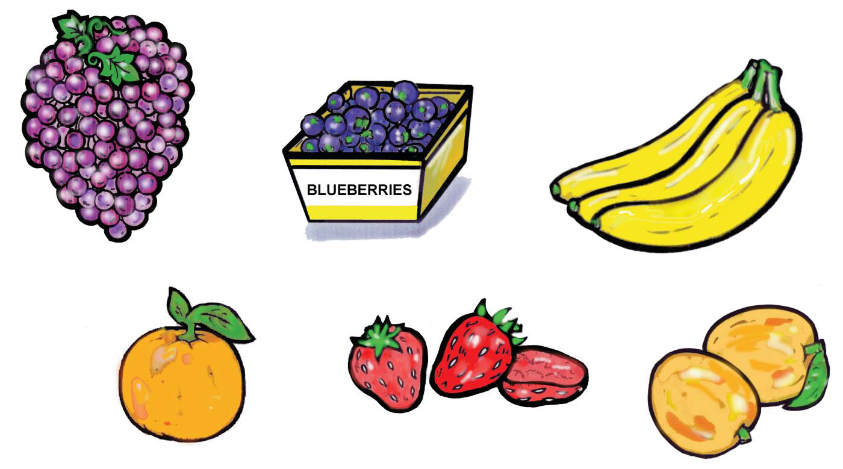
Vitamin A, vitamin C, fibre and potassium are found in many of the fruits you eat!

Slide 4
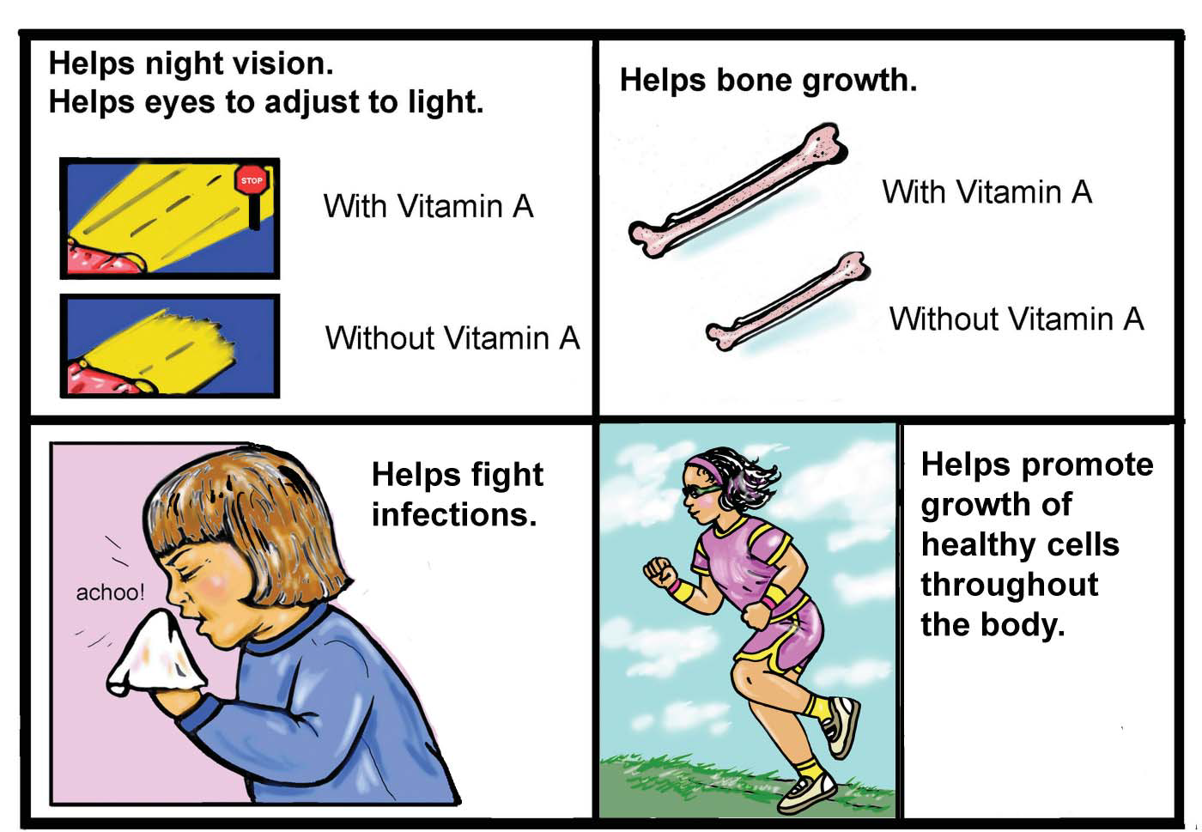
Vitamin A is good for your health.

Slide 5
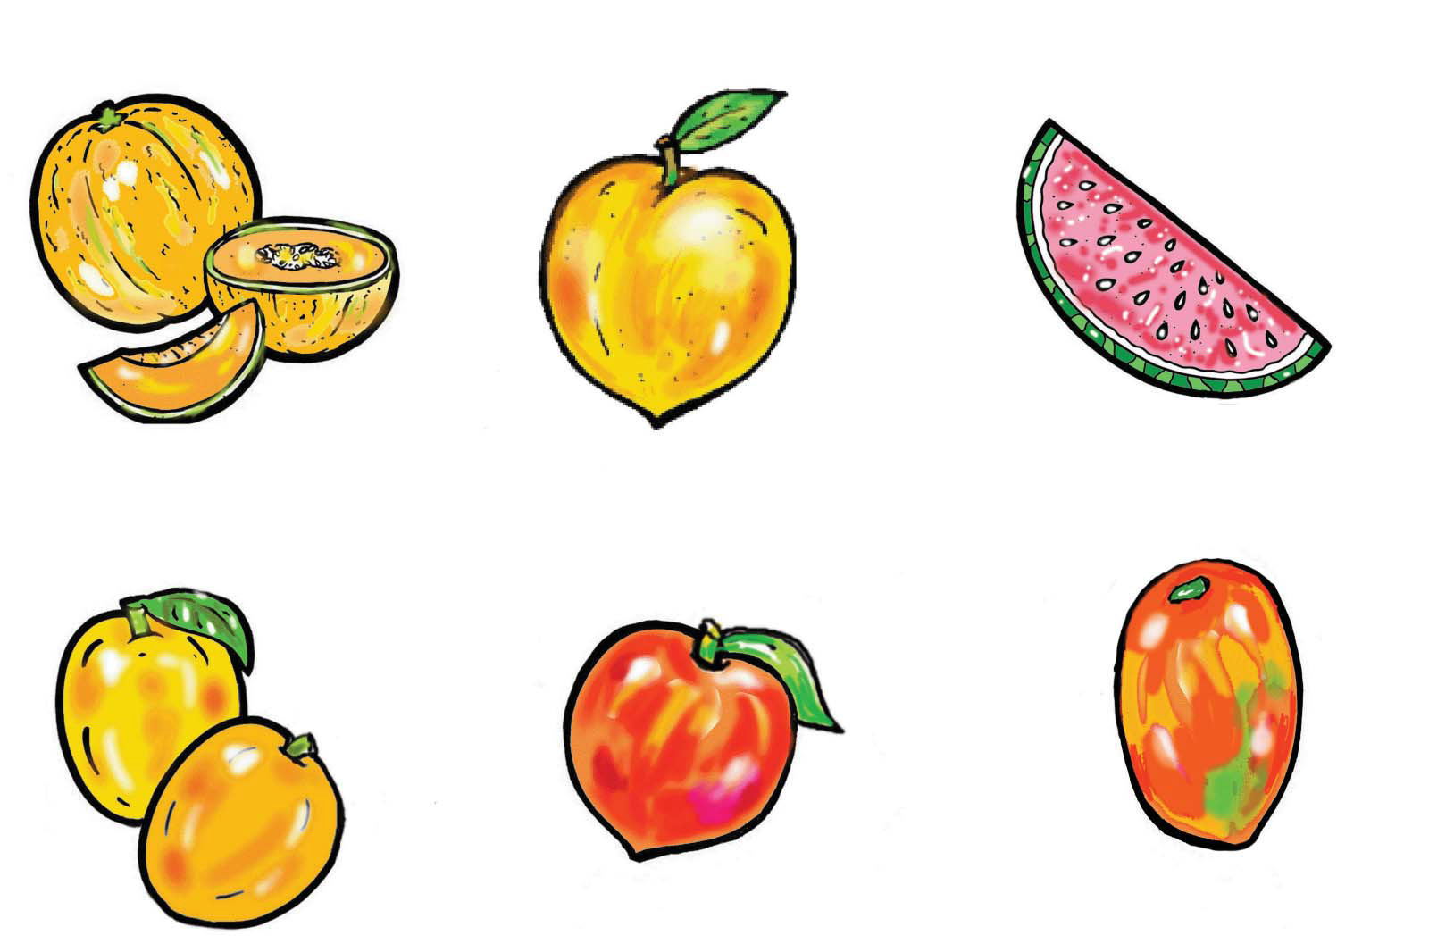
Fruits with Vitamin A

Slide 6
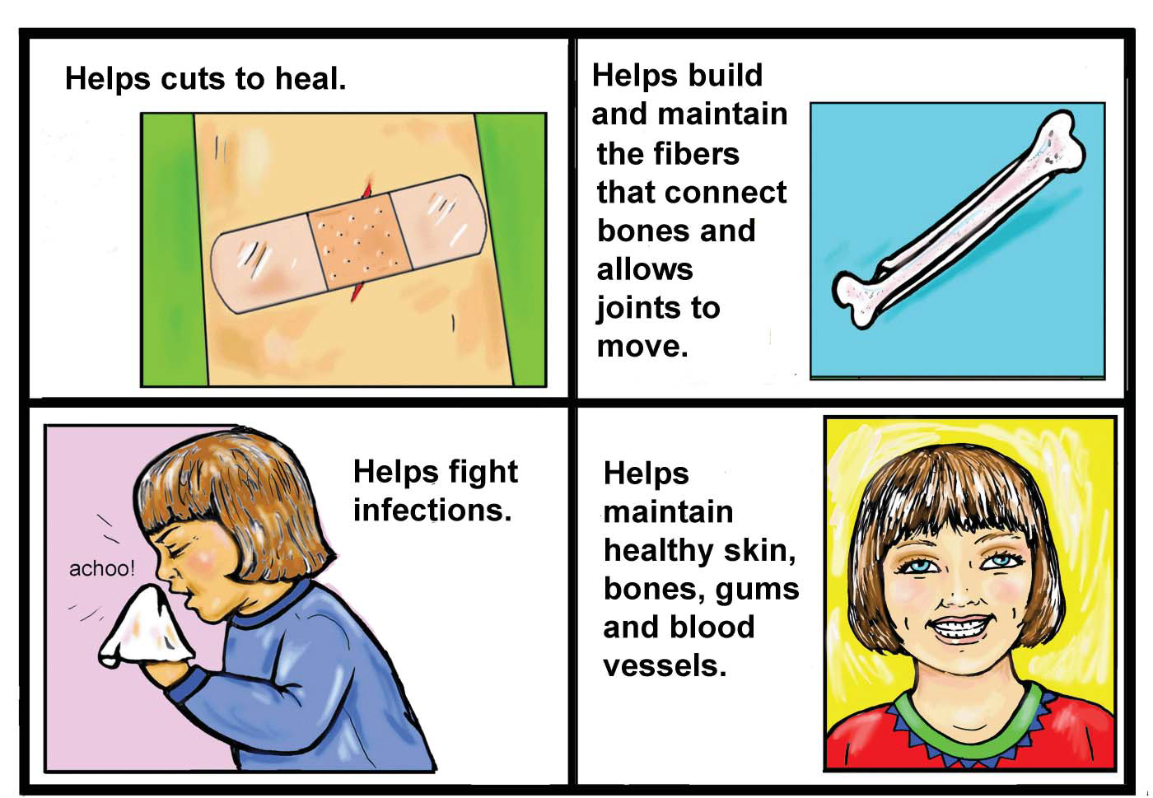
Vitamin C is good for your health.

Slide 7
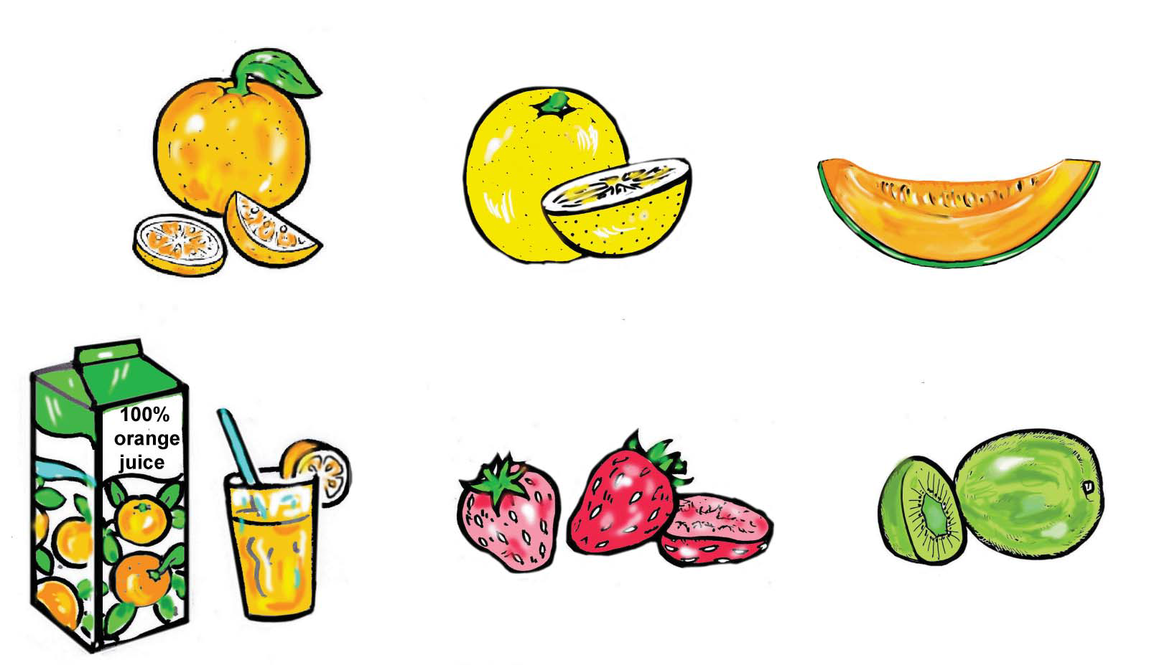
Fruits with Vitamin C

Slide 8
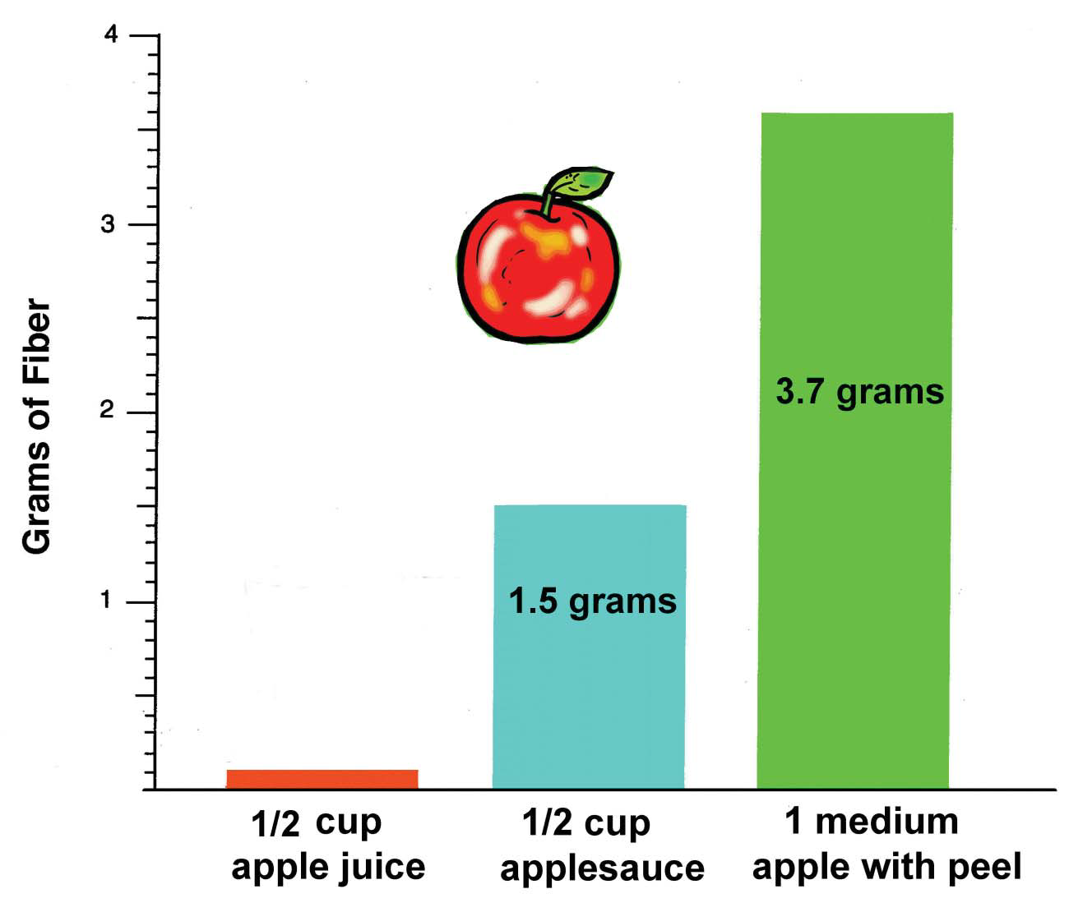
The form of the food will affect its fiber content.

Slide 9
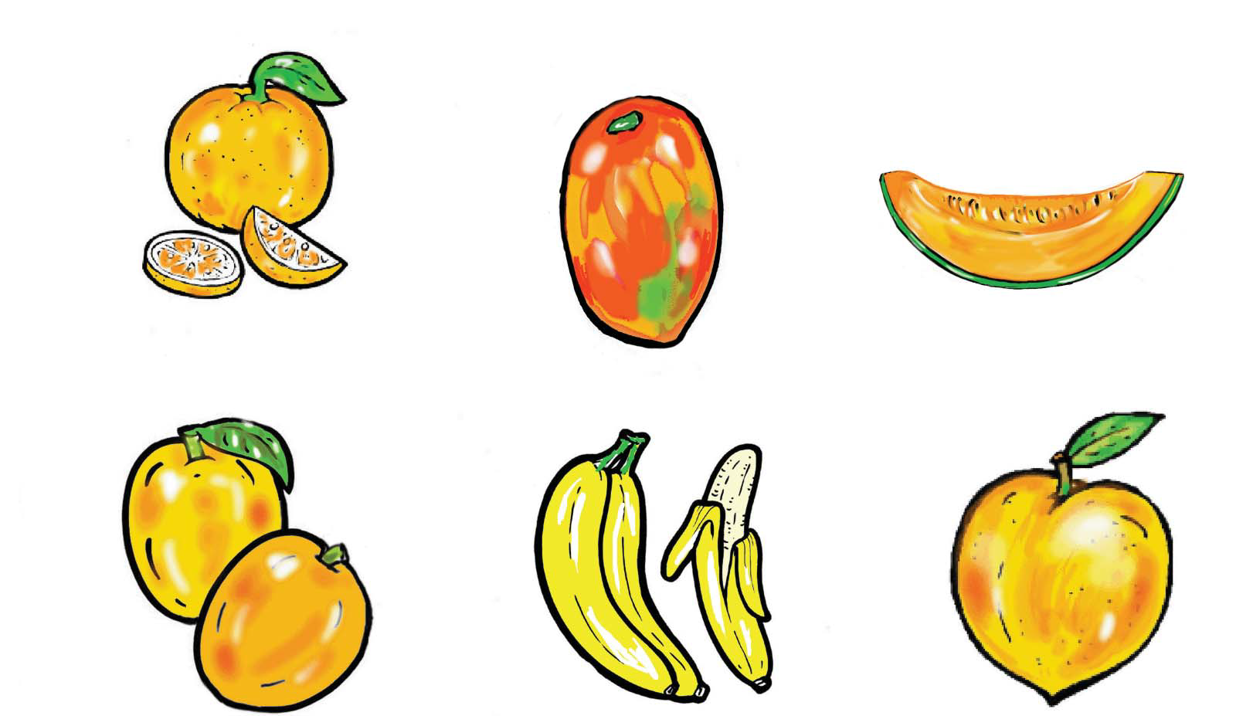
Eat potassium-rich fruit for good health.

Slide 10

Buy Fruits in Season
Spring Summer Fall Winter
strawberries cherries apples oranges
papaya peaches pears grapefruit
grapefruit plums grapes apples
bananas watermelons bananas bananas
mango melons cranberries grapes
blueberries kiwi fruit lemons
raspberries
bananas

Slide 11
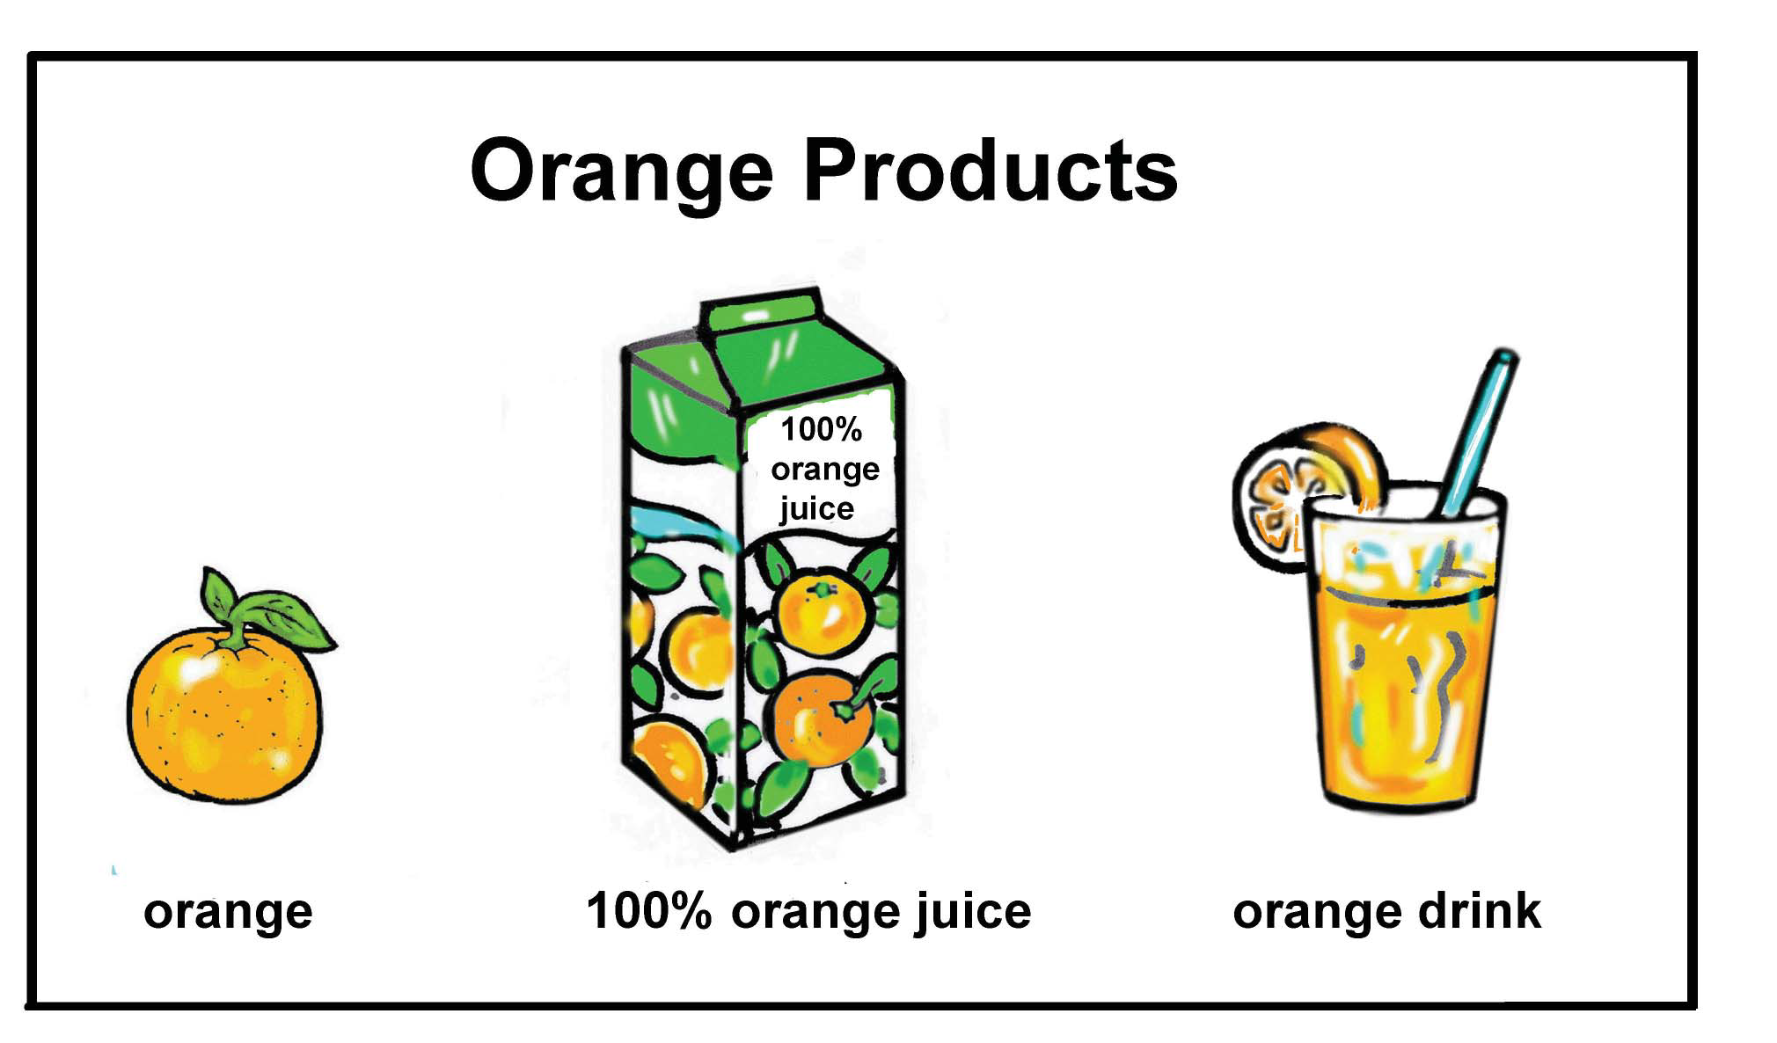

Slide 12
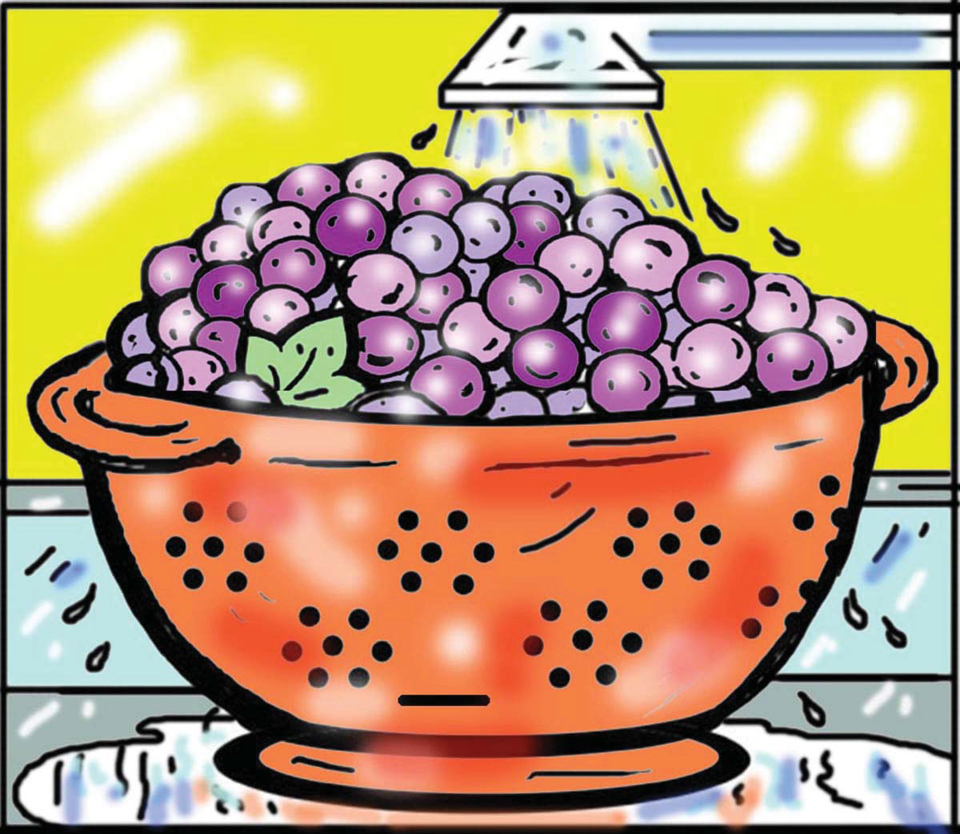
Rinse fresh fruits in water before peeling, eating or cooking.

Slide 13
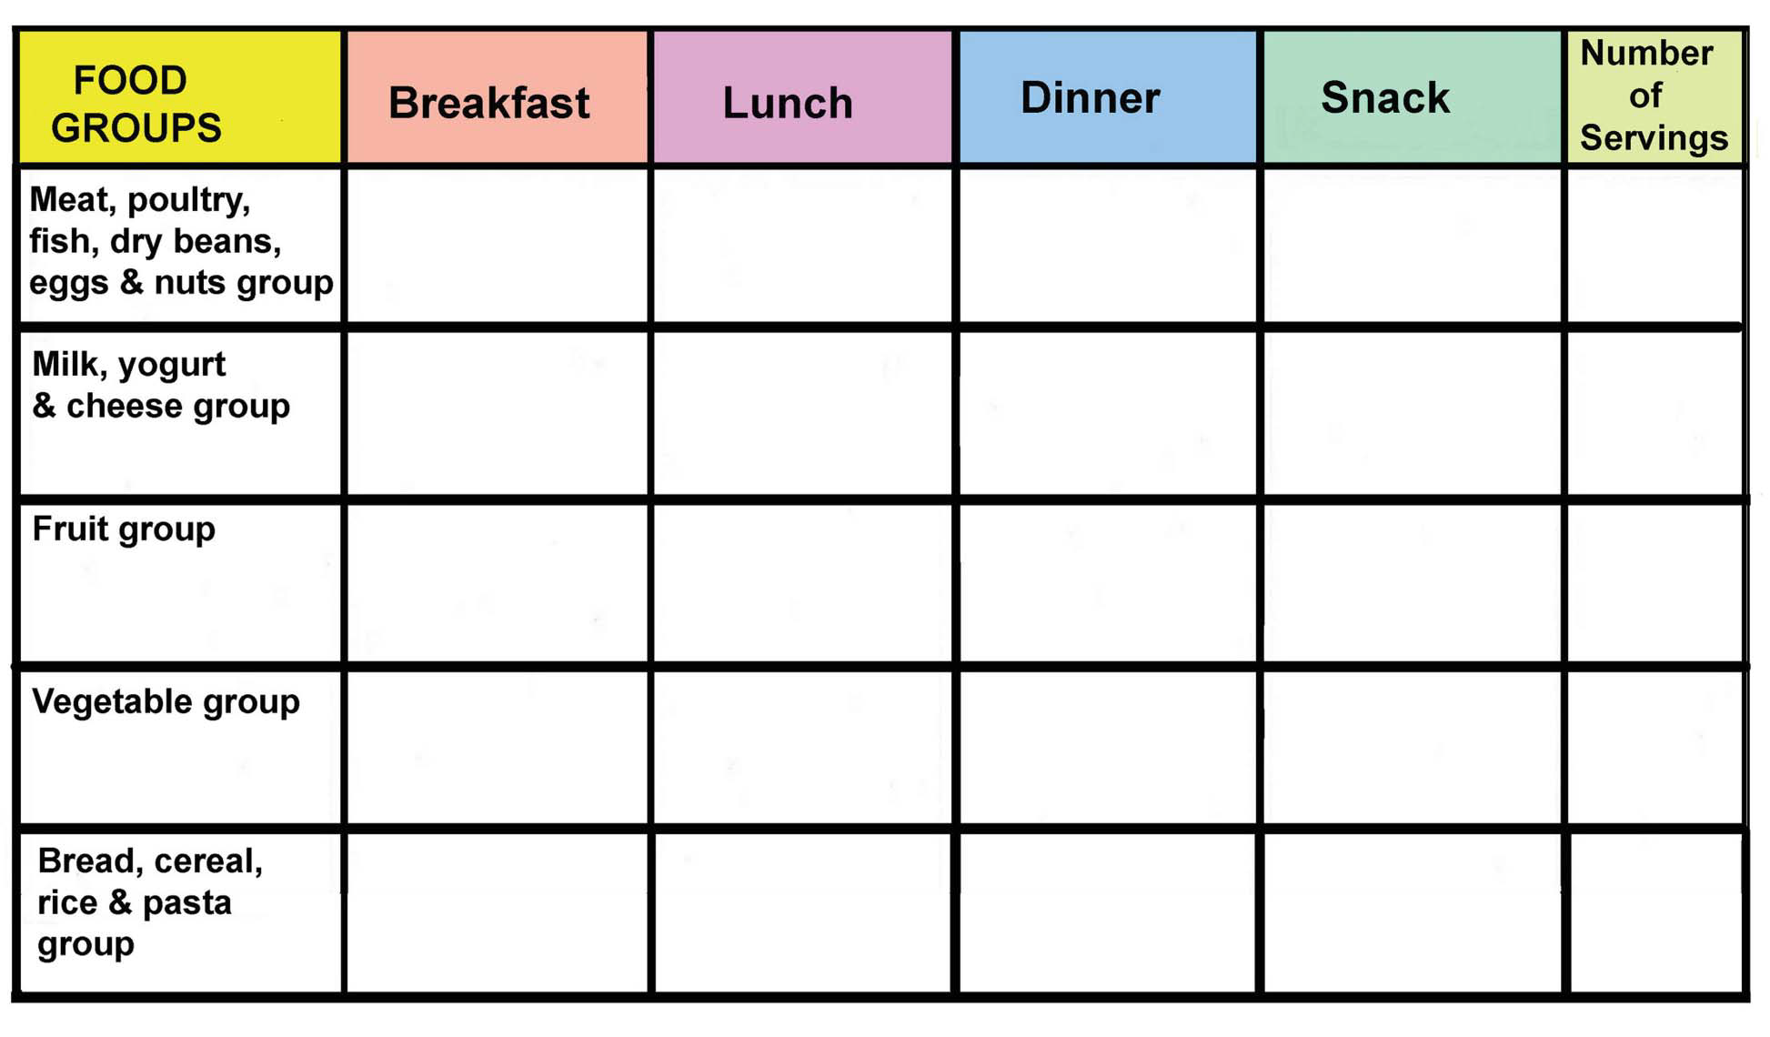
Daily Menu of Fruits
PLAN A MENU

