Slide 1
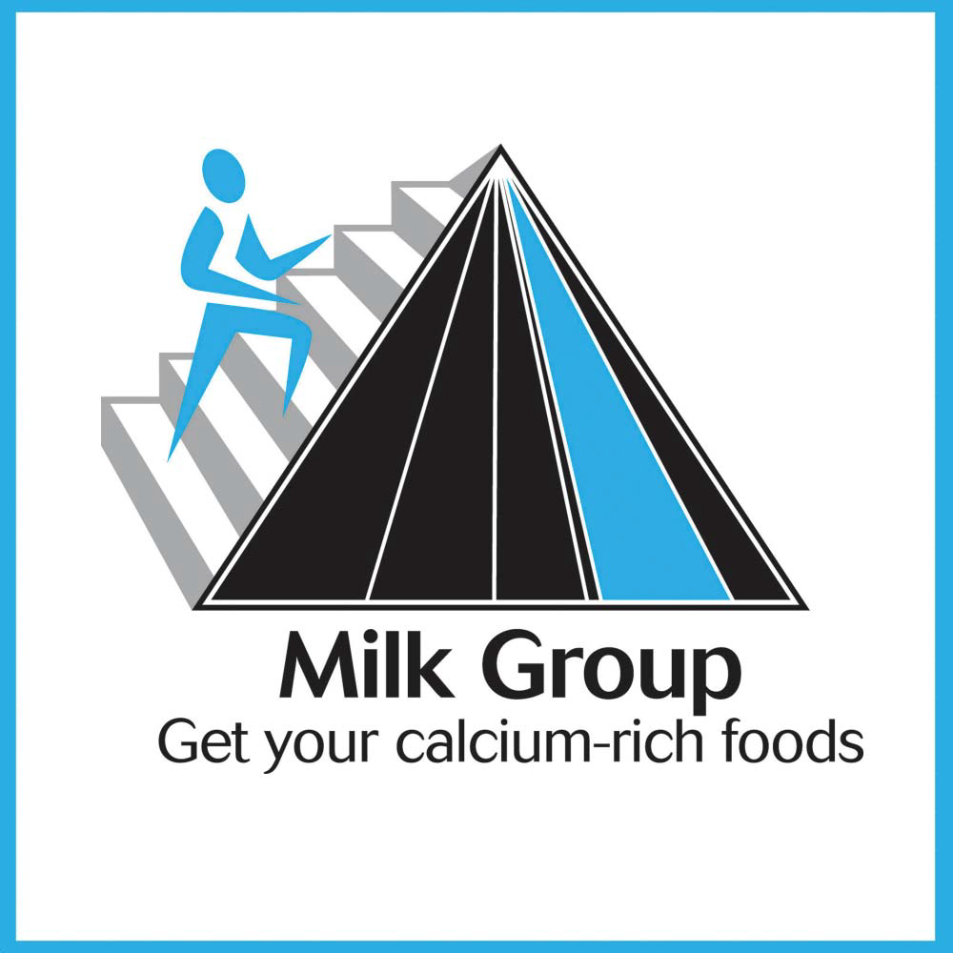
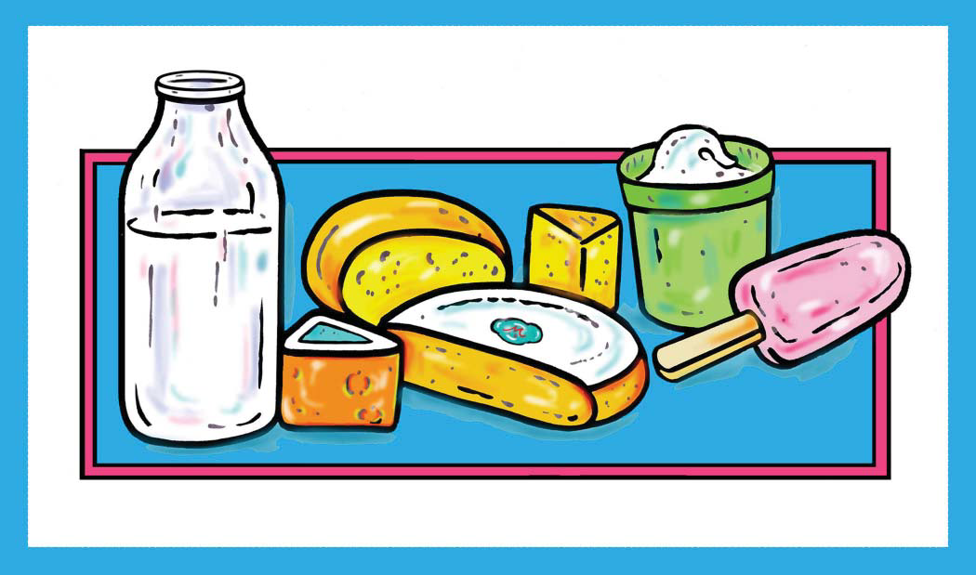

Slide 2
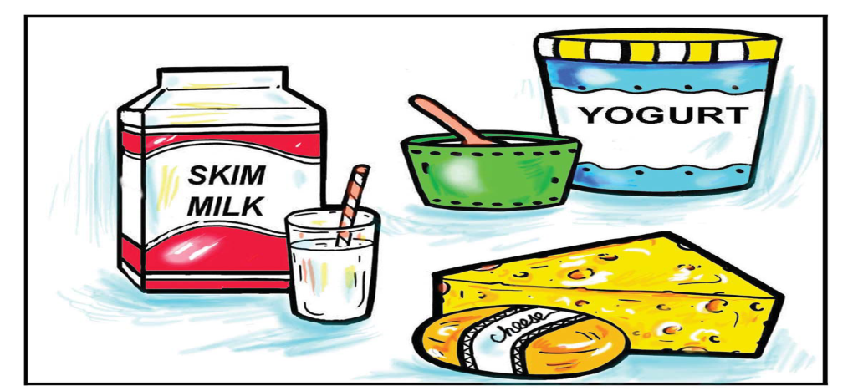
Calcium-Rich Dairy Foods
One serving of milk is equal to:
1 cup of yogurt
45 grams of natural cheese (cheddar, feta, graviera)
60 grams of soft cheese (cottage cheese, anthotyros)

Slide 3
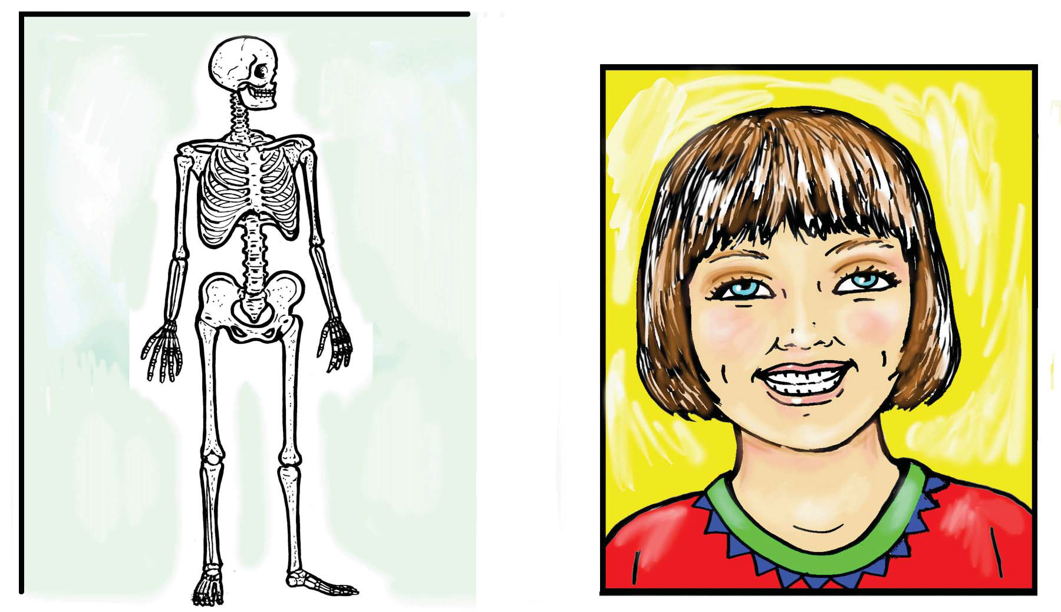
Calcium in Your Body

Slide 4
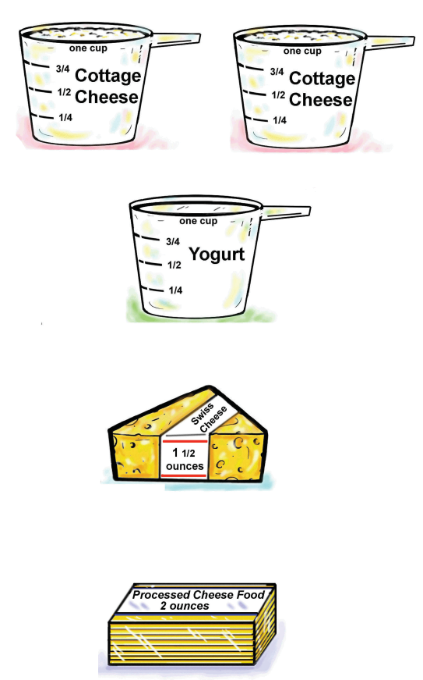
The amount of calcium in 1 cup of milk is equal to the calcium in:
• 2 cups Cottage cheese
• 1 cup Yogurt
• 45 grams Cheddar
or Graviera
• 60 grams Processed
cheese food

Slide 5
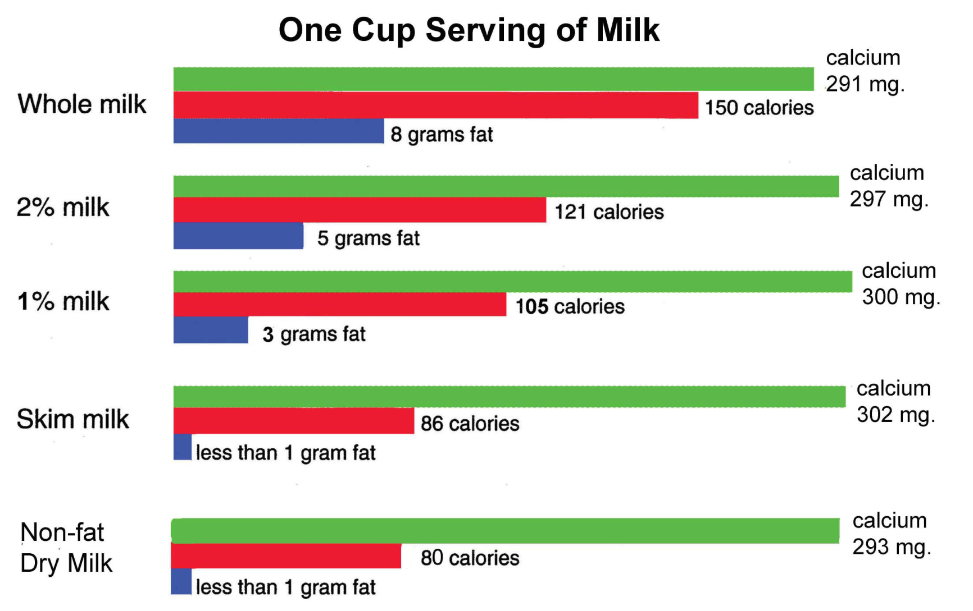
Calcium, Fat and Calories in Milk

Slide 6
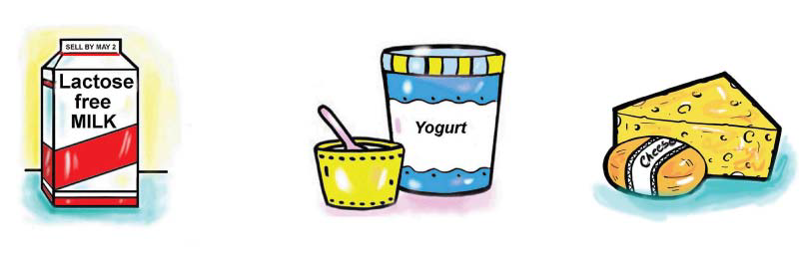
Dairy Foods for
Lactose-Intolerant Individuals

Slide 7
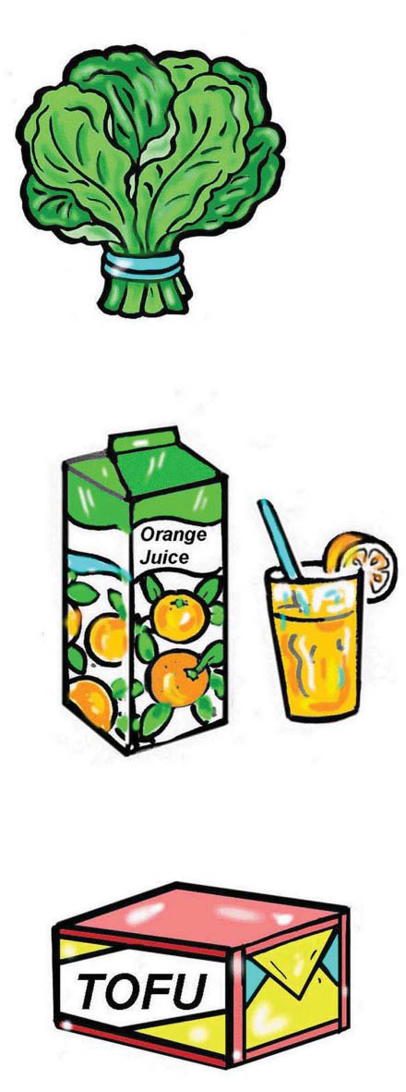
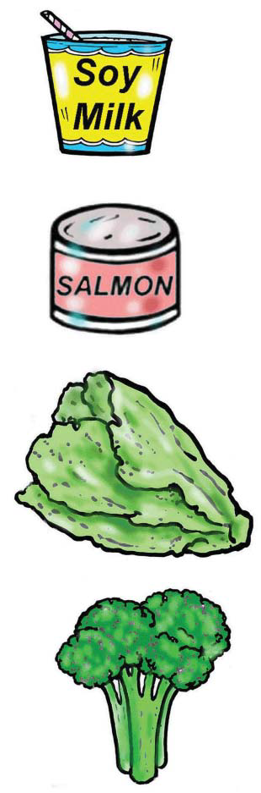
Non-Dairy Foods with Calcium
soy milk fortified with calcium
canned salmon or sardines with small edible bones
kale
broccoli
spinach
orange juice fortified with calcium
tofu

Slide 8
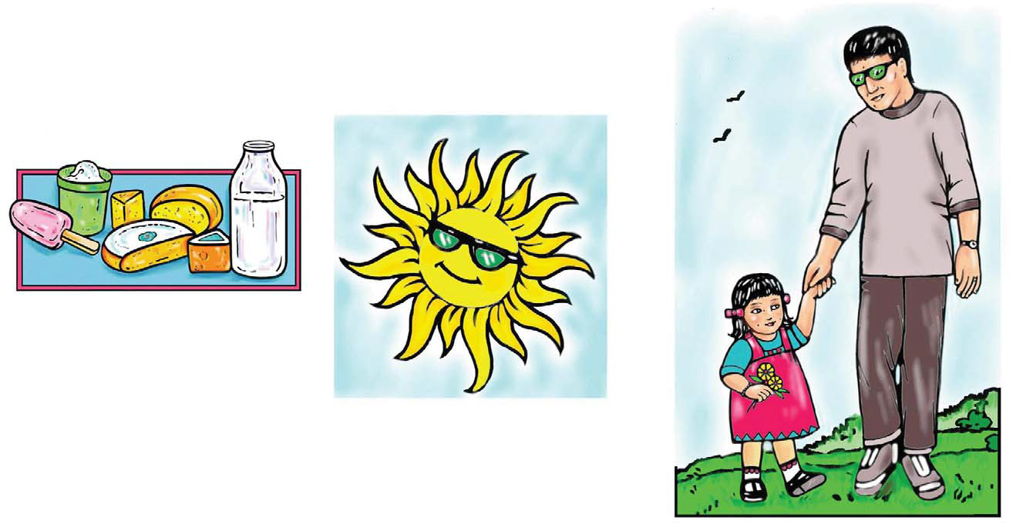
How to Build Healthy Bones
Eat dairy foods
2. Get a little sunshine (free vitamin D)
20 minutes every day
3. Weight-bearing exercise

Slide 9
Weight-bearing activities
Brisk-walking, jogging and hiking
Gardening and mowing the lawn
Team sports (basketball and baseball)
Dancing, step aerobics and stair climbing
Tennis and other racquet sports
Skiing, skating, karate and bowling

Slide 10
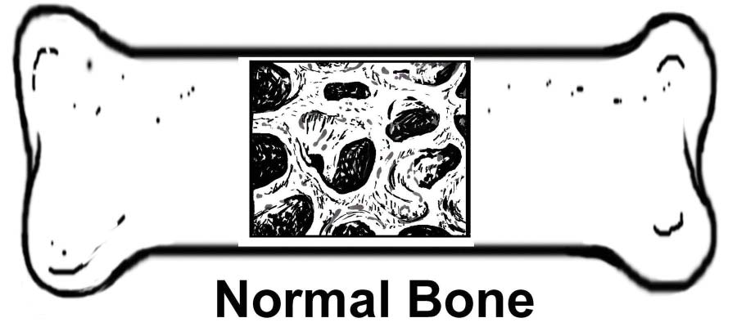
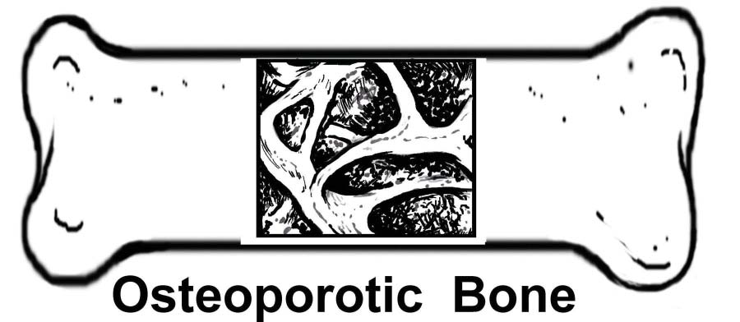
Calcium in your Bones
Section of bone showing normal bone density:
Section of bone showing osteoporosis /
reduced bone density:

Slide 11
Osteoporosis Risk Factors
Age
Gender
Family history
Body weight and bone structure
Menopause
Lifestyle
Medications

Slide 12

Read the “Sell by” Dates on All
Dairy Foods Before Purchasing
A dairy food is usually safe to eat 2 – 3 days
after the “sell by” date when handled properly.

Slide 13
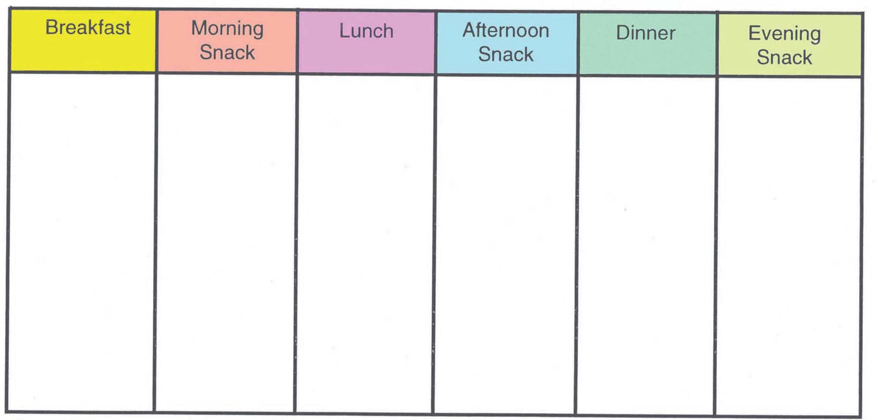
Daily Menu of Dairy Foods and Calcium Sources

