Slide 1
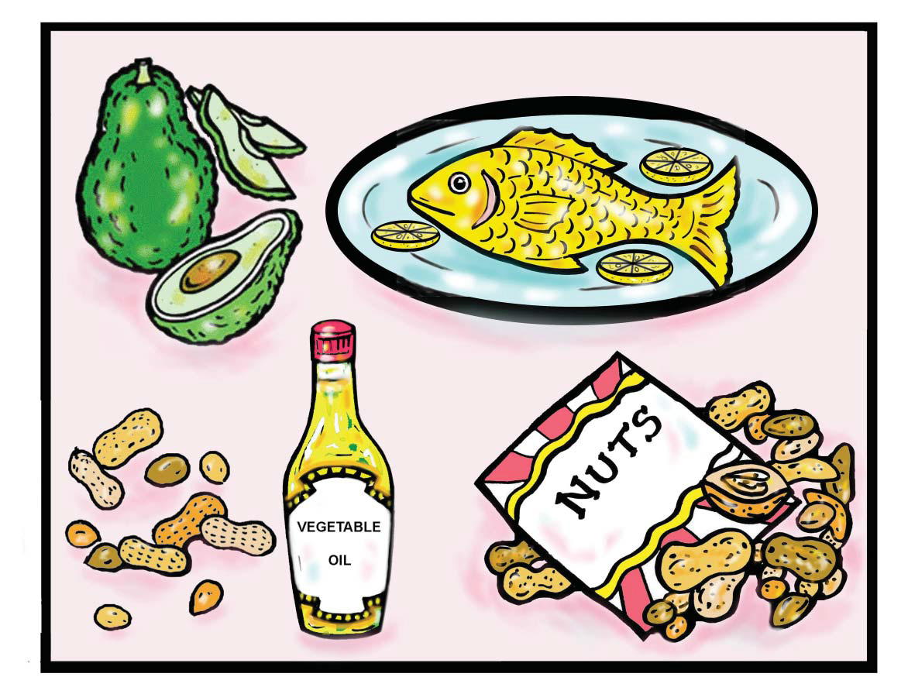
FAT and
CHOLESTEROL

Slide 2

How many people in your family have a history of heart disease, diabetes, high blood pressure, or high blood cholesterol?

Slide 3

Fats and cholesterol are needed by the body but too much can be unhealthy for you.

Slide 4
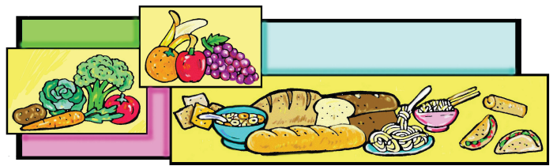
• Diets low in fat and cholesterol protect
against heart disease and cancer.
• Eat more whole-grain foods, fruits
and vegetables.

Slide 5
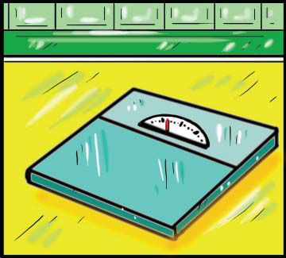
Another reason to lower dietary fat is for weight control.

Slide 6
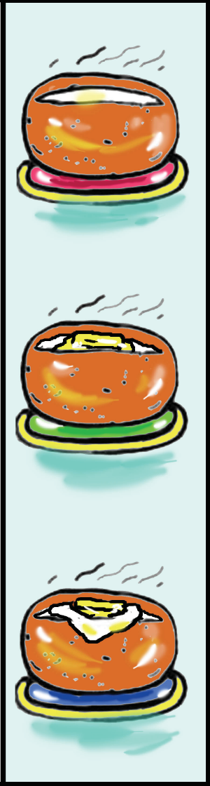
Where is the fat?
Plain baked potato = 1 gram of fat = 220 calories
Baked potato with 1 Tablespoon butter = 12 grams of fat = 320 calories
Baked potato with 1 Tablespoon butter and 1 Tablespoon sour cream = 15 grams of fat
= 350 calories

Slide 7
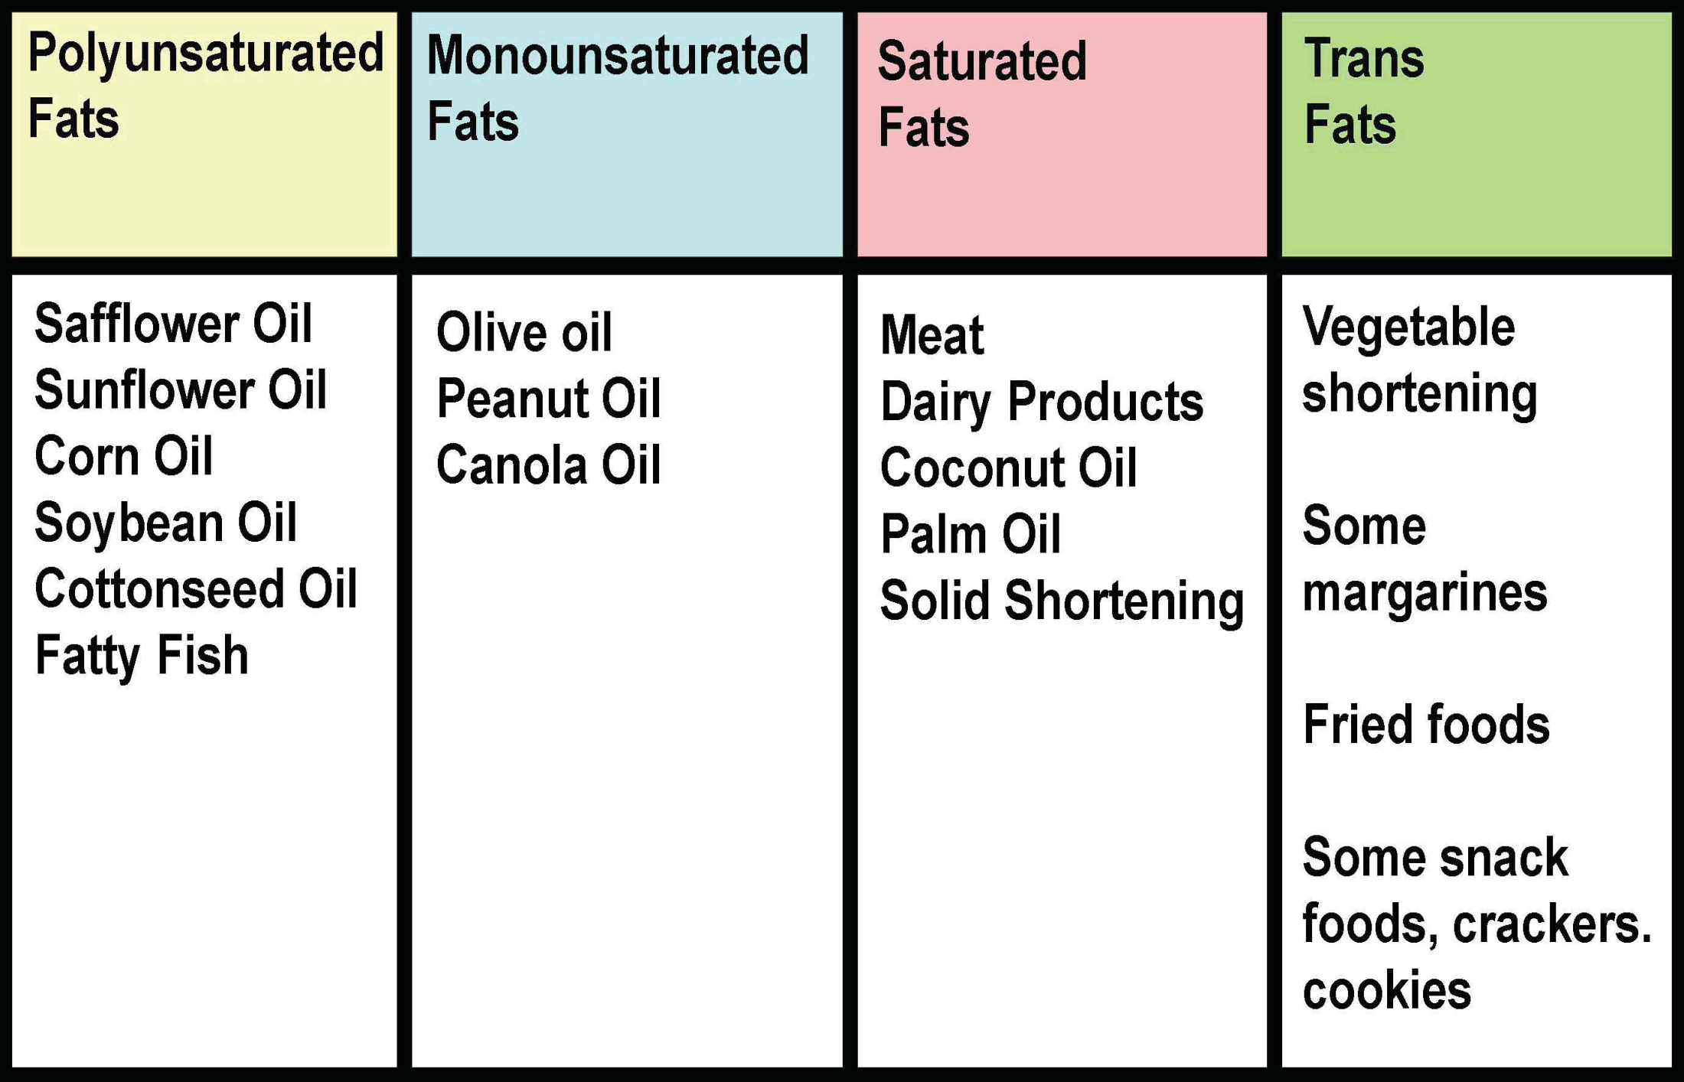
Fats in your diet.

Slide 8
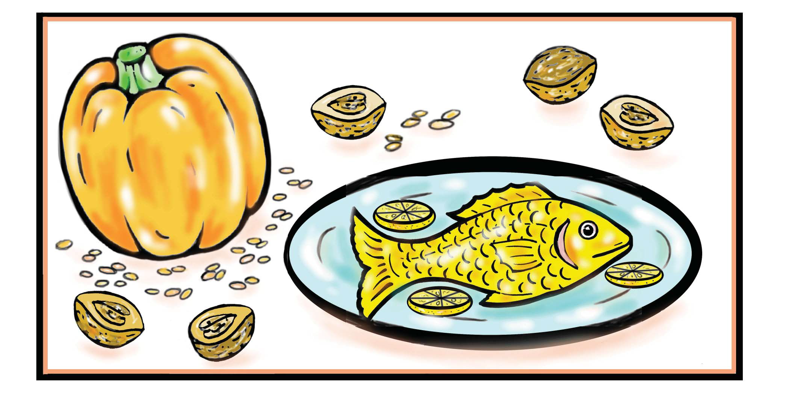
Polyunsaturated fats are part of a healthy diet.

Slide 9

Polyunsaturated fats
mackerel
swordfish
trout
herring
sardines
tuna
salmon
flax seeds
pumpkin seeds
walnuts

Slide 10

Monounsaturated fats are part of a healthy diet.
olive oil
sunflower seed oil
maize oil
sesame oil
canola oil
cotton seed oil
peanut oil

Slide 11

Trans fats are not part of a healthy diet.
They are found in many processed foods
and other foods made with “partially hydrogenated” oils.

Slide 12
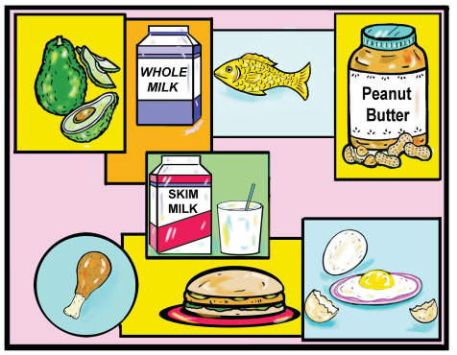
Which of the following foods contain dietary cholesterol?

Slide 13
Low fat alternatives
Instead of
Ice cream
Coffee with creamer
Apple pie
Potato chips
Broccolli with cheese sauce
Try
Low-fat frozen yoghurt
Coffee with milk
Raw apple
Carrot/celery sticks with dip
Broccolli with lemon

Slide 14
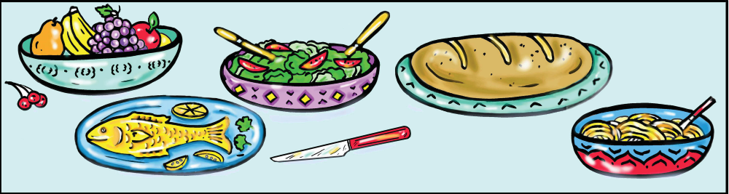
Lower the fat and cholesterol in your diet.
1) Eat lower fat foods. Read food labels to find the fat content of foods.
2) Eat more fruit, vegetables and whole-grain foods.
3) Bake, steam or grill food instead of frying.
4) Season foods with herbs and spices instead of butter/margarine, oils or cheeses.
5) Prepare lean meats when possible. Trim fat from cuts of meat. Remove skin from poultry before cooking or before eating.

Slide 15
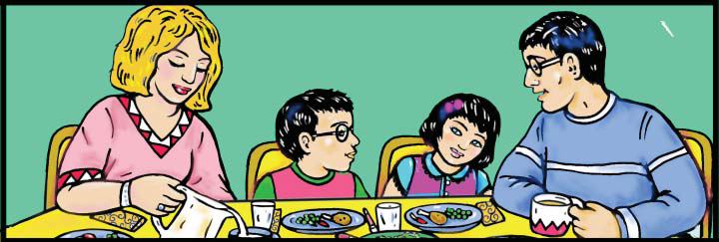
Learn to eat a heart healthy diet
• Don’t expect to change the way you eat over night.
• Make changes slowly.
• Focus on one change per month.

