Slide 1

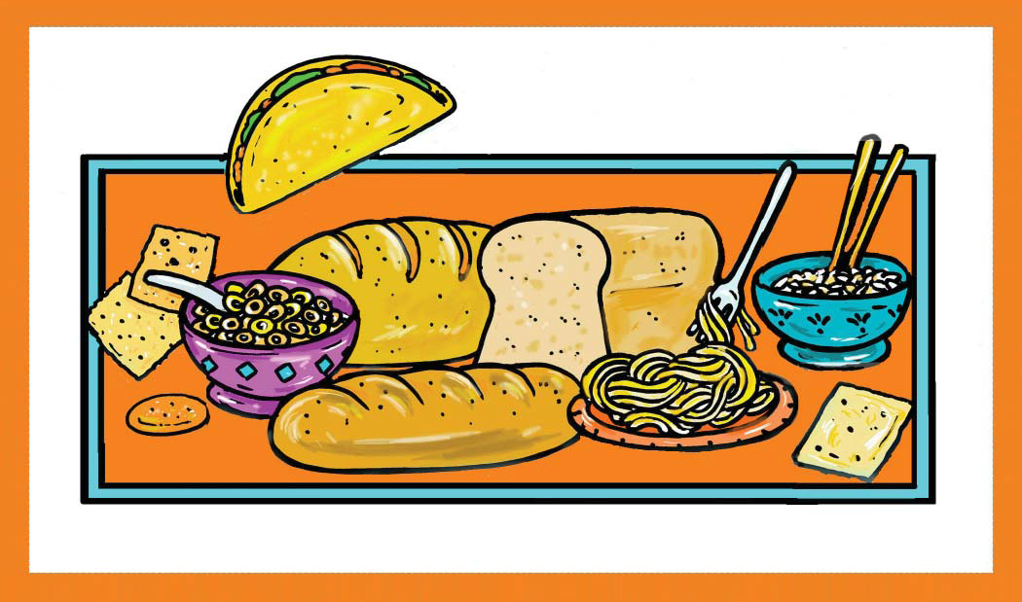

Slide 2
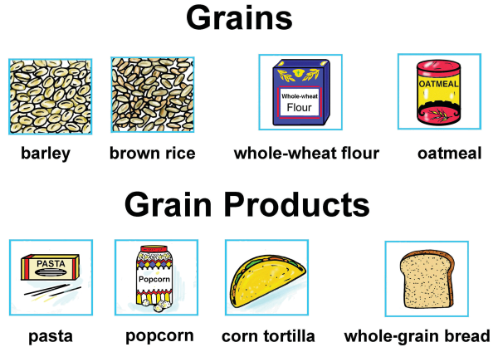

Slide 3
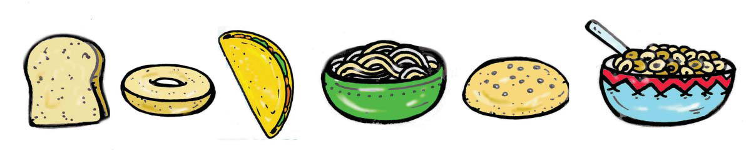
Grains
One serving of grains:
1 slice of bread
1/2 cup of cooked grain like oatmeal or rice
1 cup of ready-to-eat flake cereal
1/2 cup cooked pasta
1/2 a bun
1 pancake
1 tortilla
3 cups popped popcorn

Slide 4

Carbohydrates in grain foods give us energy!

Slide 5
Carbohydrates include:
starches
natural sugars
“added” sugars

Slide 6
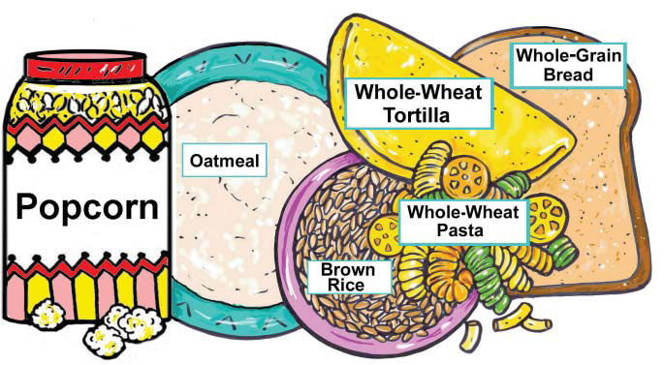
Whole-grain Carbohydrates

Slide 7
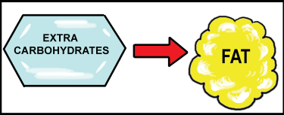
Carbohydrates we eat,
not needed by our body,
will be changed and stored as fat.
It is important not to eat more
calories than your body needs
each day.

Slide 8
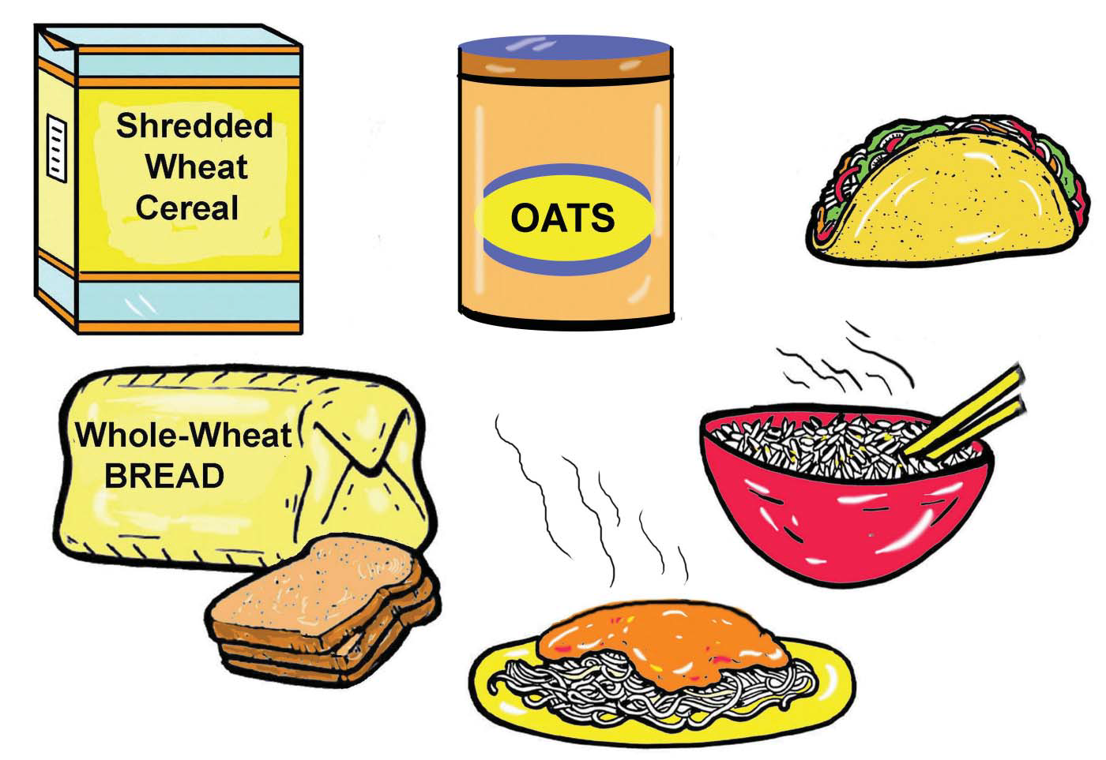
Half of the grain foods you eat should be whole-grain foods.

Slide 9
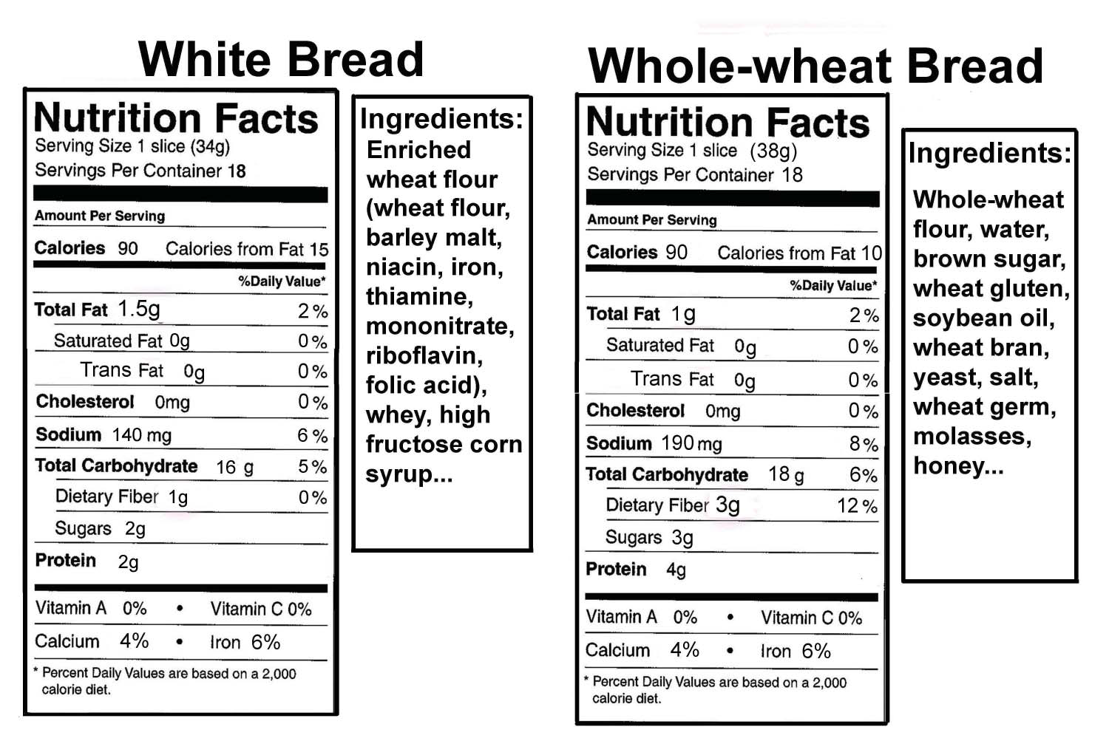
Learn to read food labels.

Slide 10
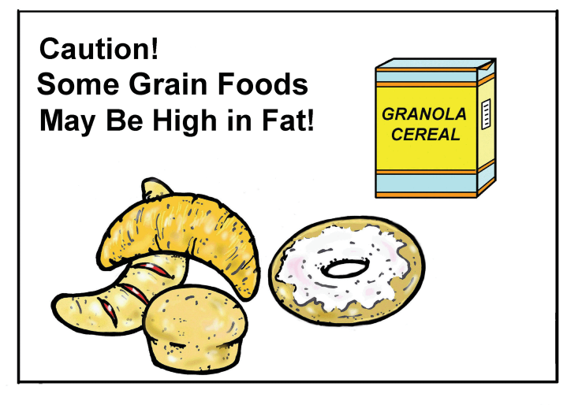

Slide 11
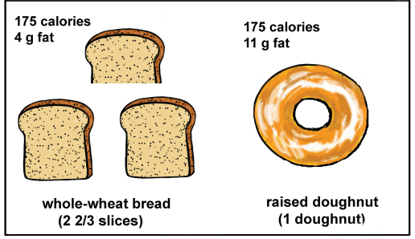
Whole-wheat Bread is Nutrient Dense
Doughnut Is Calorie Dense

Slide 12

Plain bread, cereal, rice and pasta foods are usually not high in calories.
Fats and sugars added to grain foods for flavouring raise their calorie content.

Slide 13
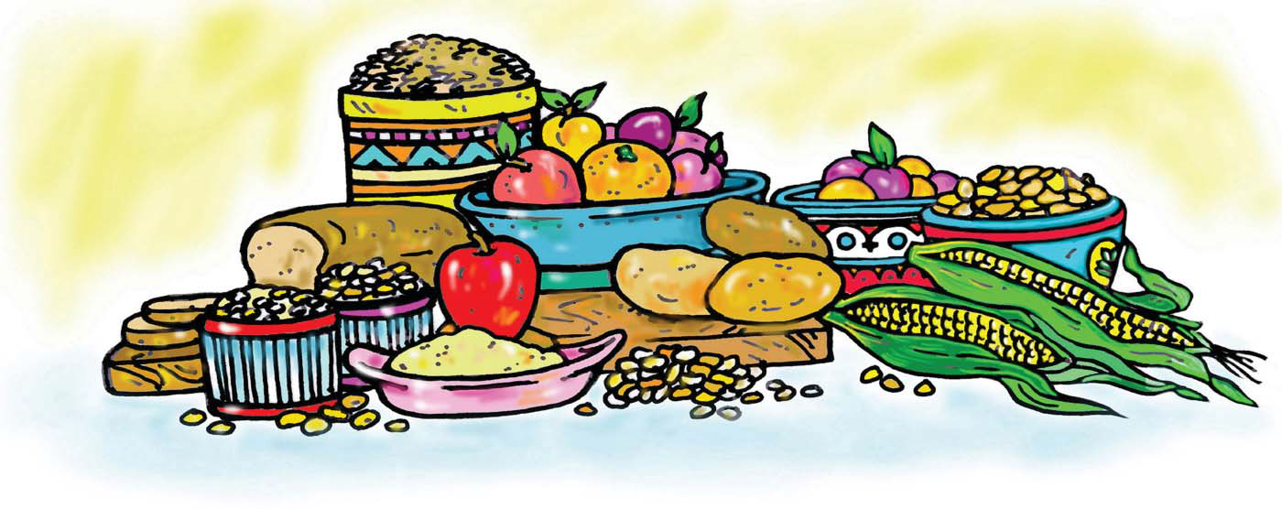
Fiber Recommendations
Adults: About 28 grams of fiber each day.
Children (ages 3 to 18):
Child’s age + 5 = number of grams of fiber each day.
Example for 7 year old: 7 + 5 = 12 grams fiber.

Slide 14
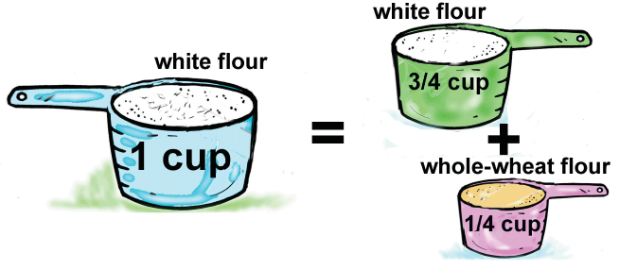
Substitute whole-wheat flour in your baking.

Slide 15
Client suggestions
Whole-grains substitutions
Breakfast
Corn flake cereal
Milk
Orange juice
Lunch
Tomato soup
Tossed green salad
Snack
Cookies and apple
juice
Dinner
Chicken-
Mashed potatoes
Broccoli
Apricot juice
Milk
Breakfast
Whole-grain cereal: oatmeal, shredded wheat
Whole-grain breads
Lunch
Add barley or brown rice to the soup
Sprinkle muesli on fruit or salad
Snack
Whole-wheat crackers, popcorn, fruit with skin
Dinner
Apricot salad sprinkled with muesli

