Slide 1
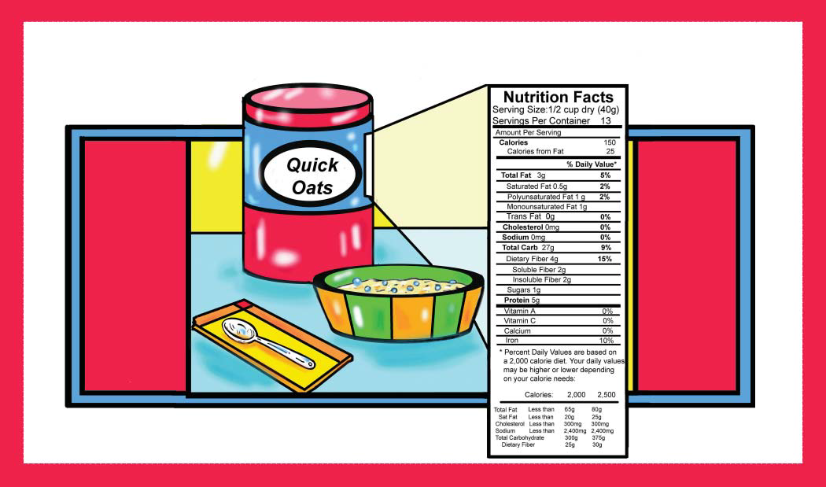
FOOD LABELS

Slide 2
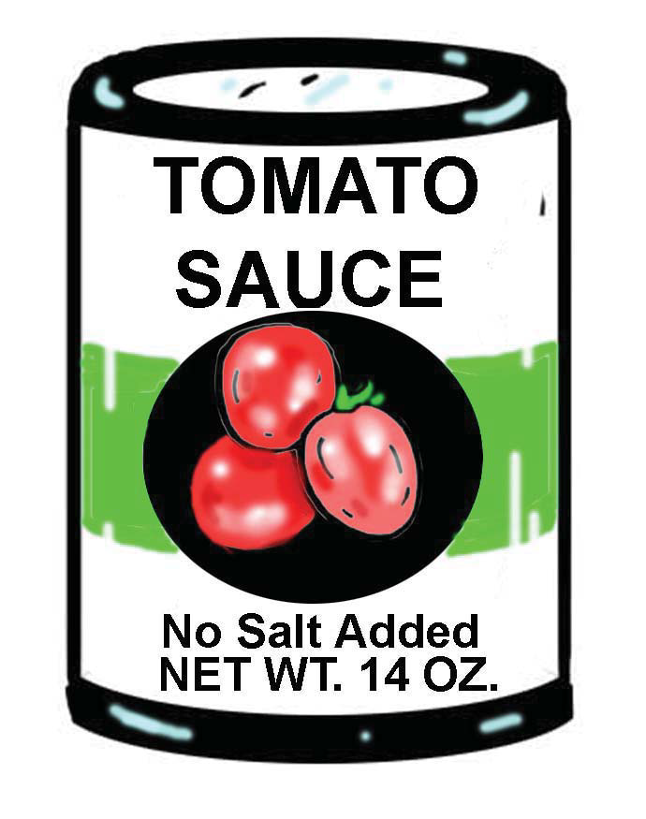
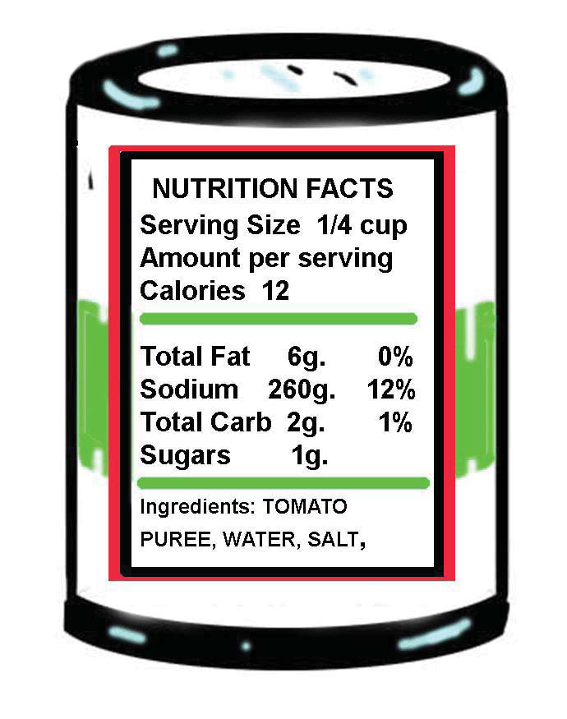
Food Labels

Slide 3
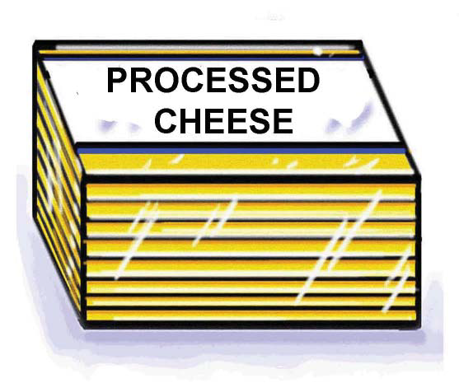
List of ingredients
Processed cheese slices
Ingredients: MILK, WATER, MILK PROTEIN CONCENTRATE, MILKFAT, WHEY PROTEIN CONCENTRATE, SODIUM CITRATE, WHEY, SALT, GELATIN, SODIUM PHOSPHATE, SORBIC ACID AS A PRESERVATIVE, OLEORESIN PAPRIKA, ANNATTO (COLOR), ENZYMES, CHEESE CULTURE

Slide 4
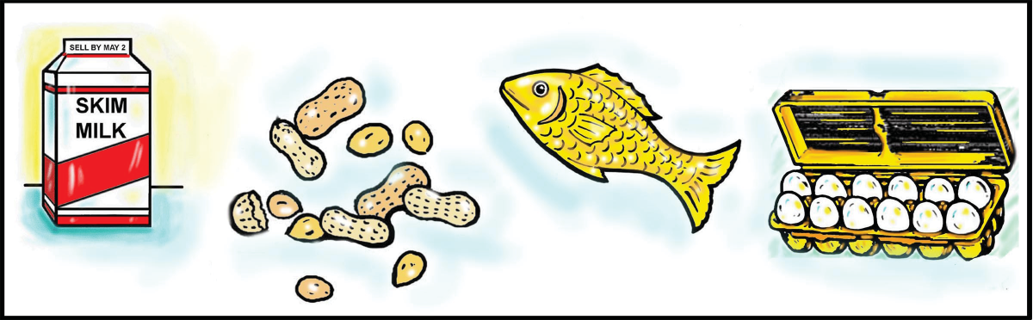
Allergens must be listed on food labels in plain language.
Common allergens:
Tree nuts (examples: almonds, walnuts, pecans)
Milk
Eggs
Fish
Crustacean shellfish
Peanuts
Soybeans
Wheat

Slide 5
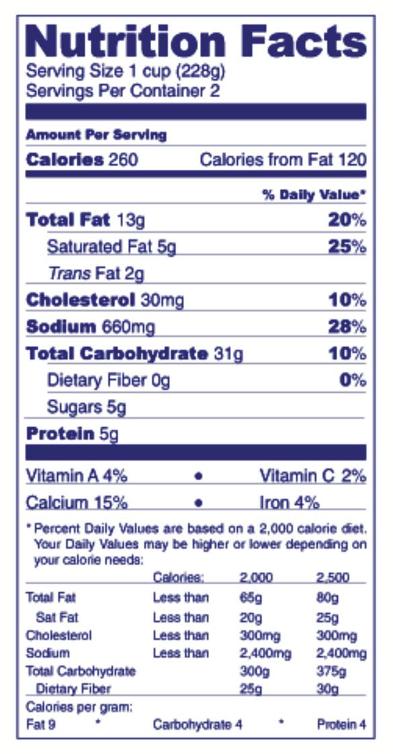
Nutrition Facts Panel

Slide 6
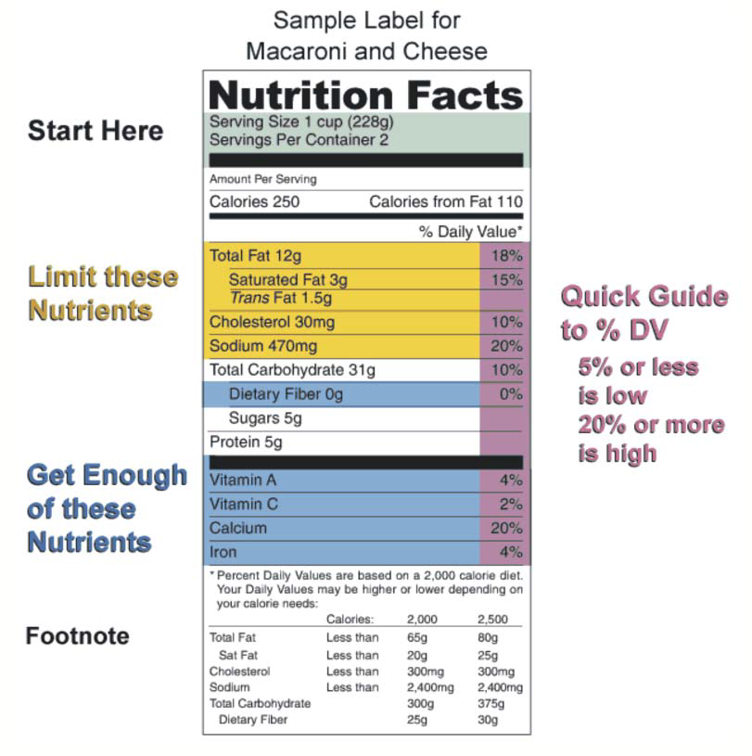
Nutrition Facts: Serving Sizes, Calories, Calories from Fat

Slide 7
More About Nutrition Facts
• % Daily Value (DV)
• Nutrient list
• Carbohydrates and protein
• Vitamins and Minerals

Slide 8
Words like free, low, and light may be used on the food label
FAT FREE - Foods must have less than 0.5 grams of fat per serving.
LIGHT FAT - Food contains no more than half the fat per serving of a comparison food.
LOW FAT - Food must have only 3 grams of fat or less per serving.

Slide 9


Slide 10
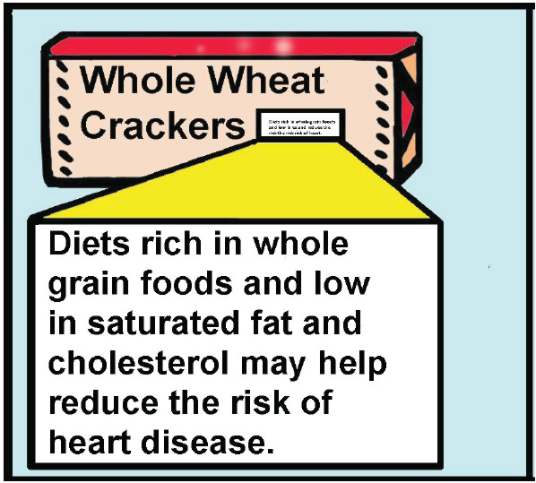
Food Label Health Claim Statement

