Slide 1
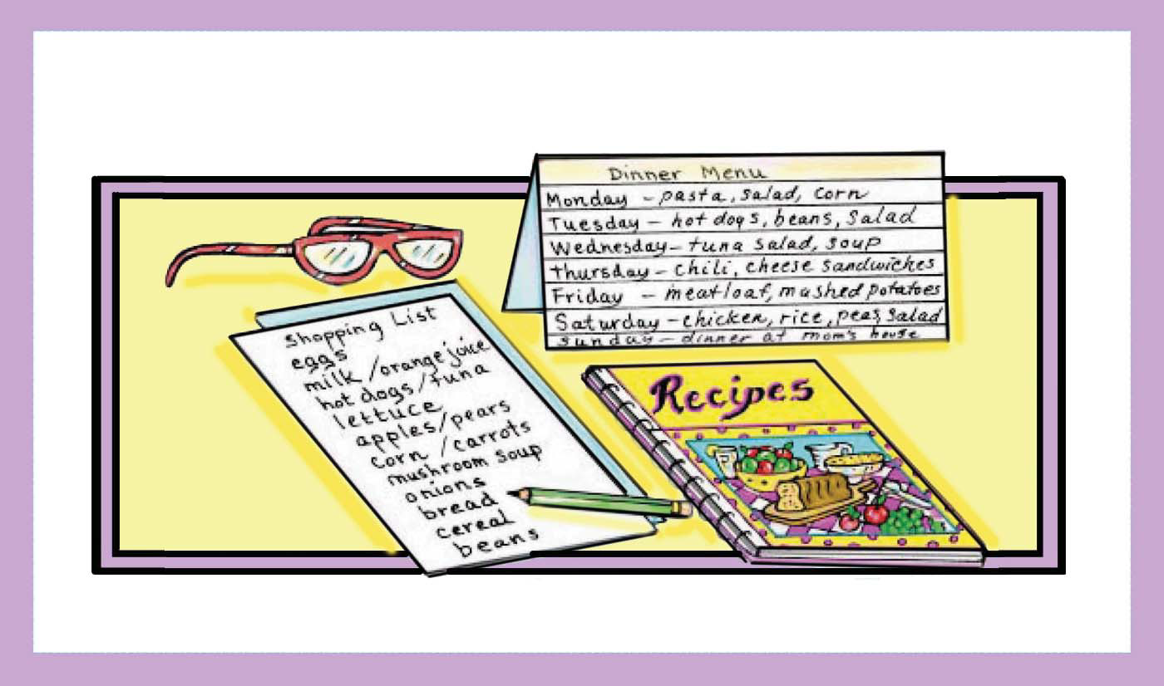
MEAL PLANNING

Slide 2
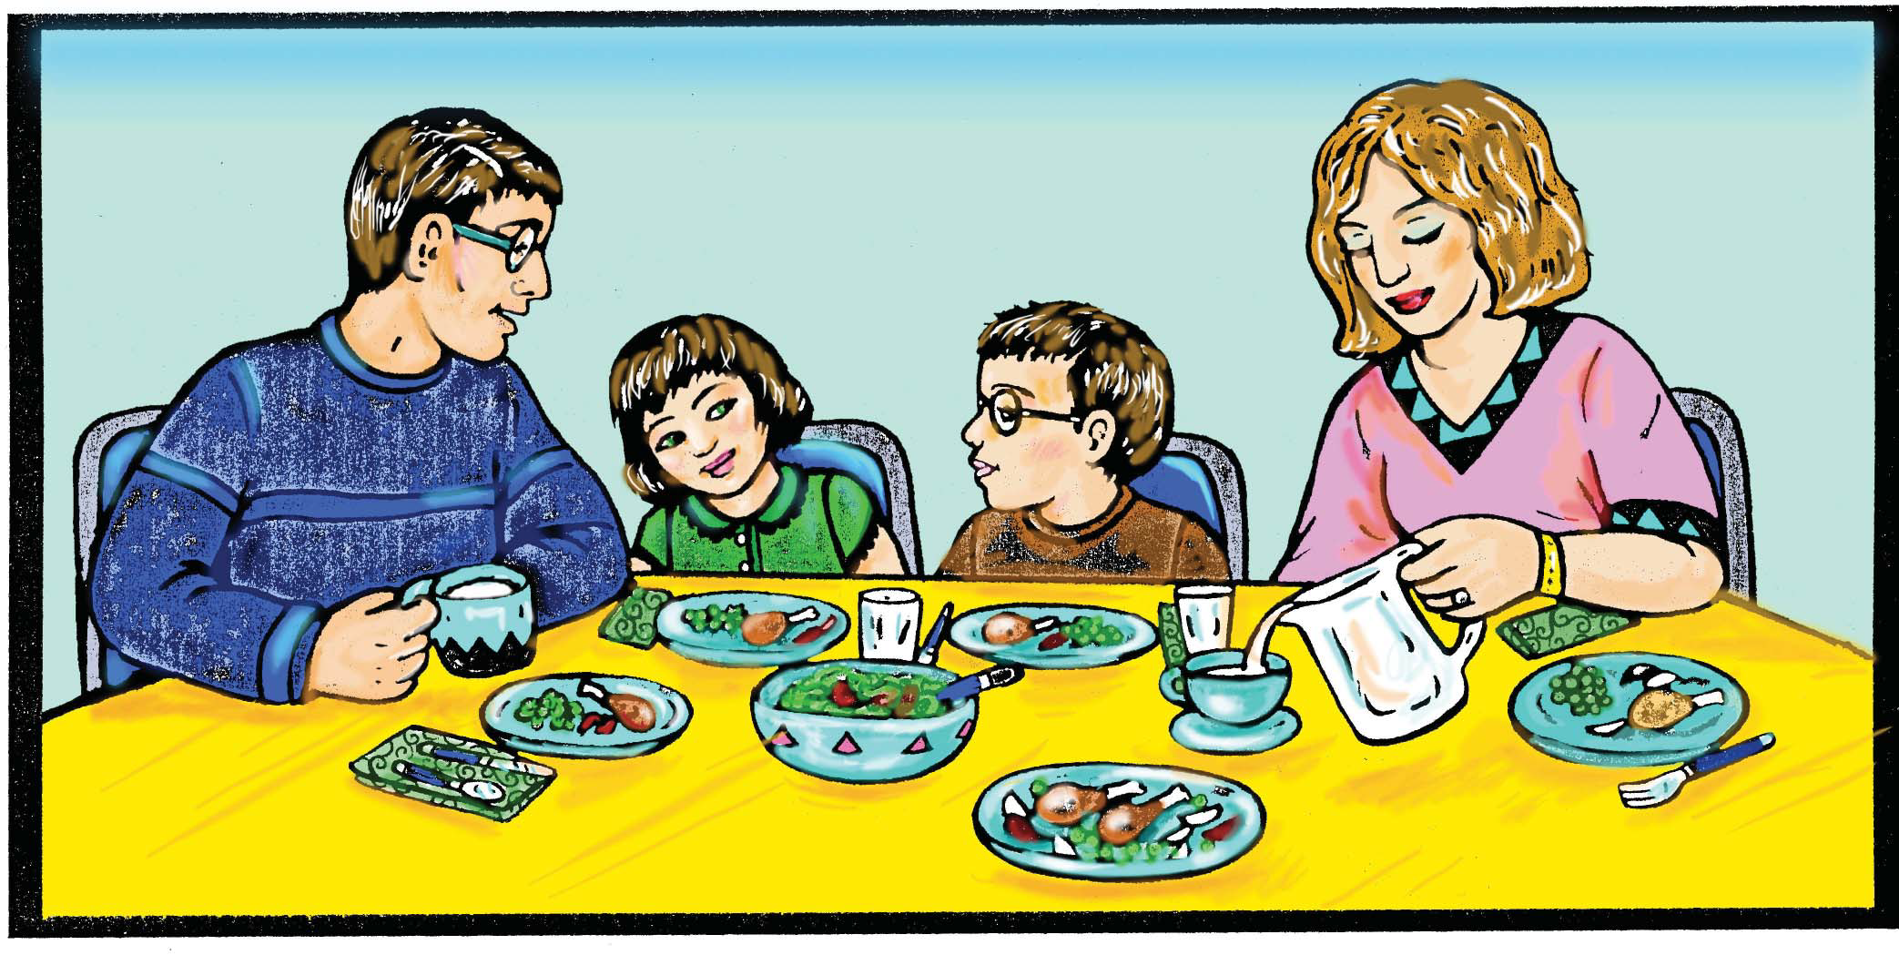
Meal Time - Family Time

Slide 3
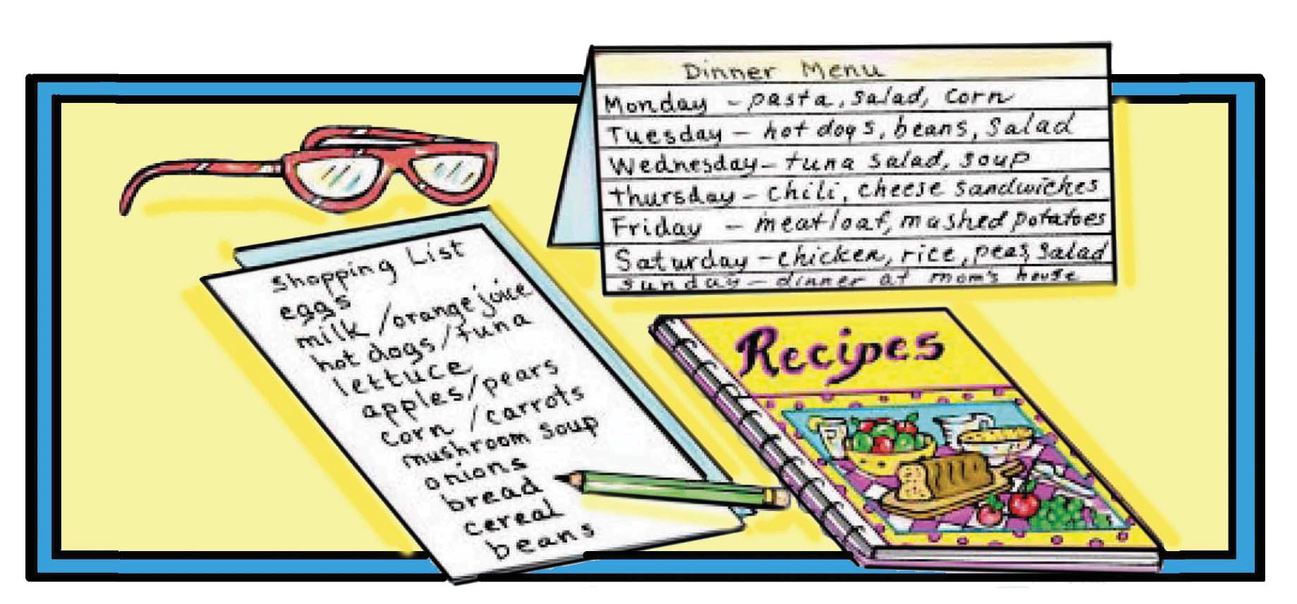
Planning meals for a week saves you time and money

Slide 4
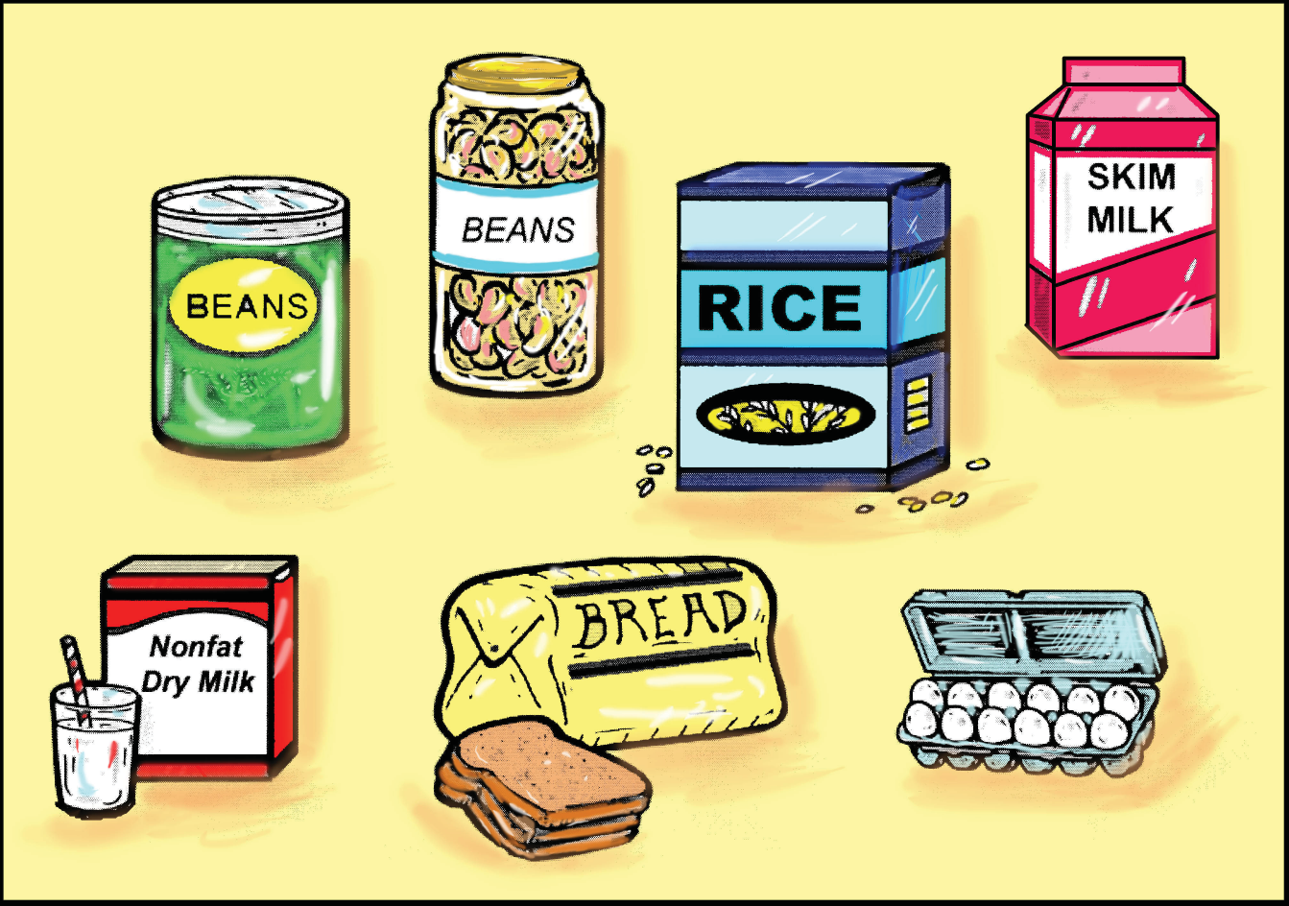
Plan meals with foods you already have on hand!

Slide 5
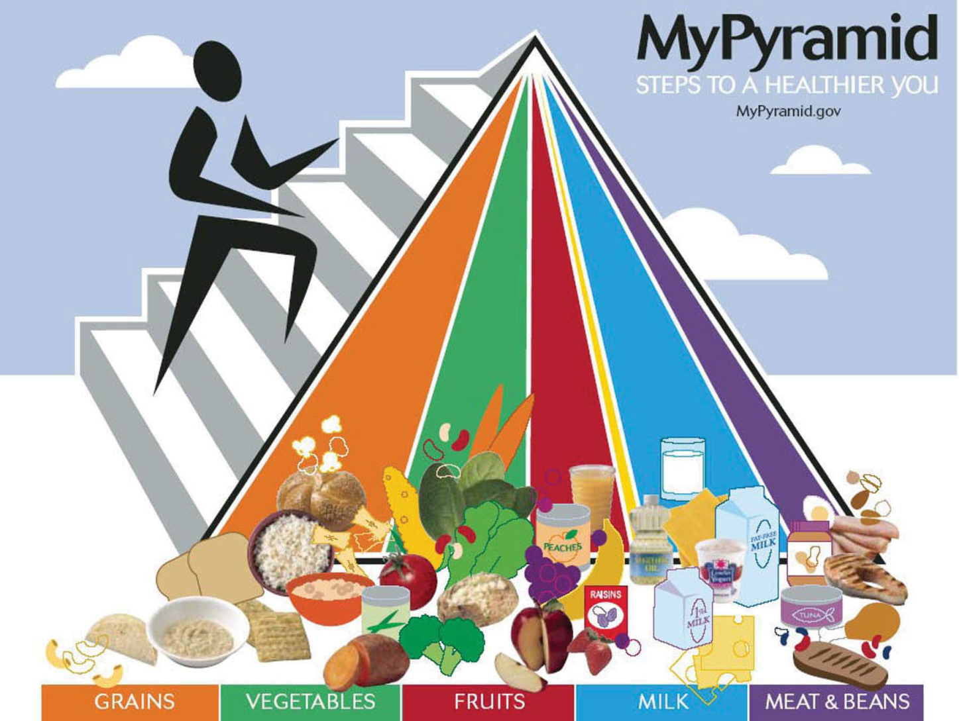
Eat a Variety of Foods

Slide 6
Recommended daily intakes per person based on a 2,000 calorie diet.
Vegetables → 2 1/2 cups
Fruits → 2 cups
Dairy → 3 cups of milk or 3 equivalent milk product servings
Grains → 180 grams
Meat, Poultry, Fish, Beans, Eggs & Nuts → 150 grams

Slide 7
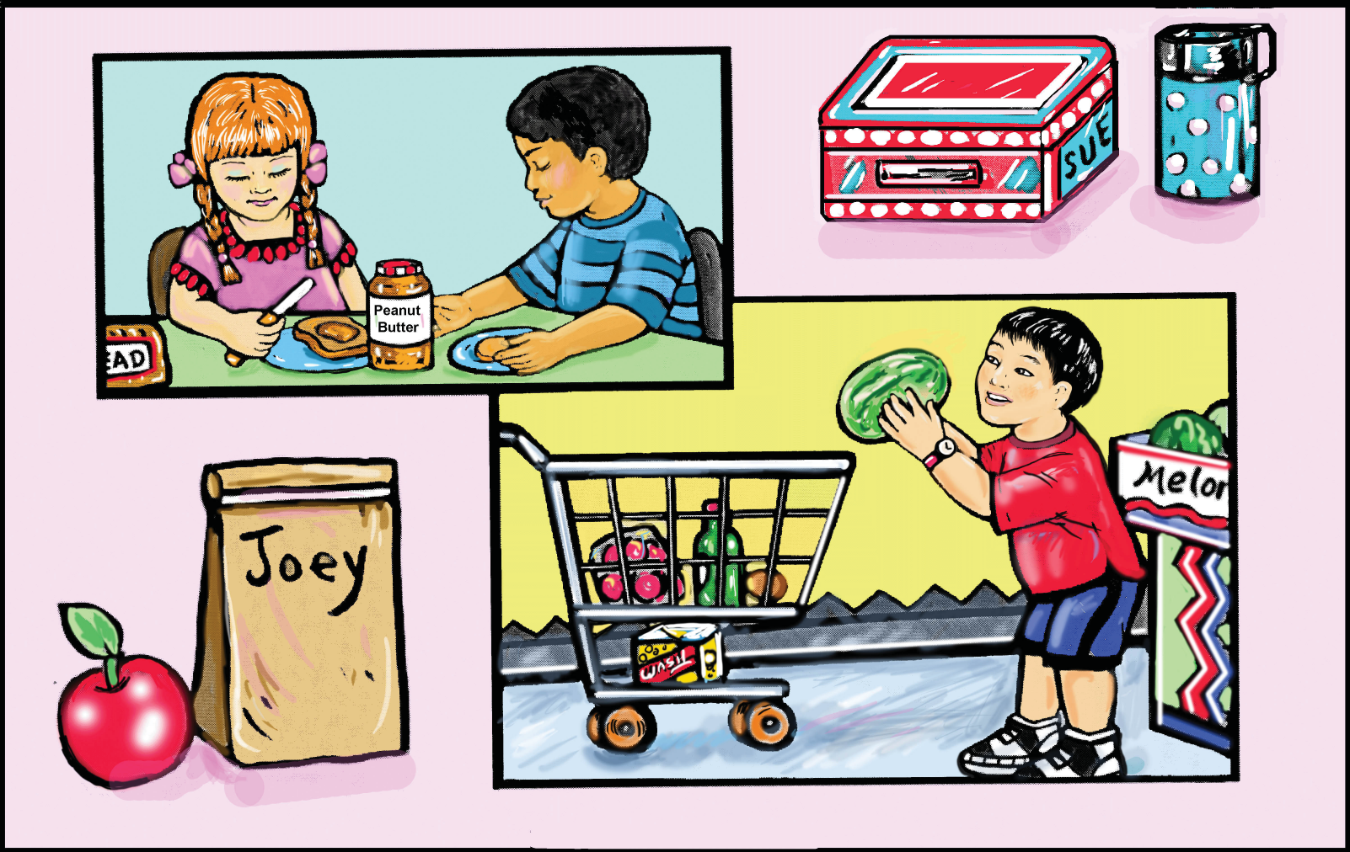
Planning Meals with the Family

Slide 8
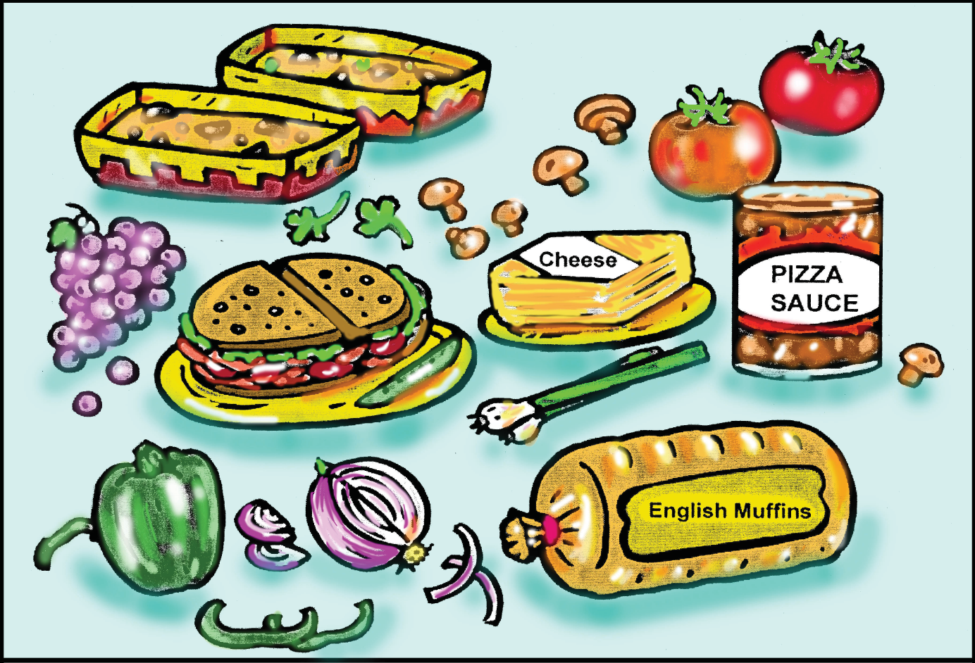
Prepare “do-it-yourself” meals

Slide 9
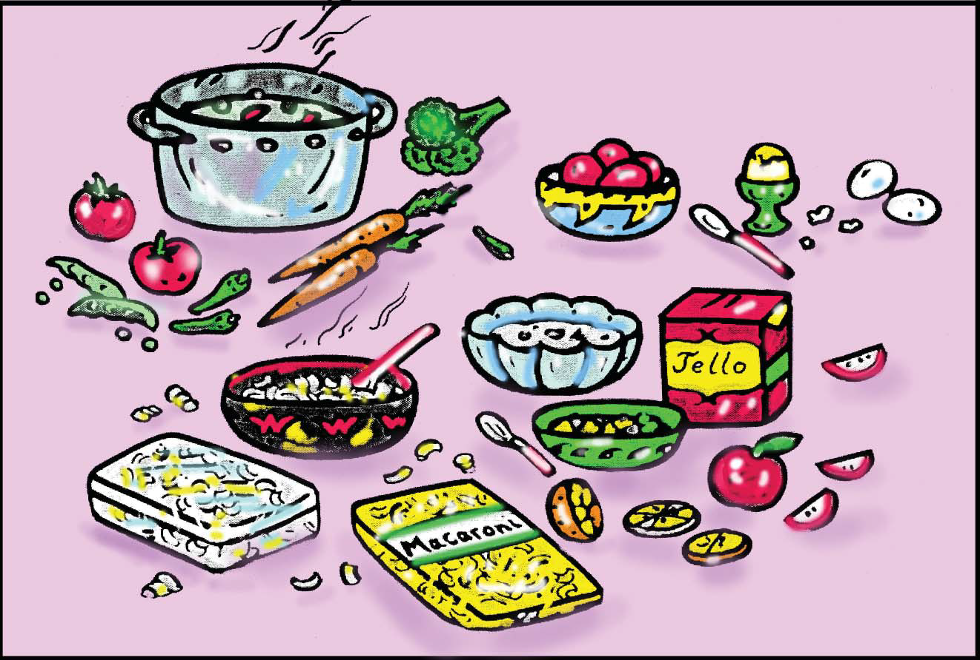
Prepare Some Foods Ahead of Time and Serve Later

Slide 10
“What are other things you do to help save time
planning and preparing meals?”
• Cook dried beans, rice, macaroni, noodles and
potatoes. Use in salads, casseroles, and side dishes
within 2 to 3 days.
• Hard cooked eggs can be kept in the refrigerator for
3-4 days. Remove shell and store in covered container.
• Prepare salads and desserts one day ahead.
• Most casserole dishes can be prepared one day,
refrigerated, and baked the next day.
• Many soup and stews improve in flavor on standing.
Cook one day, cool quickly (refrigerate) and heat the
next day.

Slide 11
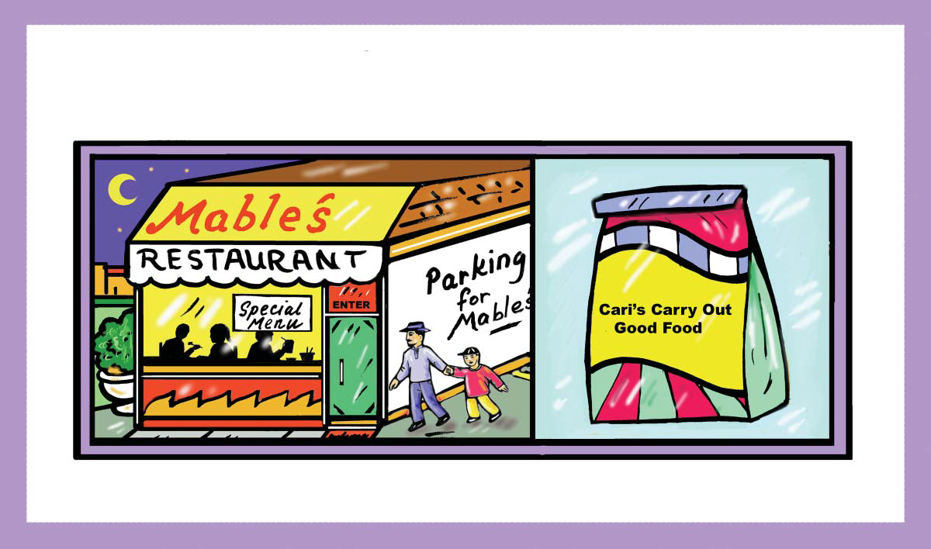
EATING AWAY FROM HOME

Slide 12
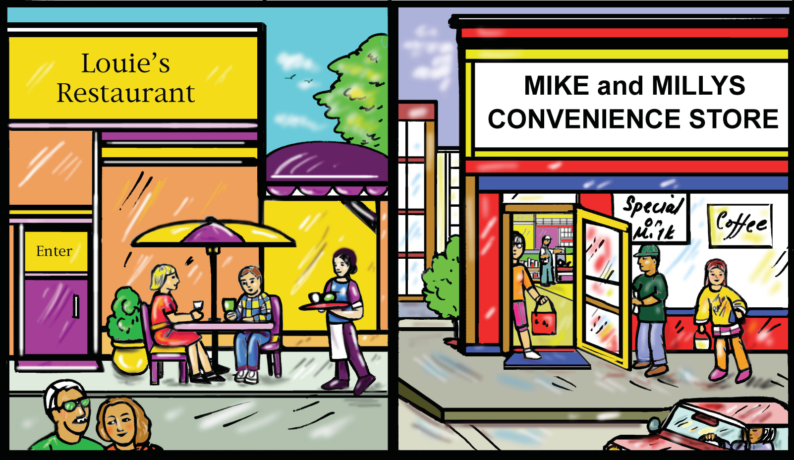
Where do people eat away from home?

Slide 13
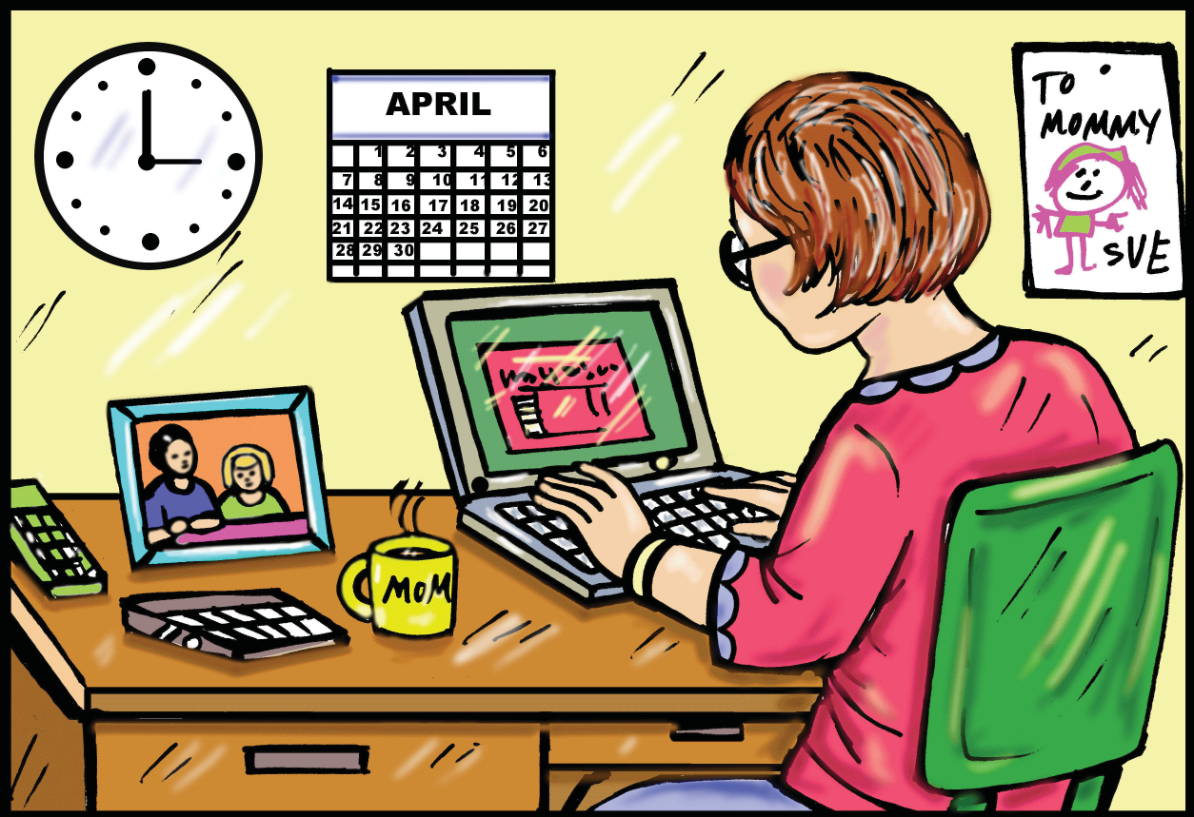
Why do people eat away from home?

Slide 14
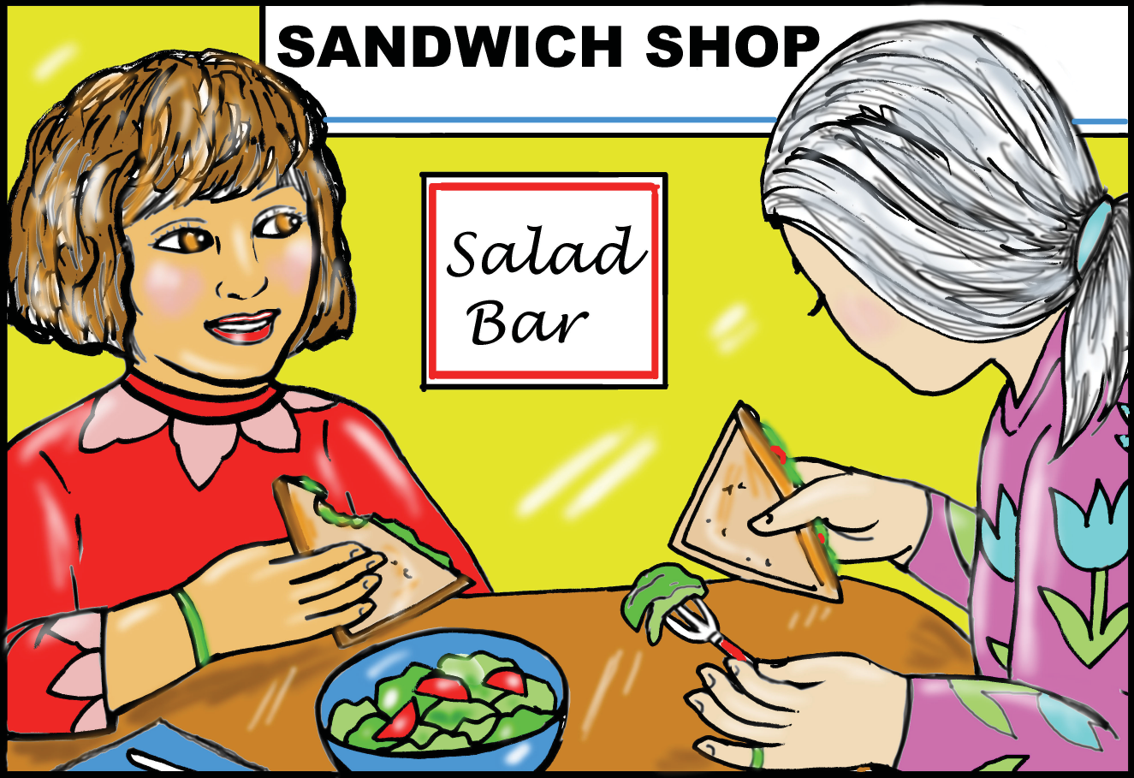
You can eat healthy away from home!

